Slide 1
PRESENTATION of
YEAR 4C

Slide 2
A Child’s Perspective on Aging Well

Slide 3
HOOK Role Play

Slide 4
FEEL

Slide 5
Common Problems faced by Elderly

Slide 6
1. Health Problems 2. Loneliness 3. Lack of Respect to Elderly 4. Social Disturbances 5. Social Anxiety 6. Financial Constraints 7. Lack of knowledge with technology

Slide 7
IMAGINE

Slide 8
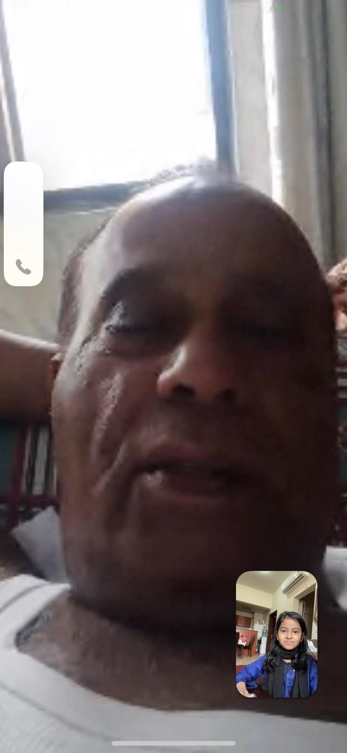
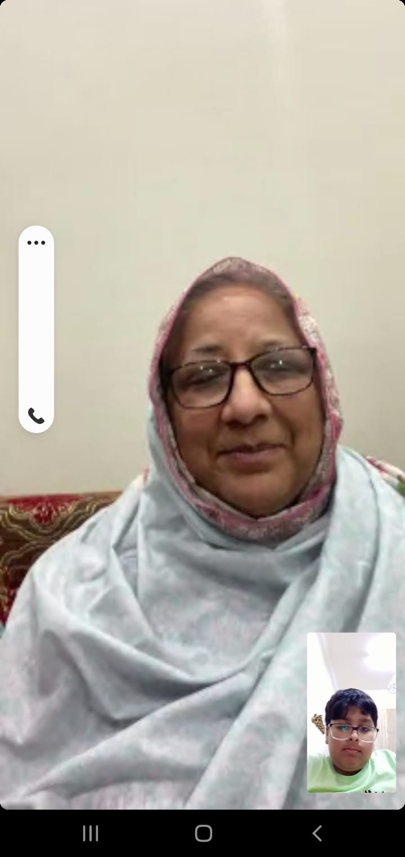
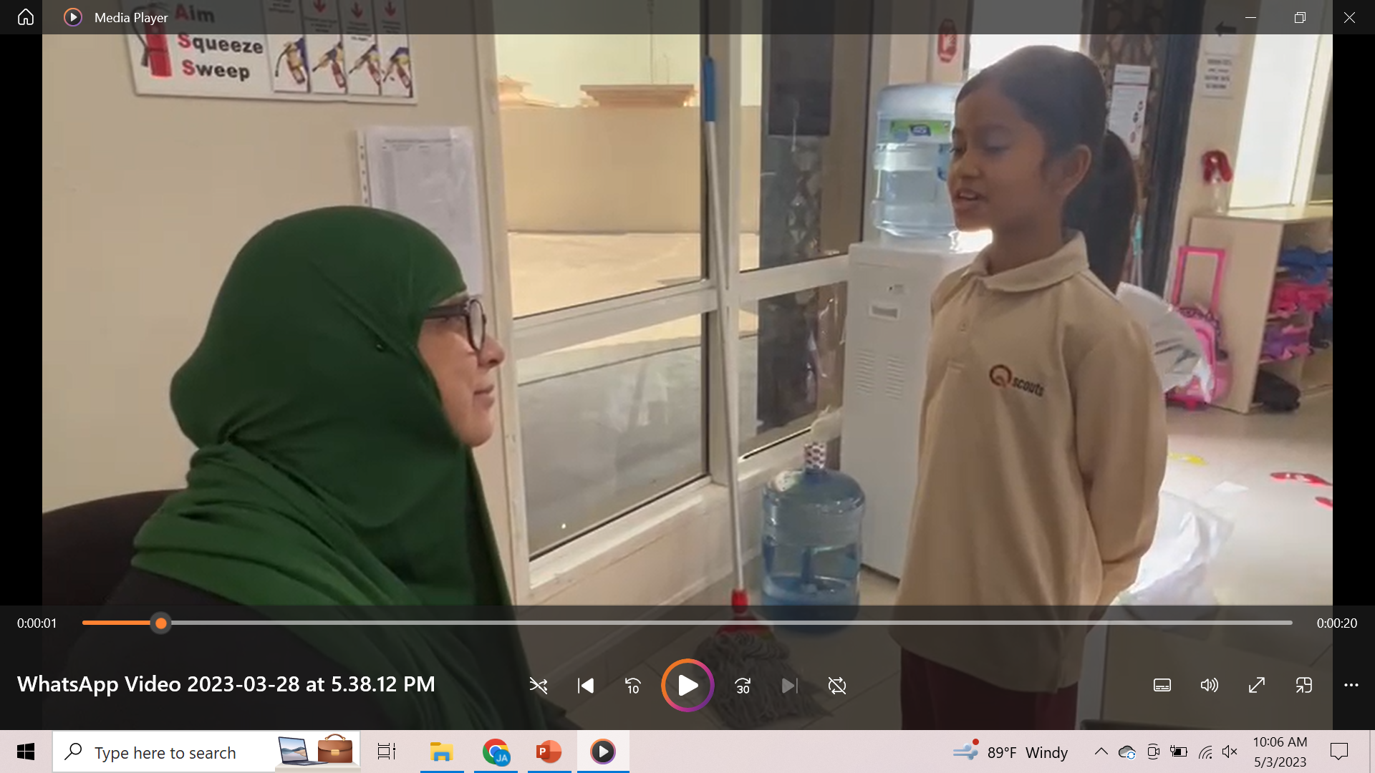
CONDUCTING SURVEY AND INTERVIEW

Slide 9
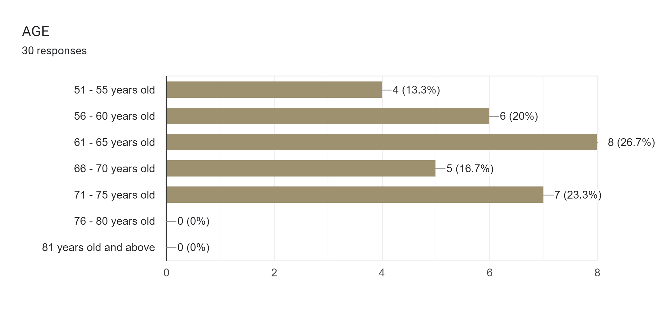
SURVEY ANALYSIS

Slide 10
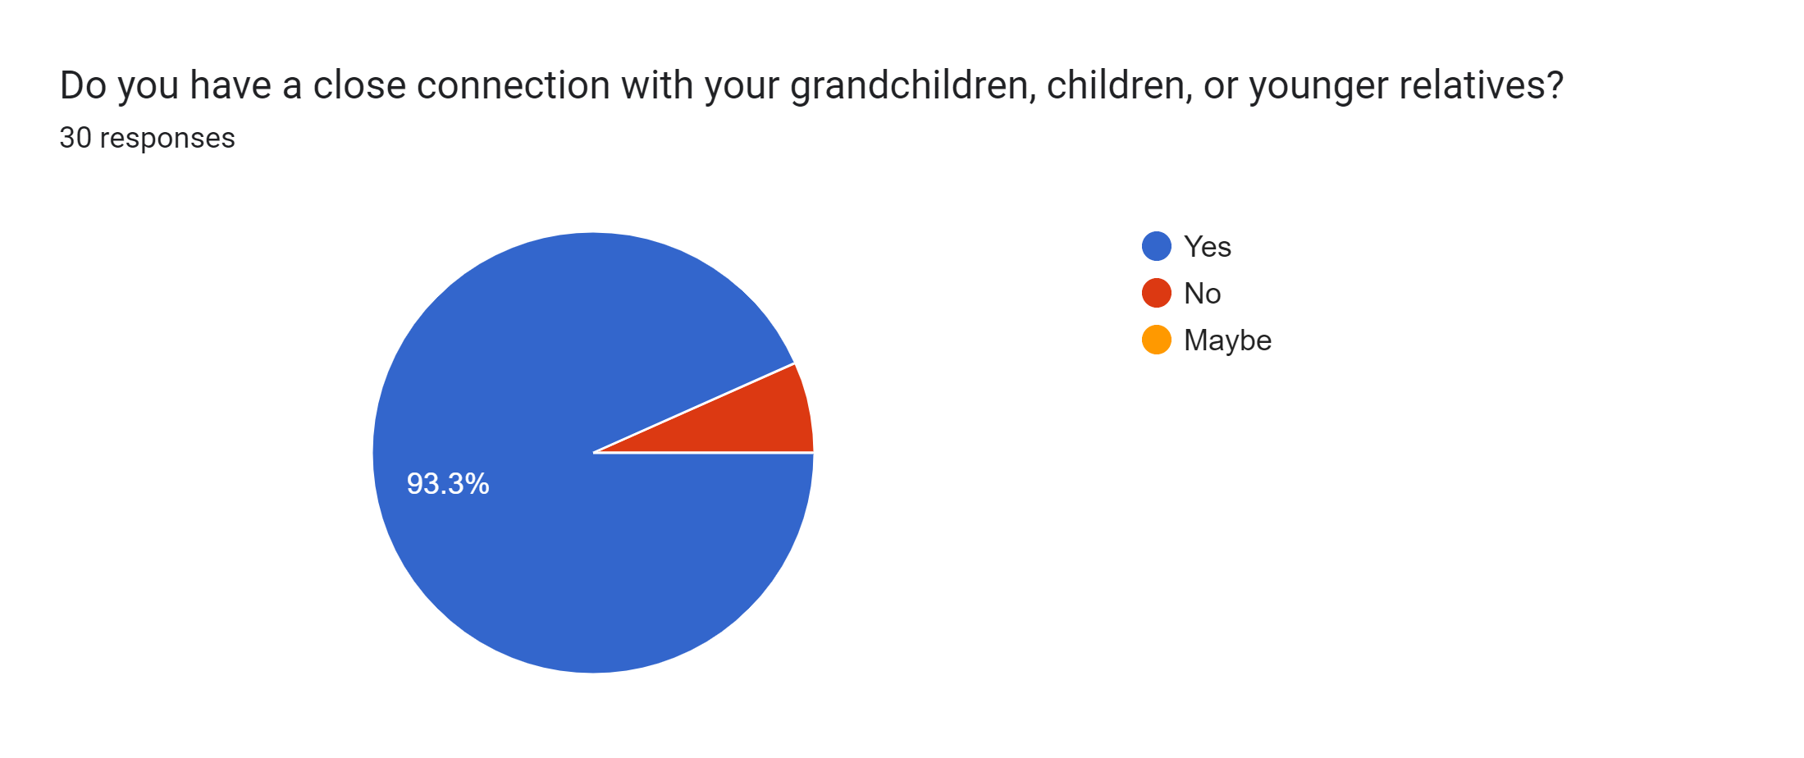
SURVEY ANALYSIS

Slide 11
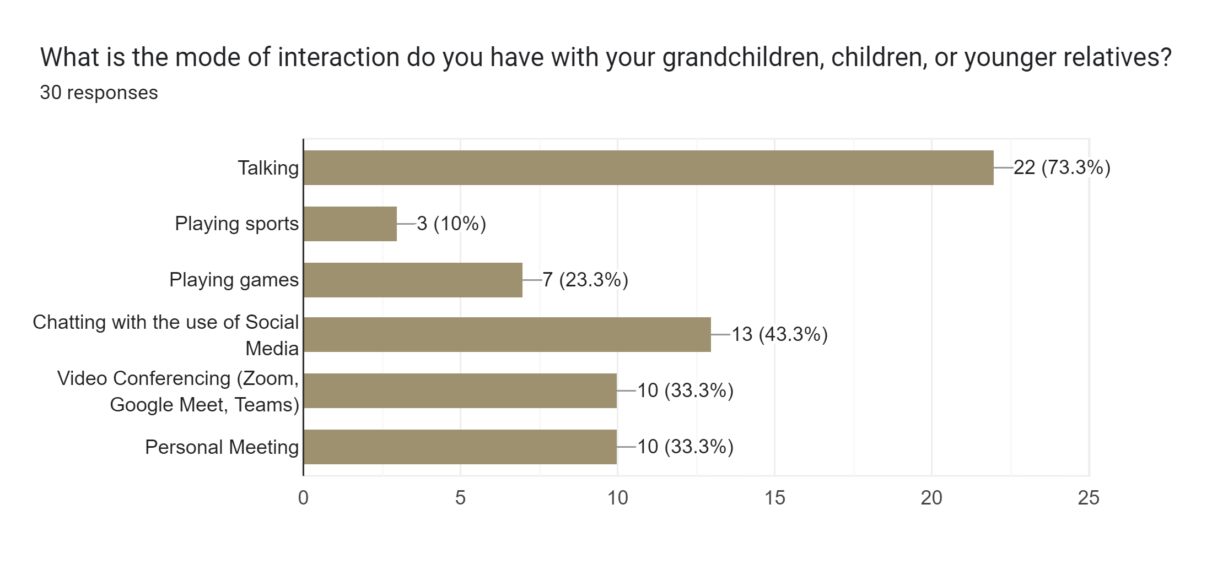
SURVEY ANALYSIS

Slide 12
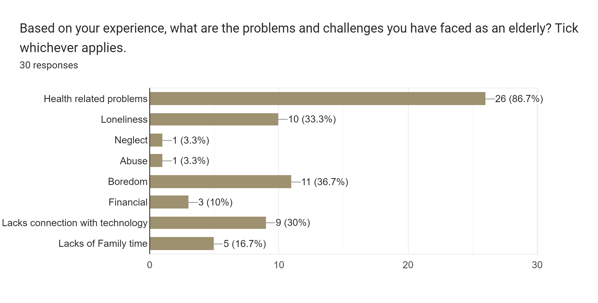
SURVEY ANALYSIS

Slide 13
Ways to Improve Quality Life of Elderly

Slide 14
1. Spend quality time 2. Extend help 3. Listen to them 4. Teach them something new 5. Make them feel useful and needed 6. Encourage regular physical activity 7. Take them out 8. Teach them computer and internet skills

Slide 15
DO

Slide 16
ELDERLY FACILTY

Slide 17
HELPIFY APP https://scratch.mit.edu/projects/812328207

Slide 18
QUESTION AND ANSWER

Slide 19
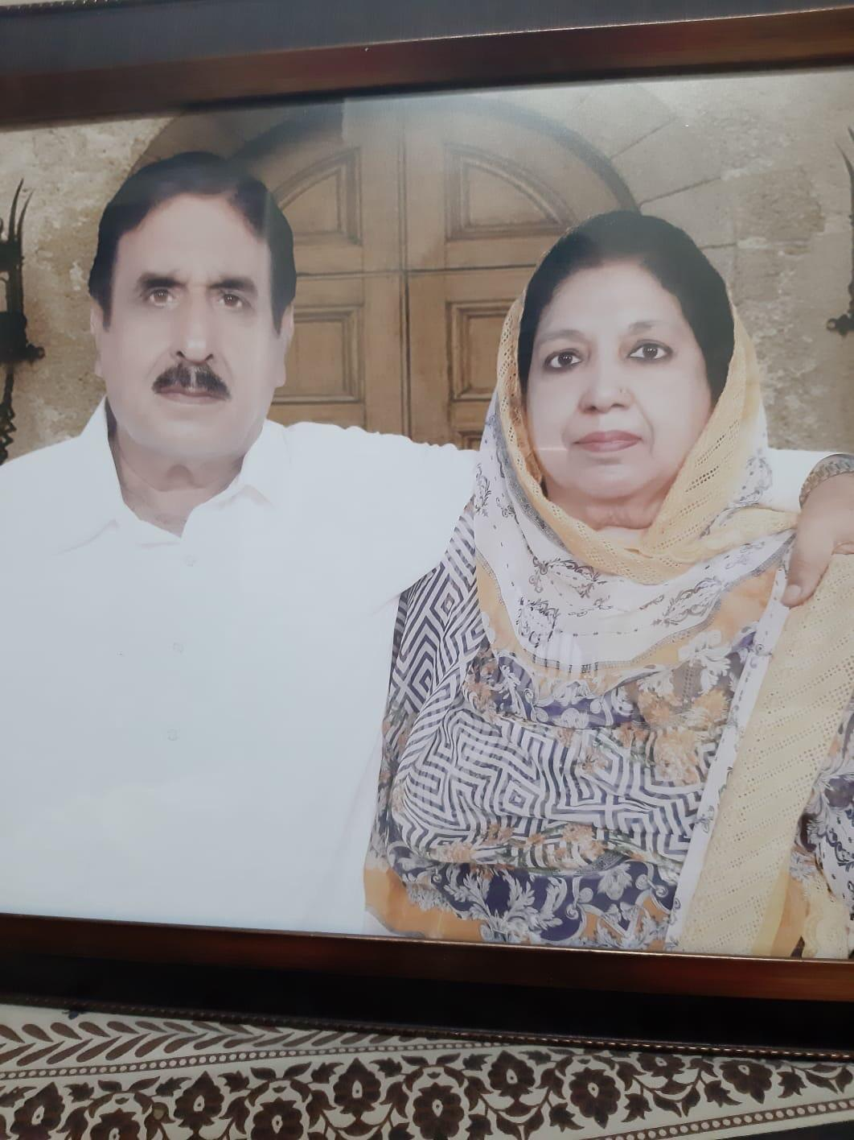
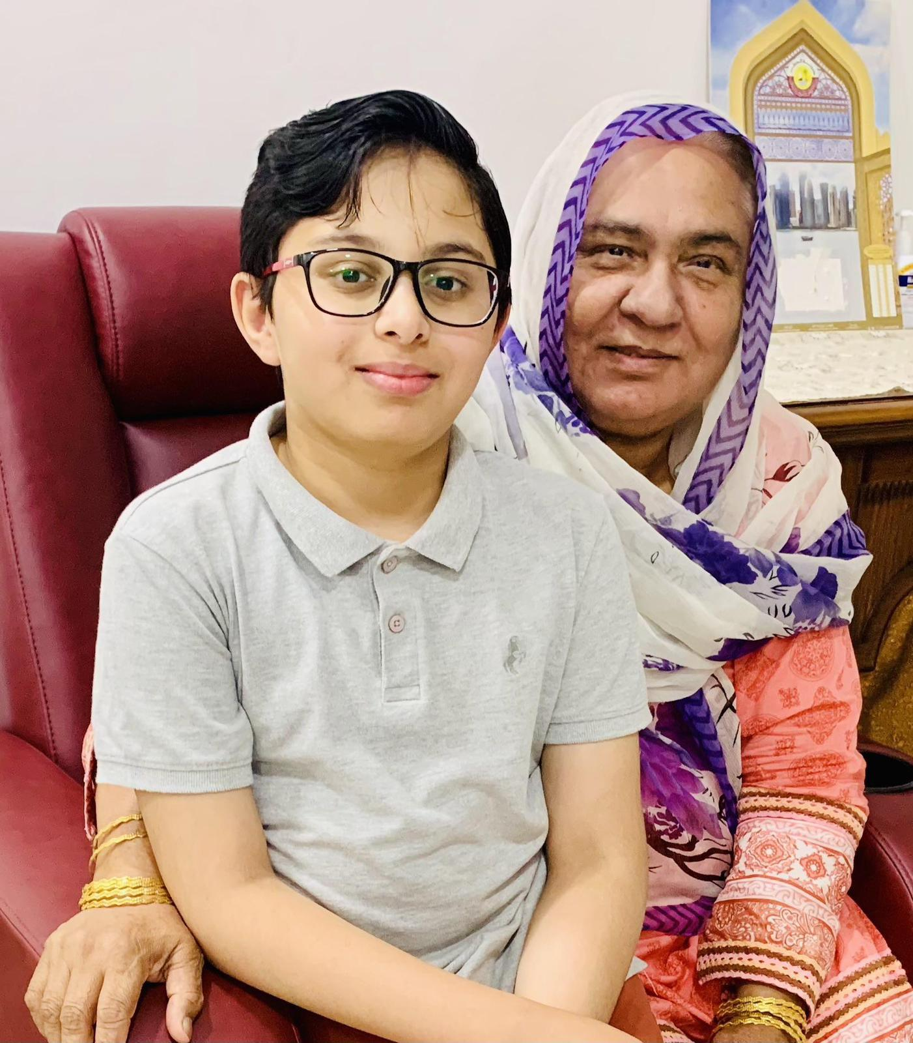
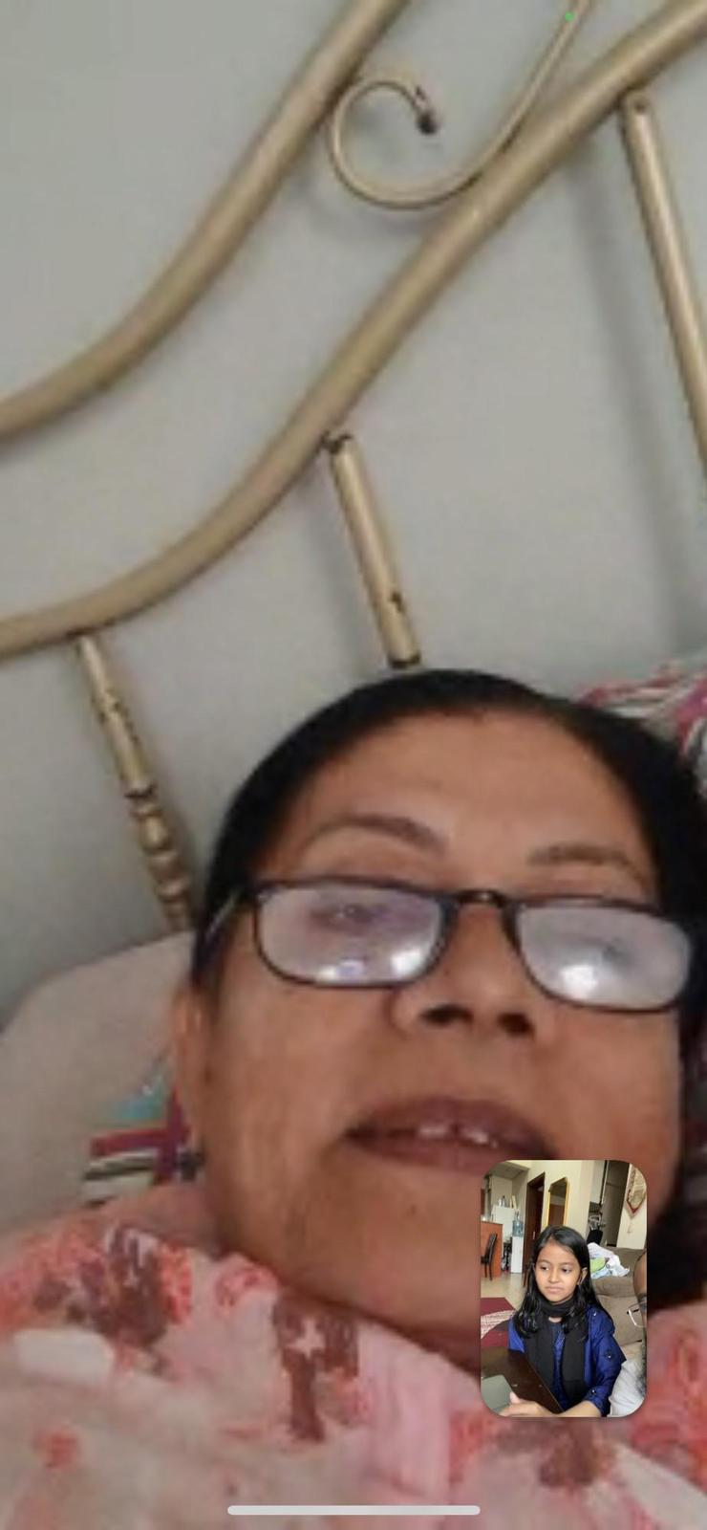
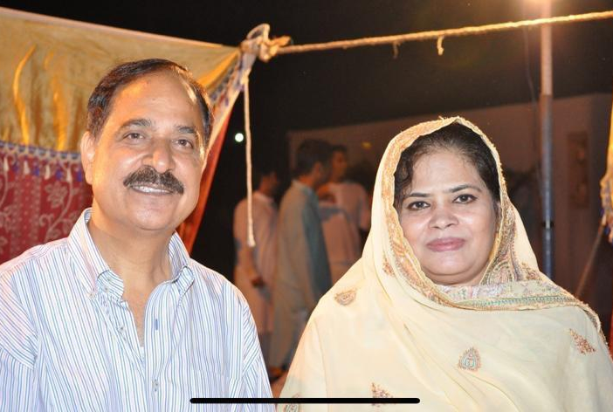
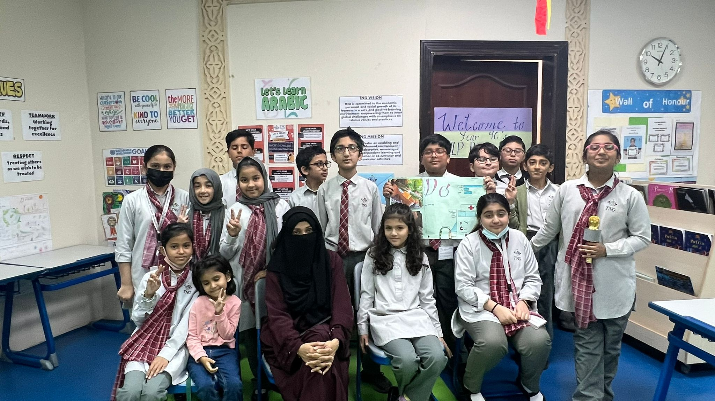
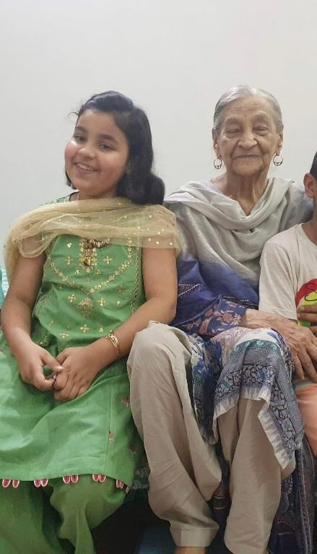
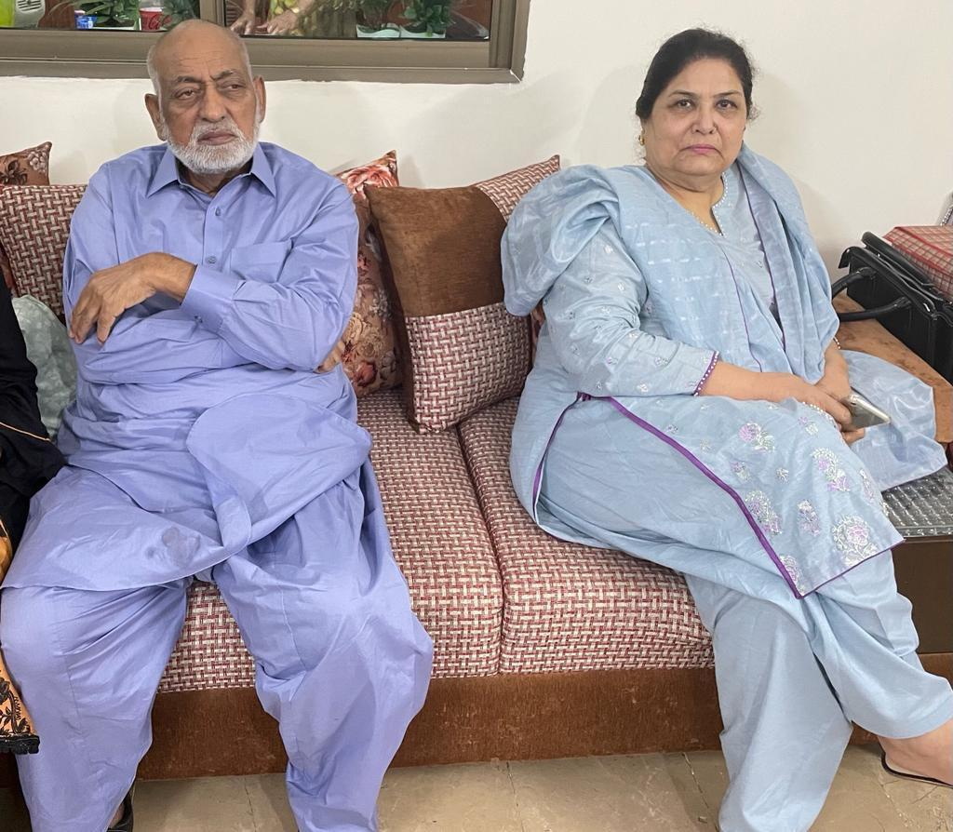
Thank you grandparents! We love, value and appreciate you.

