Slide 1
Recurity
REQUIRES CURE AND
SECURITY

Slide 2
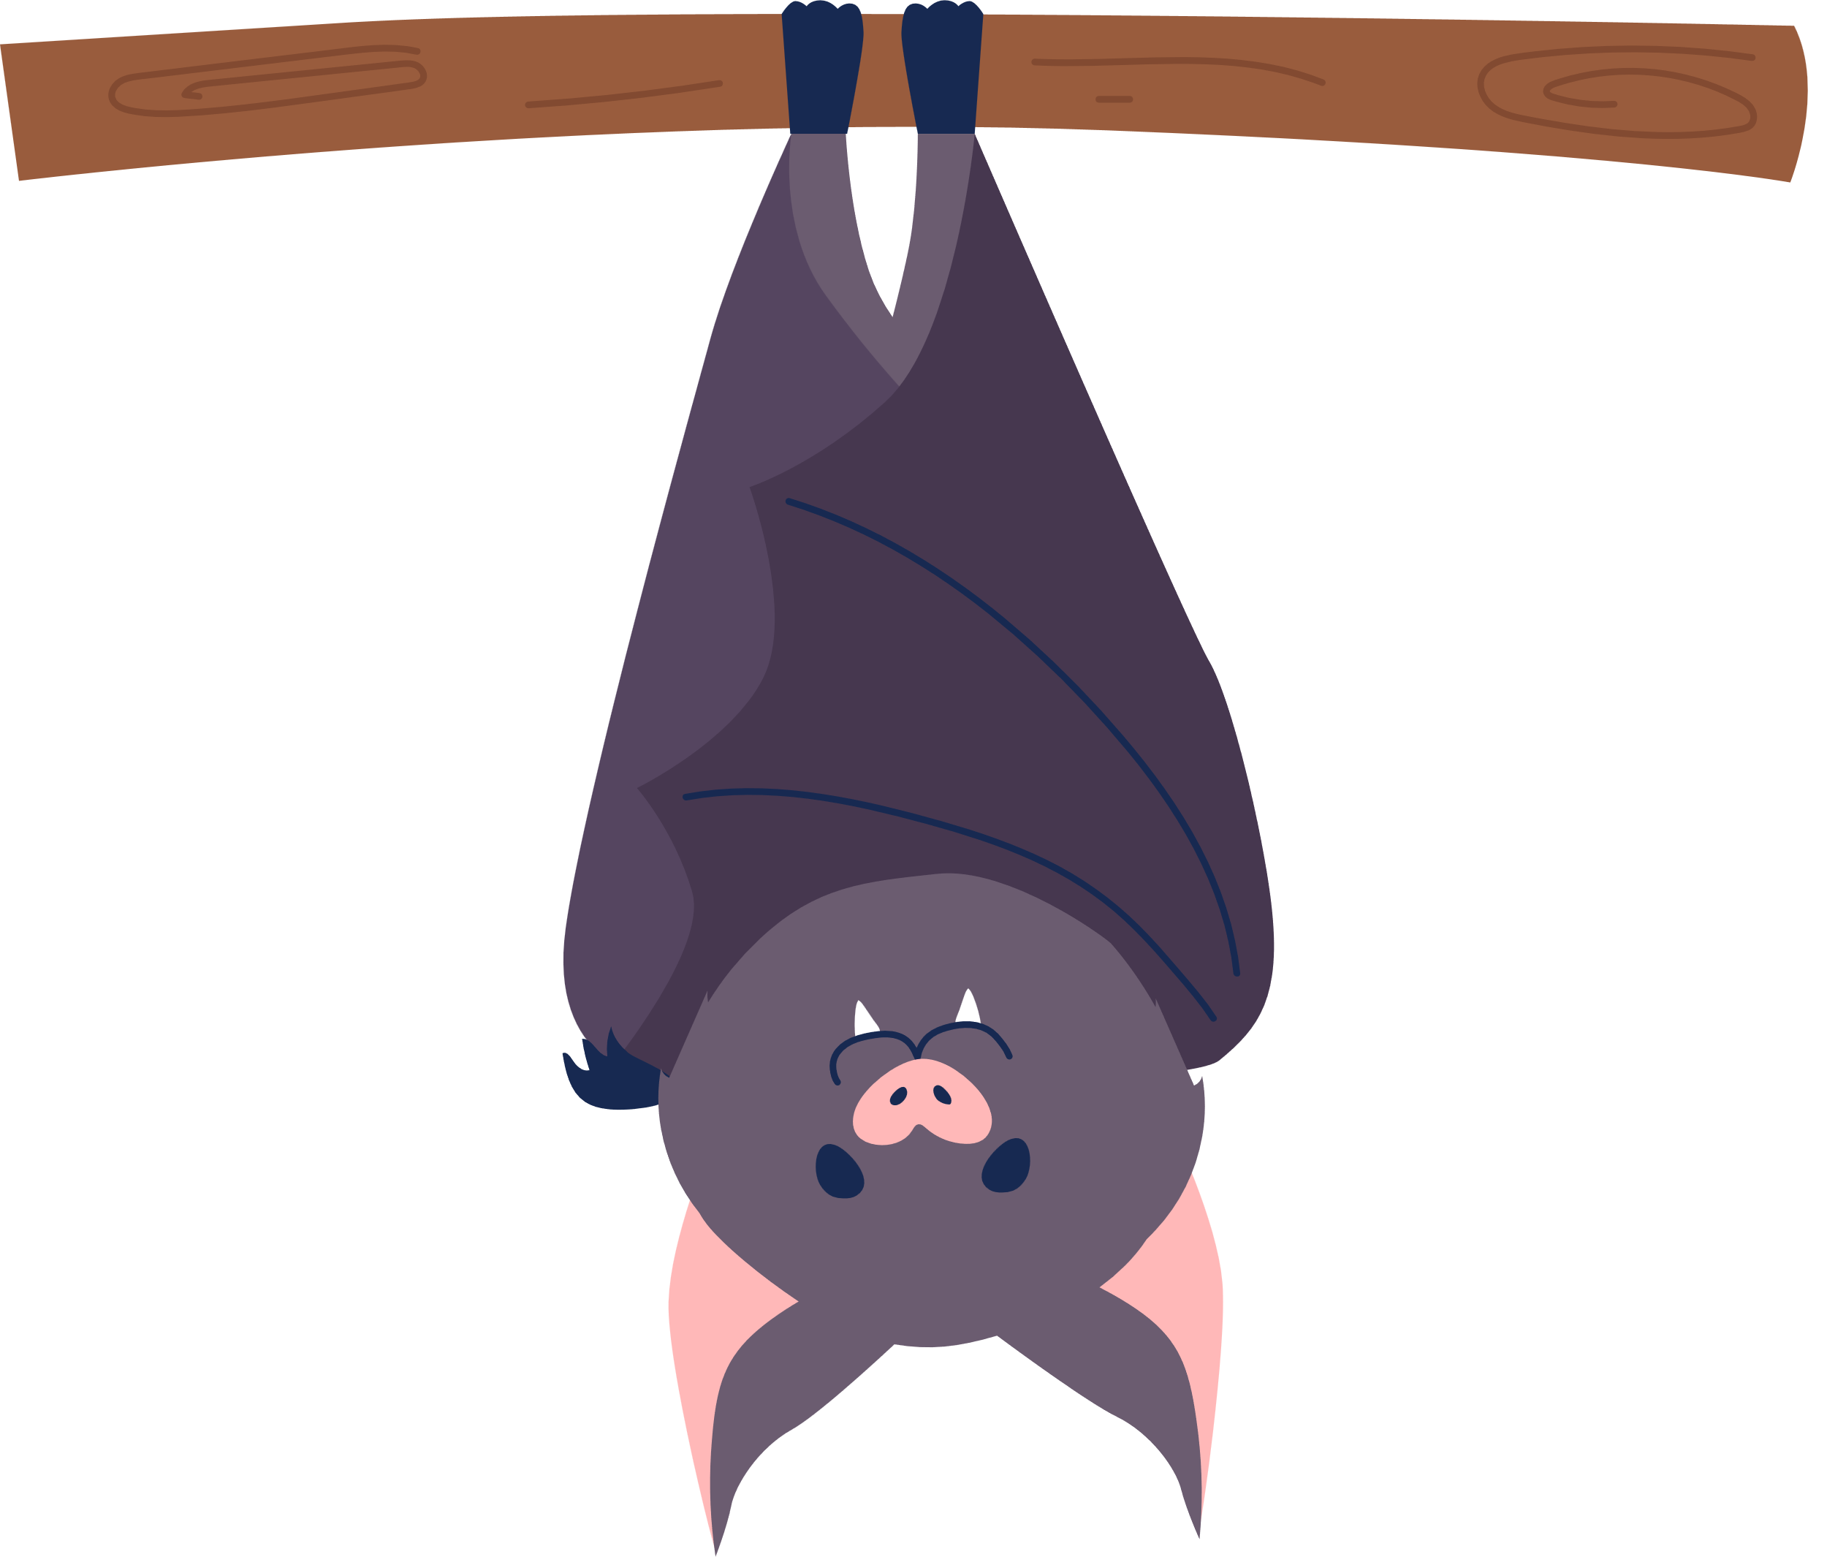
How did Covid-19 start?
And how it effected humans?
Humans
Horse-shoe bats
Pangolins
This is called a Zoonotic spillover, in which a virus is transmitted from animals to humans

Slide 3
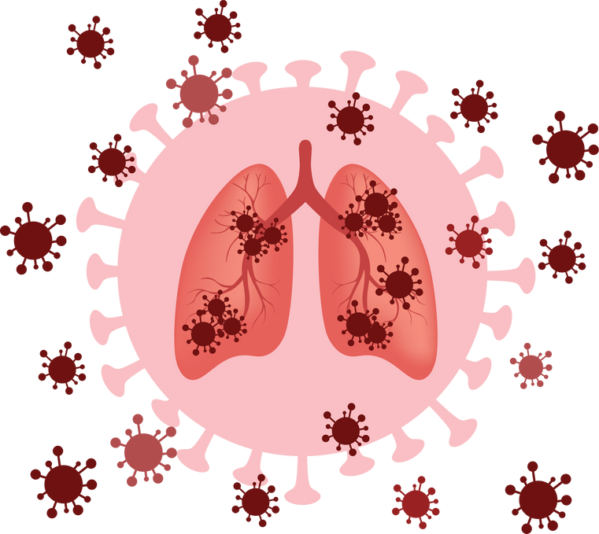
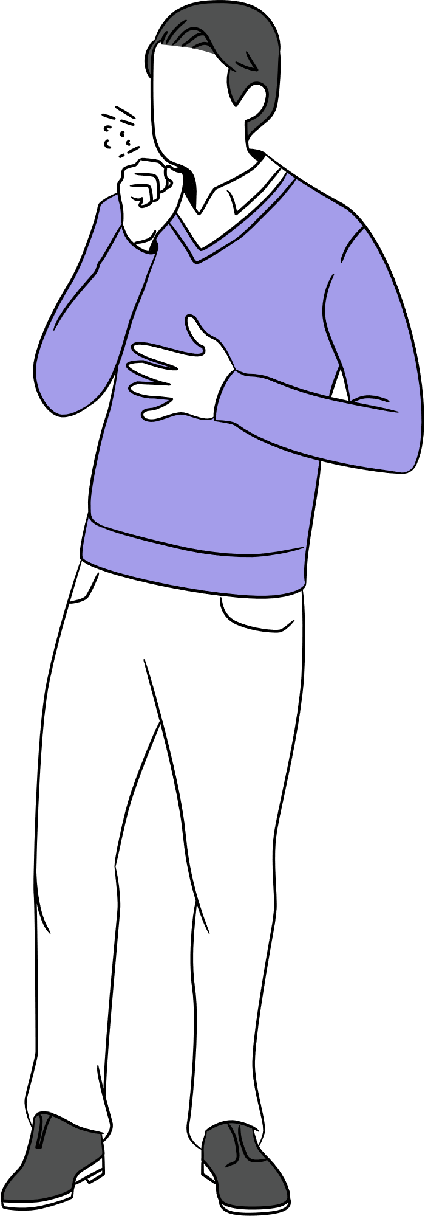
Pneumonia
Sneezing
Severe Cough
Shortness of breath

Slide 4
Why did it start?

Slide 5
Reason behind our prefernce?
Planning and
preparation?
The solution we have provided

Slide 6
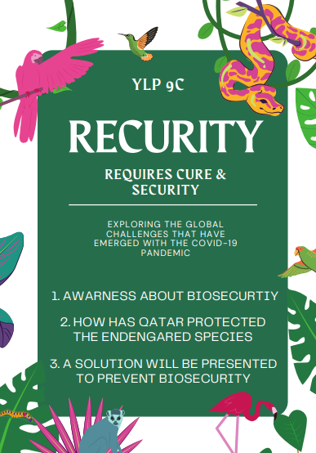
Poster for our
YLP

Slide 7
What is Bio-security?
Bio-security is the prevention of disease-causing agents entering or leaving any place where they can pose a risk to farm animals, other animals, humans, or the safety and quality of a food product. The COVID-19 pandemic is an example of an infringement on bio-security that posed a serious threat to the world.

Slide 8
Bio-security protocols for:
Animals:
Plants:
Humans:
1. Isolation and quarantine when they are sick
2. Monitoring and testing so they don't get diseases
3. Vaccination
4. Hygiene
5. Bio-security plans and procedures to prevent diseases
1. Pest exclusion
2. Monitoring programs to detect pests
3. Sanitation
4. Plant certification and traceability
5. Training to plant producers etc to prevent the diseases
1. Vaccination
2. Personal hygiene
3. Environmental hygiene
4. Isolation
5. Education and awareness

Slide 9
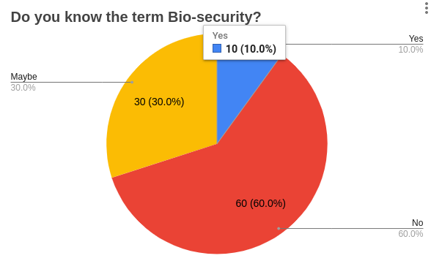
Reason behind choosing the topic- BIO-SECURITY
We conducted a survey asking students about their knowledge of biosecurity prior to choosing the topic. Here are the results:

Slide 10
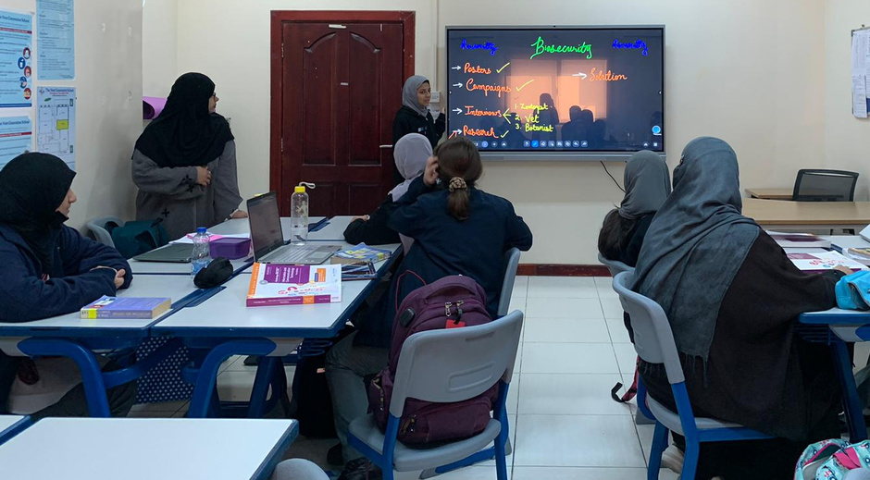

Slide 11
Therefore, we chose bio-security as our subject because we want to stop diseases from spreading plants. Because illnesses like the Ebola and corona viruses pose a threat to the environment. We hoped to raise awareness of the issue through this YLP project so that fatal diseases can be avoided in the future.

Slide 12
Plans and Implementation
Our project will be focusing on three aspects mainly:
1. Awareness about Bio-security- Our class intended to run awareness campaigns to inform students about biosecurity in the wake of the survey results.
The campaigns were successful, and now many students in our school are aware of bio-security and are aware of how to care of themselves to avoid diseases. diseases.

Slide 14
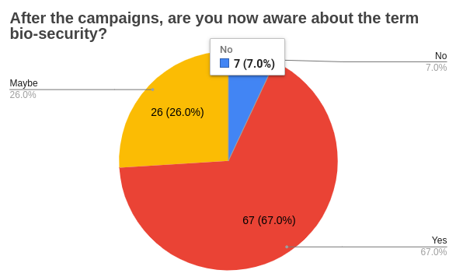
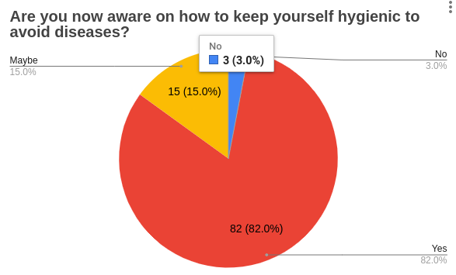

Slide 15
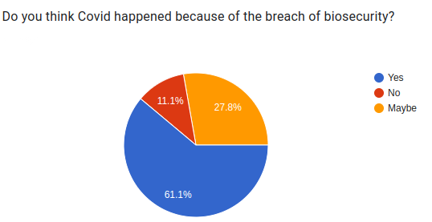

Slide 16
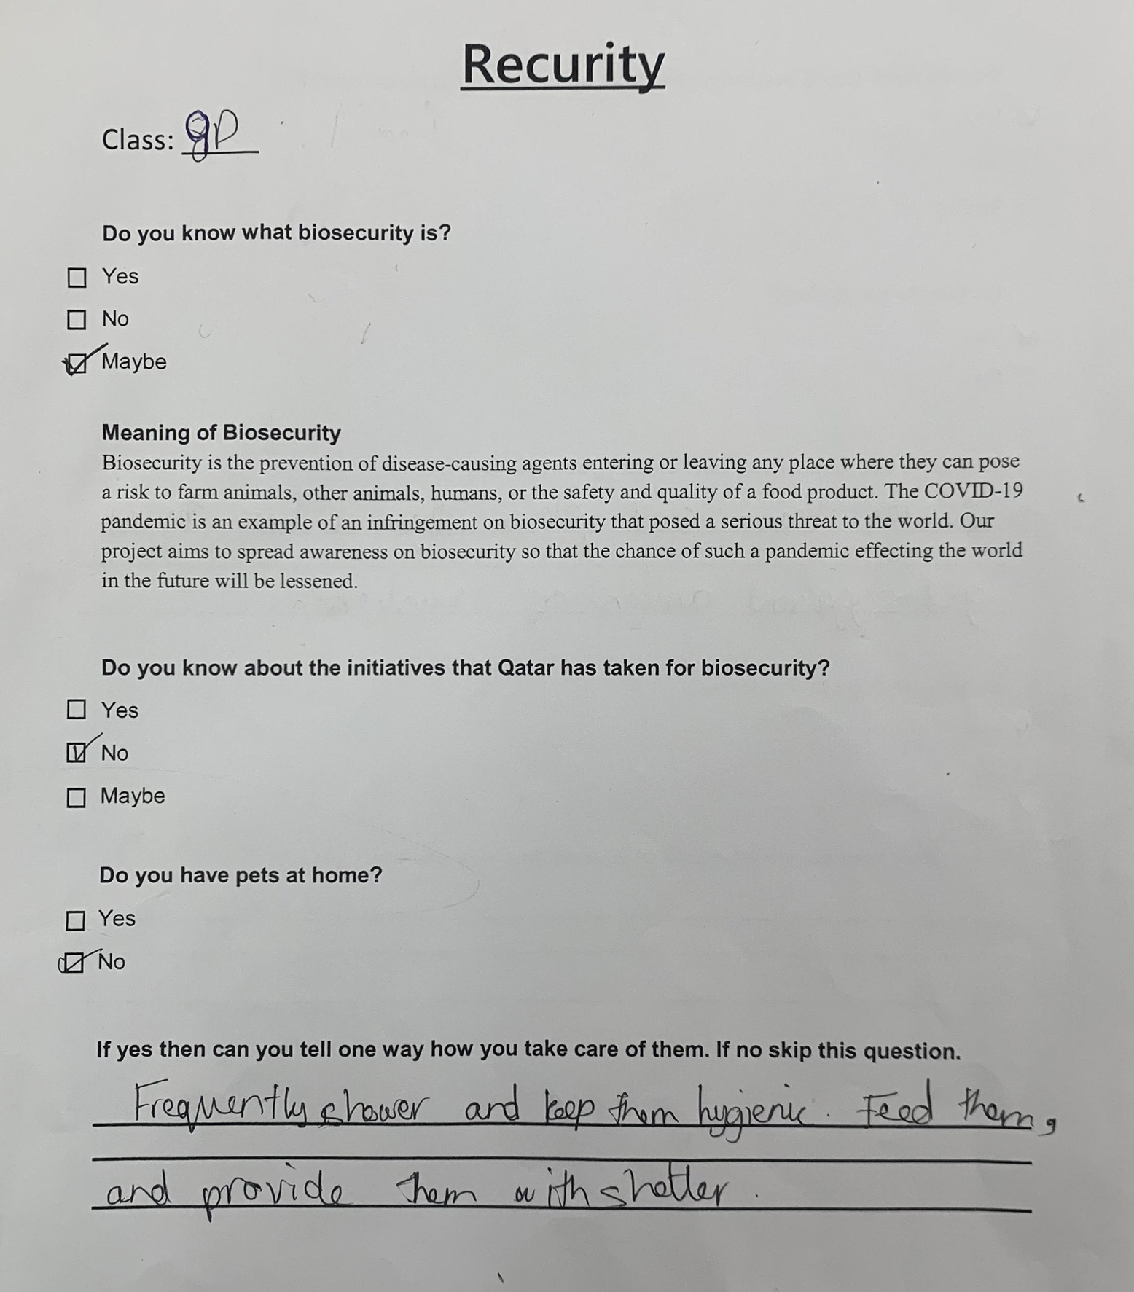
A few responses of our survey

Slide 17
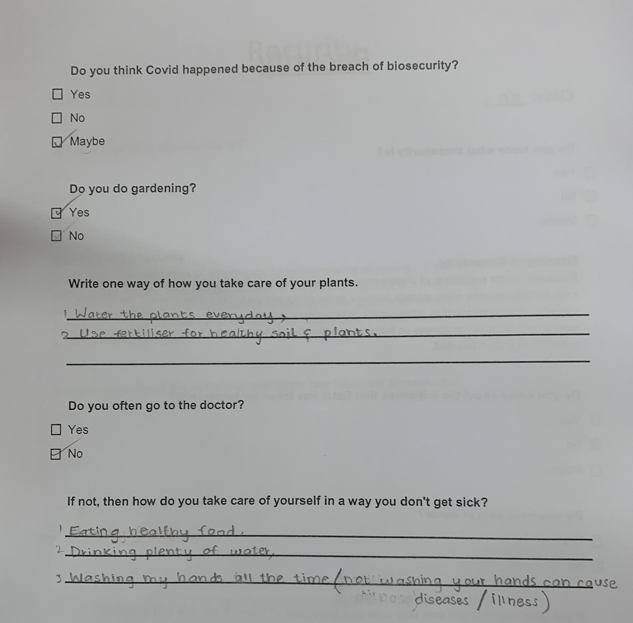

Slide 18
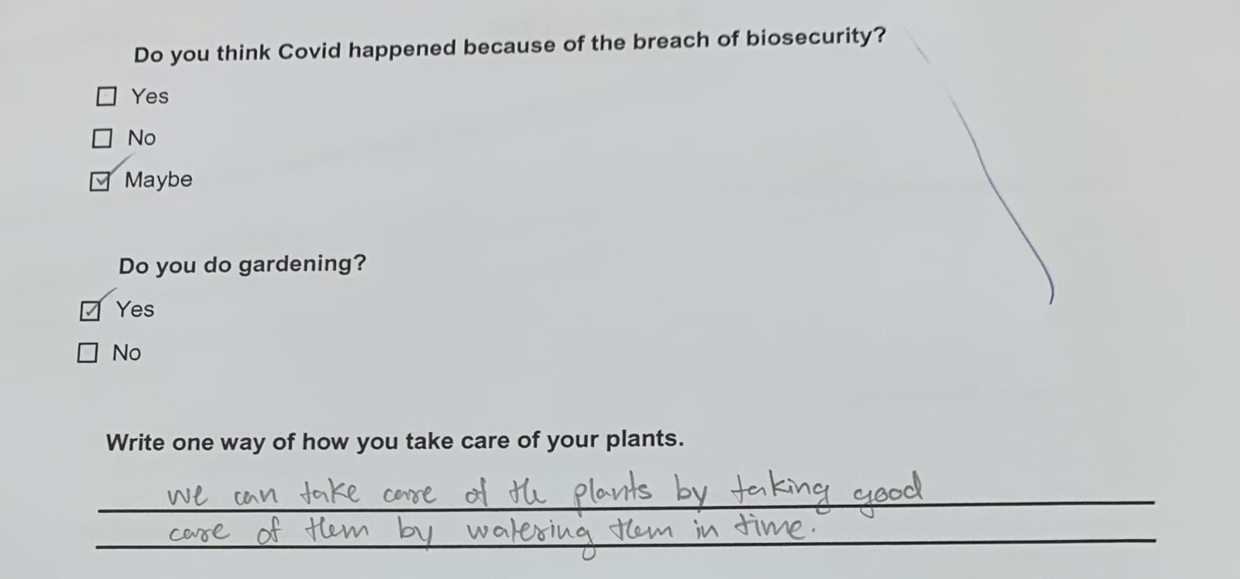

Slide 19
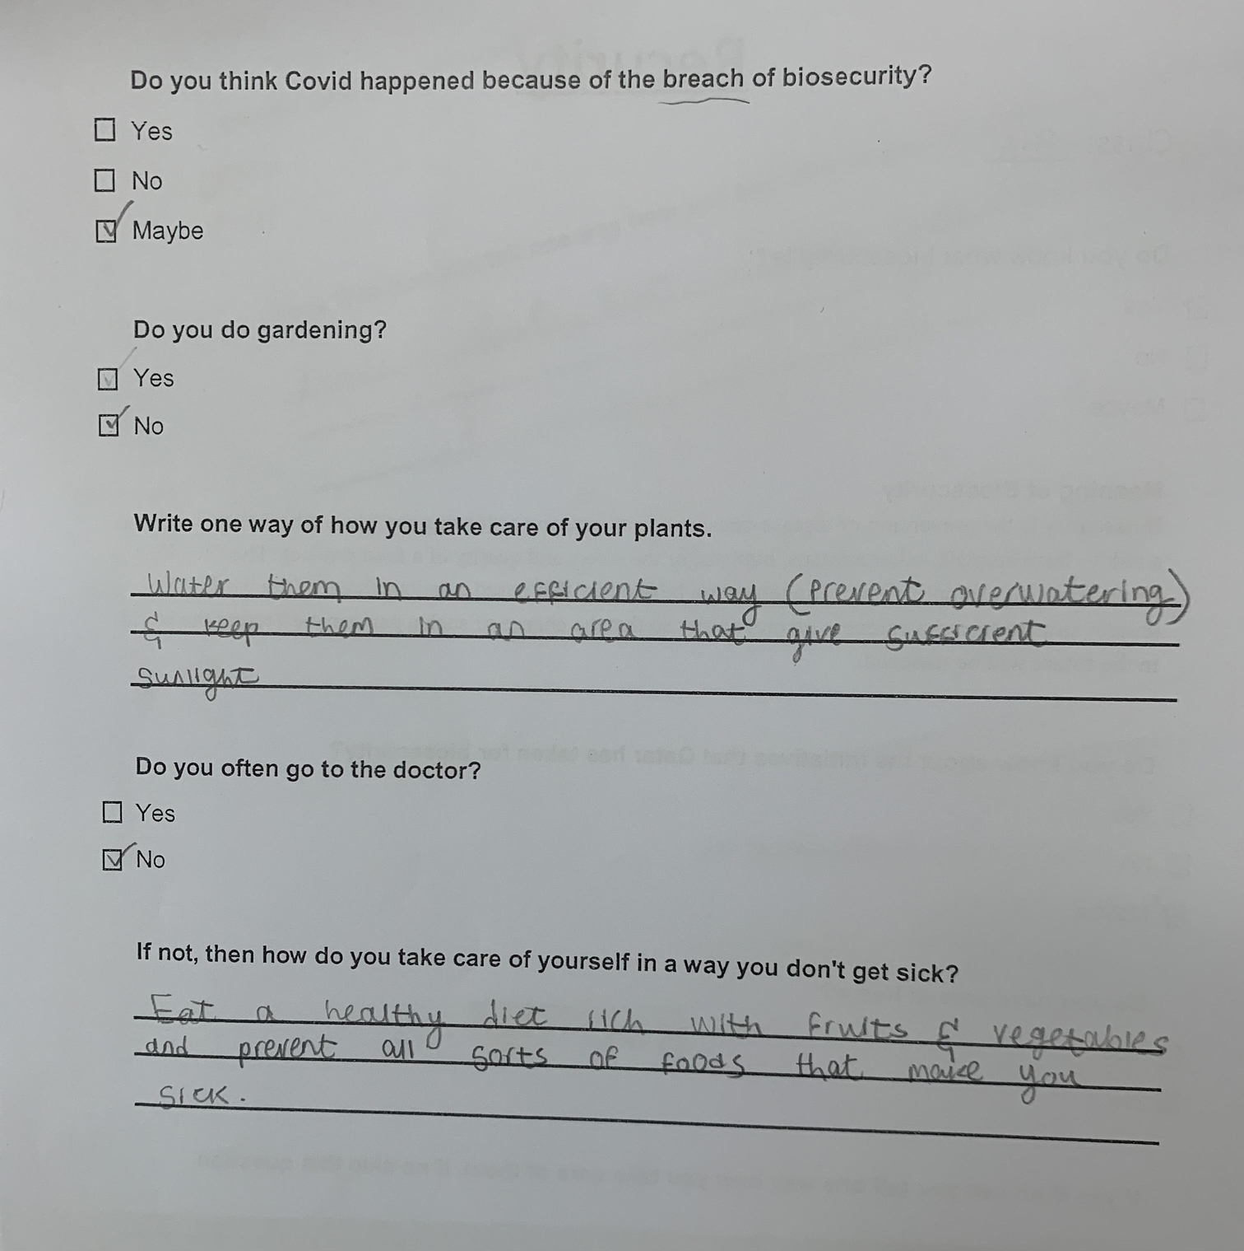

Slide 21
2. How has Qatar protected the endangered species through bio-security- Interviews were conducted with vets, doctors, and care takers of the animals as to how to prevent diseases from approaching the animals and humans.

Slide 22
Qatar has made numerous biosecurity-related efforts
1. Qatar marked the International Day for Biological Diversity which falls on May 22 each year and is celebrated under the slogan "Protecting Life on Earth
2. Qatar plays along with the countries of the world by working together to preserve biodiversity through the ratification of international and regional conventions.
The most important of these are:
The International Biodiversity Convention since 1996
The Convention on Combating Desertification in 1999
The International Convention on the Regulation of Traffic in Endangered Species of Wild Fauna (CITES) in 2001
The Regional Convention on the Protection of Wildlife of the Gulf Co-operation Council States in 2004
The Cartagena Protocol on Biosafety in 2007.

Slide 23
3. The Ministry also carries out several pilot projects aimed at protecting the marine environment and enriching biodiversity, such as the whale shark protection project, turtle nesting, the crocodile protection, and coral reef culture projects in several locations.
4. Qatar is one of the five Arab states parties to the Convention on the Suppression of International Traffic in Endangered Species of Wild Fauna and Flora (CITES) and among the best countries that were committed to the convention.
5. In order to protect biodiversity, the Ministry of Municipality and the Environment has adopted laws to protect wildlife and natural habitats.

Slide 24
Interview with the vet

Slide 25
Interview with the zoologist

Slide 26
Interview with the botanist

Slide 27
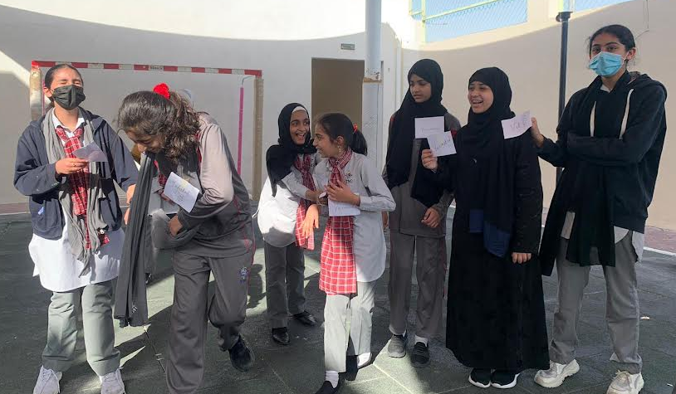
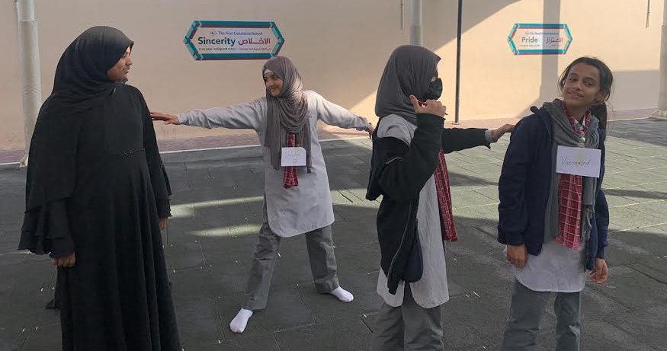
Activity for grade 7:
OUTBREAK TAG
They pretend to be the animals in a flock.
One of them was designated as the infected animal.
The rest of the class (healthy members of the fl ock) had to run around and avoid
being tagged (infected) by the person who infected.
One of participant acted as a vet and gave vaccines to the infected participants.

Slide 28
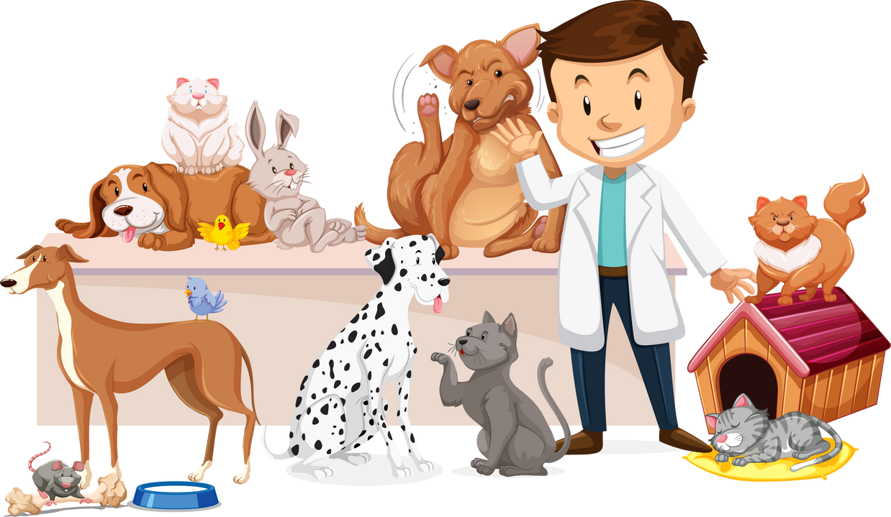
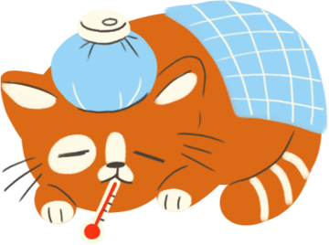
This taught them that when there was a vet it took longer for all of the animals to become infected, or not all of the animals got infected. And that it is important to have a good animal health management plan in place and to be prepared in case
of disease outbreak or illness in the flock; such a plan can reduce losses and keep the animals healthier.
And this is one of the reason why it is important to have strong bio-security
protocols

Slide 29
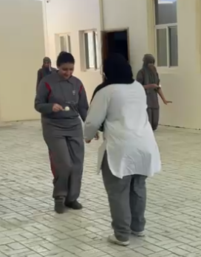
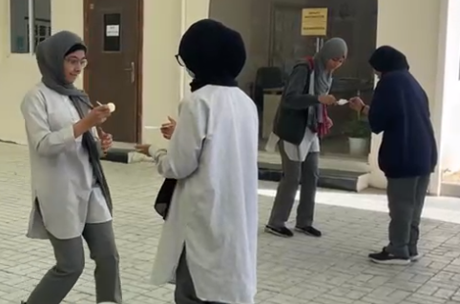
Activity for grade 8:
INDIRECT CONTACT- Ping Pong Ball Relay Race
Participants were divided into two teams and each were given a spoon.
A ping-pong ball was placed on the first person from each team.
The ball represents a pathogen, while the spoon represents a surface. Each participant runs until they pass the ball to the next runner on their team. They must transfer the ball to the next runner’s spoon without directly touching the ball. This represents pathogens being carried on surfaces such as boots or equipment.
If the ball falls off their spoon as they run, participants may pick it up to put it back on but this means that they are now infected — through indirect contact transmission — and because they are now “sick,” they must walk instead of run.

Slide 30
What we learned through this activity is that
The disease transmission can also occur when animals seem healthy (represented by the participants
who never dropped the ball and ran the entire way) as well as when they show symptoms
(represented by the participants who dropped the ball and had to walk)
Participants never had to touch one another for the pathogen to be able to travel from the first
participant to the last; they all came into contact with it indirectly

Slide 31
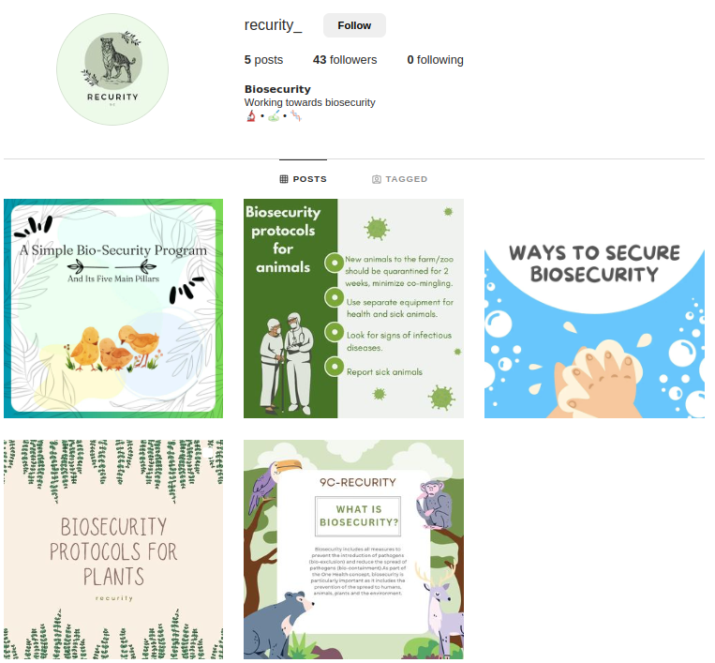
Social Media
account:

Slide 32
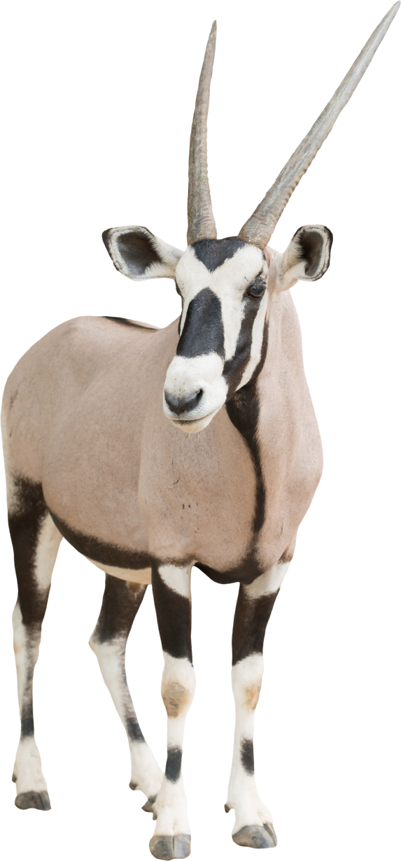
3. Students presented a solution/prevention to such diseases for developing and under-developed countries which lead students to collaborate to prevent animal extinction from these diseases.

Slide 33
Protocols taken by Developed countries for Biosecurity
The main statutory legislation for controlling and conserving nature in general, is covered under the Wildlife Act, 1976.
The government of Portugal, has ordered a major review of their National Parks and Wildlife services to revamp their method in conservation, protection ad sustainable development of the same.
Italy: Protecting areas with large mammals
Regular surveys and animal check-ups
The need for the injured and sick wildlife has been taken care of by the Wild Animal Rescue Centre which supports the government efforts in tacking the illegal wild life trade .
Departments include various projects one of which is the Golden Coin Turtle Conservation project to prevent this species from becoming extinct.
Execution of projects for the conservation of local endangered species

Slide 34
Protocols taken by countries to protect animals in developing countries
Illegal to capture or kill endangered animals or birds.
Establishment of Protected areas, National Parks, Sanctuaries , Conservation Reserves and Community reserves
Breeding programs for endangered species
Notes:
---> Conservation of Wildlife is necessary to recognize the importance of nature and other wildlife species.
----> Protected areas, National Parks, Sanctuaries , Conservation Reserves and Community reserves have been created in the countries covering important habitats to provide better protection to wildlife, including threatened species and their habitat.

Slide 35
Protocols taken by the underdeveloped countries to protect animals
Establishment of National Environmental Protection Agency
National Biosecurity Strategy and Action Plan (NBSAP):
NBSAP's purpose is:
To provide the government of these countries with a policy document that can help them with the development of the country's biosecurity.
And secondly, and to communicate bio-security conservations priorities in underdeveloped countries.
Notes:
Protocols taken by the underdeveloped countries to protect animals
----> This National Biosecurity Strategy and Action Plan (NBSAP) for these countries has been prepared by the National Environmental Protection Agency with technical advisory inputs from relevant government agencies, non-governmental organization, international development organizations and user groups at both national and provincial levels. ------> NBSAP's purpose is:
1. To provide the government of these countries with a policy document that can help them with the development of the country's biosecurity.
2. And secondly, and to communicate bio-security conservations priorities in underdeveloped countries.

Slide 36
The solution:
Developing and underdeveloped countries can create national parks and reserves, similar to the one in Portugal, and conduct reviews to enhance bio-security procedures.
Since developing and underdeveloped nations place a greater emphasis on their economies, animals become extinct by diseases like the Ebola and Corona viruses. So, in order to stop this, we could create an organization in those countries with the following primary goals:
1. Medical infrastructure/disease surveillance: Special care for animals; vaccinate all animals, including pets, once a year.
2. International Cooperation and Bio Security Policies: International Cooperation
3. Educating the public through yearly campaigns

Slide 37
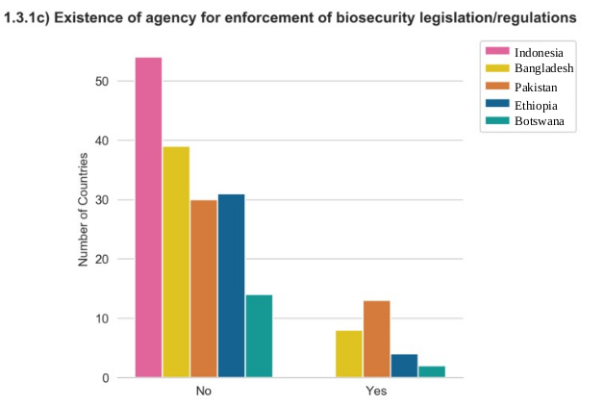

Slide 38
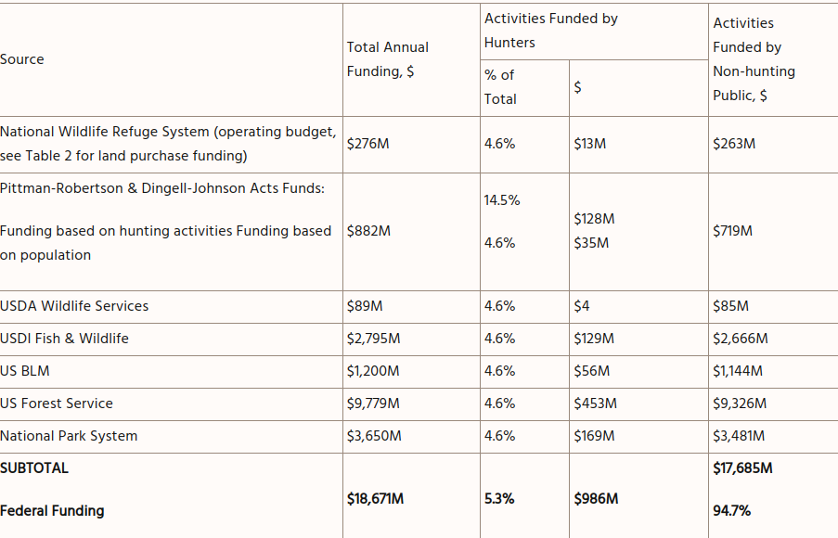

Slide 39
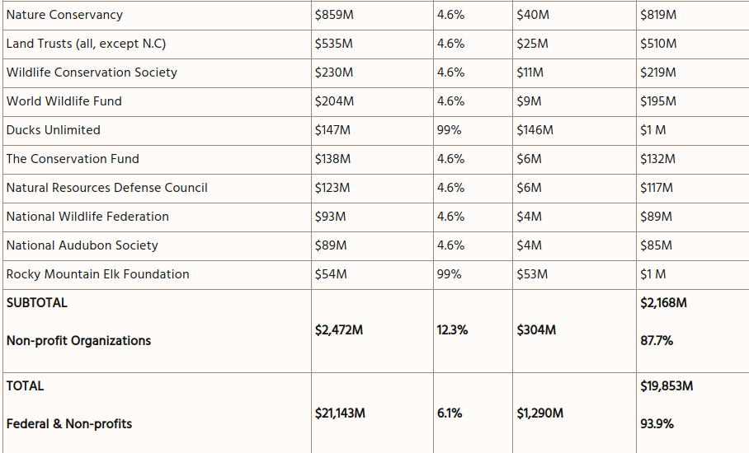

Slide 40
Most of these are in different states of US
And US is a developed country
So what our class is suggesting that we should create such non-profit organization and can take funds from other countries too (developed countries)

Slide 41
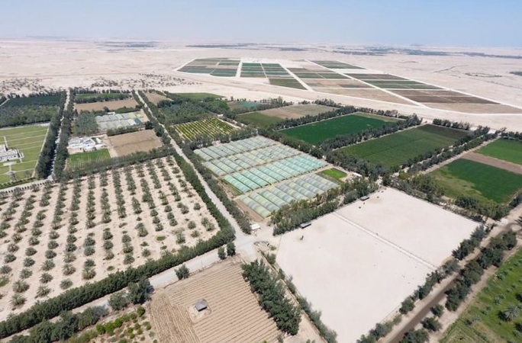
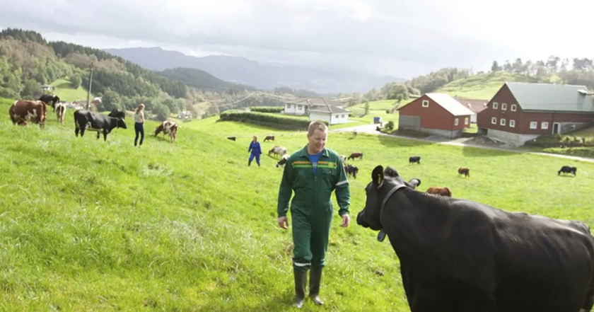
Farms in a developed countries
Qatar
Norway
Sweden

Slide 42
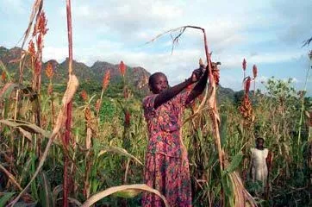
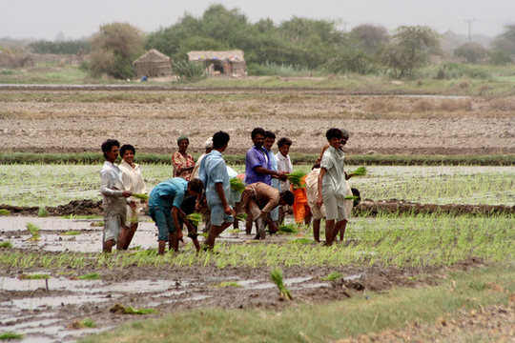
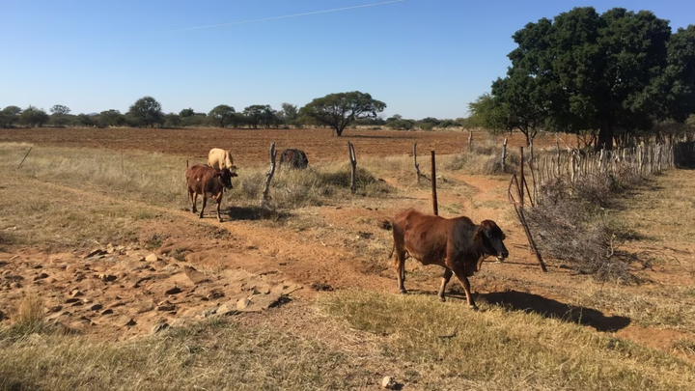
Farms in a developing and underdeveloped countries
Angola
Pakistan
Botswana

Slide 43
Our class created a simple model of a farm for a developing and an underdeveloped countries so there can be prevention of diseases

Slide 44
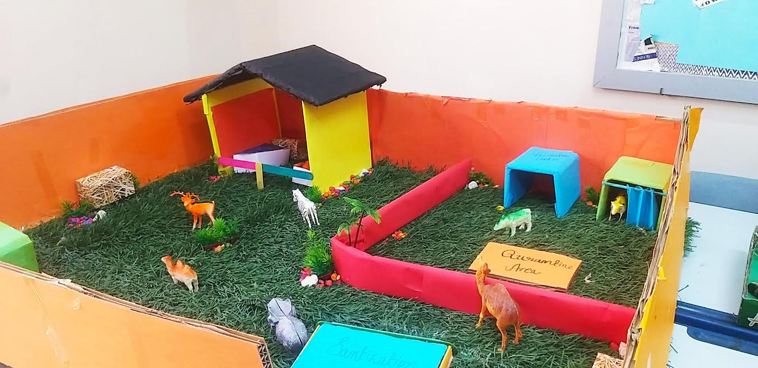
Model

Slide 45
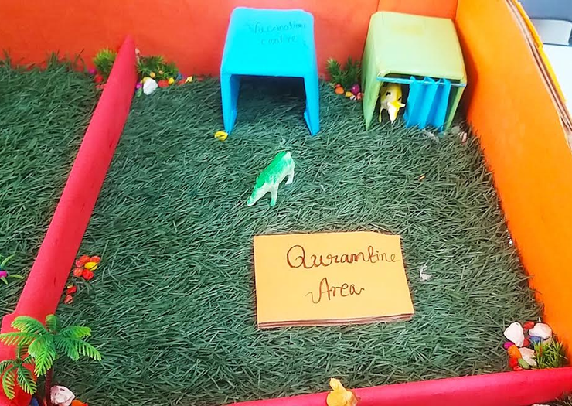

Slide 46
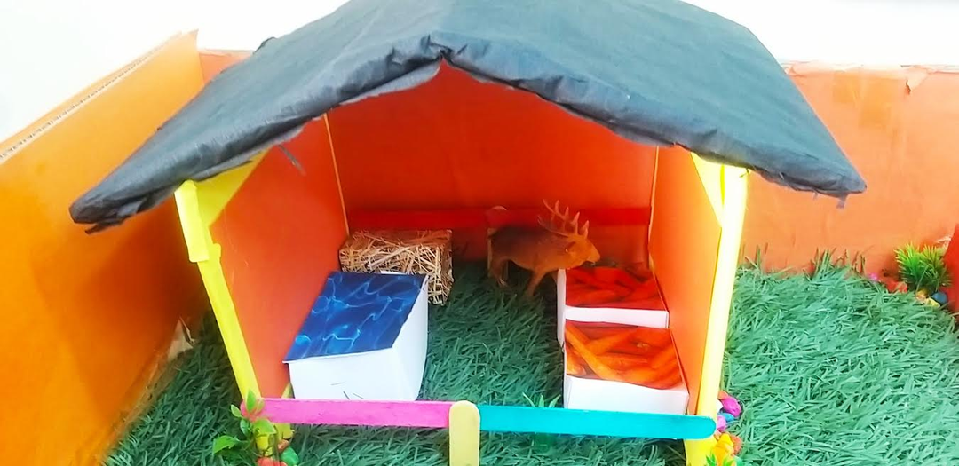
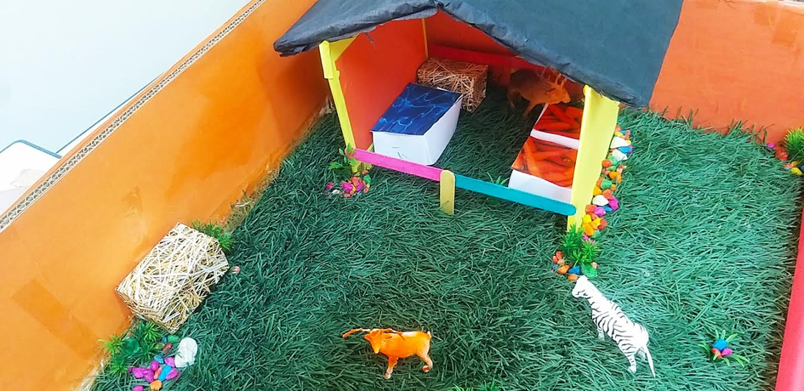

Slide 47
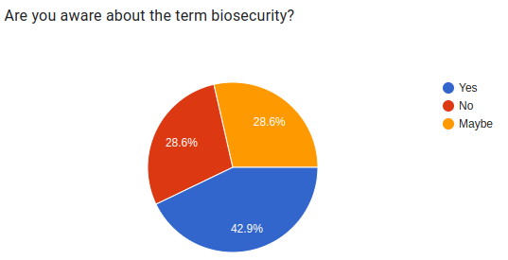
Parent engagement:
Thank you to all the parents who took out their time and filled the survey and did an interview.

Slide 49
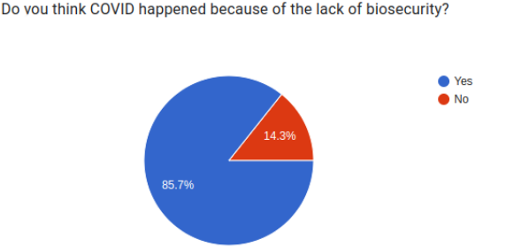

Slide 50
We had planned to do an interview with the Ministry of Municipality and Environment, but due to the time slot given which was after Ramadan, we couldn't conduct it.

Slide 51
YLP Journey video

