Slide 1

Introduction
At Contoso, we empower organizations to foster collaborative
thinking to further drive workplace innovation. By closing the
loop and leveraging agile frameworks, we help business grow
organically and foster a consumer-first mindset.

Slide 2
STANZA SENSORIALE
STIMULATE YOUR SENSES

Slide 3
Primary goals
To design a custom sensory room that utilizes a variety of stimuli to aid in the development and engagement of the senses of children and students with special needs

Slide 4
Timeline
YLP presentation
Jan 2023
Assigning roles and planning of sensory activities for each group
Feb 2023
Conducting sensory activities for special needs and Year 1 students at TNG Al Wakra Primary & Secondary
Mar 2023
Present our biodegradable crayons at Qatar Youth Science Forum
Mar 2023
March 30, 2023
Interview the school psychologist, Ms. Nubla

Slide 5


Agenda
A
Introduction
Primary goals
Timeline
Sensory Activity
Areas of Growth
Way Forward

Slide 6
“Snoezelen” is a combination of two Dutch words “snuffelen” – to seek out/explore and “doezelen” – to doze/snooze.

Slide 7
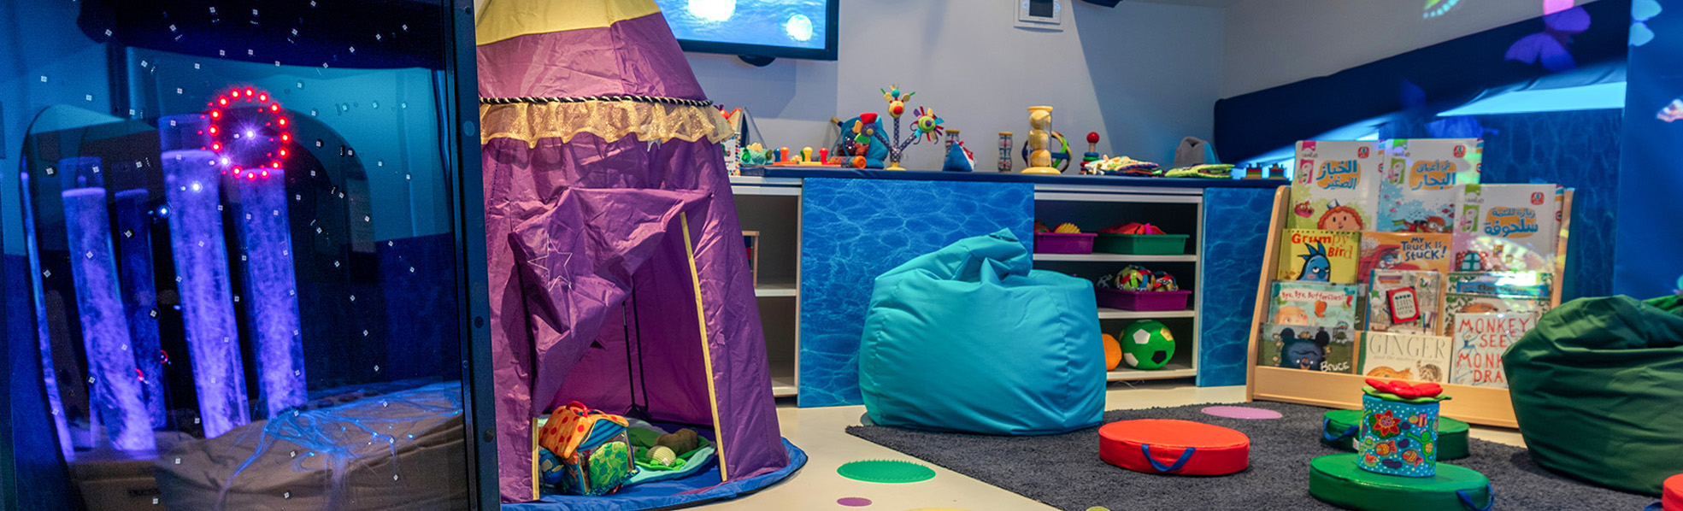
Business opportunities are like buses. There's always another one coming.
“
”
Richard Branson

Slide 8
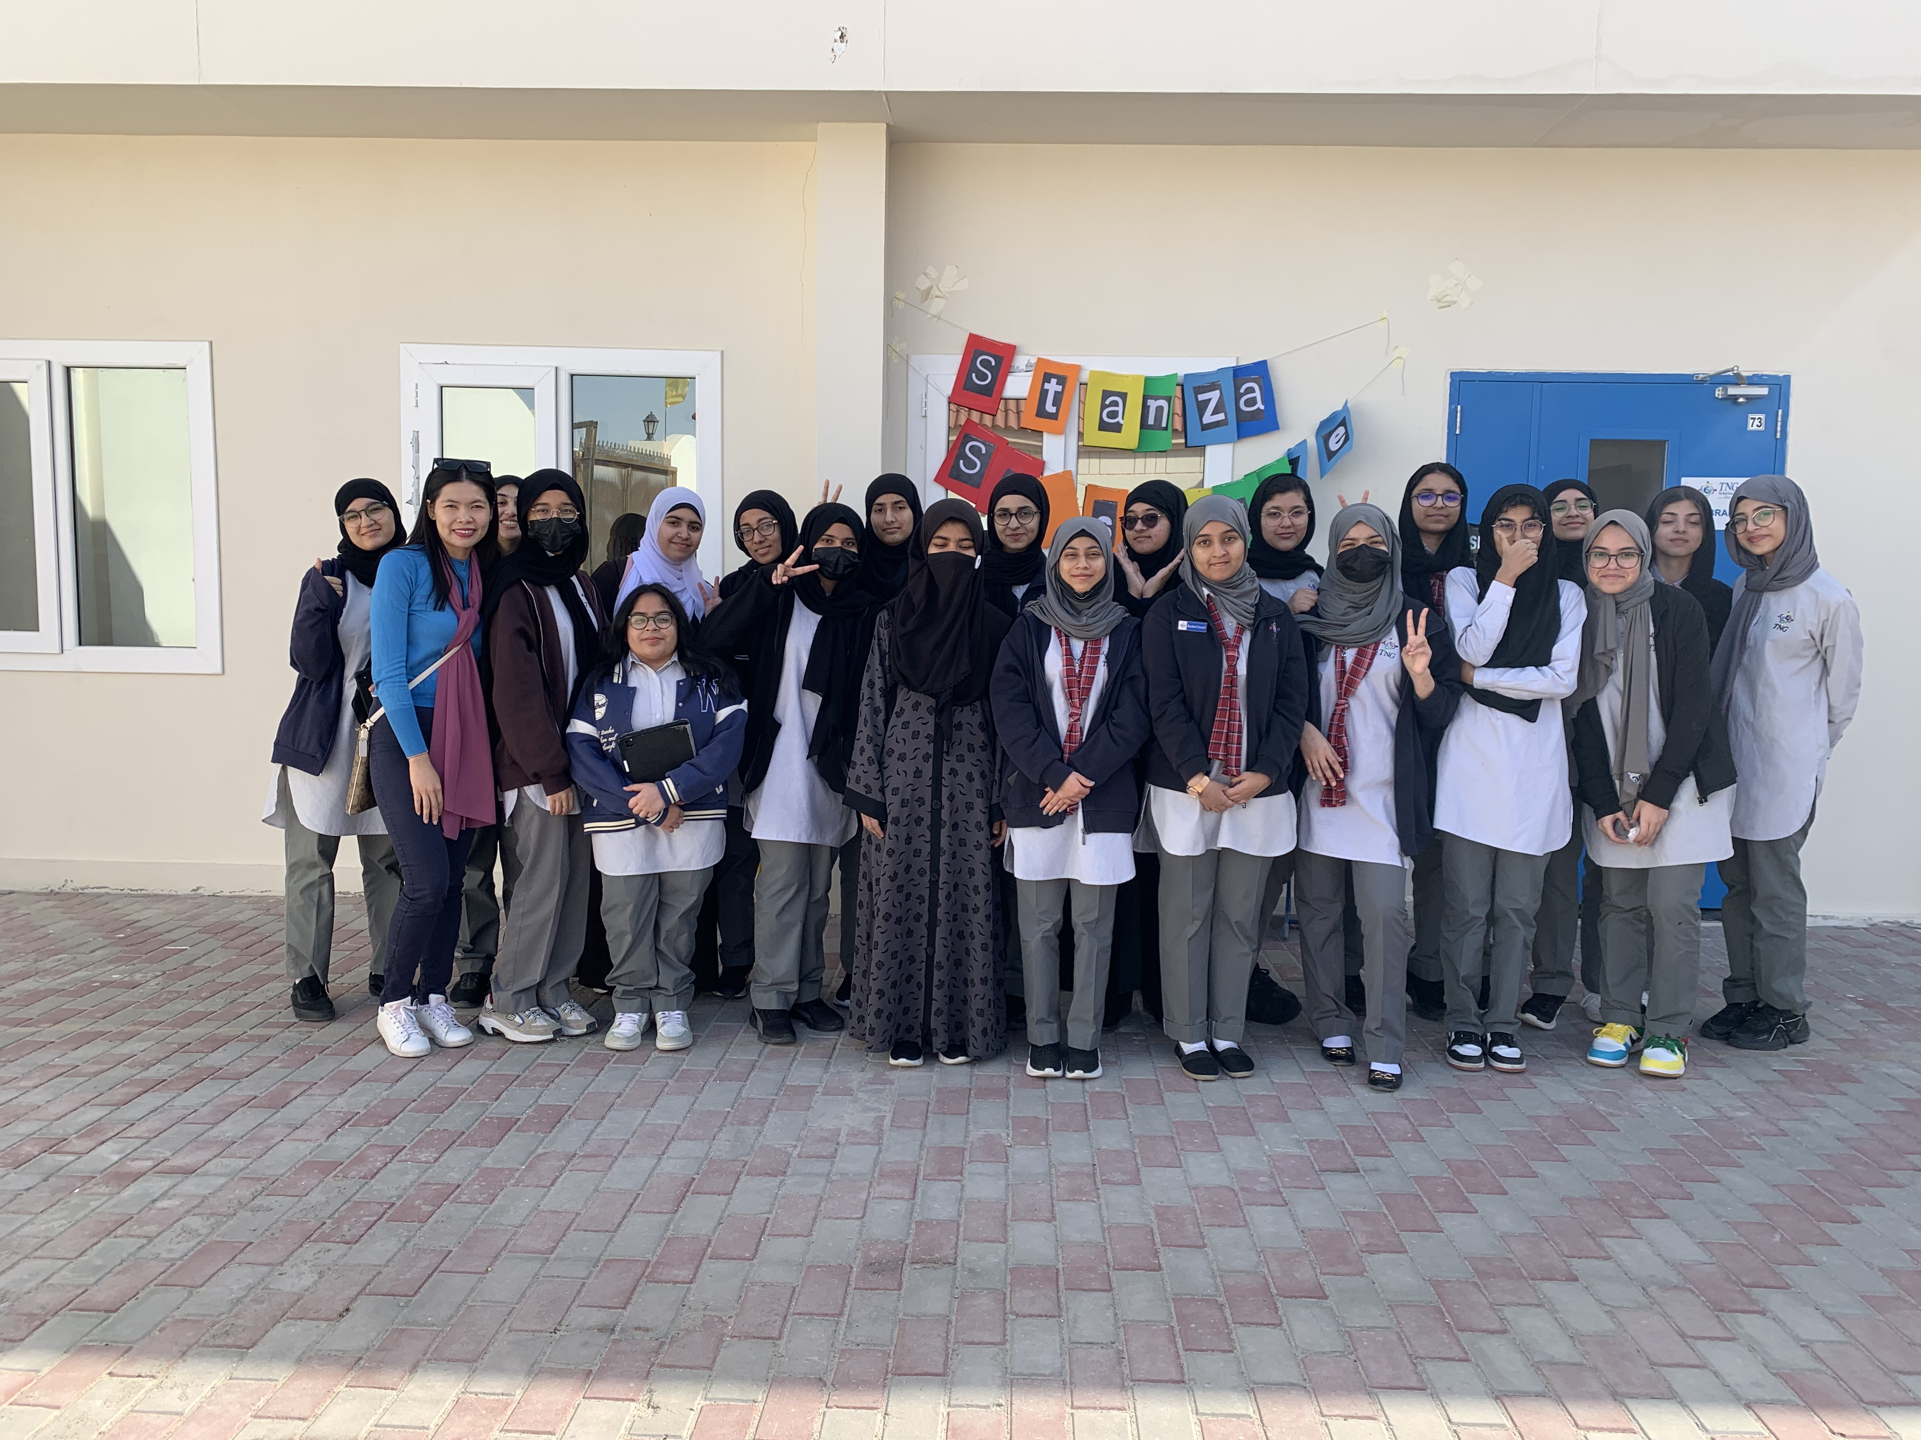
11A
B2B market scenarios
Develop winning strategies to keep ahead of the competition
Capitalize on low-hanging fruit to identify a ballpark value
Visualize customer directed convergence
Cloud-based opportunities
Iterative approaches to corporate strategy
Establish a management framework from the inside

Slide 9
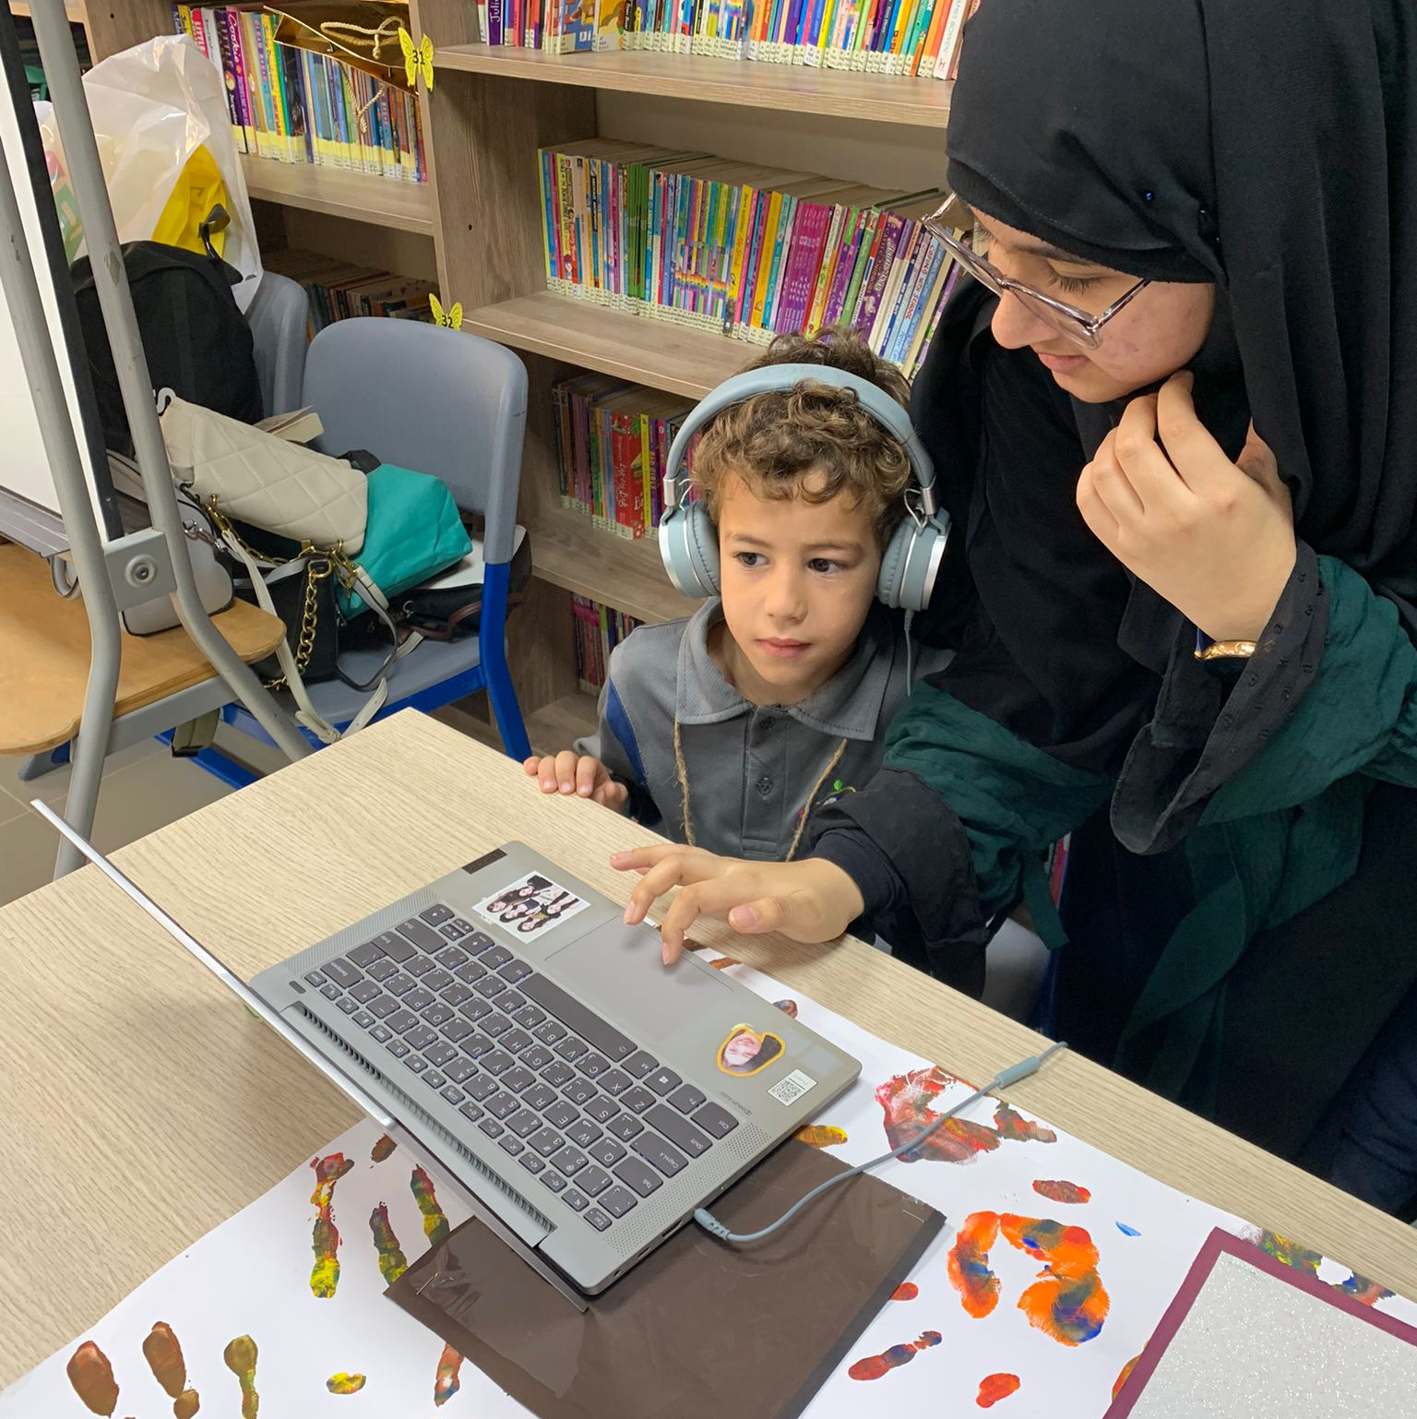
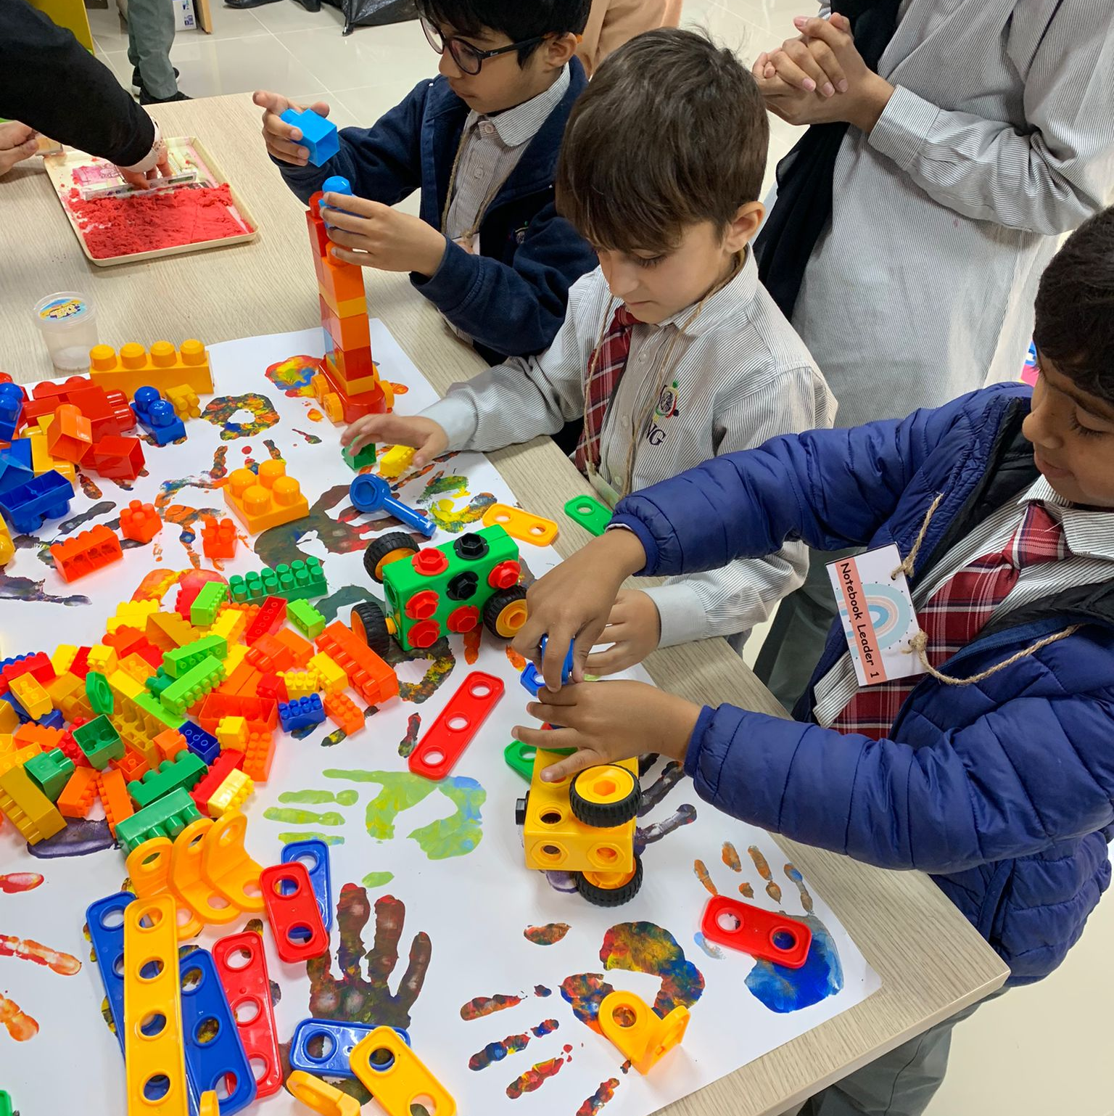
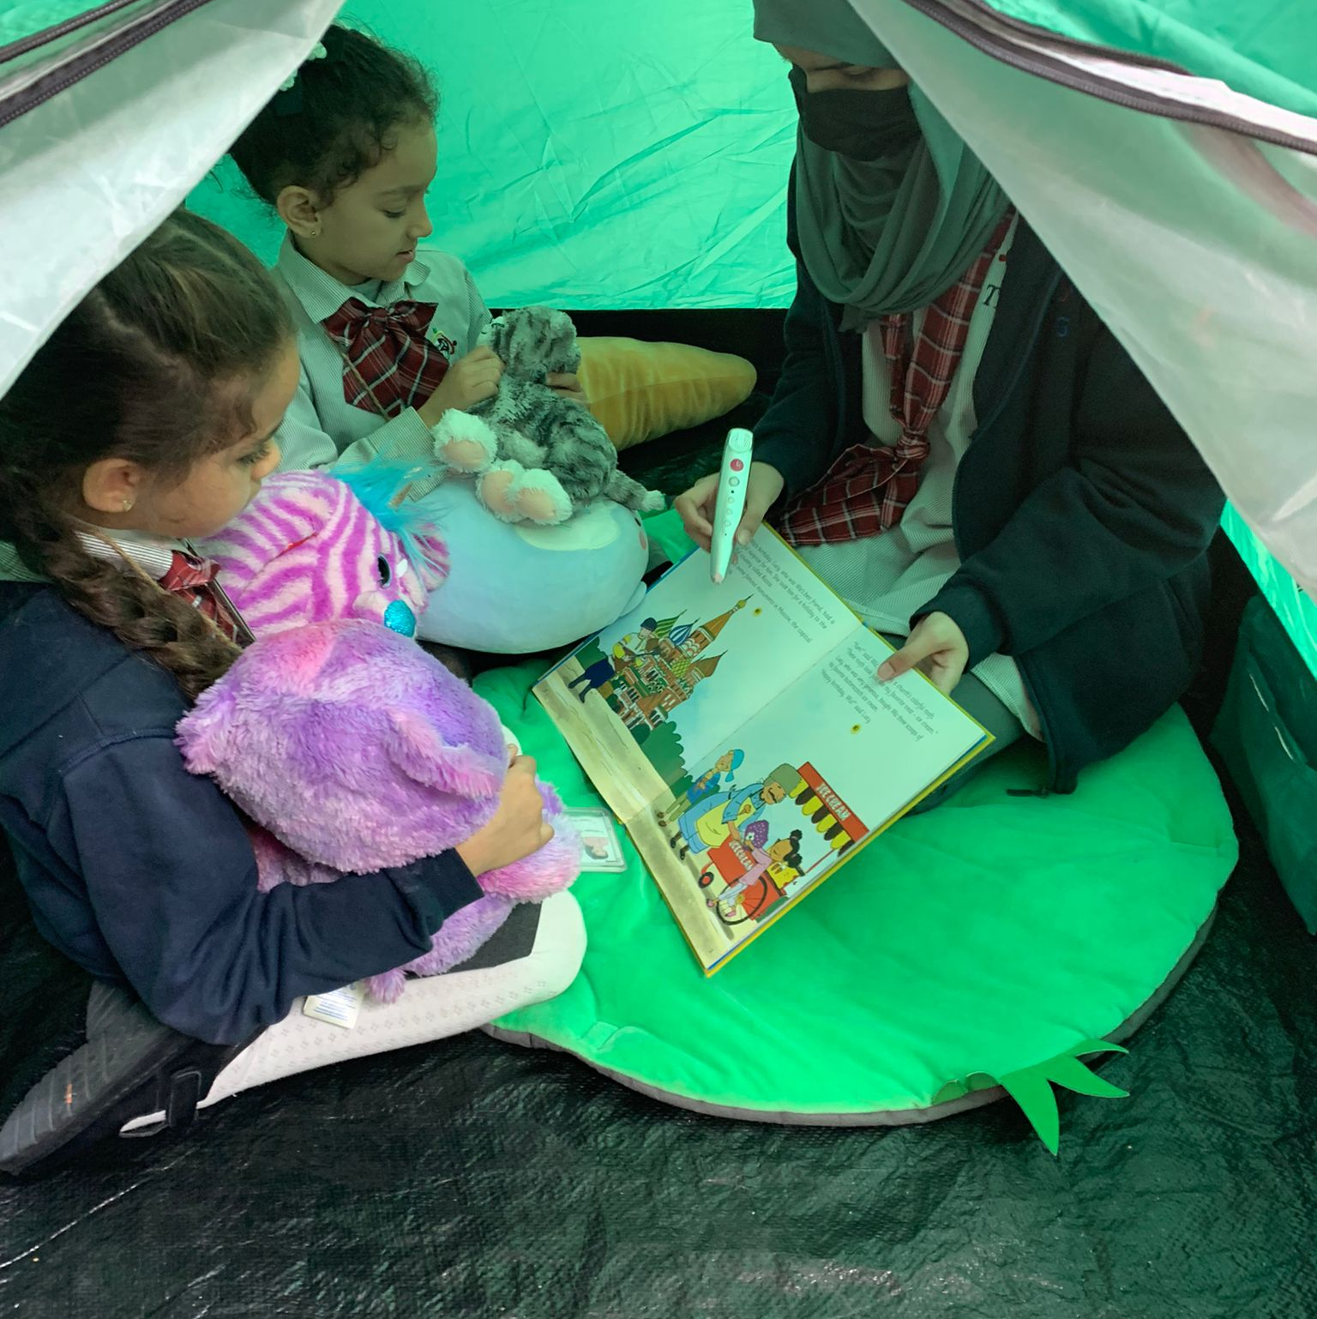
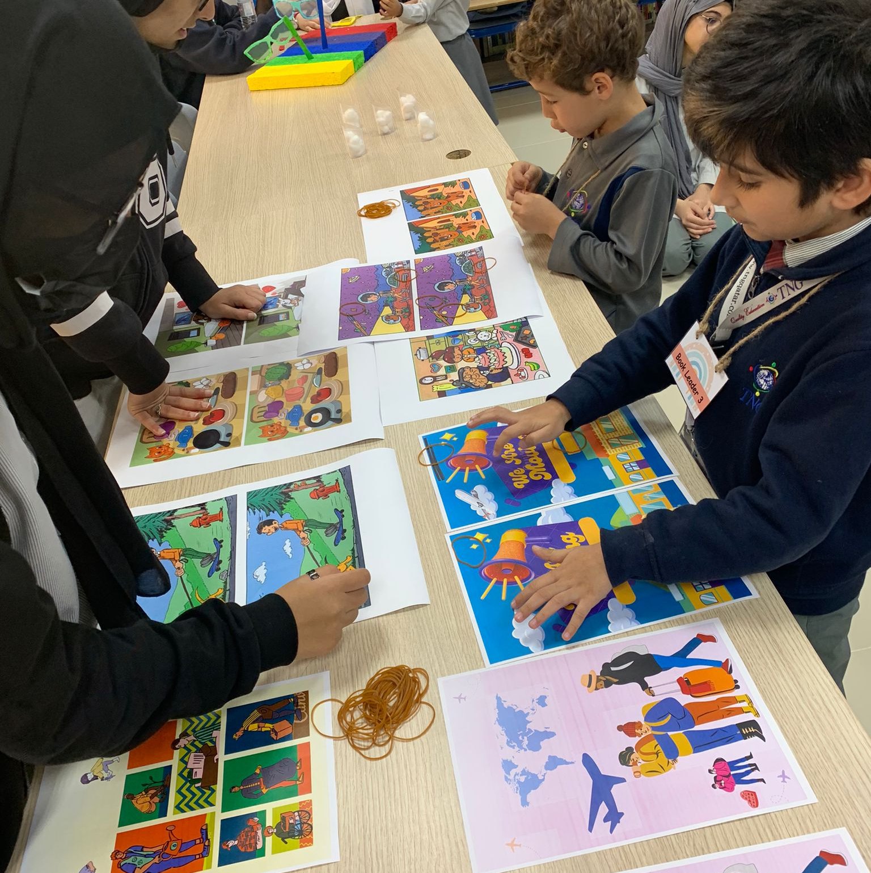
Sensory Activities
Silent Disco​
Building Blocks​
Glamping​
Spot the Difference
Auditory
Kinesthetic
Visual and Auditory
Visual

Slide 10
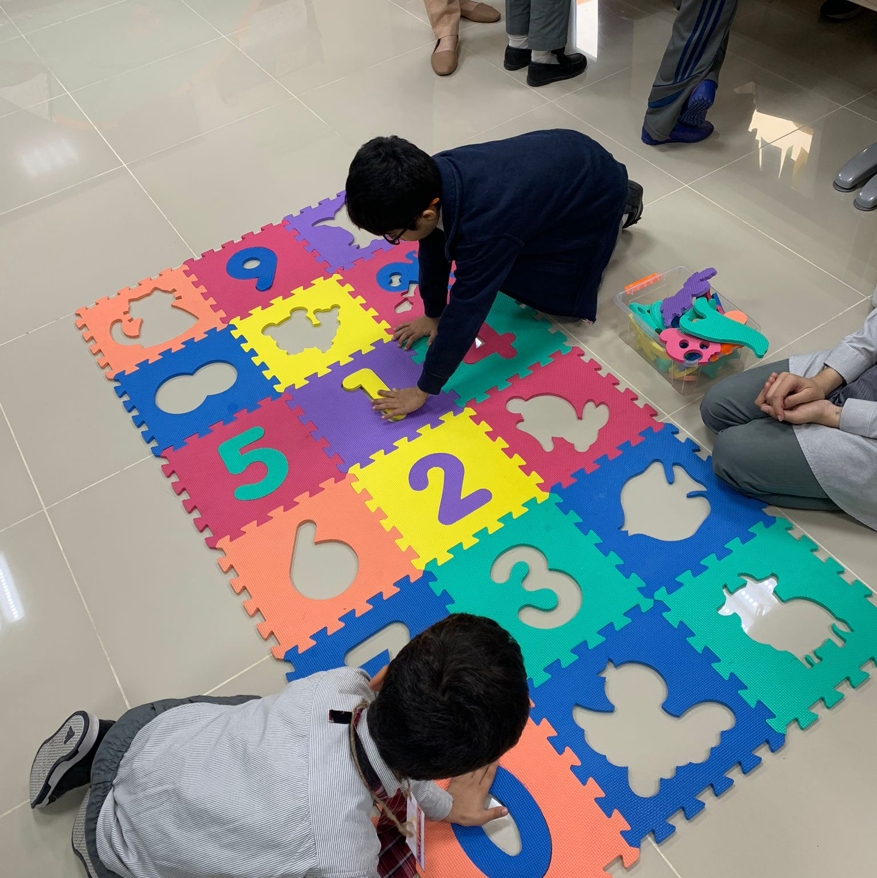
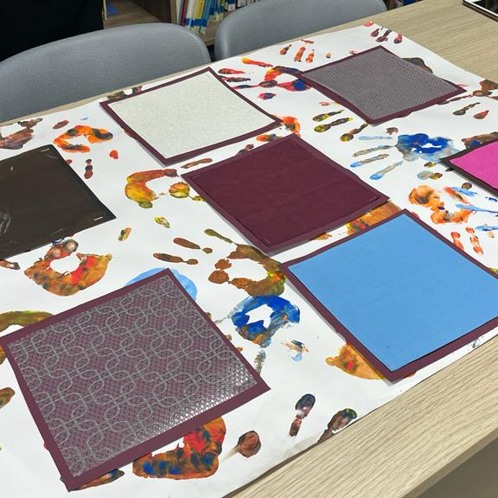
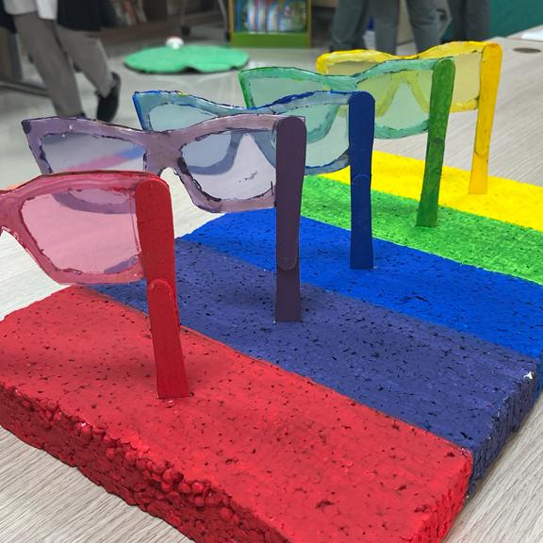
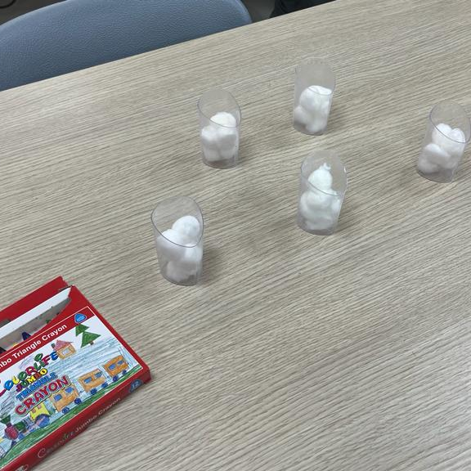
Sensory Activities
Puzzle
Touch me
Rainbow glasses
What’s the scent?
Kinesthetic
Tactile
Visual
Olfactory

Slide 11
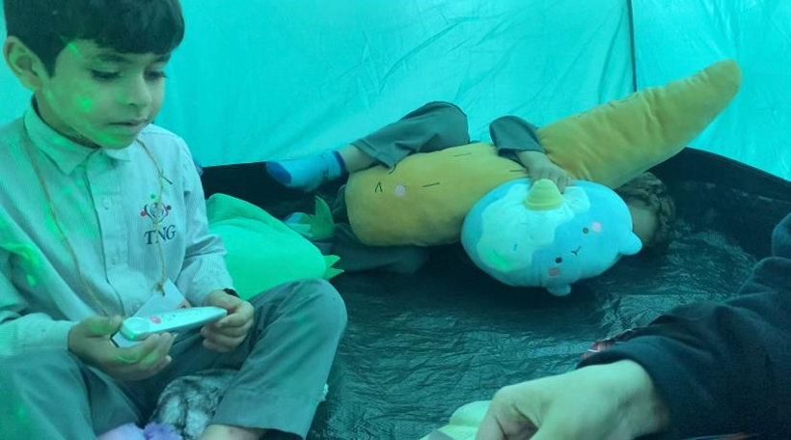
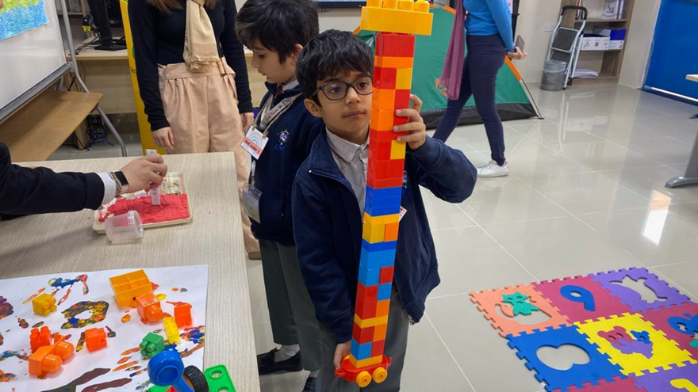
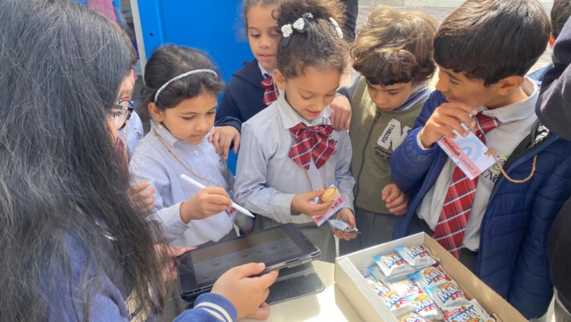

Slide 12
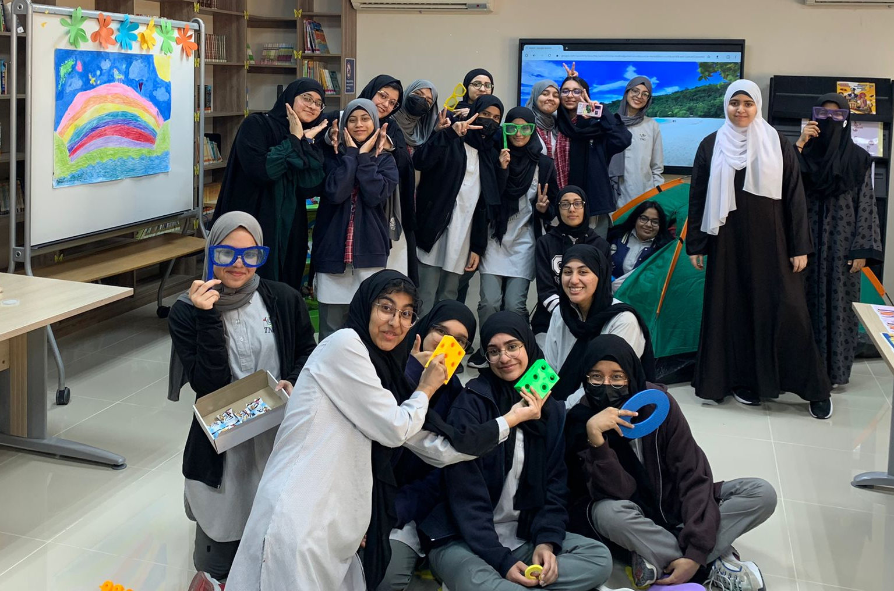
11A
B2B market scenarios
Develop winning strategies to keep ahead of the competition
Capitalize on low-hanging fruit to identify a ballpark value
Visualize customer directed convergence
Cloud-based opportunities
Iterative approaches to corporate strategy
Establish a management framework from the inside

Slide 13
Ms. Nubla
The sensory room is the space where the individual will receive sensory input so they can control themselves and feel more at ease doing daily activities. The sensory room will assist them in creating a private environment where they may study and develop their social skills. For children with special needs, a sensory room will have numerous impairments, thus having one will give them a secure and encouraging learning environment. The use of sensory activities in the classroom will help pupils decompress and improve their study skills.

Slide 14

QYSF
B2B market scenarios
Develop winning strategies to keep ahead of the competition
Capitalize on low-hanging fruit to identify a ballpark value
Visualize customer directed convergence
Cloud-based opportunities
Iterative approaches to corporate strategy
Establish a management framework from the inside

Slide 15
Areas of growth
Conduct sensory activities in a room with less distractions which can stimulate certain senses of special needs students

Slide 16
Way Forward
Sensory rooms are highly recommended to kindergarten schools as it creates a safe space designed to help an individual with sensory issues learn to regulate their brain’s negative reactions to external stimuli by developing coping skills for these experiences.

Slide 17
Thank you
Sensory Souk
Phone: 4411-0147
https://www.sensorysouk.com

