Slide 1
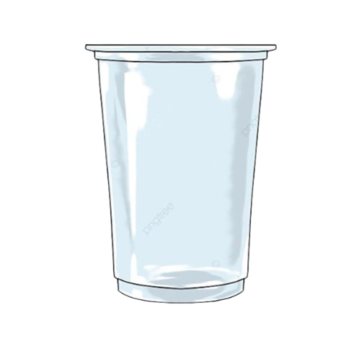
Sip Smart,Waste Less
Campaign by : Year 9

Slide 2
The cups we use are biodegradable plastic which means that they will break down when exposed to the micro-organisms.

Slide 3
So Why Are We Removing The Cups?

Slide 4
Biodegradable cups or plastic usually takes 3-6 months to decompose a normal plastic bag which might already cause the damage to the environment.

Slide 5
Biodegradable cups or plastic usually takes 3-6 months to decompose a normal plastic bag which might already cause the damage to the environment.

Slide 6
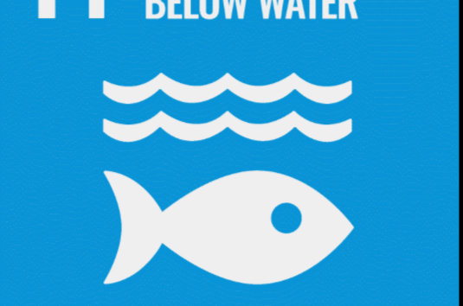
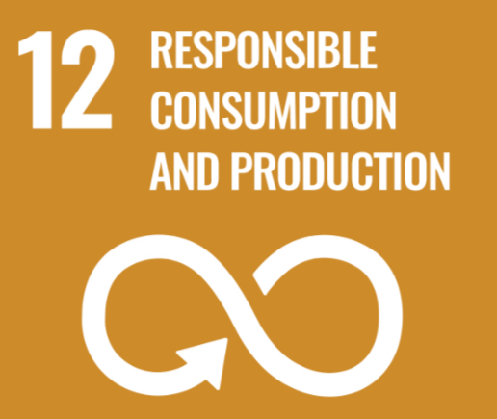
Our Aim during this year is to create a sustainable environment in our school by taking some steps to reduce or completely finish the cups we use today.

Slide 7
So help us step out and reduce plastic wastage with first starting within our school.

Slide 8
Our Solutions:

Slide 9
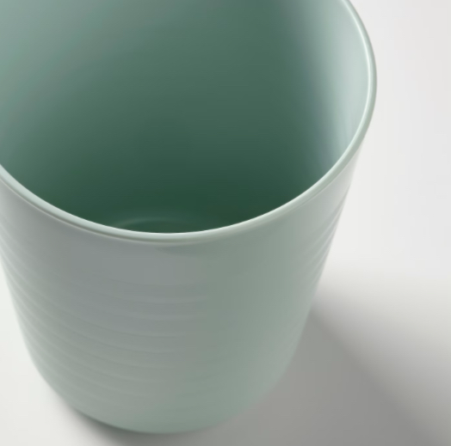
1
Reusable plastic cups (IKEA):

Slide 10
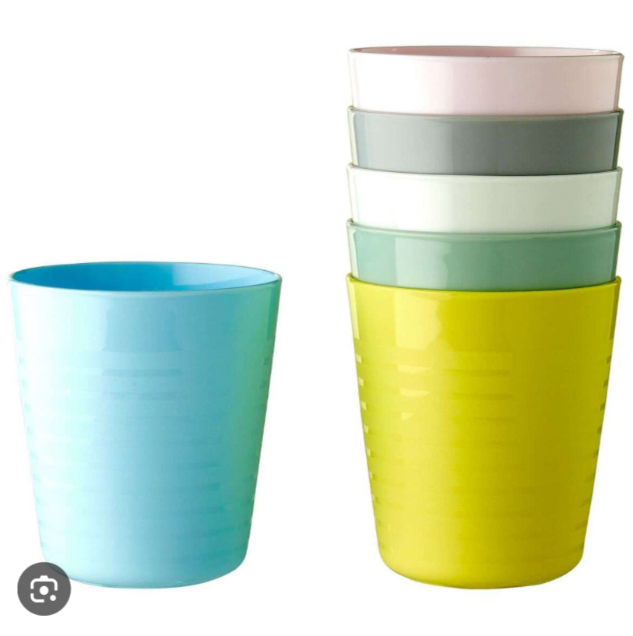
1
Reusable plastic cups (IKEA):

Slide 11
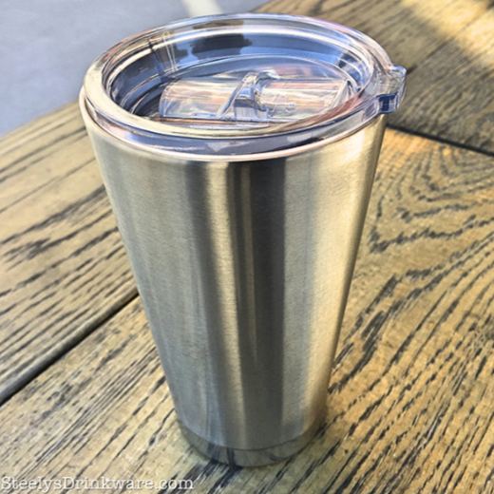
2
Same cups with different lids:

Slide 12
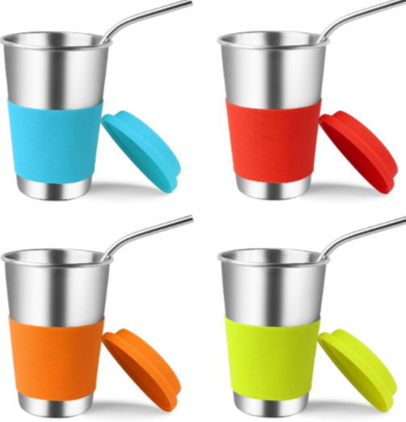
2
Same cups with different lids:

Slide 13
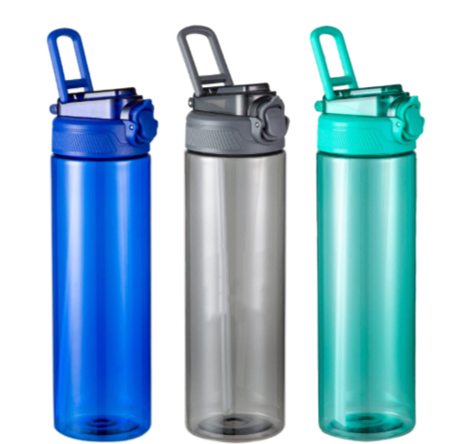
3
Plastic/steel bottles:

Slide 14
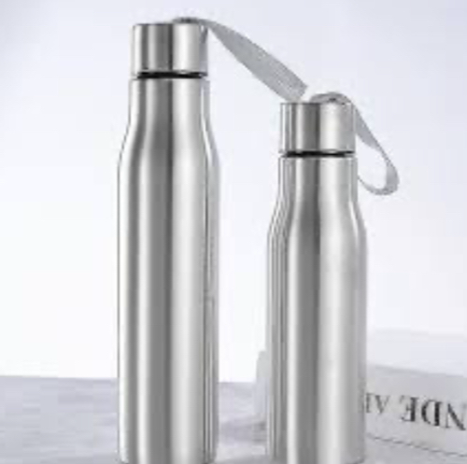
3
Plastic/steel bottles:

Slide 15
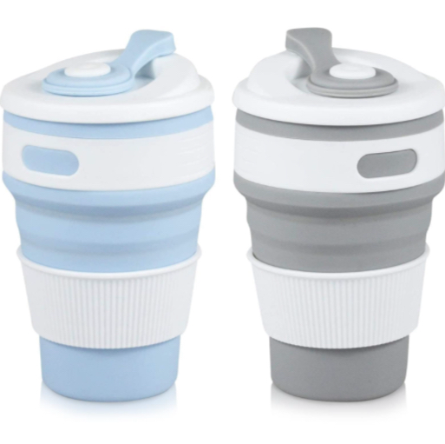
4
Foldable cups:

Slide 16
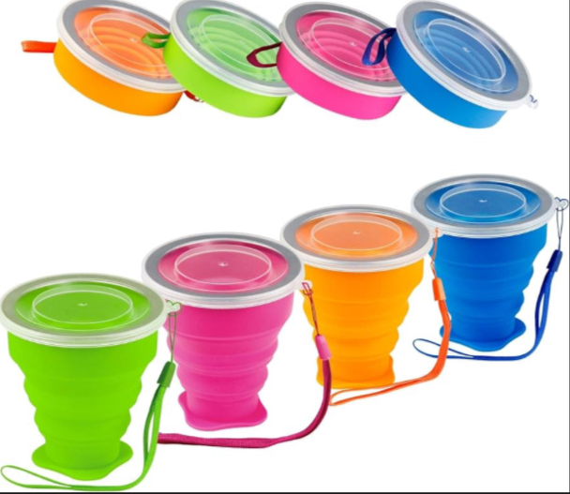
4
Foldable cups:

Slide 17
We might just change the world with the support we get from you and buy following those simple solutions.

