Slide 1
EPIC FISHES
BY WALEED.K

Slide 2
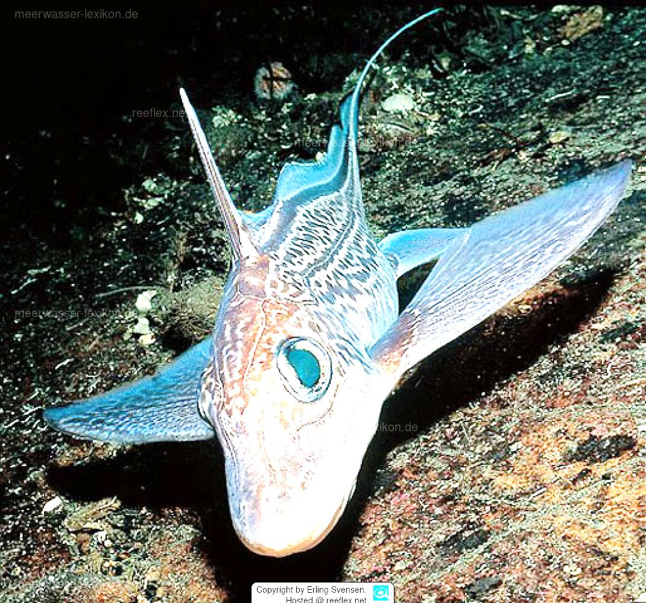
Chimaera monstrosa
Unlike sharks and rays, chimaeras have a single external gill opening, covered by a flap as in the bony fishes, on each side of the body. Male chimaeras, unique among fishes, also possess a supplemental clasping organ.

Slide 3
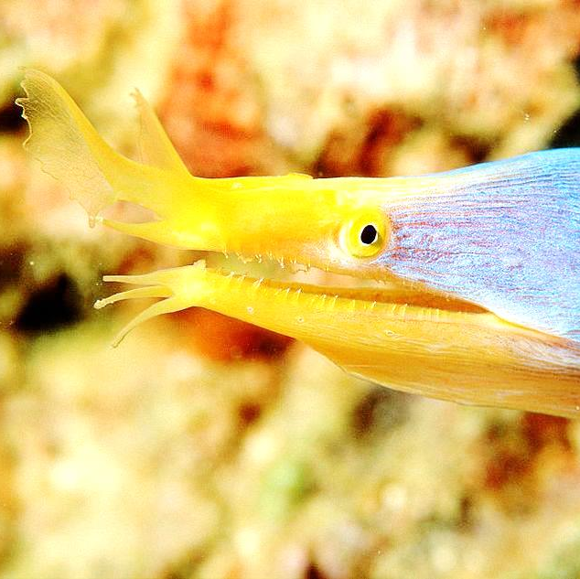
Ribbon Eel
Usually seen nestled into burrows around coral reefs, the ribbon eel (sometimes called the leaf-nosed moray eel) lives in Indonesian waters from East Africa, to southern Japan, Australia, and French Polynesia.

Slide 4
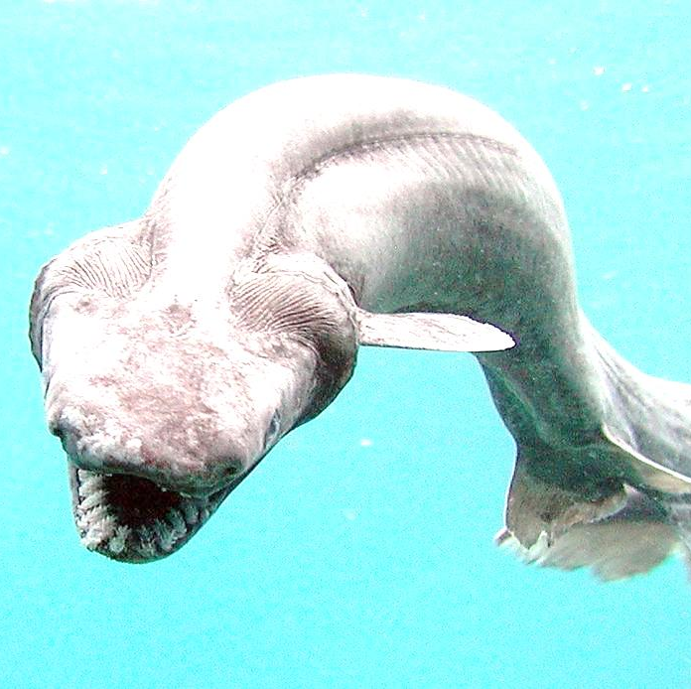
Frilled Shark
The frilled shark, Chlamydoselachus anguineus, is one of the gnarliest looking creatures in the sea. If it looks like an ancient beast, that’s because it is: the prehistoric creature’s roots go back 80 million years.

Slide 5
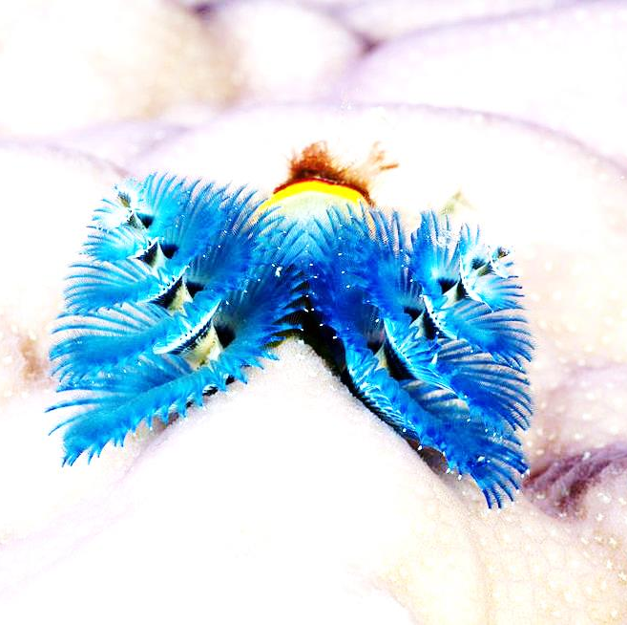
Christmas Tree Worm
Scientists found this strange creature at the Great Barrier Reef’s Lizard Island and named it, aptly, the Christmas tree worm. The spiral “branches” are actually the worm’s breathing and feeding apparatuses, while the worm itself lives in a tube.

Slide 6
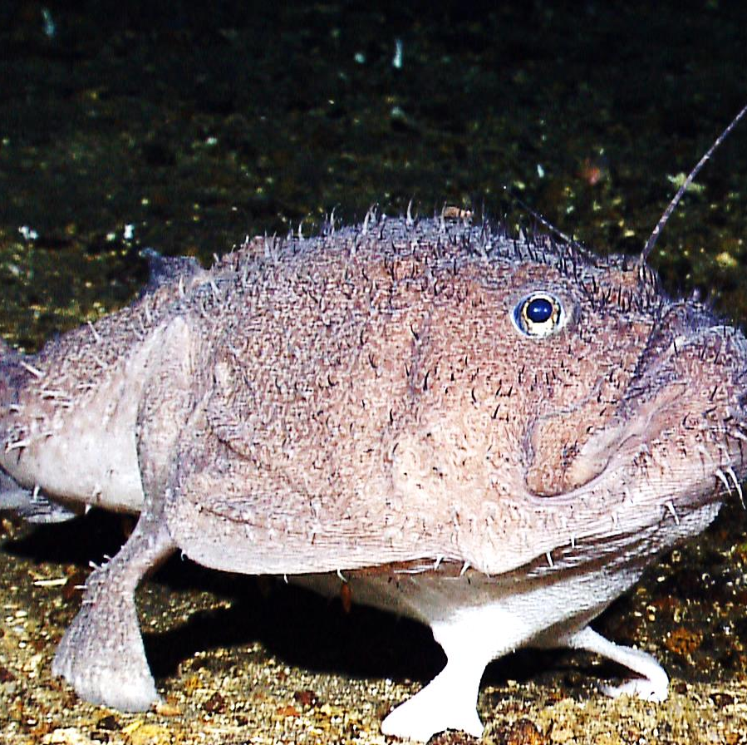
Coffin fish
A quirky bunch of deep-sea inhabitants celebrated for their inflatable bodies and preference for the ocean floor. The fish is named for its uncanny resemblance to a miniature coffin.

Slide 7
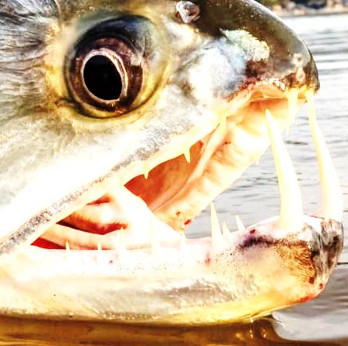
vampire fish
On the freshwater side, the vampire fish is a nickname for the payara, an abundant gamefish found in the Amazon Basin. While this large, 1.5-to-3 foot fish does not suck the blood of its prey, its six-inch-long fangs, which protrude from an undershot jaw.

Slide 8
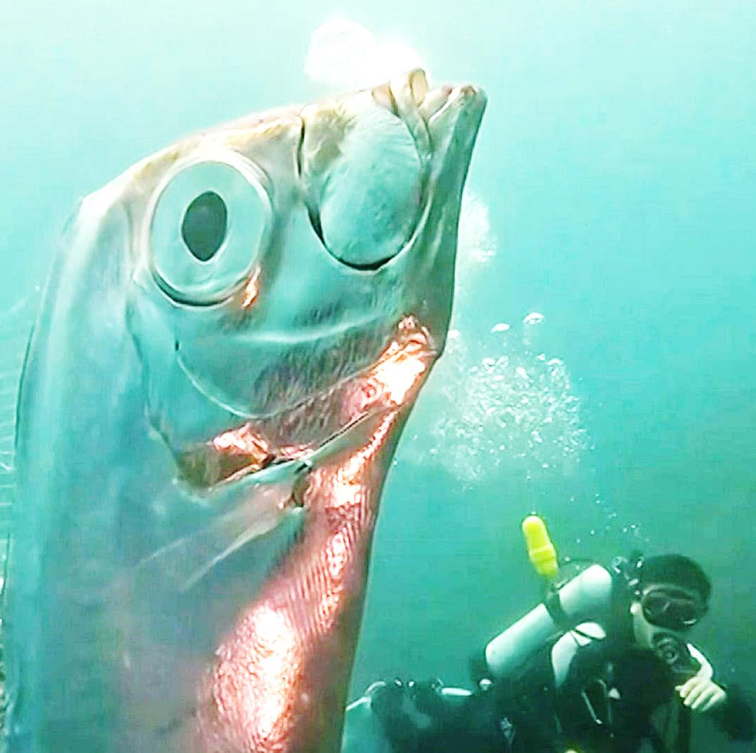
oarfish
In Japan, the giant oarfish is known as the "messenger from the sea god's palace". They are said to be the harbinger of doom. But scientists dispute these ideas.

Slide 9
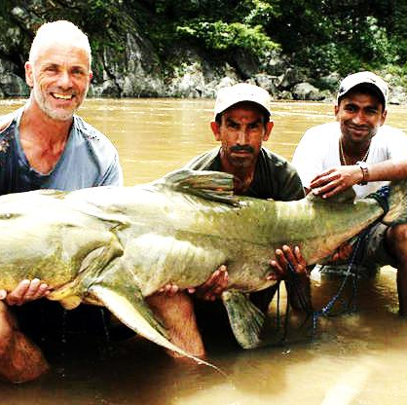
Goonch Catfish
The enormous goonch, a type of catfish, is said to have developed a taste for human flesh after feeding on corpses thrown into the river after funeral ceremonies. Locals rumours have held for years that a mysterious monster lurks in the water.

Slide 10
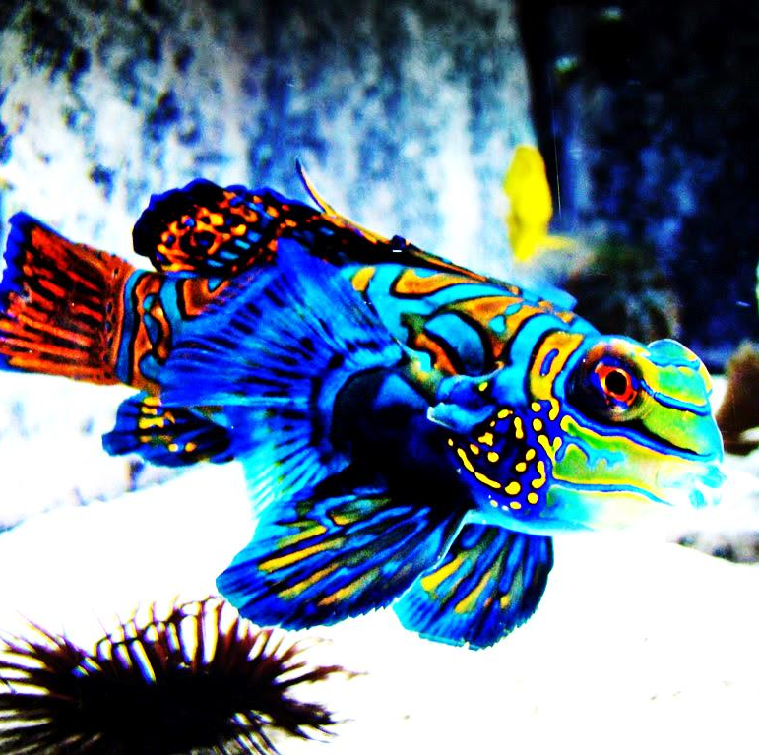
Mandarin Fish
One of the most common and popular fishes in the aquarium trade, the Mandarin fish is a small but brightly colored saltwater fish. Also known as the Mandarin dragonet this Pacific native fish can be found from Australia to the Ryukyu Islands.

Slide 11
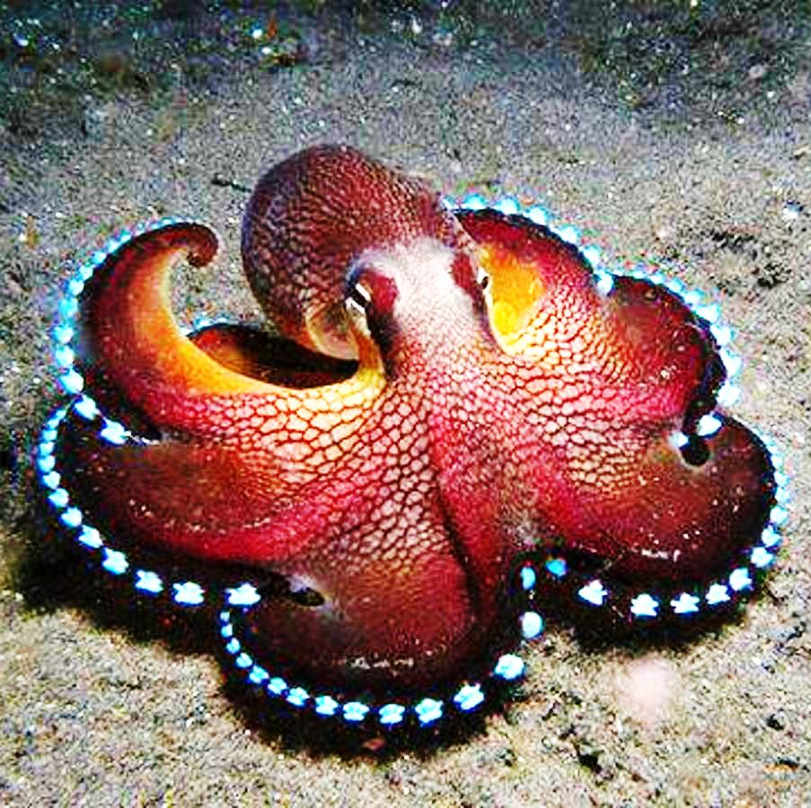
Bioluminescent Octopus
These sea creatures are of yet another species which may be found in a sci-fi movie. While little is known of this specimen, the octopus is scientifically named Stauroteuthis syrtensis with tentacles averaging 14 inches in length and approximately 60 suckers on each one.

Slide 12
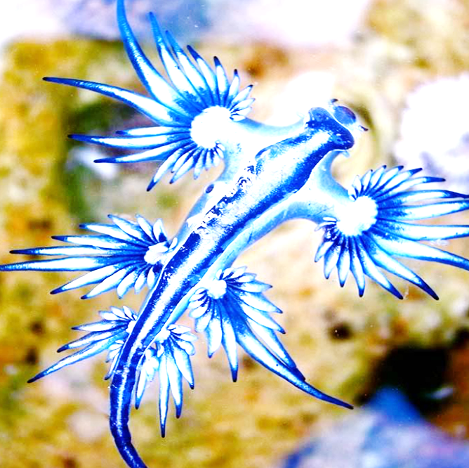
Glaucus atlanticus
These little go-with-the-flow sea slugs are a true work of oceanic art. The glaucus atlanticus float upside down, allowing the winds and ocean currents to carry them. But be warned! If you interrupt their relaxing swim, they will sting (and they are venomous).

Slide 13
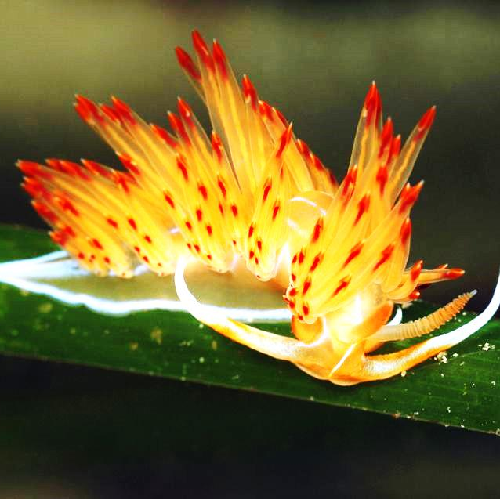
Nudibranchs (new-dih-bronx)
Tropical sea cousins of the slug, which can most commonly be found crawling along the bottom levels of the shallow seas. These mollusks shed their shells and reveal their vibrant skins when they become slug-teenagers.

Slide 14
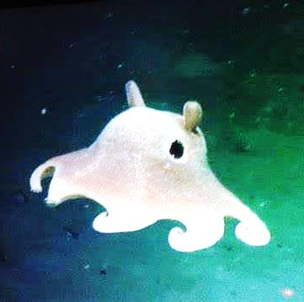
Dumbo Octopus
The odd, adorable, deep-sea "dumbo" octopus is not the name of a single species, but instead refers to an entire genus of umbrella octopuses. As a group, dumbo octopuses are known to live over 22,000 feet deep.

Slide 15
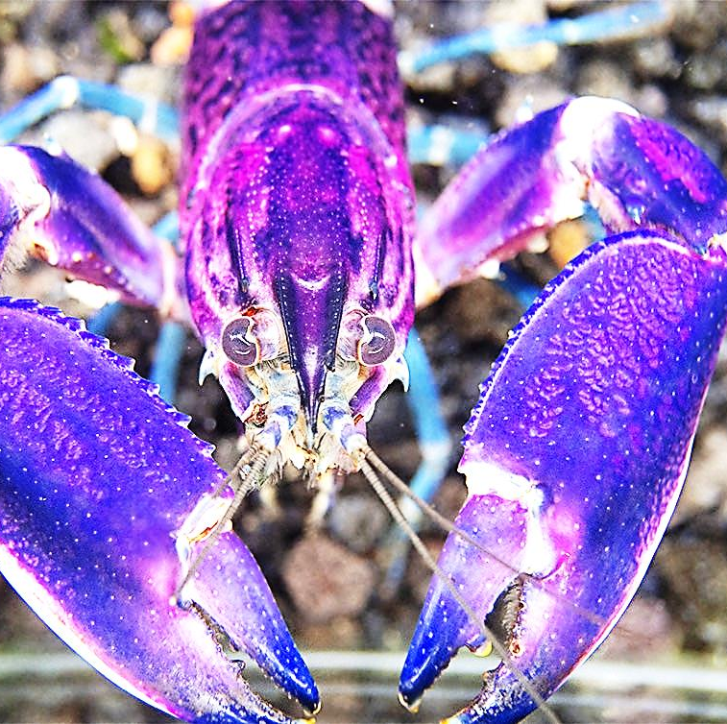
Crayfish
Crayfish are freshwater crustaceans belonging to the infraorder Astacia, which also contains lobsters. They breathe through feather-like gills. Some species are found in brooks and streams, where fresh water is running.

Slide 16
Axolotl
The Axolotl is a species scientists are apprehensive about going extinct soon; they estimate that there are only about 50 to 1,000 left in the wild.

