Slide 1

Youth Leadership Program 2022-2023
Green Code
Year 8C

Slide 2
What is Our Project About?
Our project works towards promoting electronic stewardship which is simply raising awareness regarding responsible recycling solutions to solve the growing issue of electronic waste

Slide 3
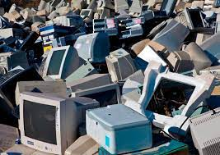
Why E-waste?
E-waste is a major contributor to climate change. E-waste can be toxic as it is not biodegradable and accumulates in the environment, soil, air, water and living things. What makes it even more dangerous is the lack of awareness people have on the dangers of E-waste.

Slide 4
59.4 MILLION TONS OF EWASTE WAS GENERATED IN 2022

Slide 5
Our Goals For This Project
Reduce
Awareness
Encourage
Reducing out carbon footprint by the recycling of malfunctioned electronic devices.
Spread awareness in our society regarding electronic stewardship.
Encouraging people in our community to refrain from throwing away malfunctioned electronics.

Slide 6
Journey
A glimpse across the three phases of our YLP journey

Slide 7
Planning Phase
01
Think green!
Where it all started!

Slide 8
What Did We Do?
Brainstorming our project and planning the preparation and implementation phases.
Grouping each student into teams such as research, social media, and photography teams (providing them with tasks to do).

Slide 9
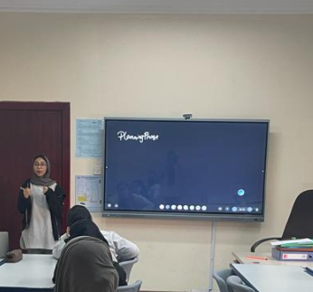
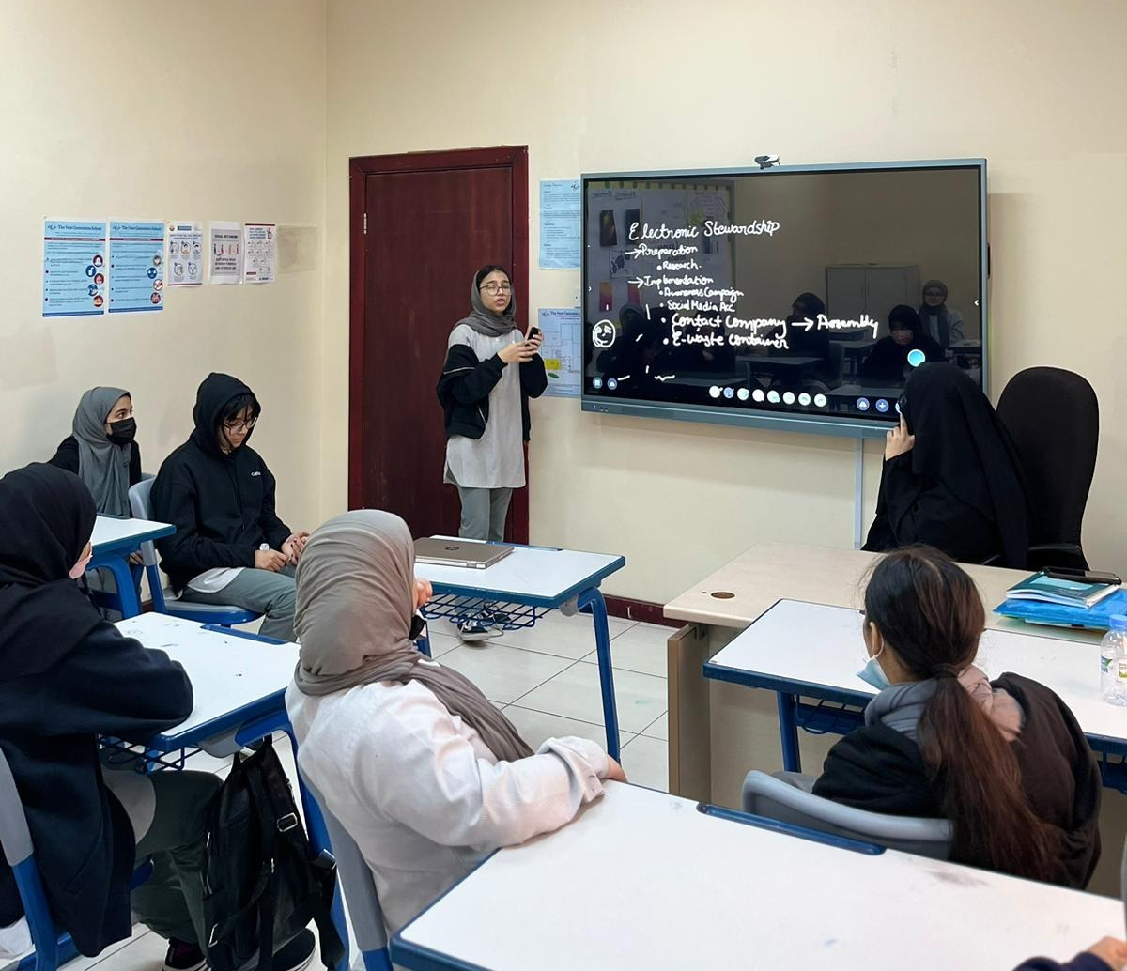
Brainstorming our project and planning the different phases.

Slide 10
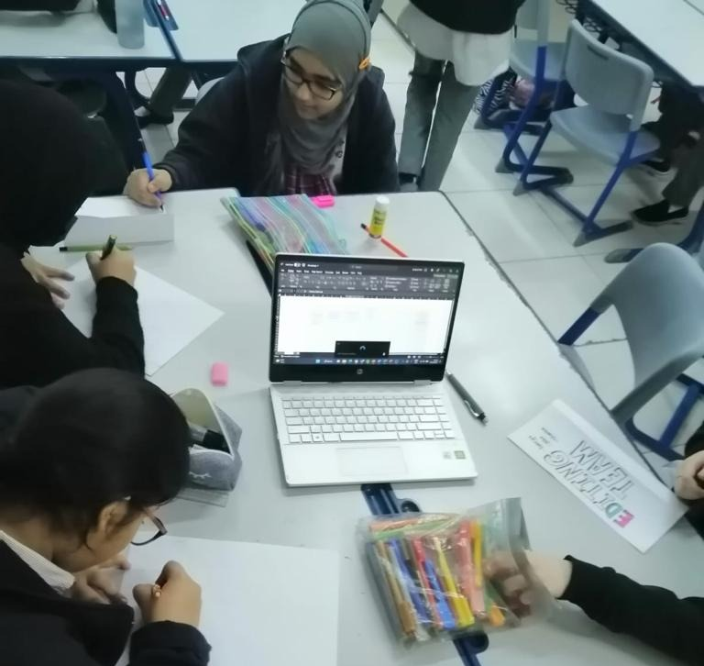
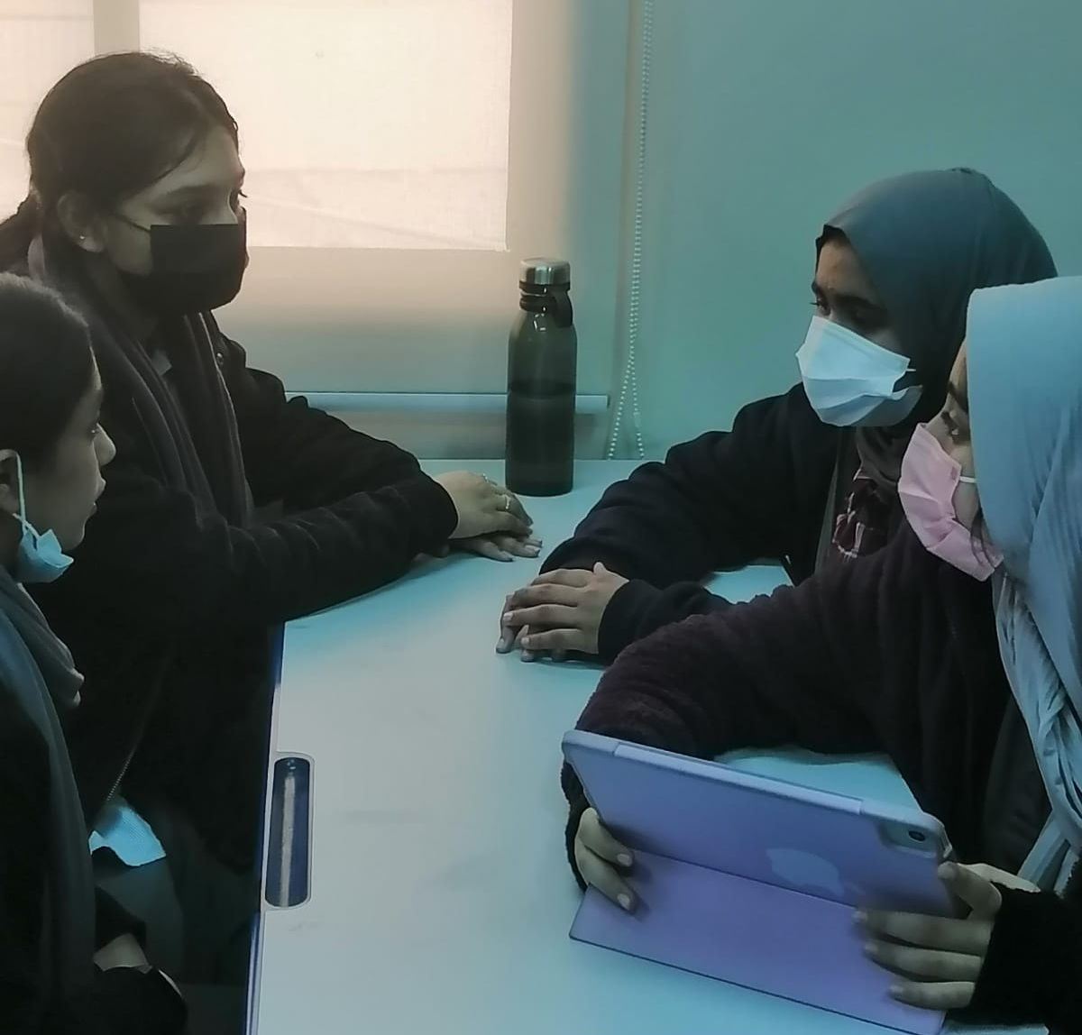
Students being divided into different committees

Slide 11
02
Preparation Phase
We’re almost there!

Slide 12
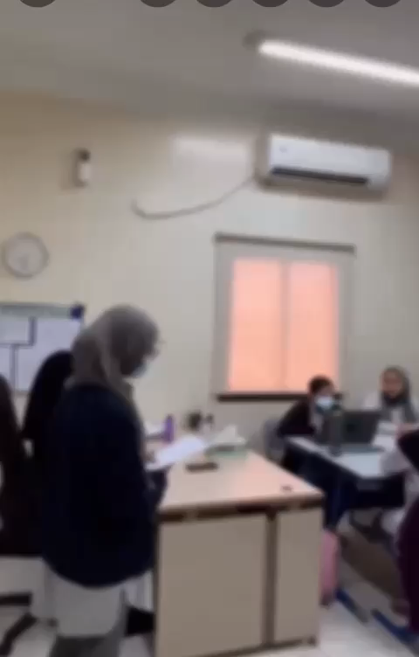

Slide 13
What We Did?
Survey
Research Questions
Art Work
A survey was given out to not ethe efficiency of the project.
Students were assigned with research questions which they the presented in class.
Creating a YLP poster to display our project and the art team created a e-waste collection box.

Slide 14
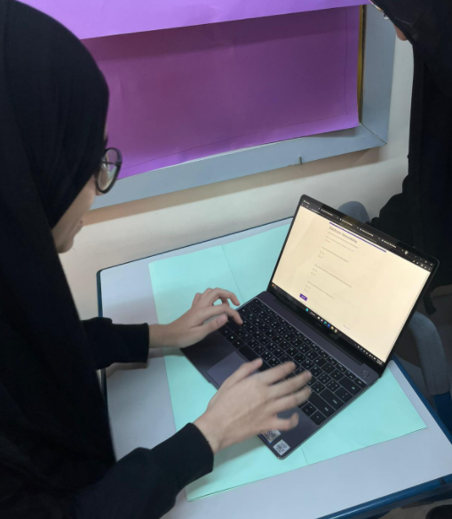
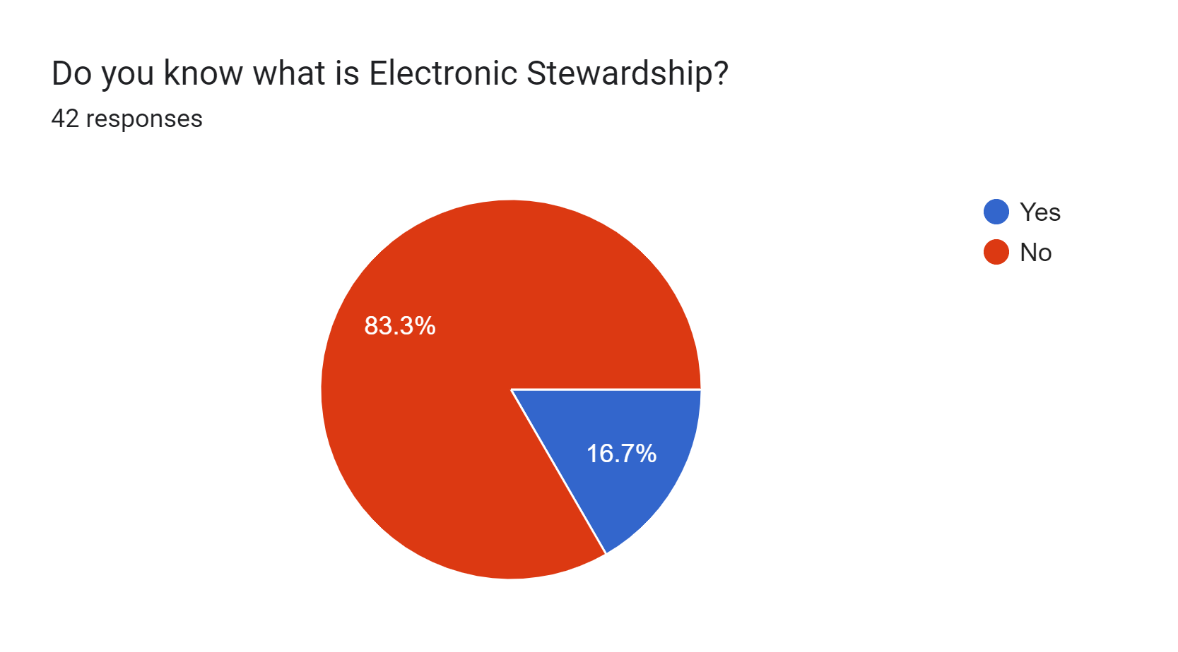
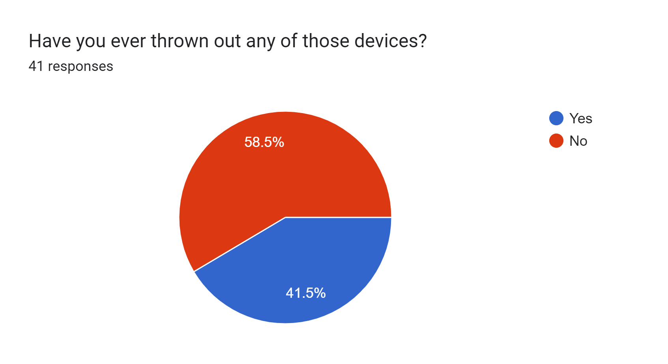
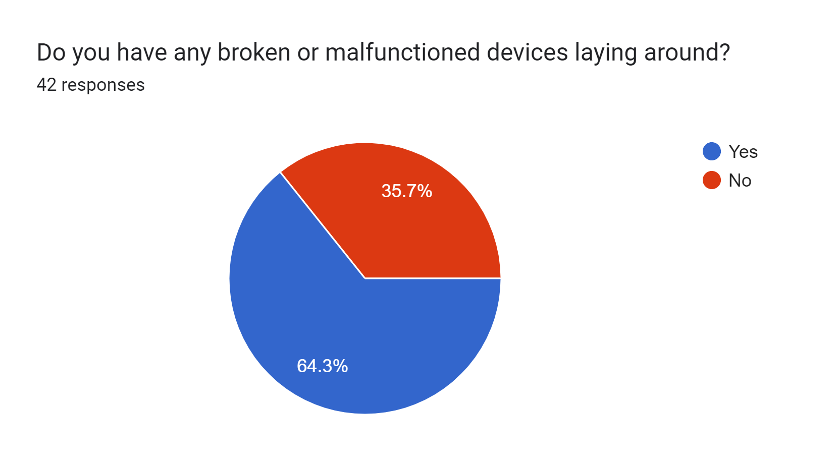
Research Survey

Slide 15
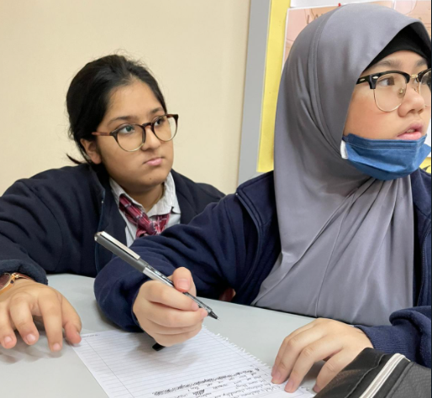
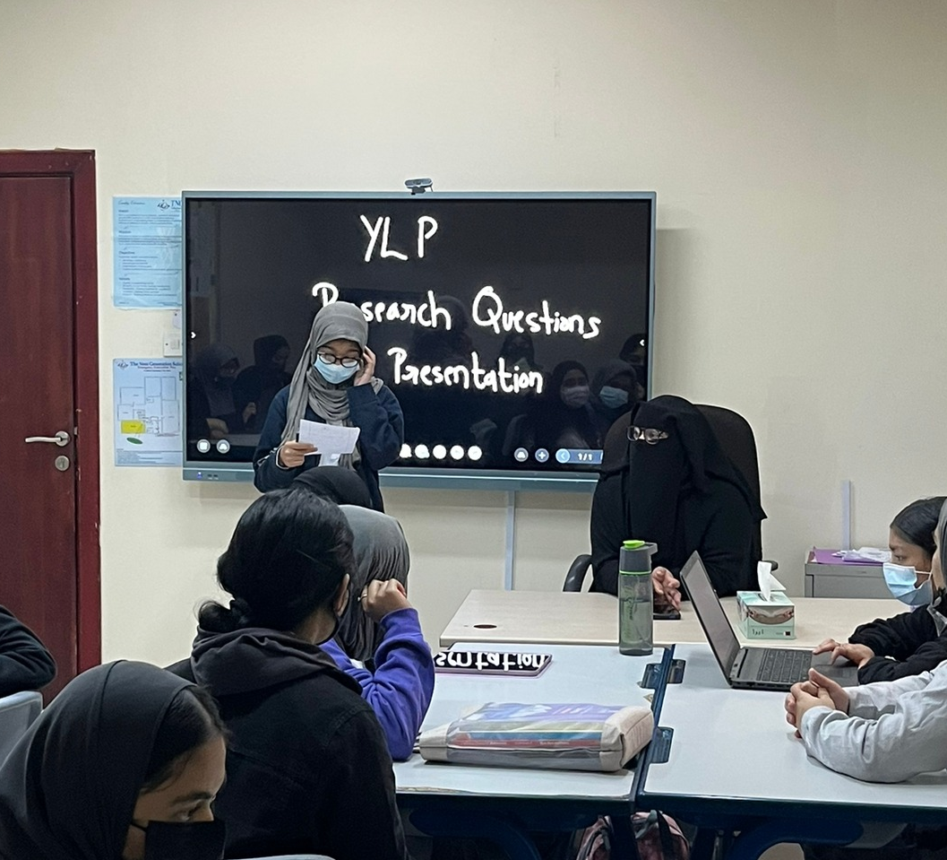
Working on the research questions and presenting them

Slide 16

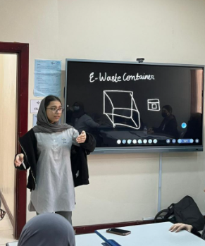
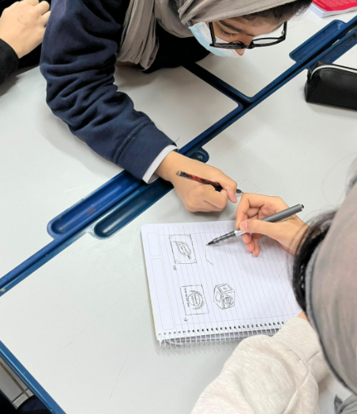
E-waste container and YLP poster

Slide 17
Implementation Phase
03
Think green!
Making it all happen!

Slide 18
Implementation
Awareness Campaign
Instagram Account
Pledge
E-waste Drive

Slide 19
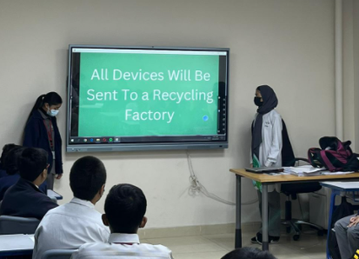
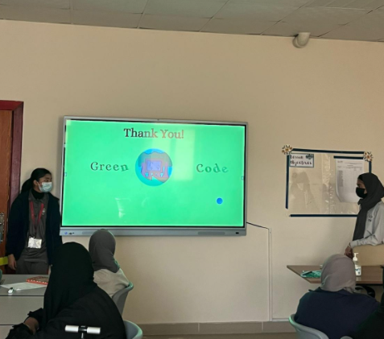
Awareness Campaign

Slide 20
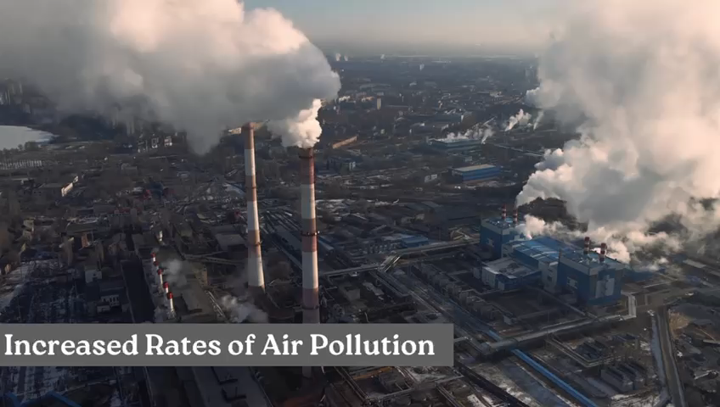

Slide 21
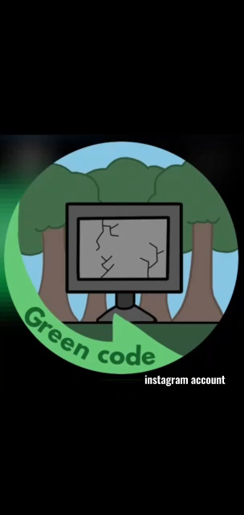

Slide 22
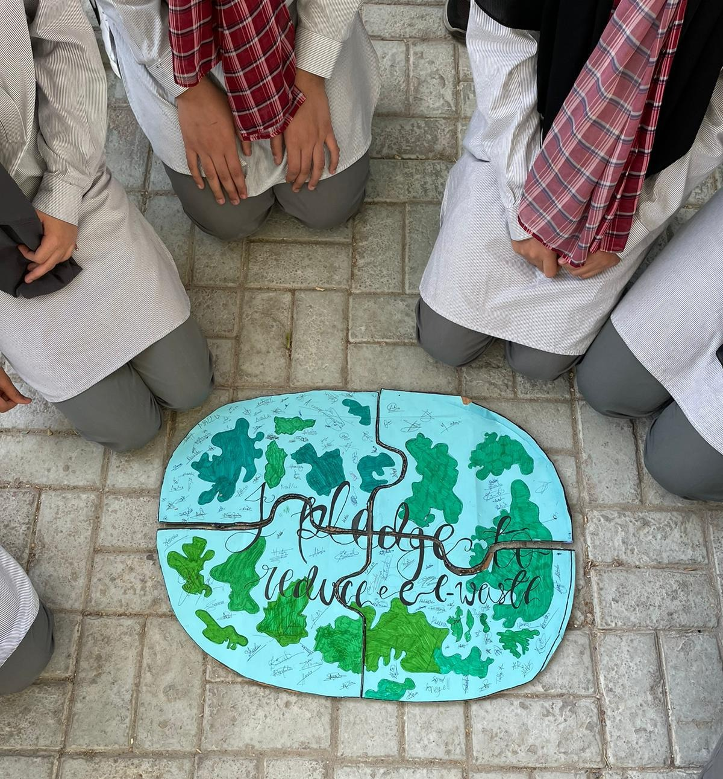
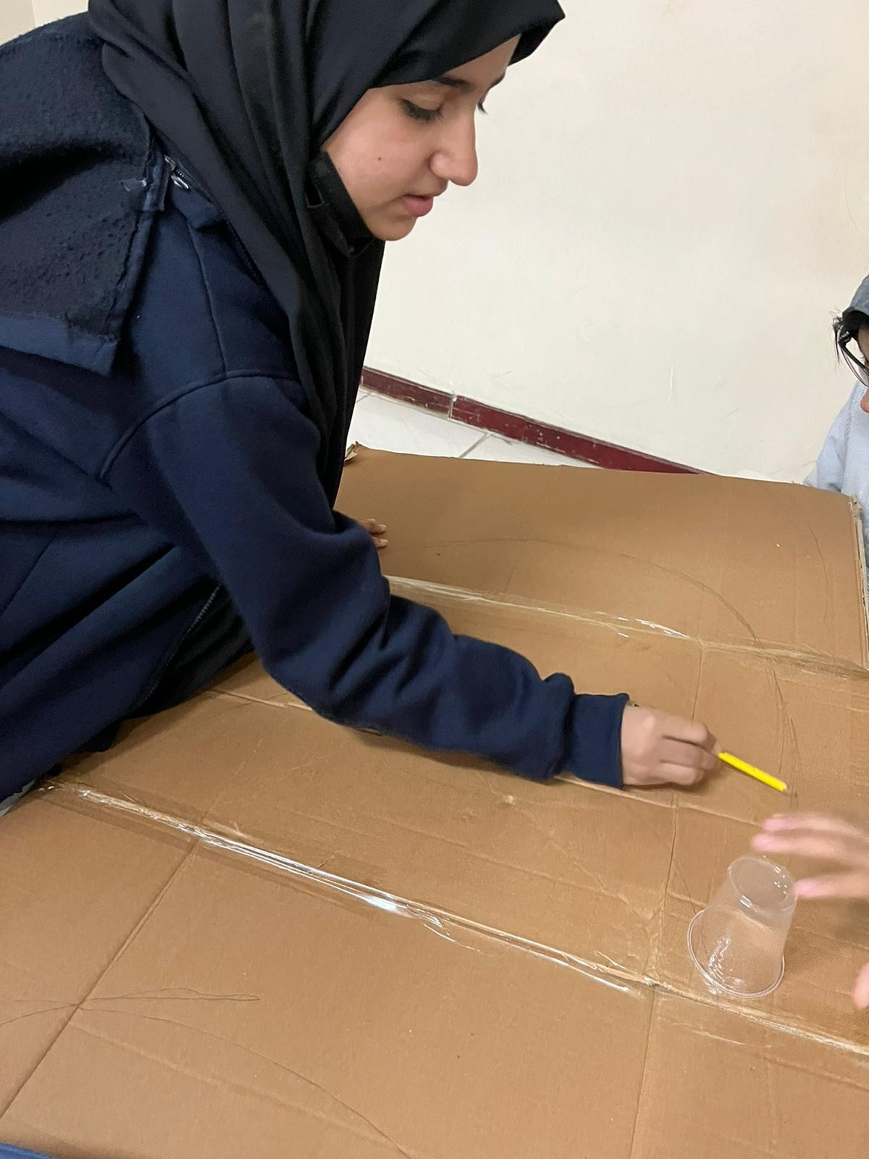
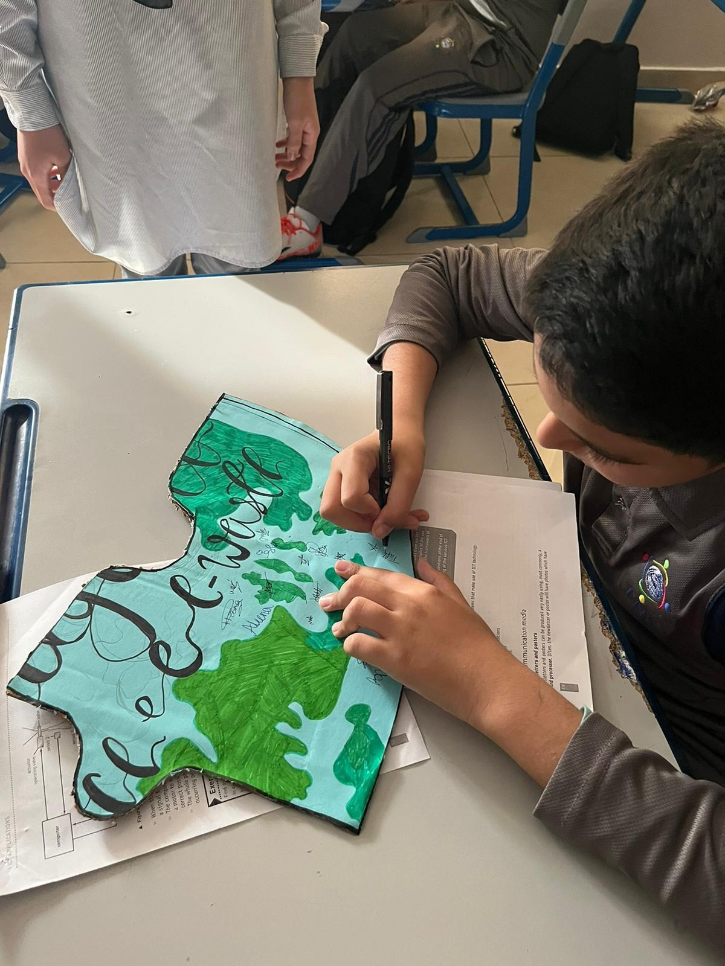
Pledge

Slide 23
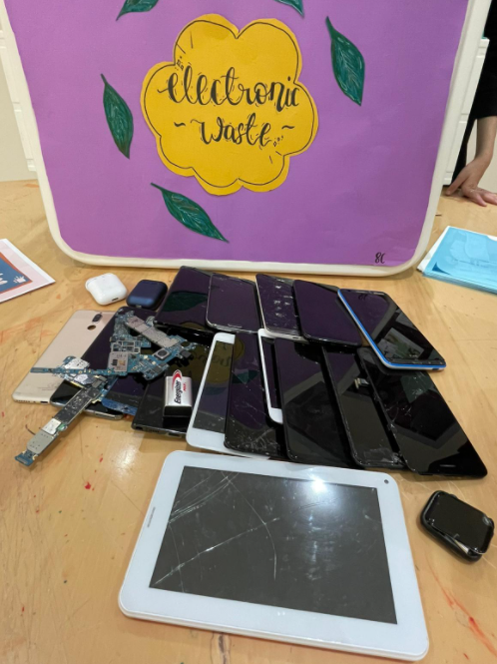
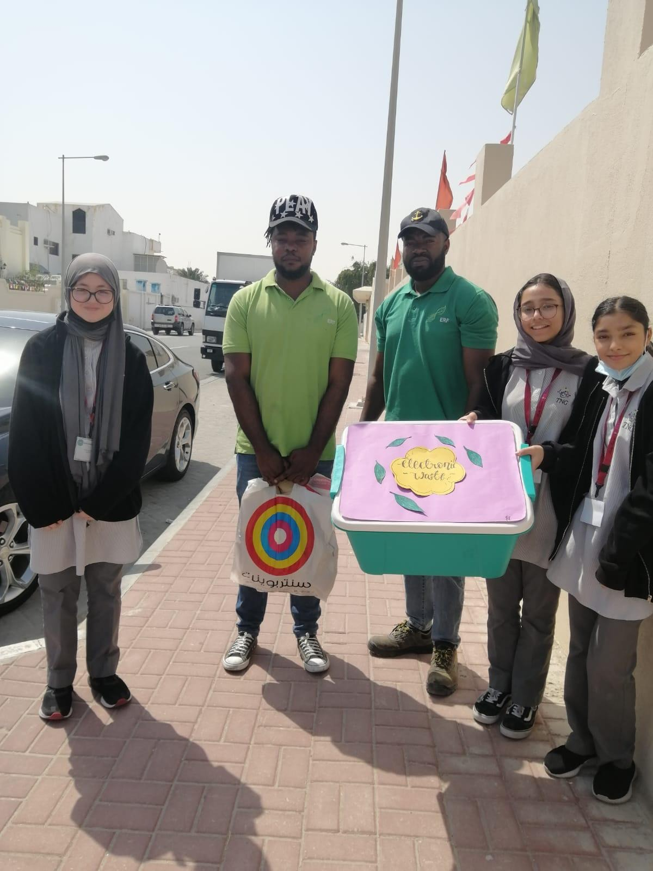
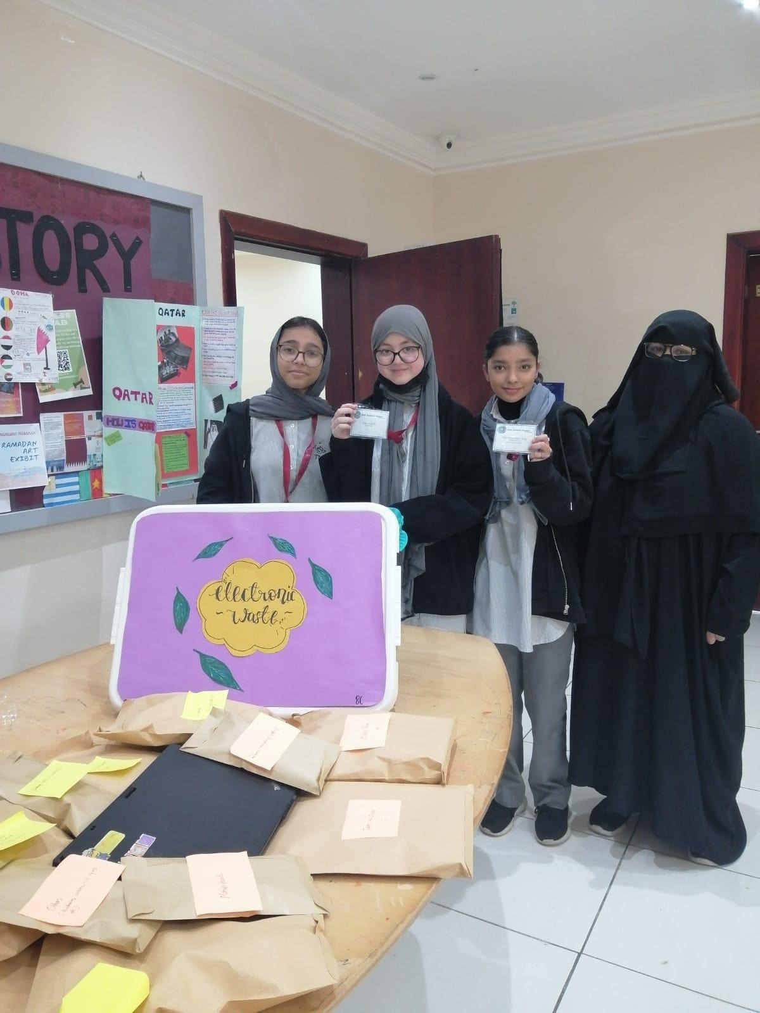
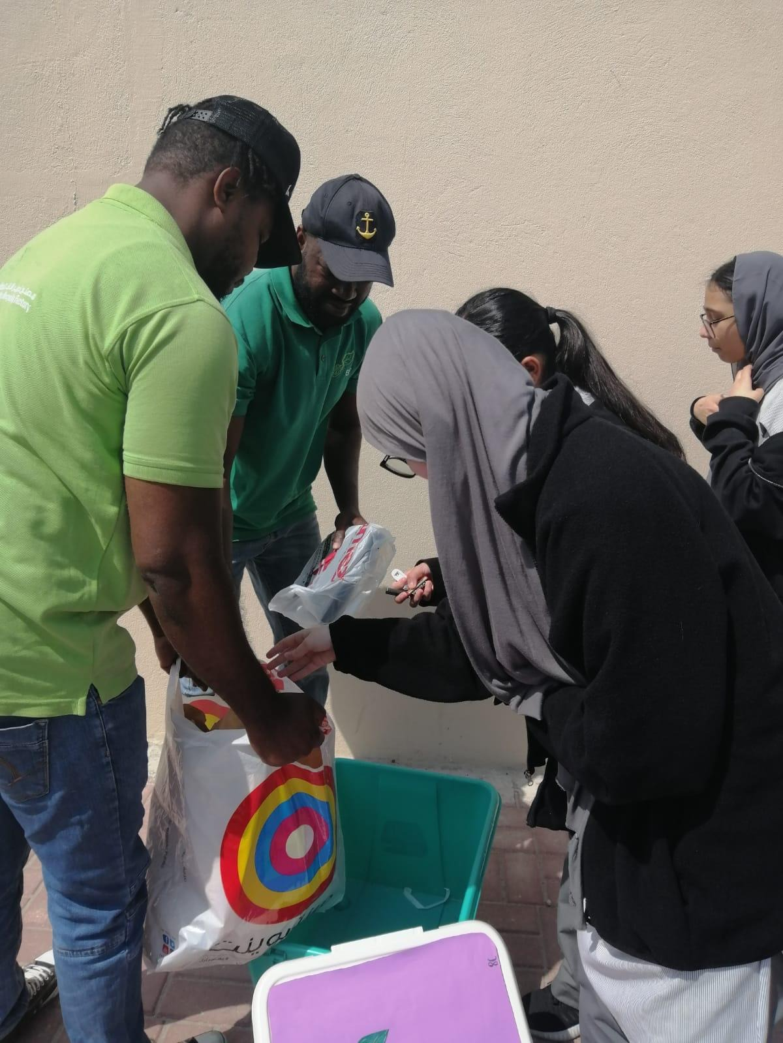
E-waste drive

Slide 24
OVER 100 DEVICES
COLLECTED

Slide 25
We are working on establishing a permanent e-waste container at school.
We have contacted the newspaper to display our project in order to get publicity.
We are working on collaborating with Al-Wakra Municipality for electronic stewardship.
Way Forward

Slide 26
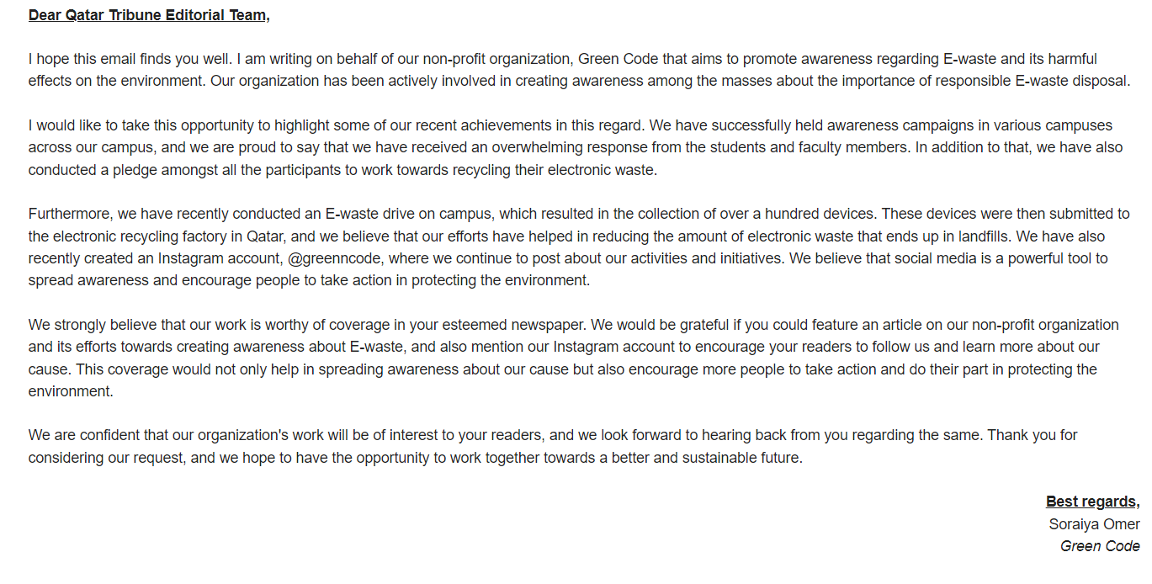
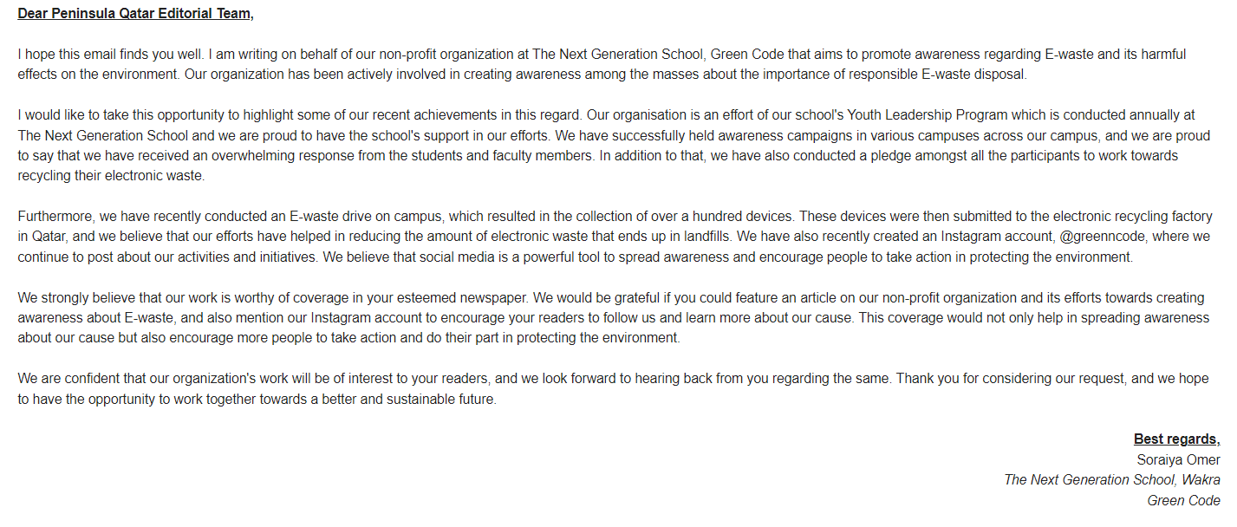
Email to Newspapers

Slide 27
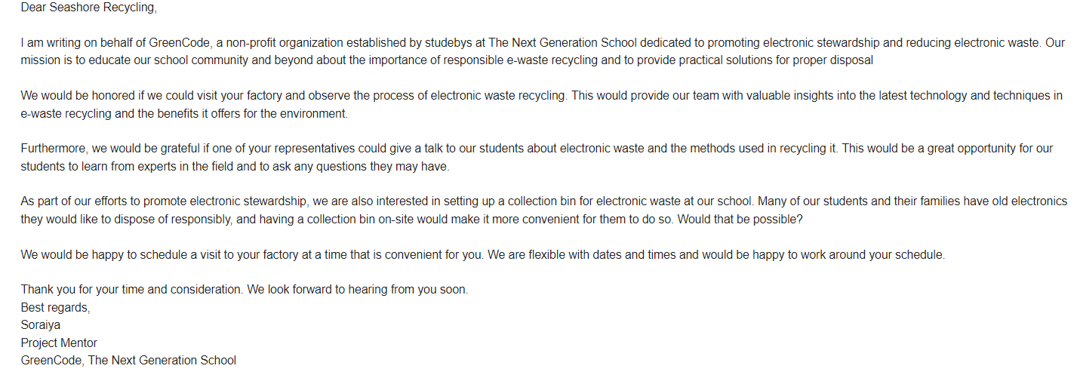
Email requesting for Permanent E-waste Container

Slide 28
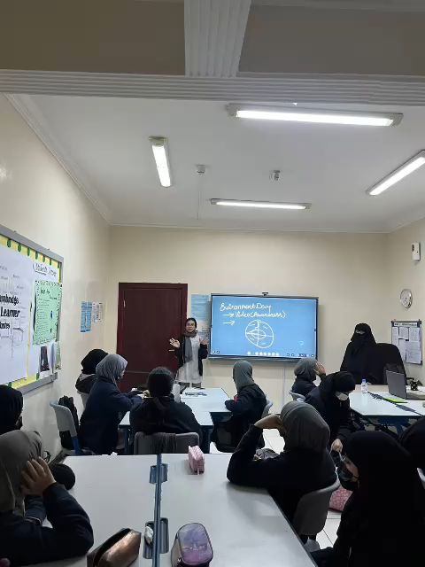

Slide 29
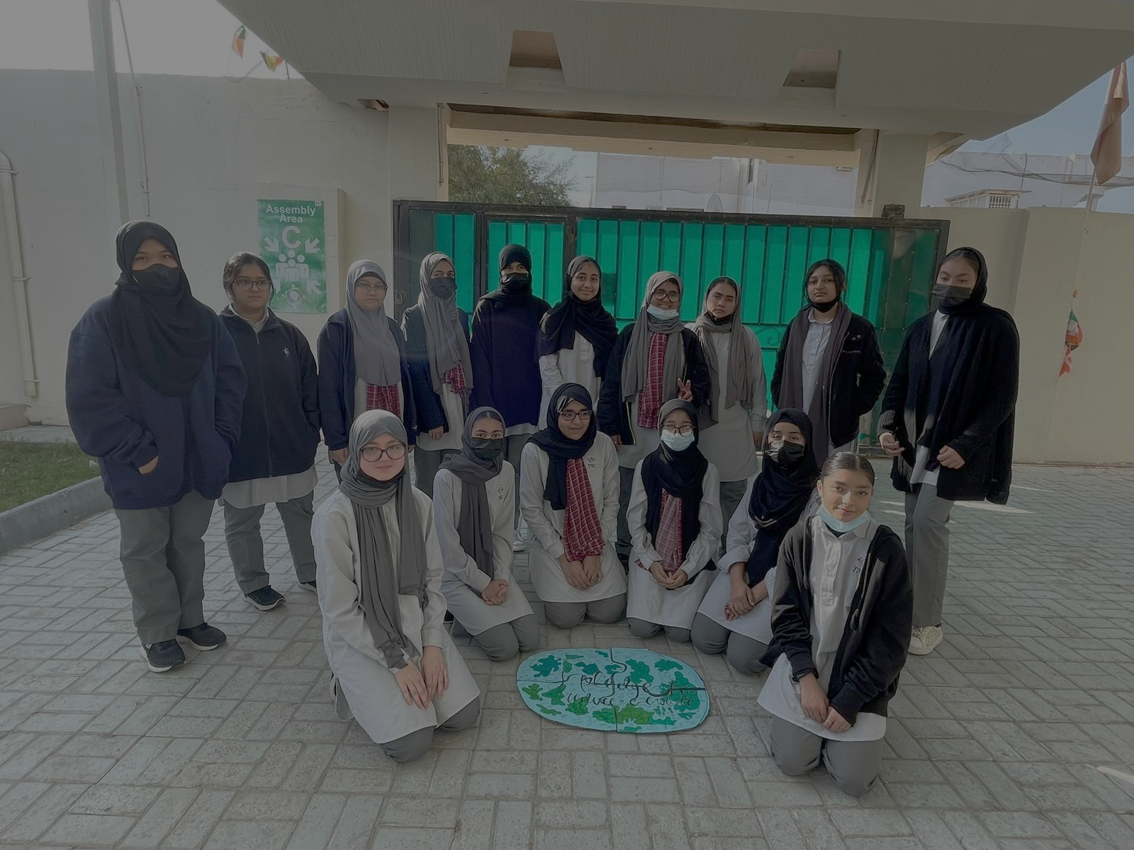
THANK YOU

