Slide 1
SDG 11
Waste Management

Slide 2
What are the 3Rs?
Reduce
Reuse
Recycle

Slide 3
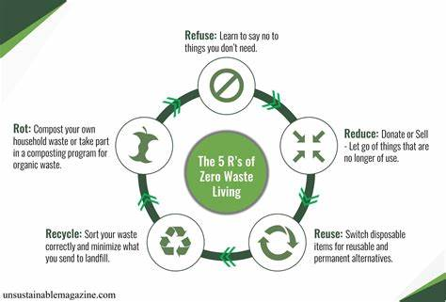
Have You Heard of the 5Rs of Zero Waste?

Slide 4
In 2013, Bea Johnson launched a book that was to become the bible for zero-waste livers. The title was
Zero Waste Home.
It’s a part inspirational story that tells how Bea transformed the life of herself and her family for the better by reducing their waste to an astounding one litre a year (one single mason jar).

Slide 5
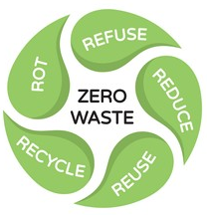
Refuse: Learn to say No to single plastic use, say No to straws.
Recycle: Recycle things to their proper places. Eg. Papers.
Reuse: Stop using disposable products. Say yes to reusables.
Reduce: Don’t buy a lot of things that you will not use.
Rot: Turn your kitchen scraps, like banana peels, into compost.

Slide 6
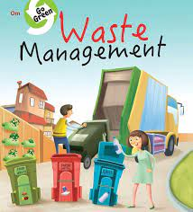
Waste is generated any time anywhere. Waste Management shall mean “the collection, transport, recovery and disposal of waste, including the supervision of such operation and aftercare of disposal sites”.
However, the newer concepts of Waste Management” talk about “Reduce, Reuse and Recycle of waste” over and above waste disposal.

Slide 7
How can the leaders, businesses, and people in Qatar work together to make sure we have less garbage and make the Earth happy, just we want in 2030?
Qatar is primarily focusing on waste management and treatment to protect the environment and to reduce its effects on health. The Qatar government is trying to lessen the amount of waste that is produced by industries, commercial sites, and households, as well as recycle and reuse waste.
Qatar is currently hosting an Expo to raise global awareness to promote long-term environmental change in attitudes and behaviors toward the environment. It promotes cultural sustainability and environmental preservation.

Slide 8
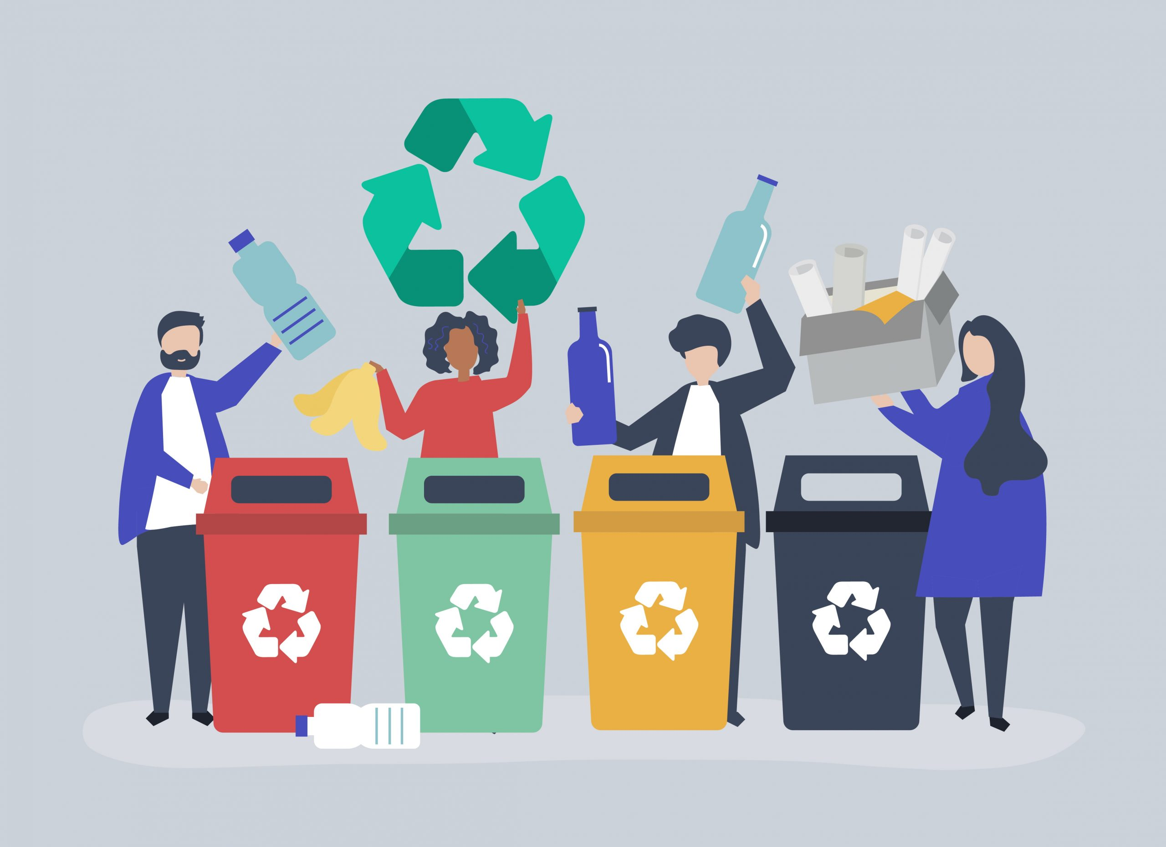
Mandatory implementation of “No Plastic Policy” in all big and small grocery and shopping establishments.
Reiterate in using Eco bags and other recyclable materials in substitute of plastics
Mandatory implementation of waste segregation from household areas since domestic waste holds the largest percentage of the total collected waste
Continuous teaching of innovative methods of water and energy reduction and conservation.

Slide 9
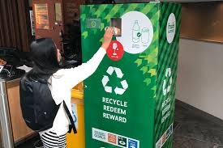
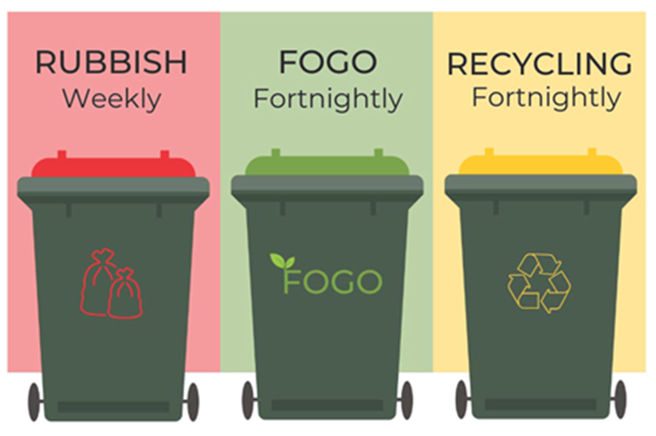
What can Qatar learn from other countries and friends around the world to make our plan for garbage and the Earth even better?
In some countries, their way to encourage their people to practice recycling is by letting them to return their used plastic bottles, cans and glasses in exchange for some amount.
To effectively implementing waste segregation is to have a waste collection schedule for every type of waste.

Slide 10
How can the leaders, businesses and people in Qatar work together to make sure we have less garbage and make the earth happy, just like we want in 2030?

Slide 11
In the midst of increasing attention to sustainability, Qatar has intensified its efforts in waste recycling. This reflects its commitment to environmental sustainability, which has been placed on its priority list and integrated into its Vision 2030. This comes as the State of Qatar prepares to host Expo 2023 Doha from Oct. 2, 2023, to March 28, 2024. It is the first A1 event of its kind to take place in Qatar, the Middle East, and North Africa. The expo aims to raise global awareness to promote long-term environmental change in attitudes and behaviours toward the environment, aligning with Qatar's National Vision 2030. In this context, Director of the Waste Recycling and Treatment Department at the Ministry of Municipality Eng. Hamad Jassim Al Bahr said in an interview with Qatar News Agency (QNA) that one of the most important ways to protect the environment is through recycling and sustainability.

Slide 12
Al Bahr further explained that the Waste Recycling and Treatment Department oversees a solid waste treatment plant, associated transfer stations, and sanitary landfills, ensuring that waste is processed according to international standards and specifications. He emphasized that recycling is a vital issue, and Qatar has facilitated it through various solutions and technologies that contribute to environmental preservation, pollution reduction, resource and energy conservation, consumption reduction, and improved production process efficiency. Regarding Qatar's success in recycling all waste generated during the FIFA World Cup Qatar 2022, achieving a 100 percent recycling rate was a significant milestone, marking the first time this rate was achieved in the history of previous World Cup events.

Slide 13
Bahar outlined the five stages of waste treatment at the center, starting with separation, recycling, incineration for energy production, and recycling to obtain high-quality organic fertilizer. The center has successfully transformed waste into energy.

Slide 14
For A Greener earth, it is a joint effort by one and all in Qatar so that we may reach our target of happy earth 2030 by participating in Recycling, reusing and reducing waste.

Slide 15
The 5Rs of Zero Waste (youtube.com) (please click to watch)
Thank you

