Slide 1
Year 2A YLP Project S.Y. 2023-2024 Becoming an Eco-conscious Individual
Year 2 A Synopsis

Slide 2
01
Introduction

Slide 3
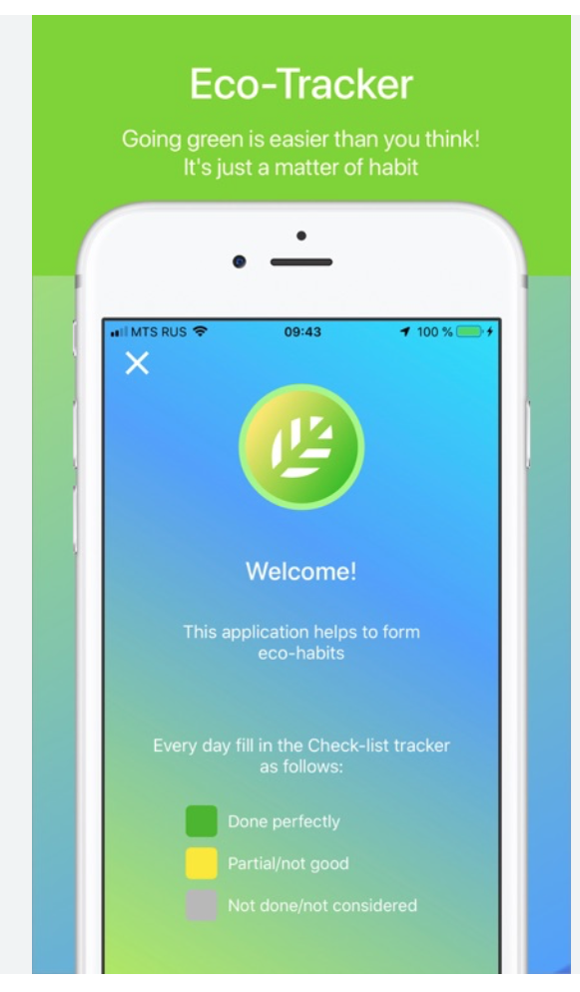
Introduction: In the school year of 2023, Year 2A learners embarked on a research project aimed at addressing the pressing need for embracing eco-friendly habits. The project focused on identifying the exact problems related to unsustainable practices and sought innovative solutions to promote environmentally conscious behavior.

Slide 4
02
Objectives

Slide 5
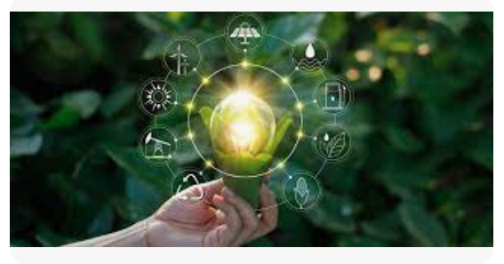
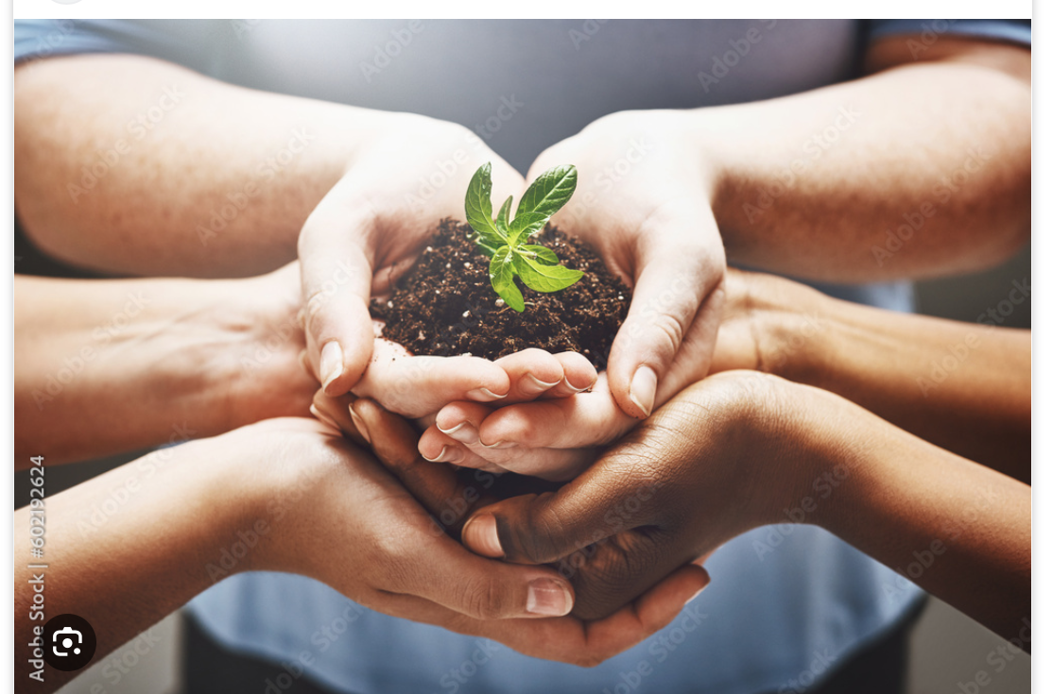
Objectives
Objective: The primary objective of the research was to develop an innovative solution that would encourage people to embrace eco-friendly habits. Learners aimed to understand the importance of sustainable living and collaborated to devise practical solutions.

Slide 6
03
Methodology

Slide 7
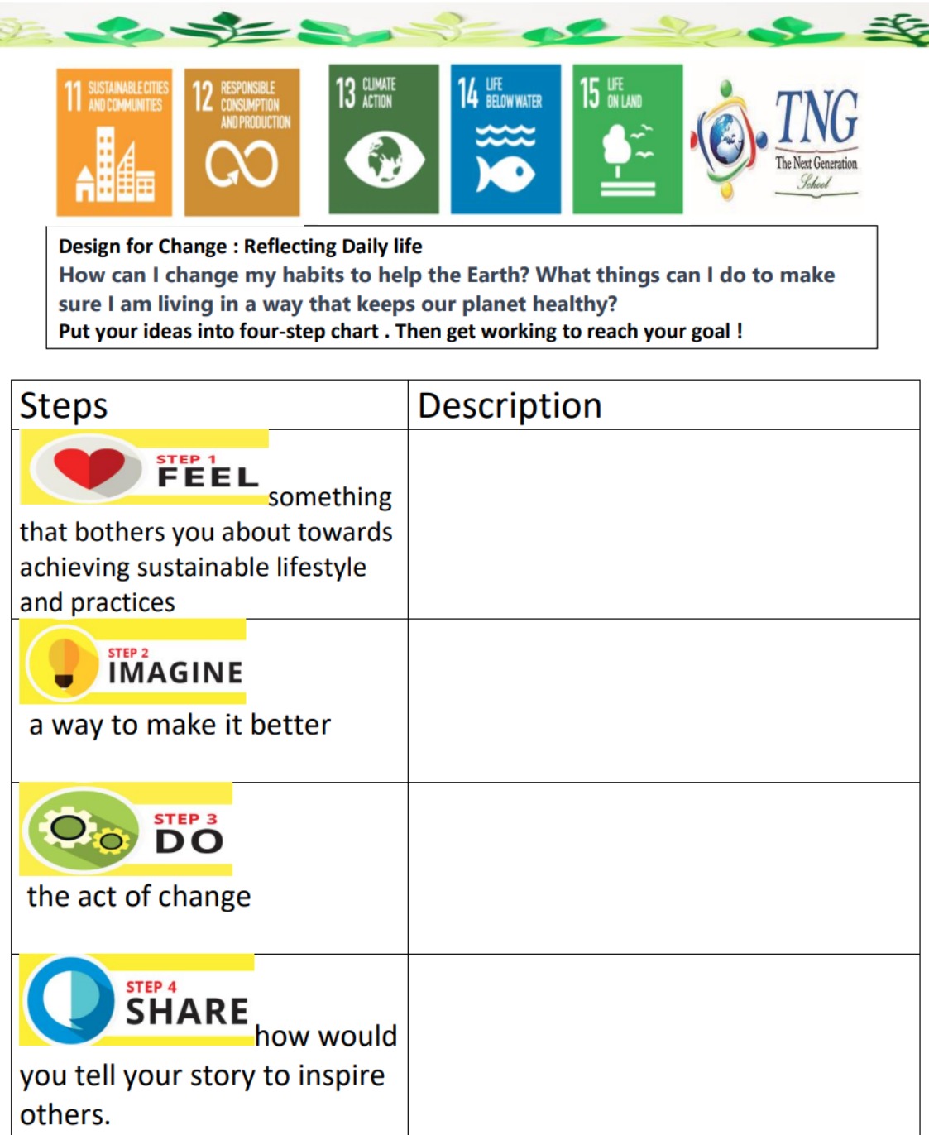
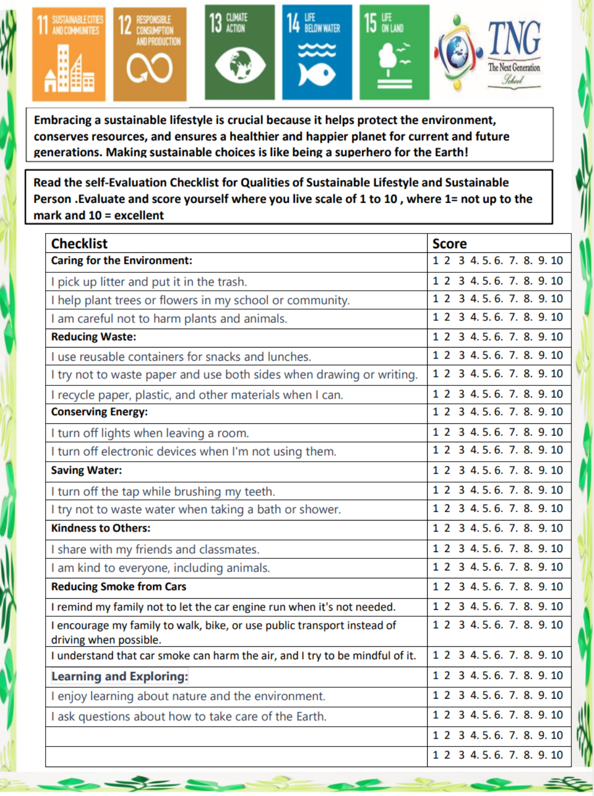
Methodology
Methodology: Learners brainstormed to identify the specific environmental issues and conducted self-evaluation checklists to assess their own sustainability practices. They collaborated in teams to explore potential solutions, including Green Packaging and Consumption, Biodegradable Packaging, Awareness Campaigns, and Land Reclamation Projects. Furthermore, they conducted research on mobile applications designed to promote environmental care, leading to the development of the EcoMind Trackers Application.

Slide 8
04
Findings

Slide 9
Findings
Through their research and collaboration, learners identified the significance of promoting eco-friendly habits and the importance of sustainable living. They recognized the need for practical solutions to address environmental challenges and devised the EcoMind Trackers Application as an innovative solution. Additionally, they will conduct an educational campaigns and surveys to spread awareness and gather perspectives on the invention.

Slide 10
05
Conclusion

Slide 11
The Year 2A learners' research project culminated in the development of the EcoMind Trackers Application, a personalized mobile application equipped with AI to encourage and track eco-friendly habits. The project highlighted the importance of collaborative efforts and innovative solutions in promoting environmental sustainability. By engaging in self-evaluation, research, and outreach activities, learners demonstrated their commitment to creating a healthier planet for future generations.

