Slide 1
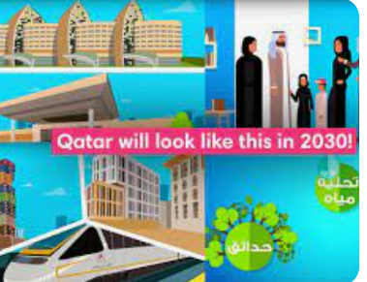
Targeting tourism for vision 2030 YEAR V-A
Tourism slogan of Qatar: Qurated for You.
Safe, vibrant and ever-surprising.

Slide 2
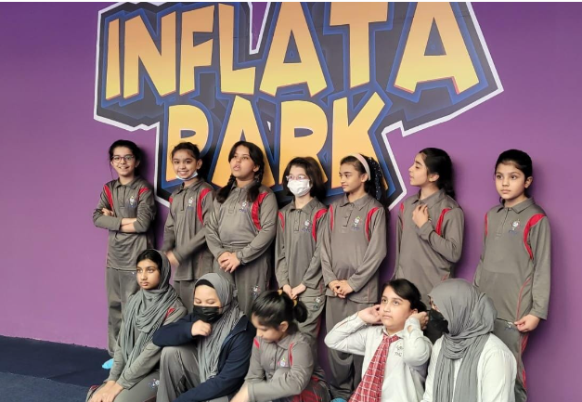
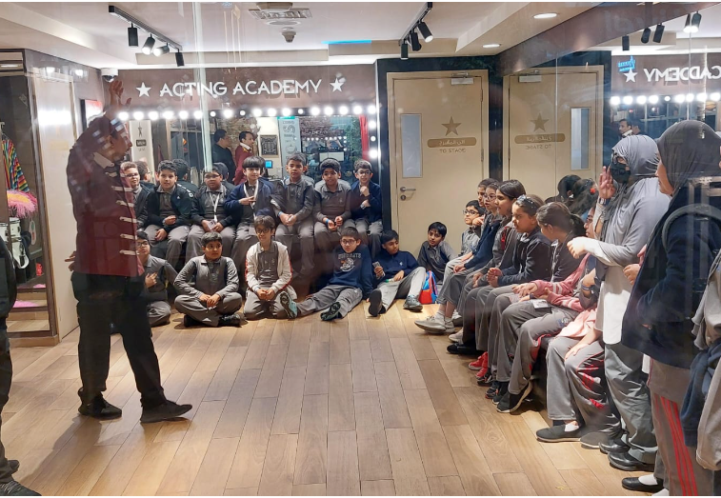
Why did we choose this topic ?
Initially the rapid change in Qatar to host the FIFA world Cup.
Building of Sustainable football stadiums.
Beautification of the country to attract tourists.
Developing a good connectivity to stadiums through Metro.
Providing accommodation to all classes of people according to their affordability.
Moreover , the organizational capability of Qatar – by handling such humongous football fans.
Issue of Hayya card.
These factors led us to choose this topic.

Slide 3
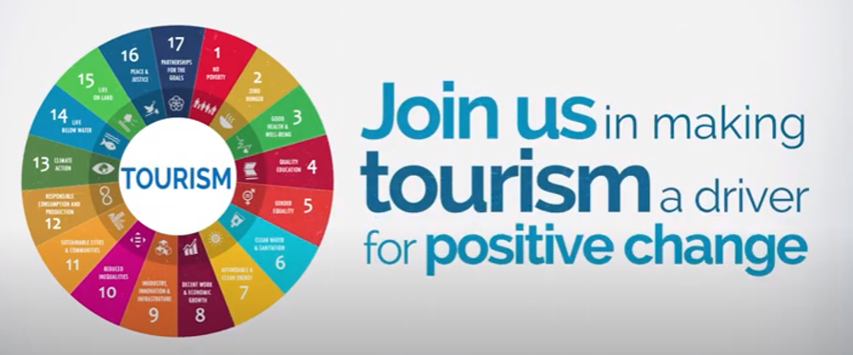
Big Idea
Development of Qatar’s economy to meet vision 2030 through tourism.
Department of economic and social affairs: Tourism
SDG goal number- 8

Slide 4
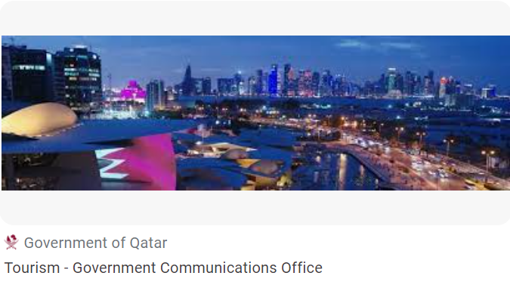
What is Qatar National Tourism Sector strategy?
Qatar Tourism has announced a package of plans and programmes for 2023, as part of its strategy aimed at strengthening Qatar's position as a leading global tourist destination by attracting 6million visitors annually and raising the tourism sector's contribution to the gross domestic product (GDP) to 12% by 2030.

Slide 5
Big Questions
What is the comfort zone of Qatar economy? What kind of economy does Qatar have? How can tourism lead to the economic growth to meet the vision 2030? How can different kind of tourism aid in economic growth? How does organizing events like FIFA help in building our economy by attracting tourists all over the world? How can medical tourism help economic growth even during pandemic times? How can we attract young tourists ?

Slide 6
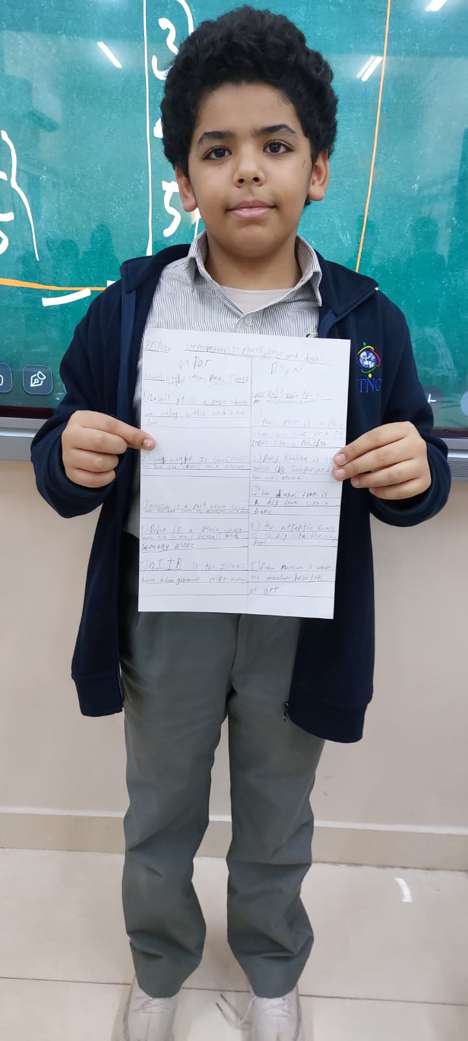
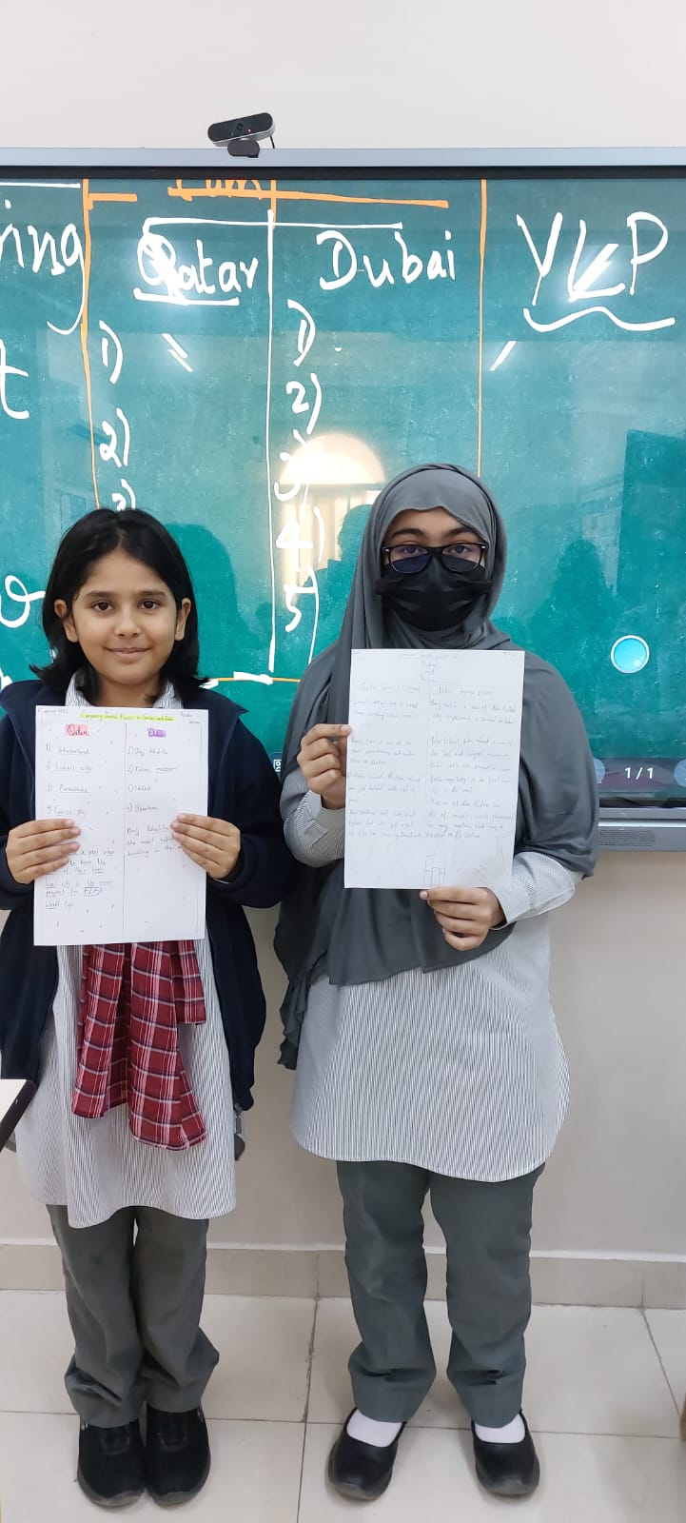
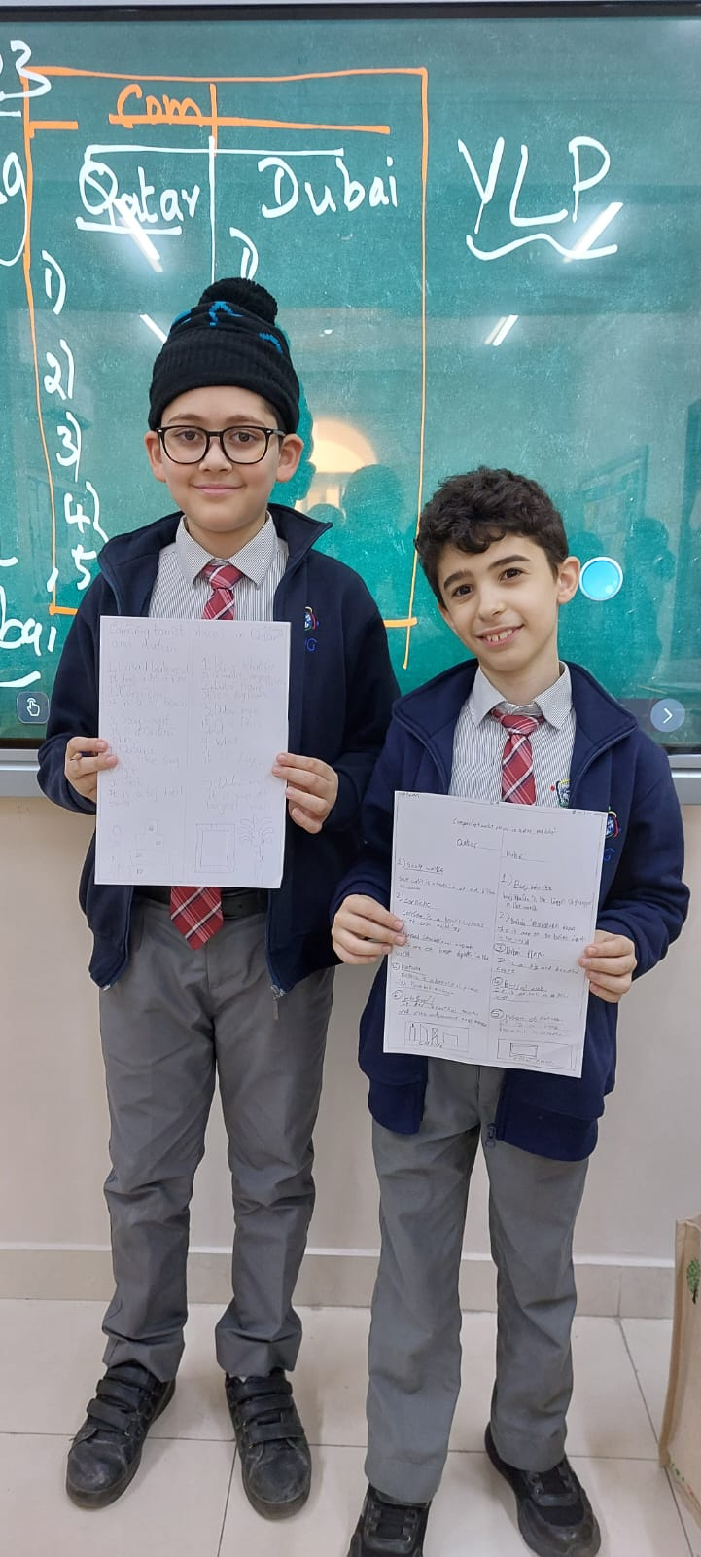
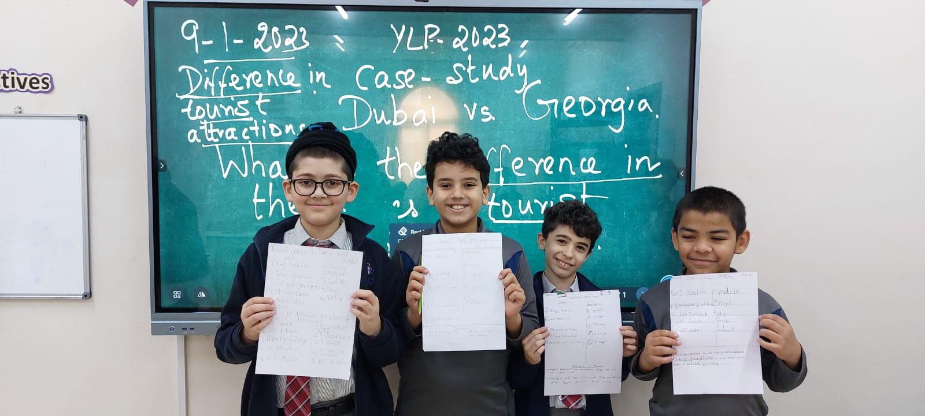
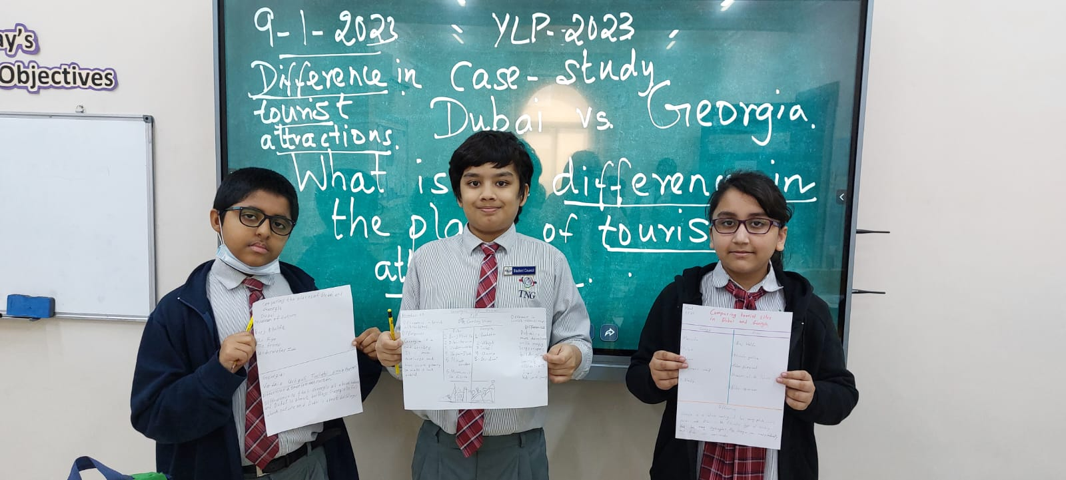
Watching Videos and writing short reflections.

Slide 7
ROAD Map to our journey
Understanding on Qatar’s tourism growth until FIFA 2022
Types of Tourism leading to economic and social growth
Case study – Dubai and Georgia.
Tourism projects planned by Qatar Tourism to meet Vision 2030
Our proposal for enhancing Tourism.

Slide 8
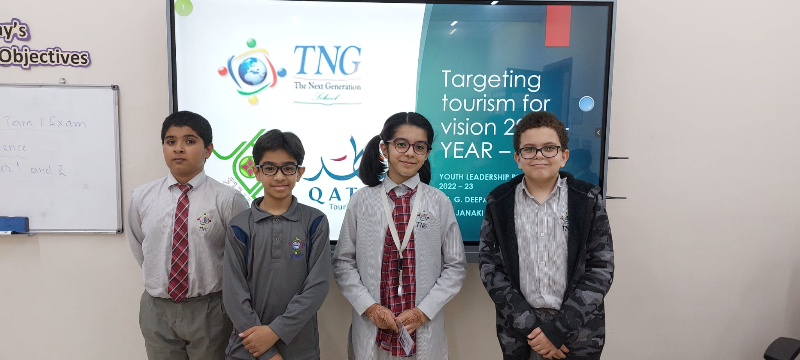
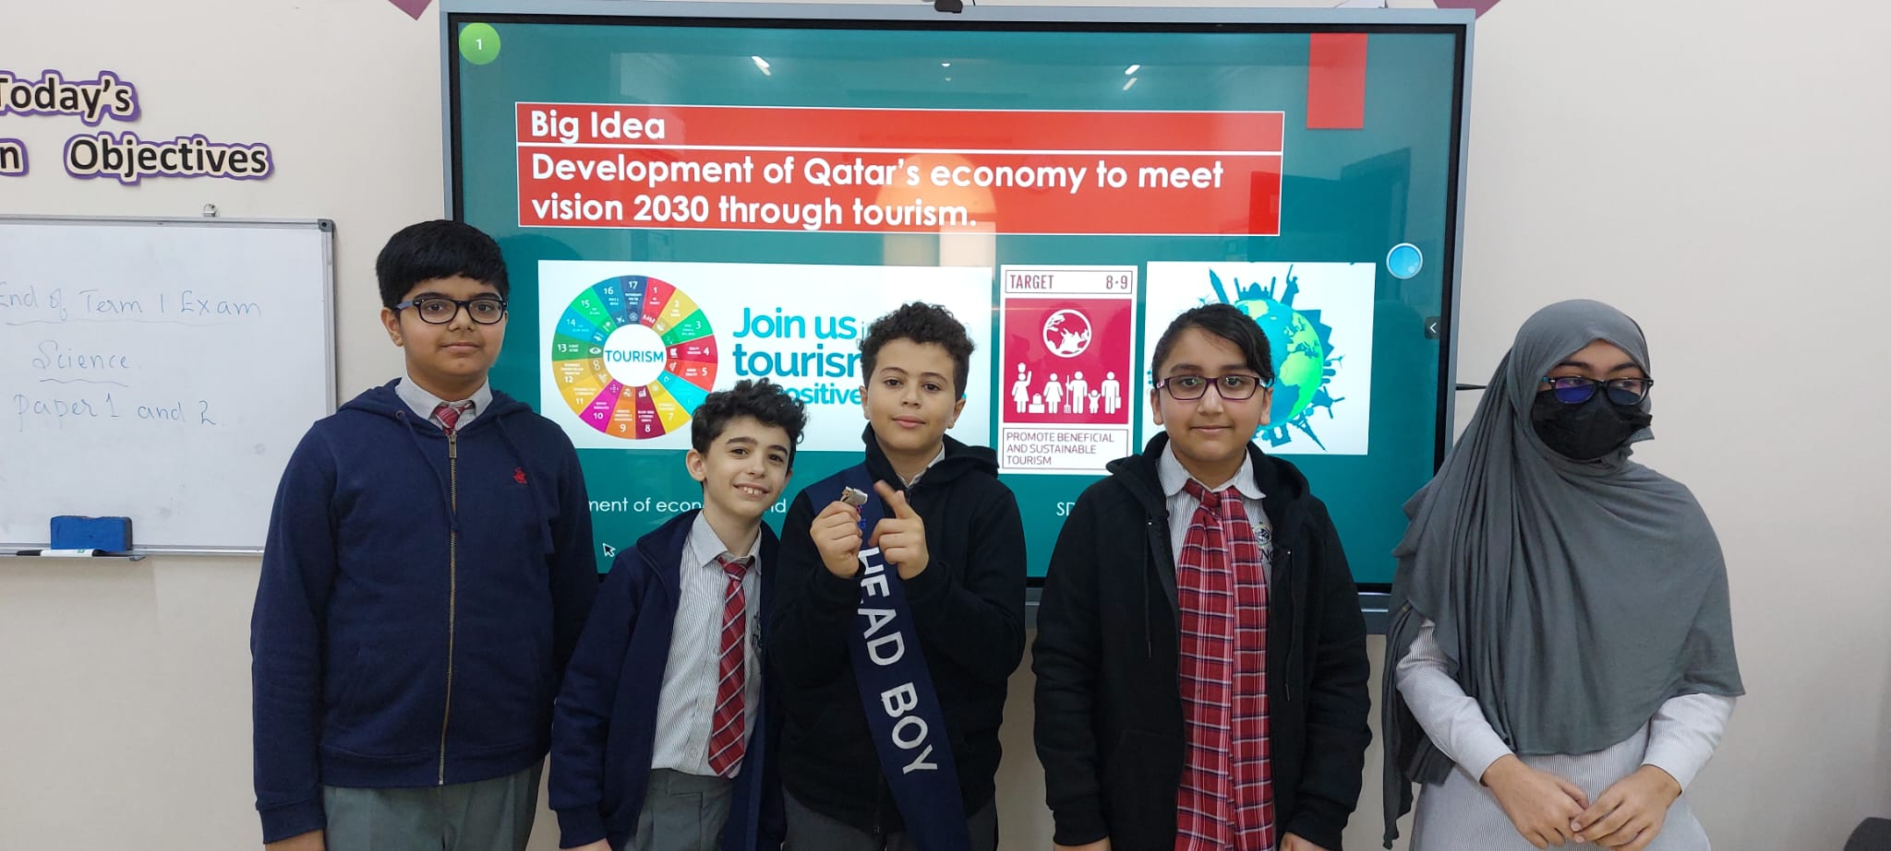
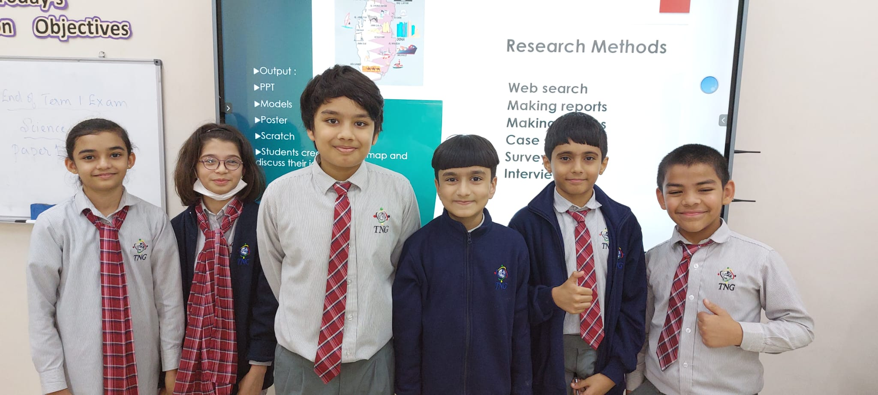
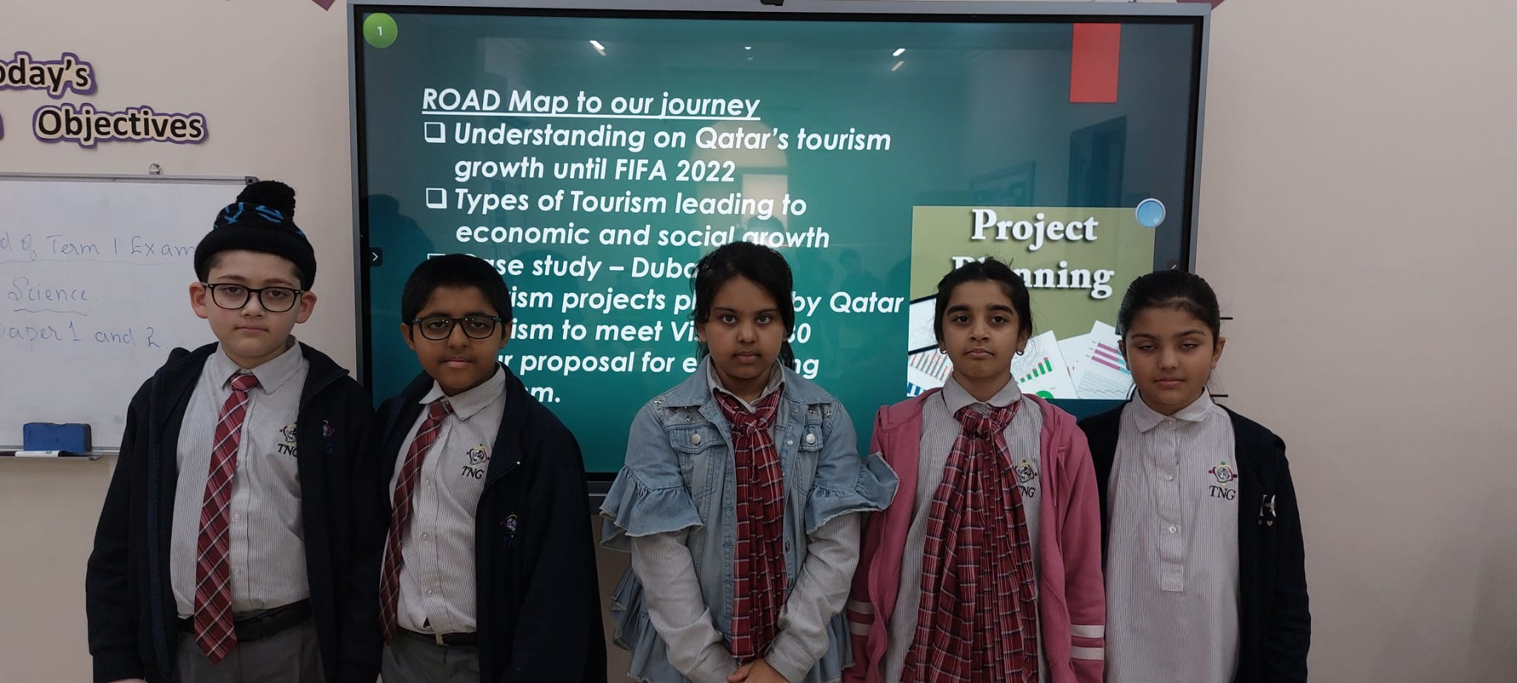
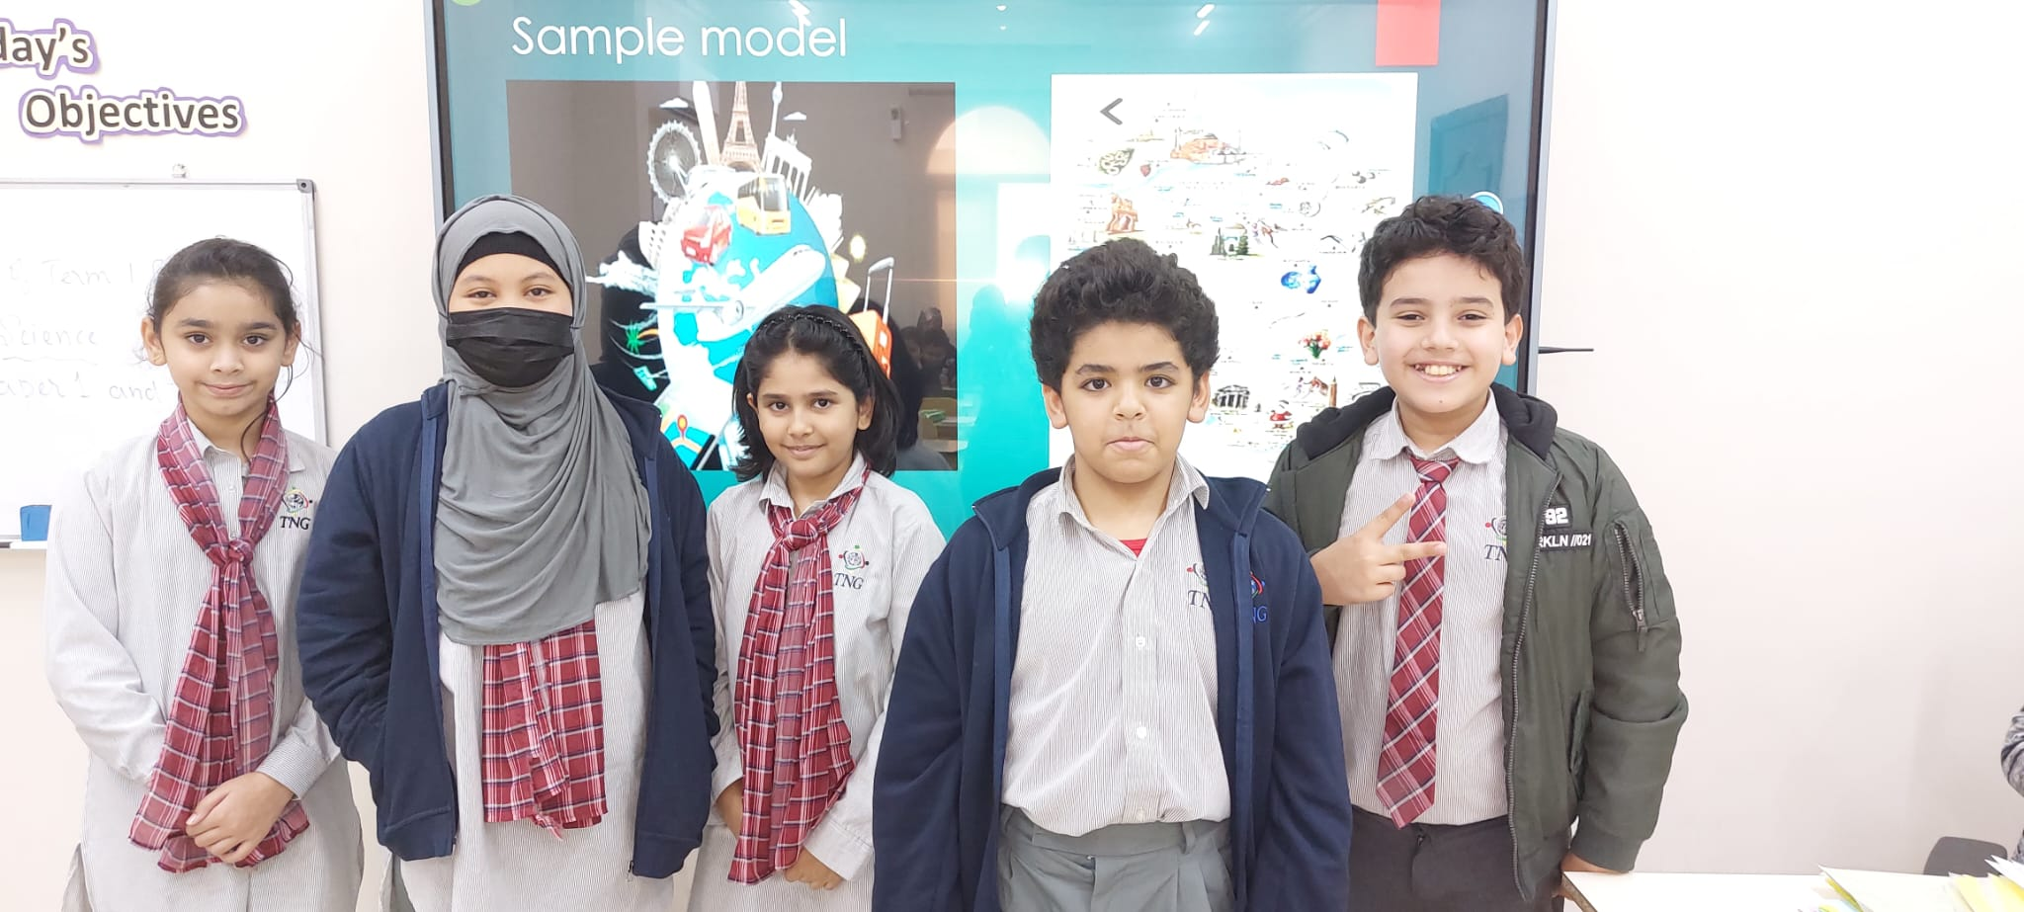
Divided into 5 major groups – Tourism until FIFA 2022, Event Tourism , Case study , Tourism to meet VISION 2030 and Our proposals.

Slide 9
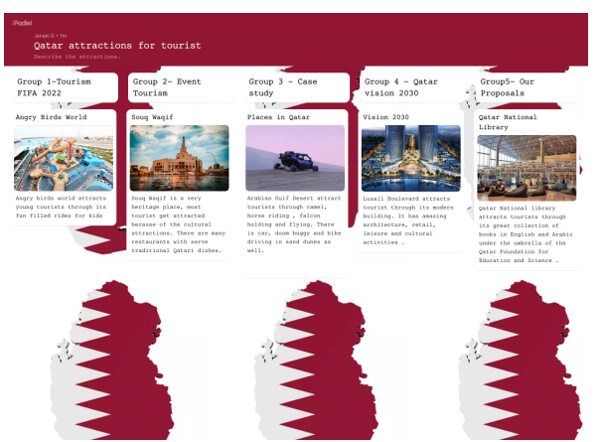
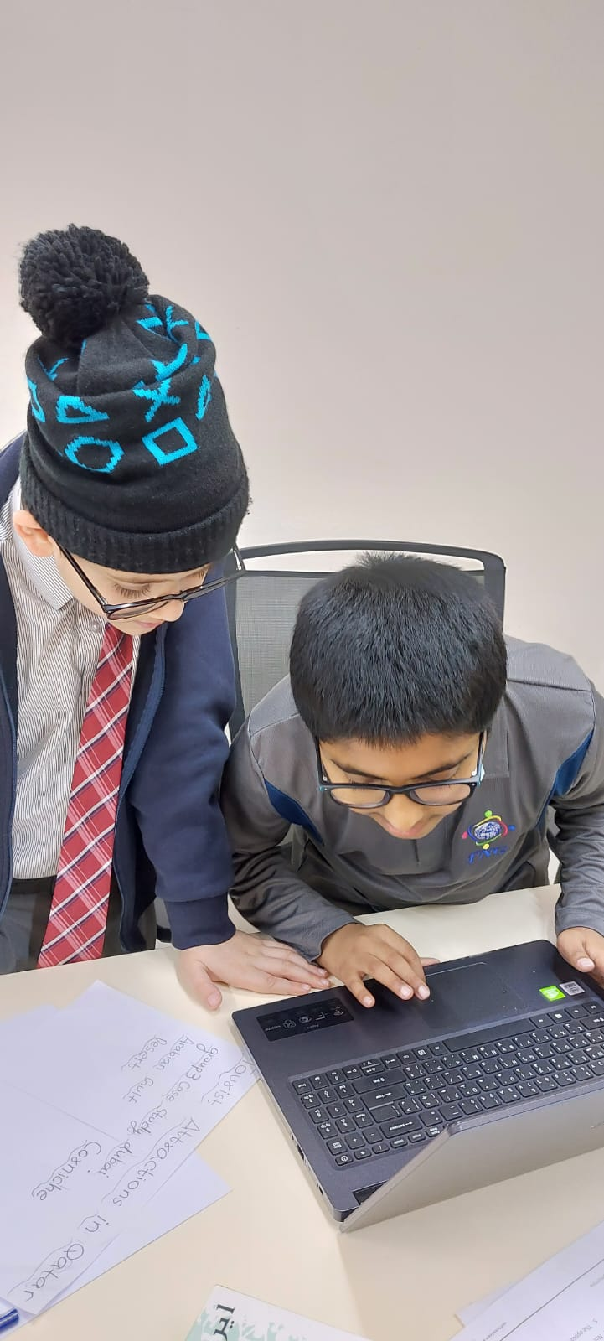
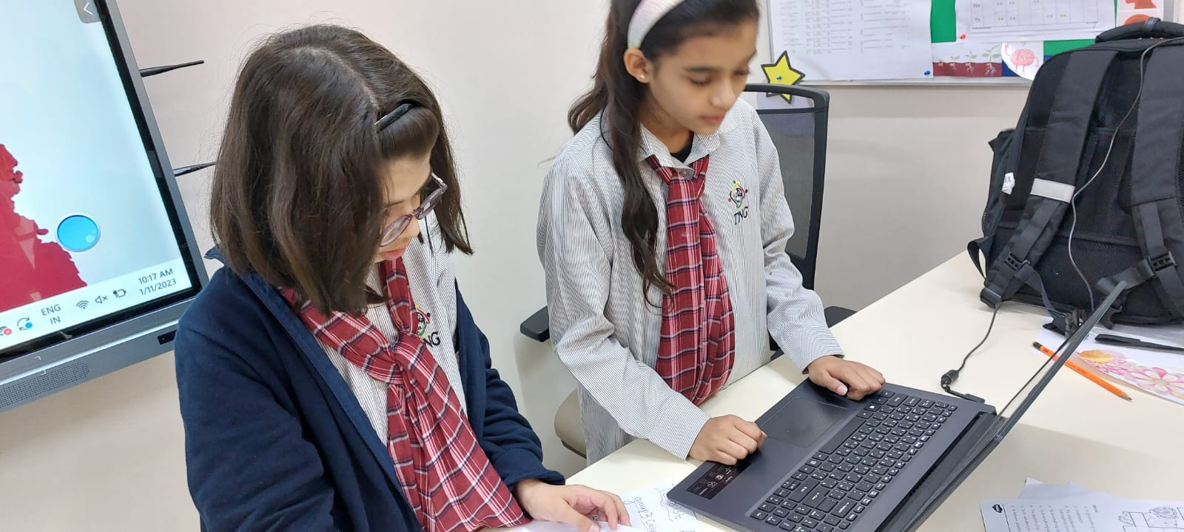
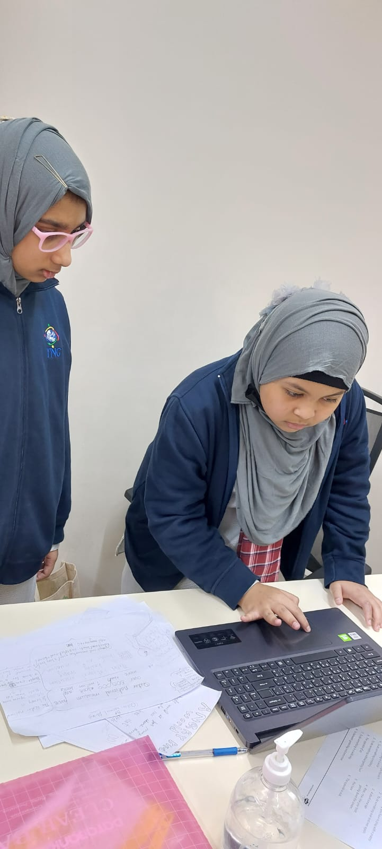
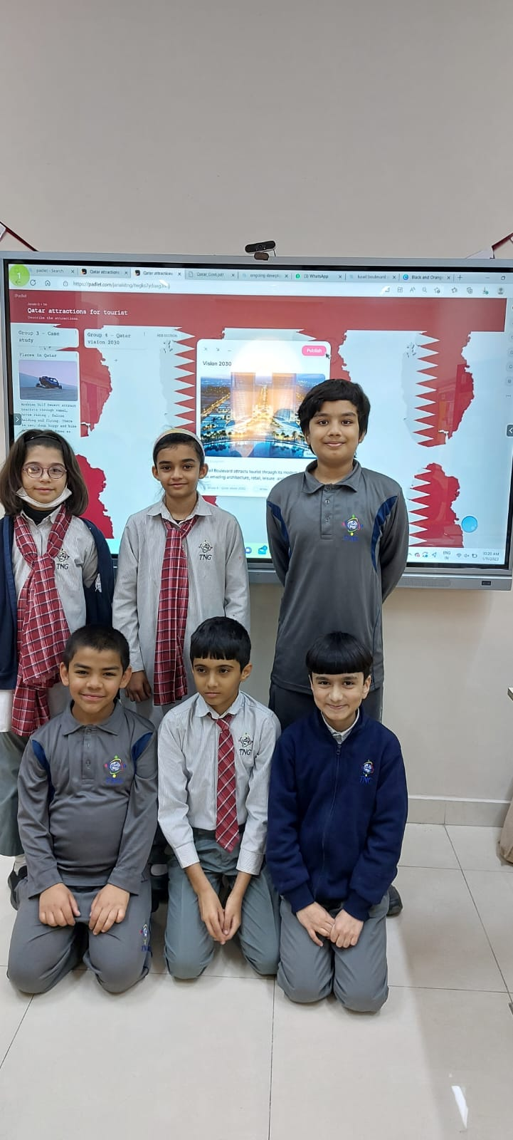
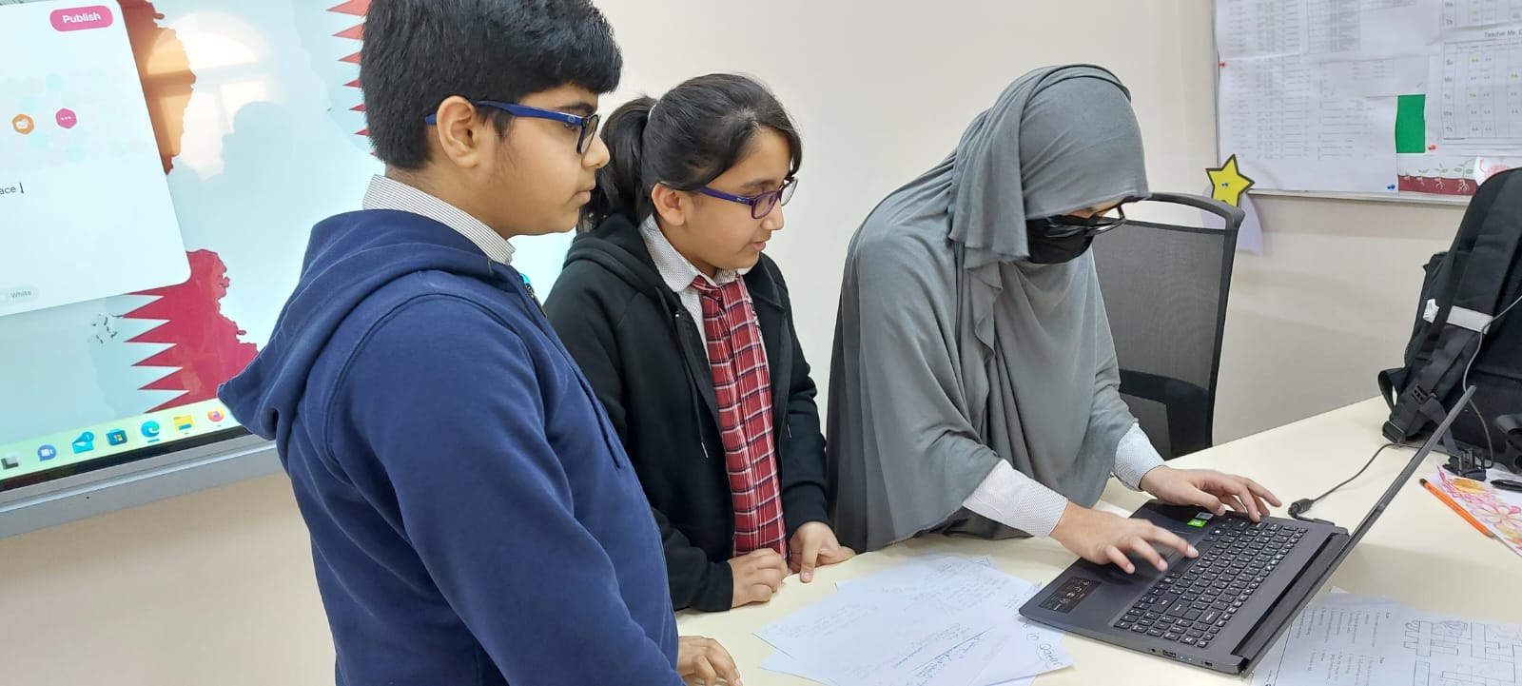
Technology driven YLP
-
Each group worked on Padlet and gave an insight of their batch.

Slide 10
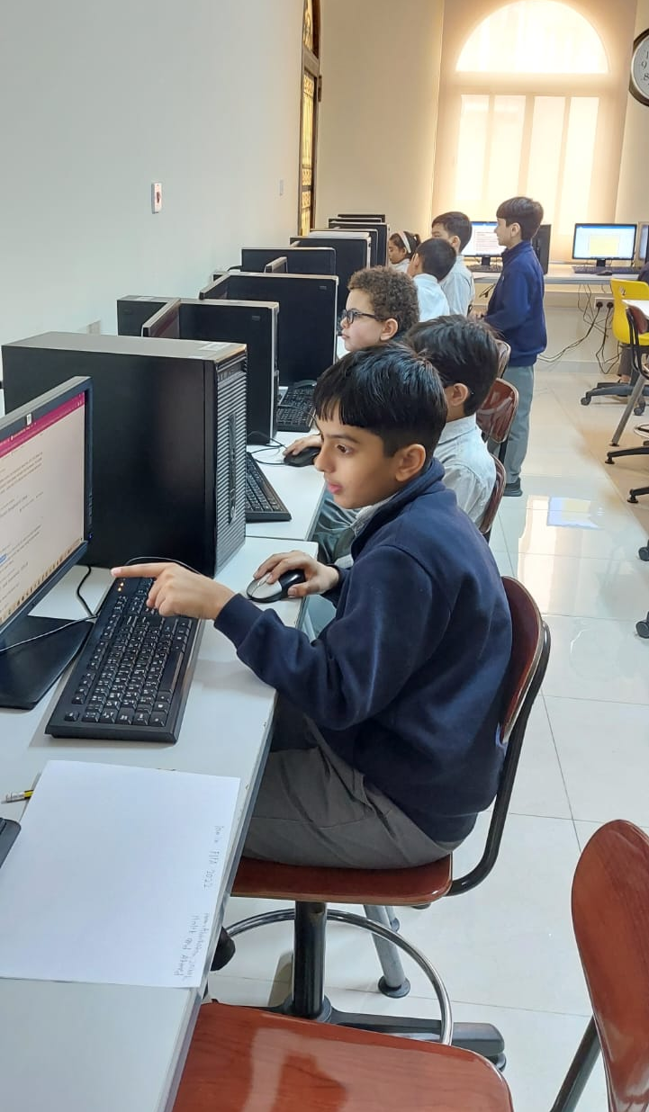
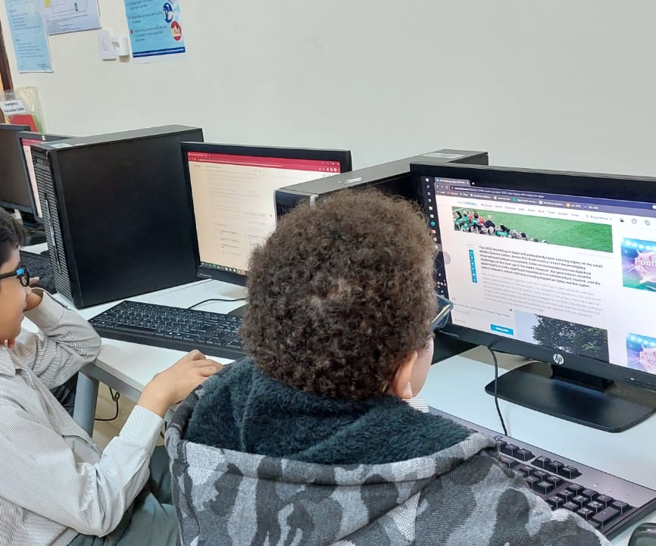
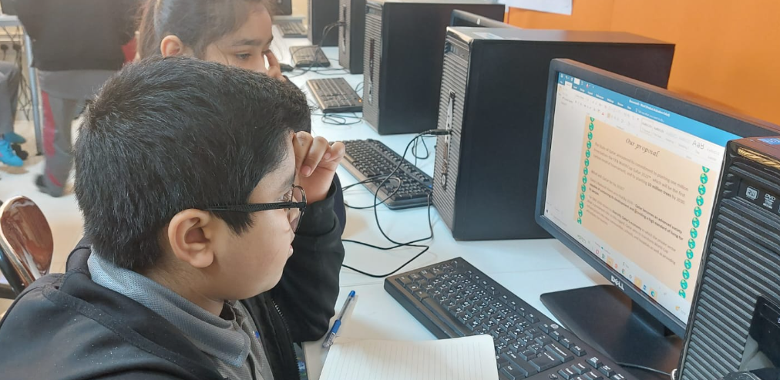
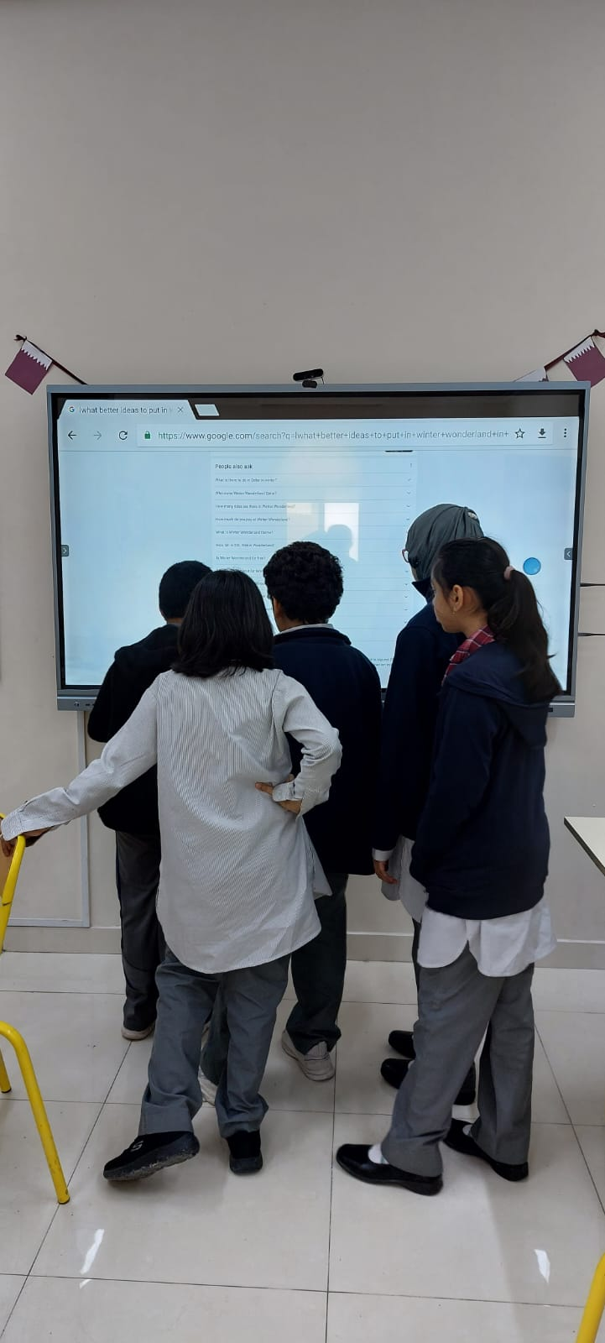
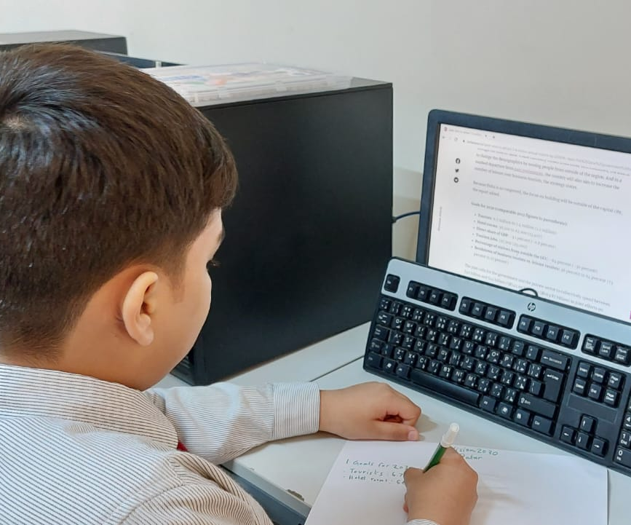
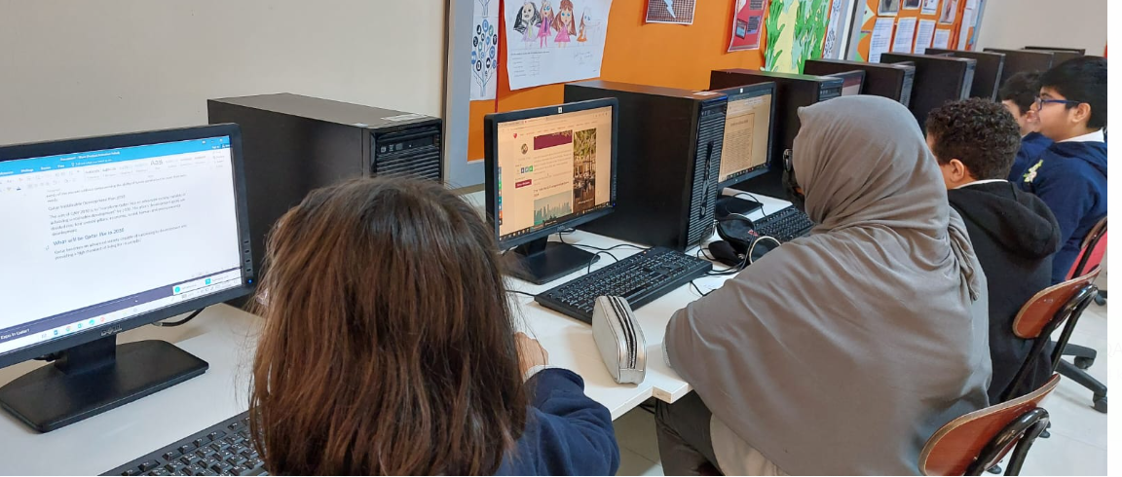
After a lot of research each batch submitted a 4-page Research Report ,Posters using CANVA software.

Slide 11
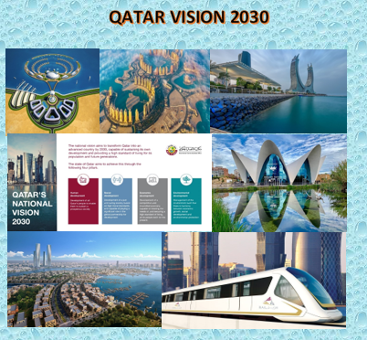
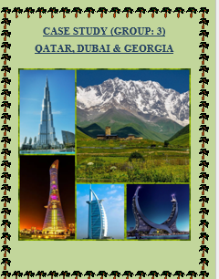
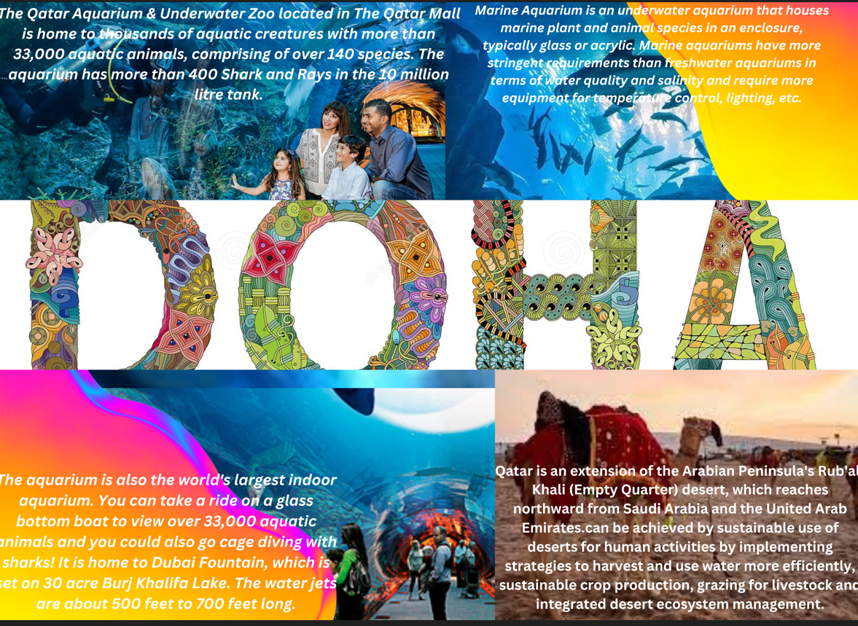
_{posters}

Slide 12
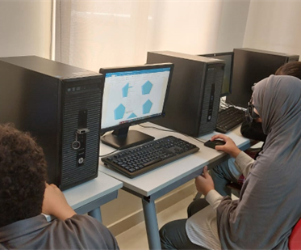
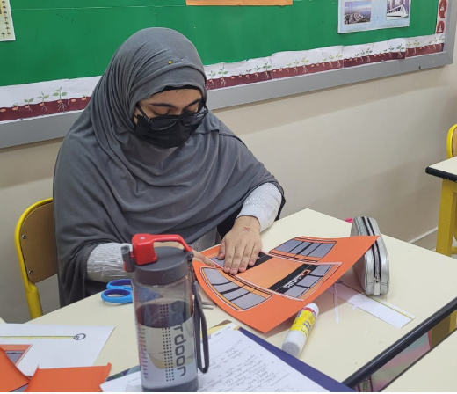
Ajwa Fatima contributed to the final poster, an online flip book and event tourism poster.She had been sincere in every ylp hour and contributed in rope car making as well.

Slide 13
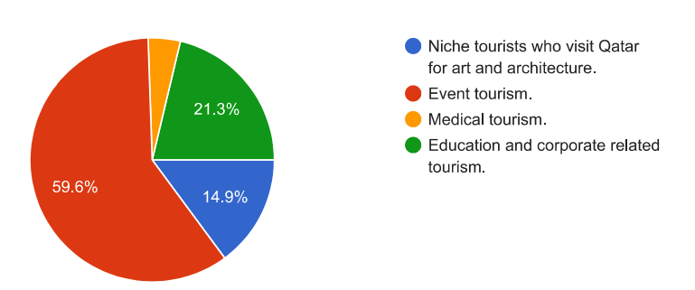
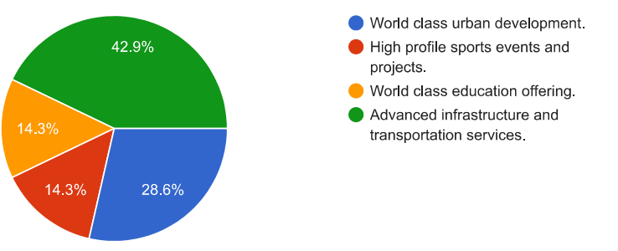
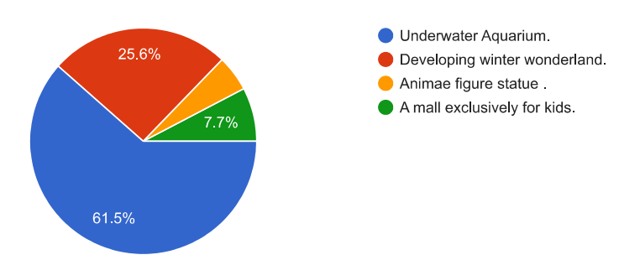
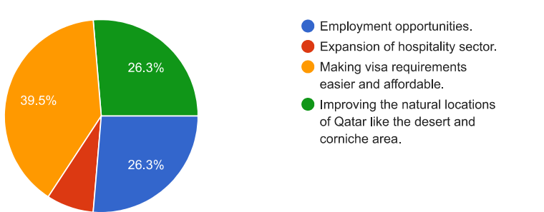
Survey Results
Students created the survey questions, and the results helped them to validate their research findings.
Teachers.
Fellow students
Parents
Friends and relatives
Community as awhole were involved in the survey

Slide 14
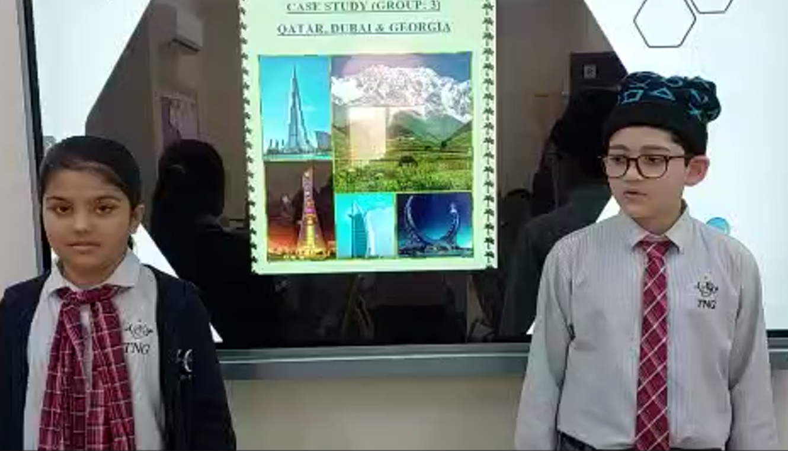
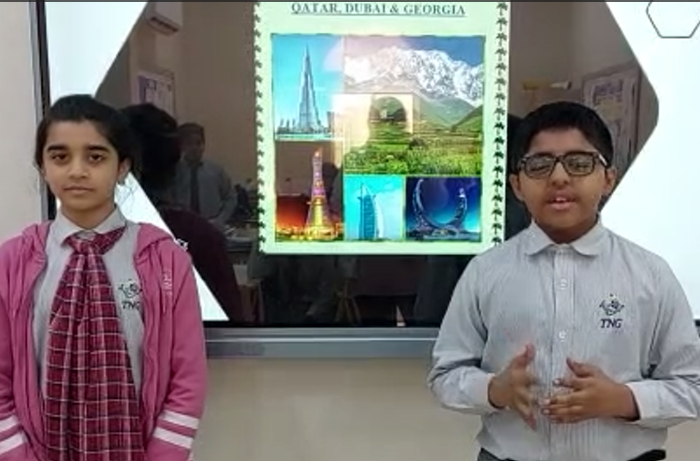
PPT and oration of our research findings.

Slide 15
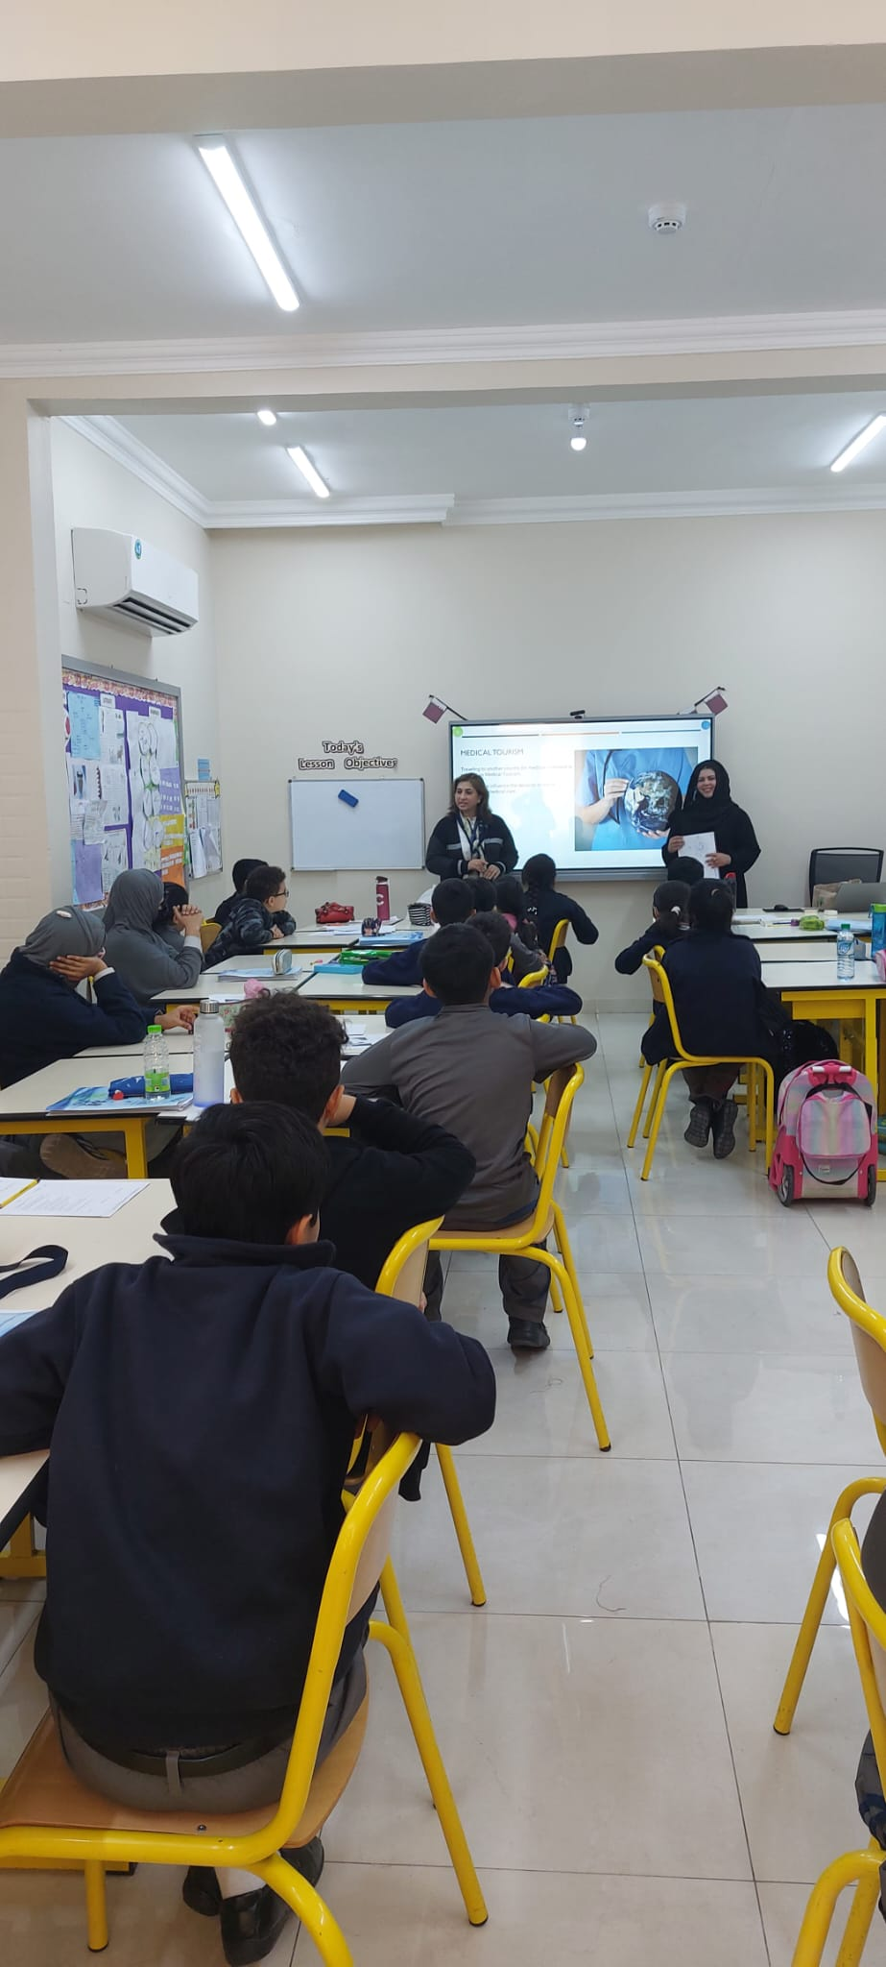
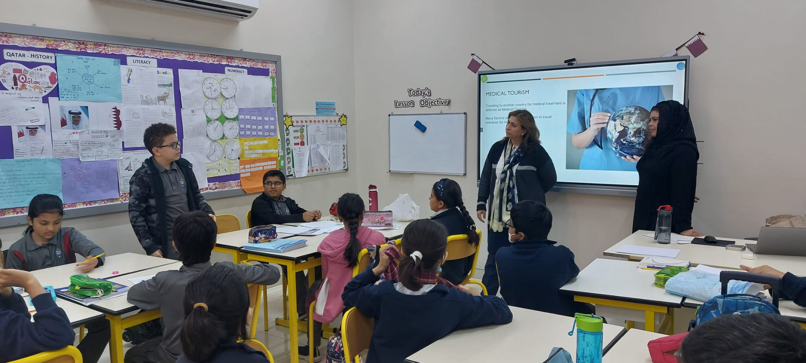
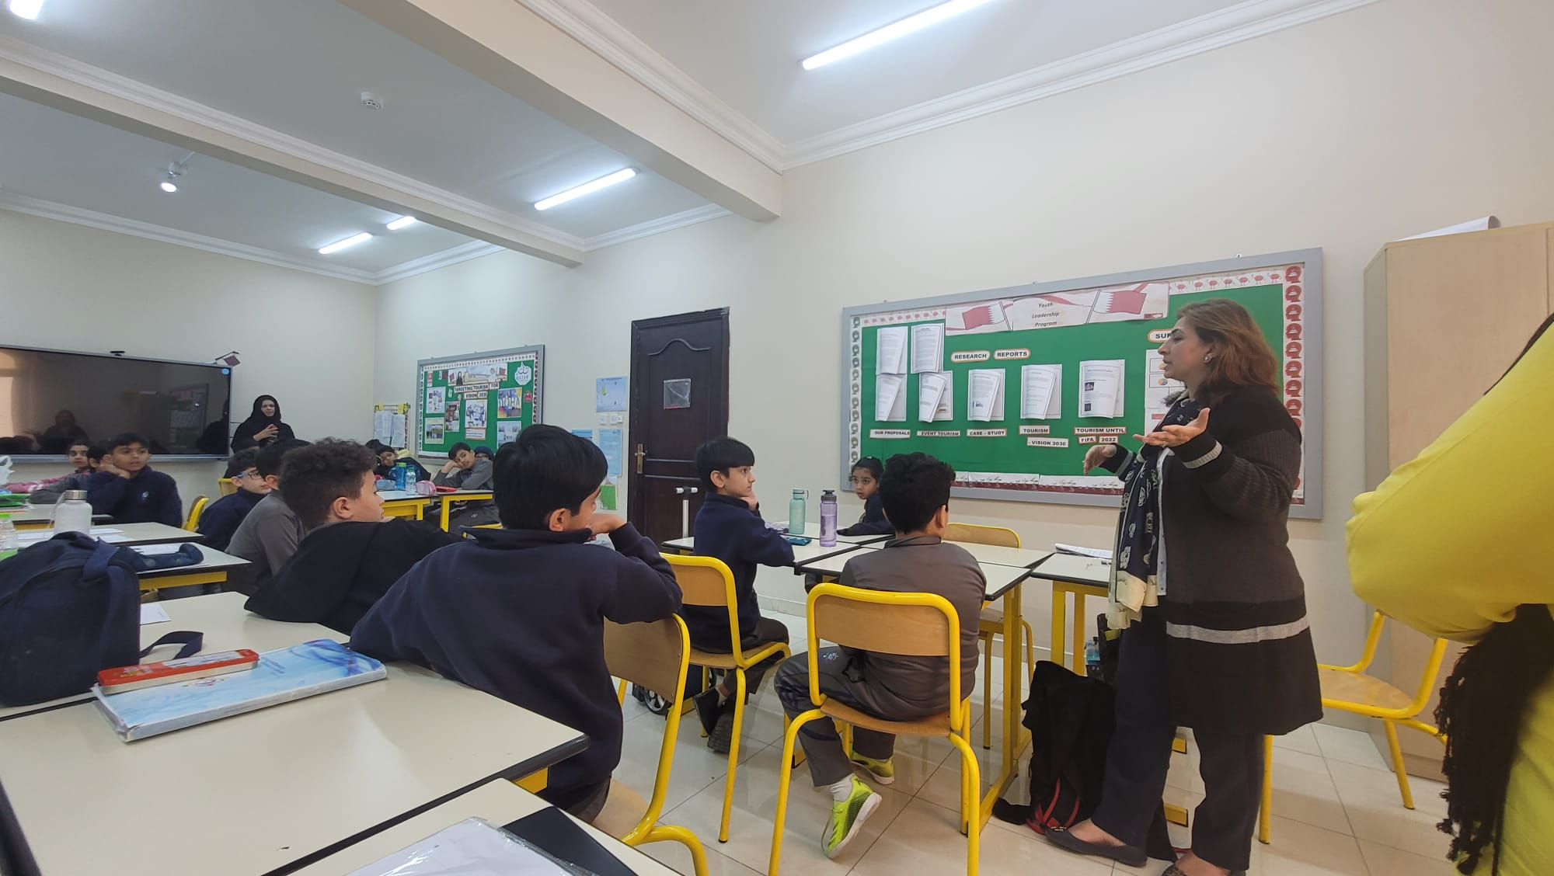
Dr Sadaqa gull , parent of Mawara Naveed delivered a guest lecture on the prospects of medical tourism in qatar.
Students had an interactive session with her and came up with a proposal of establishing many more pharmaceutical companies in Qatar to improve medical tourism.
From the discussion , they also concluded that medical facilities have to provided in affordable prices to tourists in case of emergency.
Community engagements

Slide 16
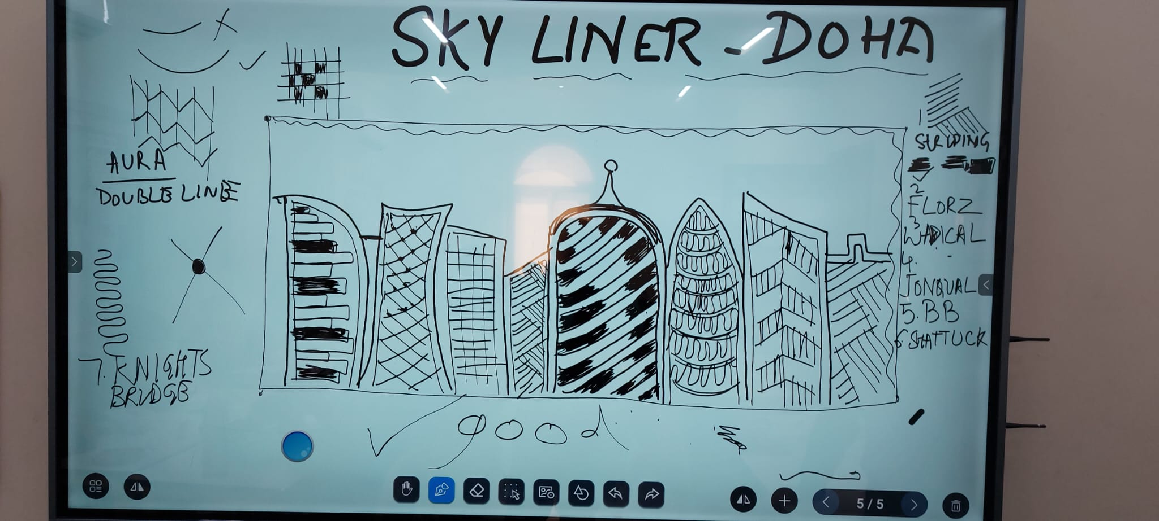
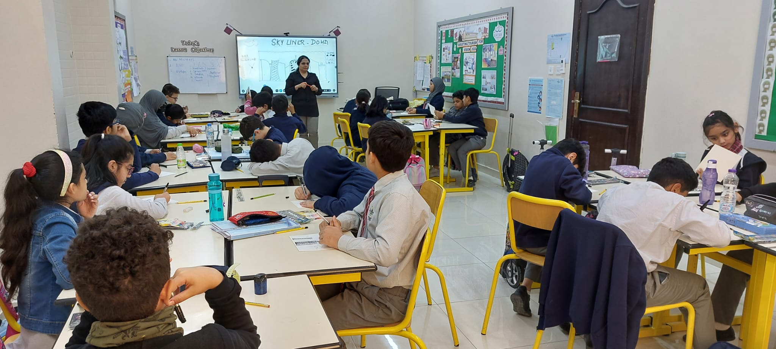
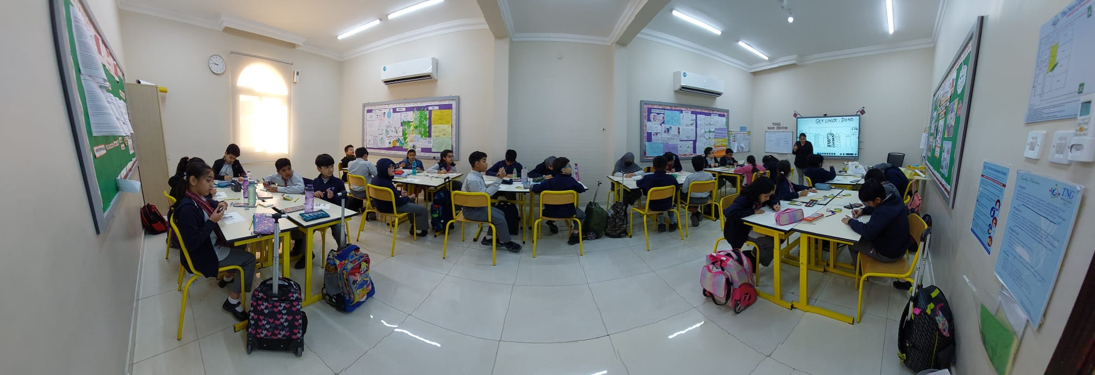
Ms Rashmit, a certified zentangle artist ( USA) and a teacher as well , based on Doha conducted an engaging ,inspiring and wonderful workshop for year 5 students. They made the sky- liner of Doha
As a proposal, the students wanted to make zentangle art of many more important places , monuments and mosques of qatar and hence attract tourists all over the world.

Slide 17
Our Proposals to develop Qatar tourism to meet Vision 2030
We Welcome you to our class to see our work and find out !!!
Thank You

