Slide 1
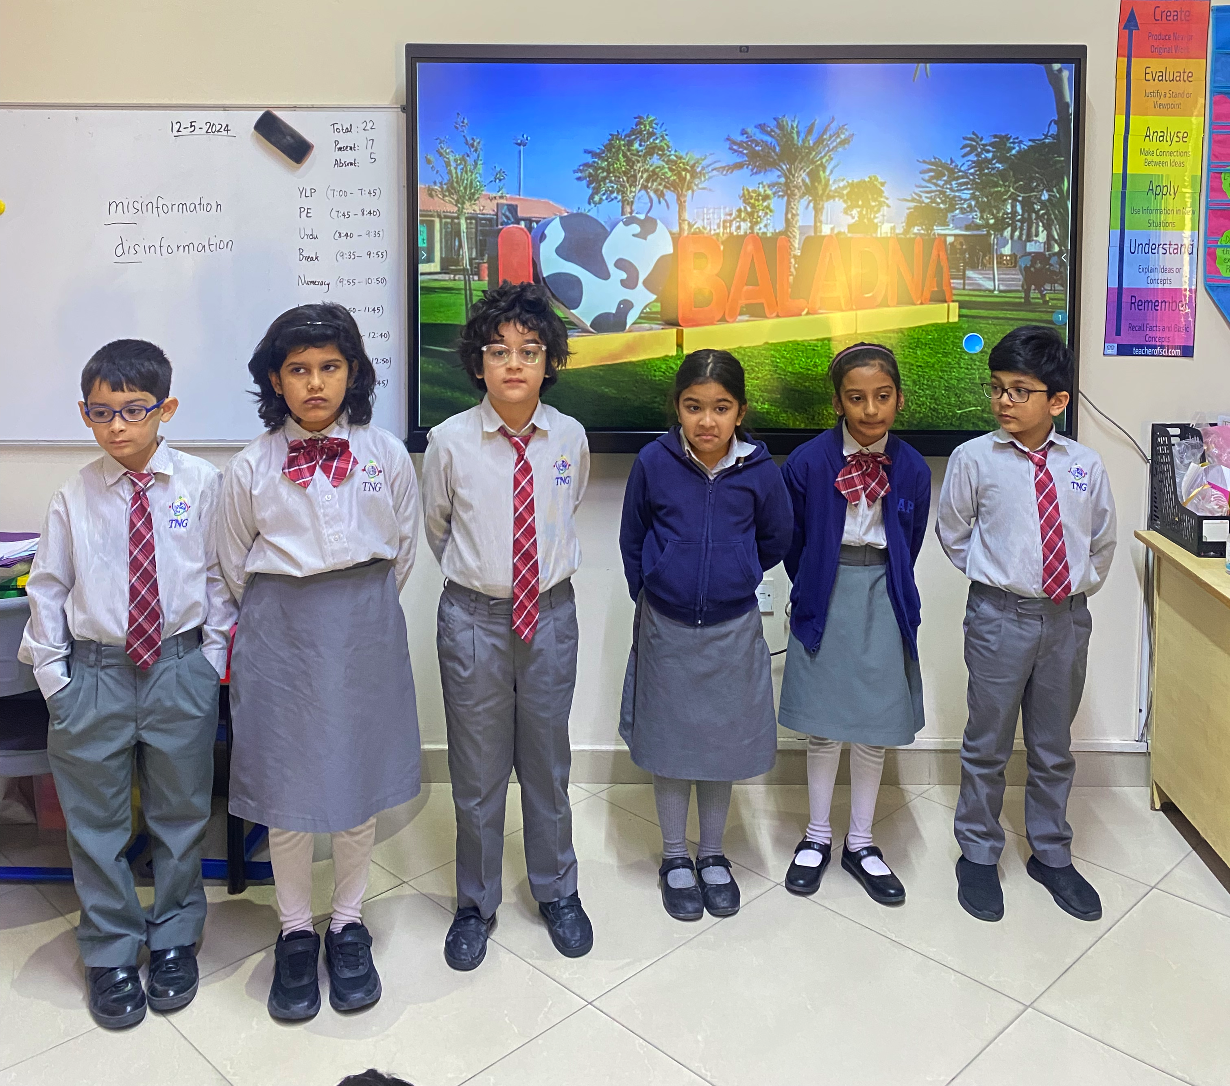
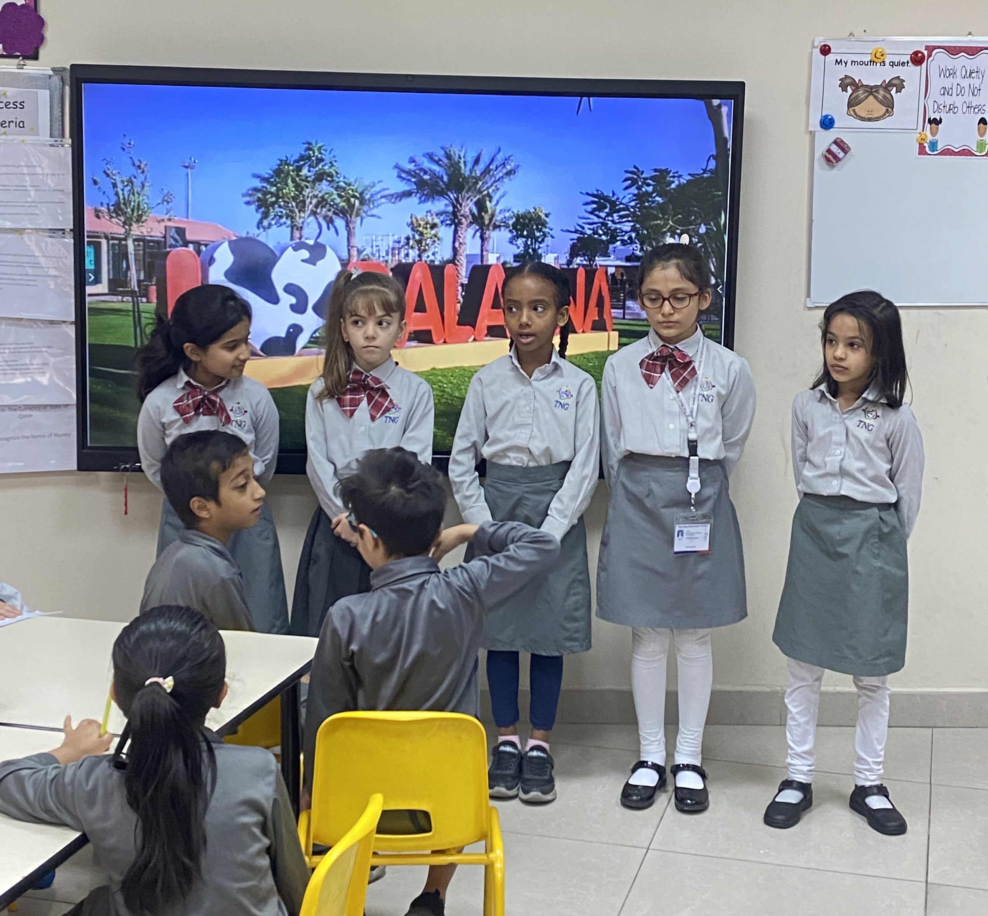
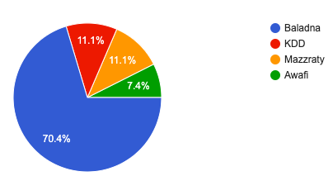
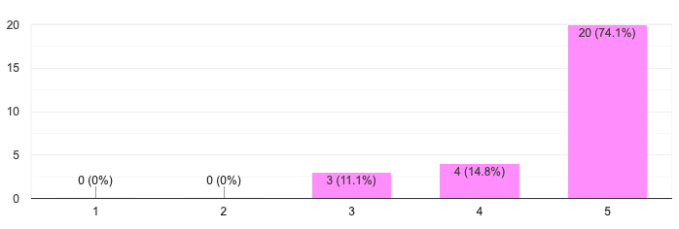
ــــــــــــــــــــــــــــــــــــــــــــــــــــــــــــــــ( Science)
Beyond the Pastures: A Deep Dive Into Baladana Farm
Big questions
Suggested Solutions
Procedures
Sharing
اعتمد الباحثون المنهج التجريبي في جمع البيانات.- مجتمع البحث: طلاب الصف السادس وأولياء الأمور في مدرسة جوعان بن جاسم النموذجية المستقلة للبنين سنة 2015-2016.- العينة: تم أخذ عينة عشوائية بنسبة 10% من طلاب الصف السادس حيث أن عددهم 75 طالب أي مايعادل تقريبا 8 طلاب.- أدوات البحث: 1- الاستبيان للطلاب وأولياء الأمور. 2- المقابلة الشخصية للهيئة الإدارية والتدريسية بالمدرسة.
In what ways can Baladana Farm implement sustainable agricultural practices to minimize environmental impact while maximizing productivity and profitability?
Implement regular training session for farm staff on proper milking techniques and hygiene practices
Conduct regular health checks on dairy cows to ensure optimal health and milk quality.
Establish a strict cleaning and sanitation protocol for milking equipment and facilities.
Monitor milk production and quality consistently.
Explore sustainable practices.
Continuously educate farm staff on the importance of proper milking practices and their impact on overall farm sustainability and profitability.
Comparative study of different milk brands
The learners have been divided in four groups in mixed ability to research on different sections of Baladana Fram. Group 1 has assigned to research on the journey of milk from cow to consumer. Group 2 has assigned to research on sustainability milk production process at Baladana Farm. Group 3 and 4 have assigned to do the comparative analysis on different aspects. Teachers have explained all the questions prior and has been giving her assistance and guidance throughout their research.
Sharing our project and ideas with different classes
Social media
School newsletter
Presentation and discussion in YLP
Importance of the research
Graphs / Charts
Research on Baladana Farm is important for several reasons. It allows for the evaluation of implemented strategies, identification of challenges and refinement of farming techniques. This research aids in optimizing resource allocation , enriching crop yield, and fostering sustainable practices. Moreover, it provides valuable insights for long term planning and adaptation to changing environmental conditions, ensuring the farm’s resilience and success.
Selected Solution
References
Explore the journey of milk from cow to consumer through different stages
Exploring sustainability- environmental impact like water usage and waste management
Explore other milk brands and have comparative analysis on different aspects like quality and taste, health and safety, price and packaging and nutritional content
Results & Recommendations
Bibliography
https://baladanapark.com/index.html
Researcher’s Name
Year 2B
Name of Supervisors
Ms Shireen Fatema
Ms Saima Sagheer
.
Objectives of the research
The objective of research on Baladana Farm is to assess the efficacy of implemented farming practices, identifying areas for improvement and refine strategies to enhance productivity , sustainability and profitability.
.
Baladana Farm milks their cows in a way that's good for the animals and the environment. They keep the cows clean and happy, and use special machines for gentle milking. This reduces stress and keeps the milk healthy. By taking good care of their cows, Baladana Farm shows how responsible production leads to delicious and nutritious milk for us!
Happy Cow Observation: Train workers to recognize signs of cow comfort and stress during milking.
Milking Machine Maintenance: Regularly check and maintain milking machines for optimal gentleness and hygiene.
Cow Comfort Focus: Continuously research and invest in methods to further reduce cow stress during milking.
Knowledge Sharing: Collaborate with other farms to share best practices in responsible milking techniques.

