Slide 1
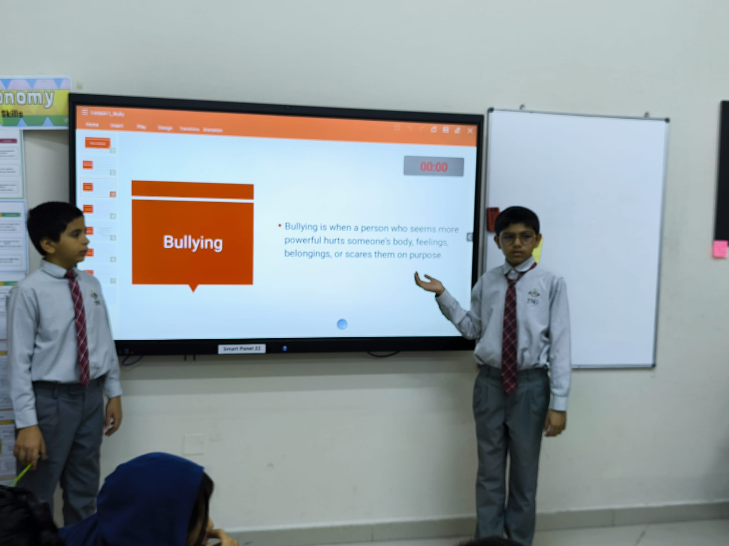
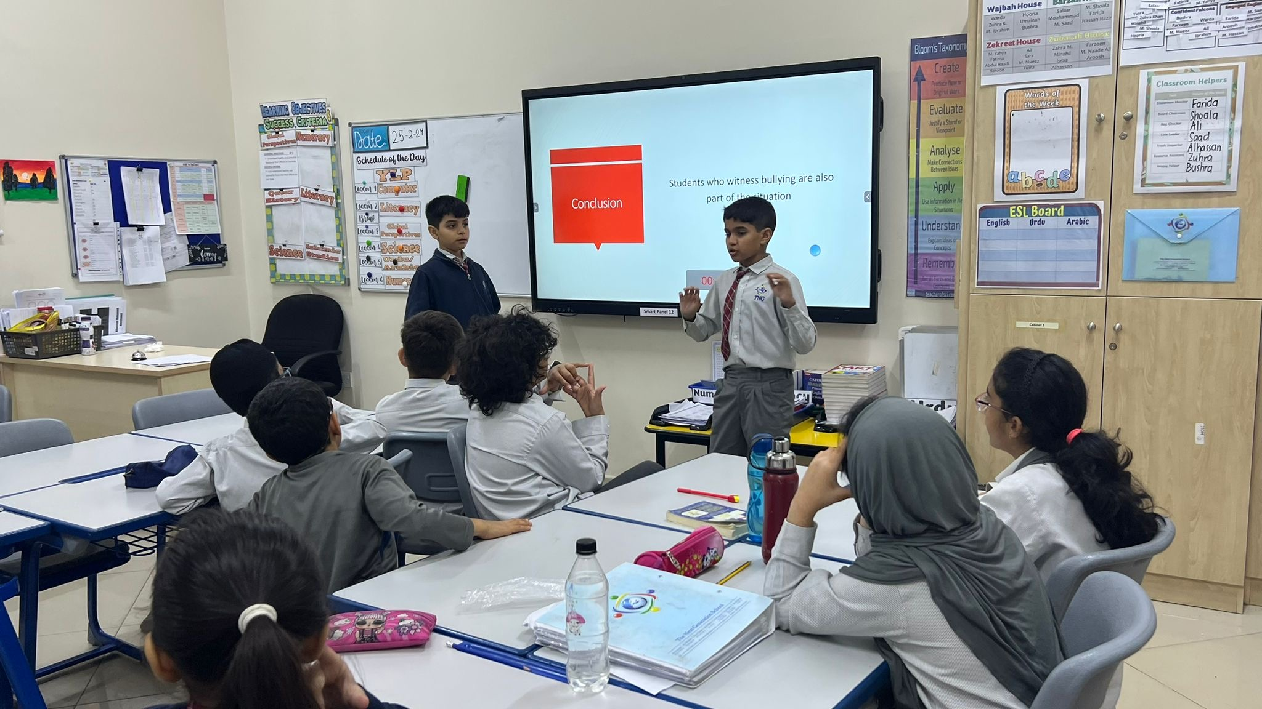
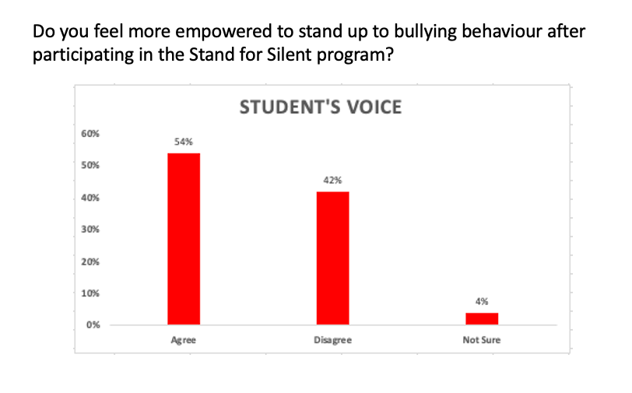
(
Understanding Bullying in School Environments: A Comprehensive Examination of Factors, Impacts, and Intervention Strategies
Big questions
Suggested Solutions
Procedures
Sharing
What is the global impact of bullying within school premises, and how does it affect the academic, social, and emotional well-being of students worldwide?"
How can we effectively implement a comprehensive program to reduce bullying in schools, addressing social dynamics, fostering empathy, and creating a safe learning environment for all students?
اعتمد الباحثون المنهج التجريبي في جمع البيانات.- مجتمع البحث: طلاب الصف السادس وأولياء الأمور في مدرسة جوعان بن جاسم النموذجية المستقلة للبنين سنة 2015-2016.- العينة: تم أخذ عينة عشوائية بنسبة 10% من طلاب الصف السادس حيث أن عددهم 75 طالب أي مايعادل تقريبا 8 طلاب.- أدوات البحث: 1- الاستبيان للطلاب وأولياء الأمور. 2- المقابلة الشخصية للهيئة الإدارية والتدريسية بالمدرسة.
Raise Awareness: Conduct regular workshops and assemblies to raise awareness about the various forms of bullying and their consequences
Mediation and conflict resolution: These programs are often used to help school staff address aggressive and violent behavior between students.
School exclusion: These efforts include “zero tolerance” or “three strikes and you’re out” type policies. When schools identify a student as a bully, that student is excluded from school.
Therapeutic treatment for bullies:
This approach might include classes in anger management or efforts to boost self-esteem and empathy.
Curricular approaches: These efforts include “zero tolerance” or “three strikes and you’re out” type policies. When schools identify a student as a bully, that student is excluded from school.
Extensive research was done to study different programs around the world to mitigate bully
Stand for the Silent program was read in details and all the activities were done to meet the objective
Brainstorming and Group discussions were done to reconcile the thoughts and feelings
Students conducted this program with junior classess
Activities and role-plays were conducted to evaluate the learning
Importance of the research
Graphs / Charts
This research is crucial for developing a nuanced understanding of bullying in school settings, which can inform the creation and enhancement of evidence-based interventions. By identifying the root causes and consequences of bullying, this study aims to contribute to the development of targeted strategies for prevention and support..
Selected Solution
References
Comprehensive approaches:
These approaches include but are not limited to classroom-based programs. They target the larger school community in an effort the change school climate and norms. They acknowledge the need for a long-term commitment to addressing bullying specifically, but they often do so as part of a larger violence prevention effort (Limber 2003). These approaches need to be developed to address the needs of a particular school or community; simply dropping prefabricated programs into place rarely works
Results & Recommendations
https://standforthesilent.org
https://clemsonolweus.org
https://www.positiveaction.net/bullying-prevention-curriculum-programs
https://safechild.org/take-a-stand-bullying-prevention/
https://ohr.dc.gov/page/bullyingprevention
https://nationalgangcenter.ojp.gov/spt/Programs/47
https://www.brainstormproductions.edu.au/student-bullying-guide-for-schools/
https://www.stompoutbullying.org
Objectives of the research
To identify and categorize the different forms and manifestations of bullying prevalent in school environments
To investigate the effectiveness of different programs and policies in mitigating bullying incidents in schools
Assess the outcomes of implementing a new comprehensive bullying prevention program within sample classes, focusing on its effectiveness in reducing instances of bullying and improving the overall school environment.
The survey of 90 students revealed that the majority agreed the "Stand for Silent" program effectively equips them to stand against bullying. The feedback highlighted the program's success in fostering a supportive and empathetic environment. Based on these positive results, it is recommended that the program be expanded to reach more students to further enhance its impact on preventing bullying.

