Slide 1
SELF-DEFENCE FOR WOMEN
Presented By : Year XI-C
Youth Leadership Program| 2024

Slide 2
OVERVIEW
Our aim was to explore the provisions within Qatari law that empower women with the right and freedom to defend themselves. This involved engaging in a basic self-defense class, led by a representative of ‘Strong Man’ karate class, promoting practical skills and awareness of personal safety. Grade 9 girls attended the session, showing active participation and fulfilling our project aim.
2

Slide 3
METHODOLOGIES
1
Calls were made to various taekwondo focused centres, and a female trainer was then invited to give a session in the girls-wing ground for grade 9 and 11.
2
The trainer demonstrated a total of 3 skills which can be used to counter commonly used assault tactics (i.e. choking from behind).
3
Analyzed Qatar’s stand on women’s right to a certain extent, allowing them to work alongside men and participate in various government and social activities, all while feeling safe and protected.
5

Slide 4
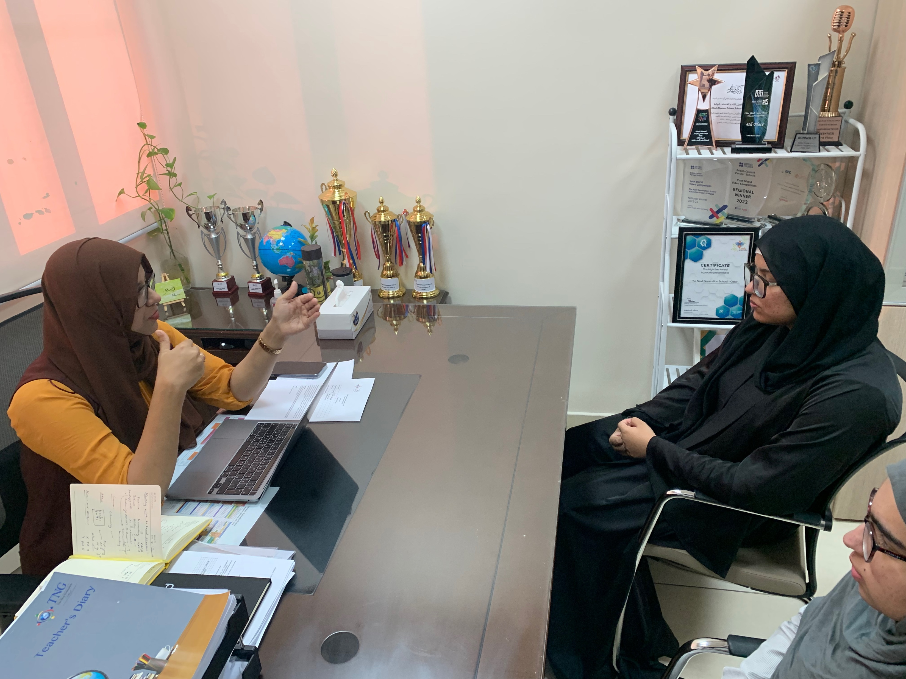
PLANNING
6

Slide 5
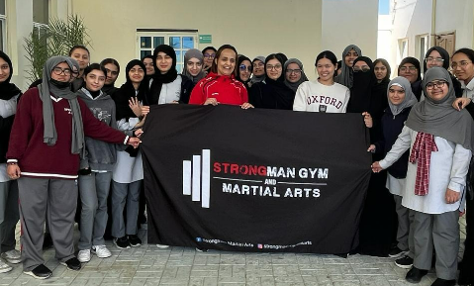
IMPLEMENTATION
6

Slide 6
Strategy no. 1
grabbing the hair from behind
6

Slide 7
Strategy no. 2
6
grabbing the neck from behind (choking)

Slide 8
Strategy no. 3
slapping from the front
8

Slide 9
REFLECTIONS
Rimlah Adnan - 9C
Attending the self-defense class arranged by 11th grade at school for girls was incredibly empowering. Learning practical techniques for protecting oneself in various situations felt both empowering and essential. I gained confidence in my ability to defend myself if ever faced with danger. Moreover, it underscored the importance of being prepared and aware of one's surroundings, implanting a sense of empowerment and security. Overall, it was a valuable experience that equipped me with skills for life.
- Rimla Adnan, 9C
9

Slide 10
THANK YOU

