Slide 1
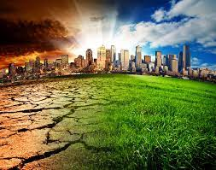

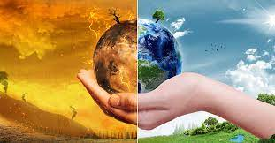
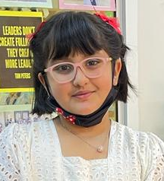
Climate Change
Our Climate, Our Future
Youth Leadership Program 2022-23
TNG Wakra Primary & Secondary
By Zara Habib
Class 4A

Slide 2
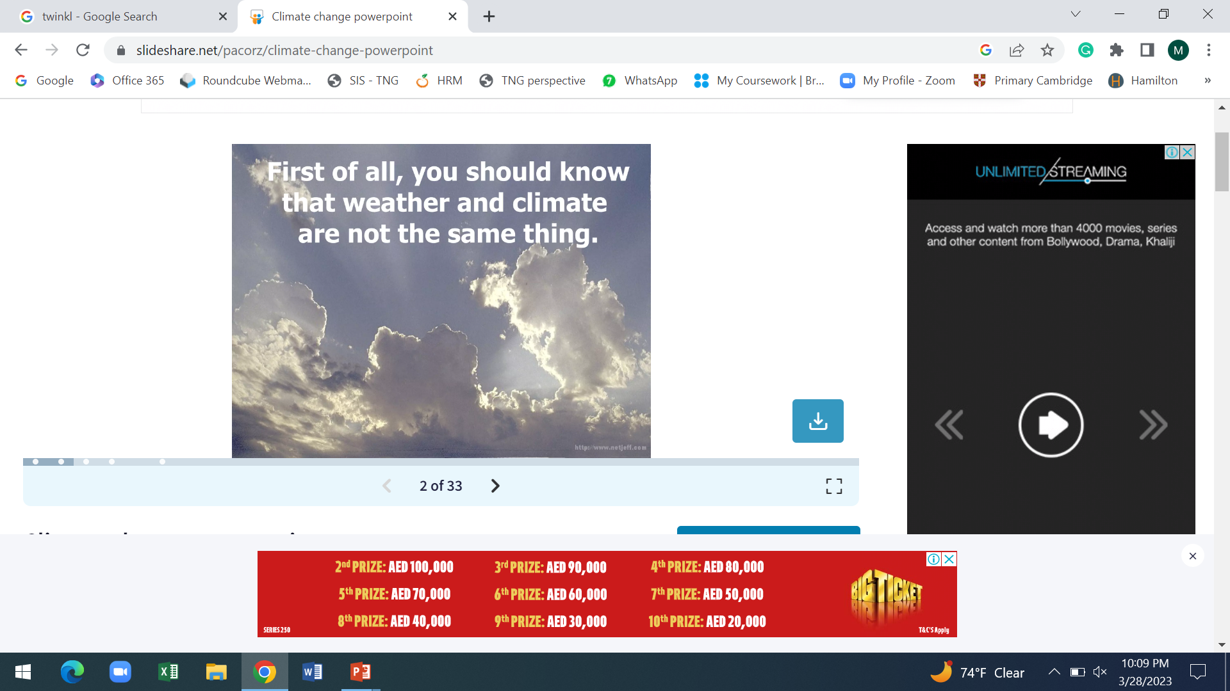
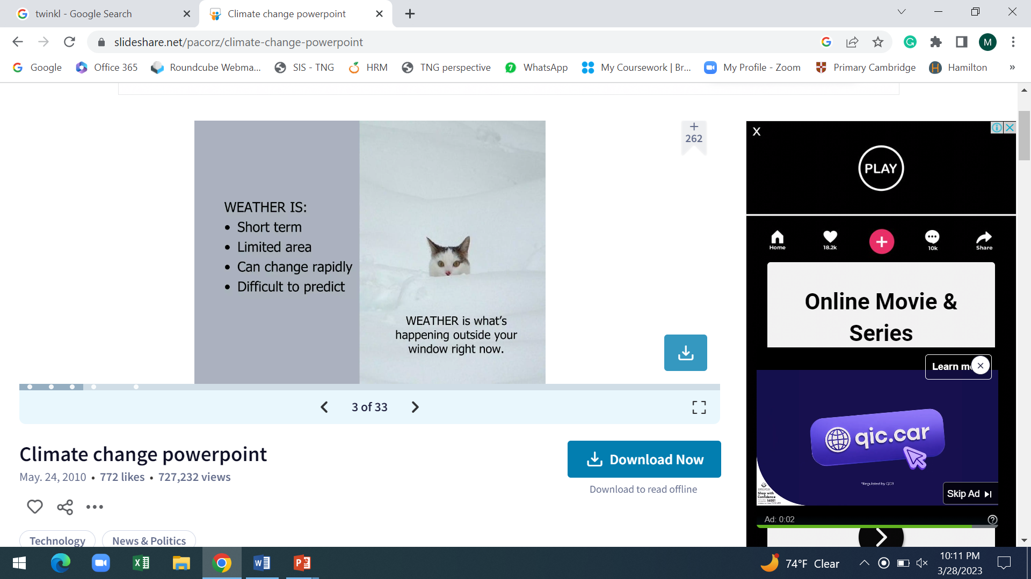
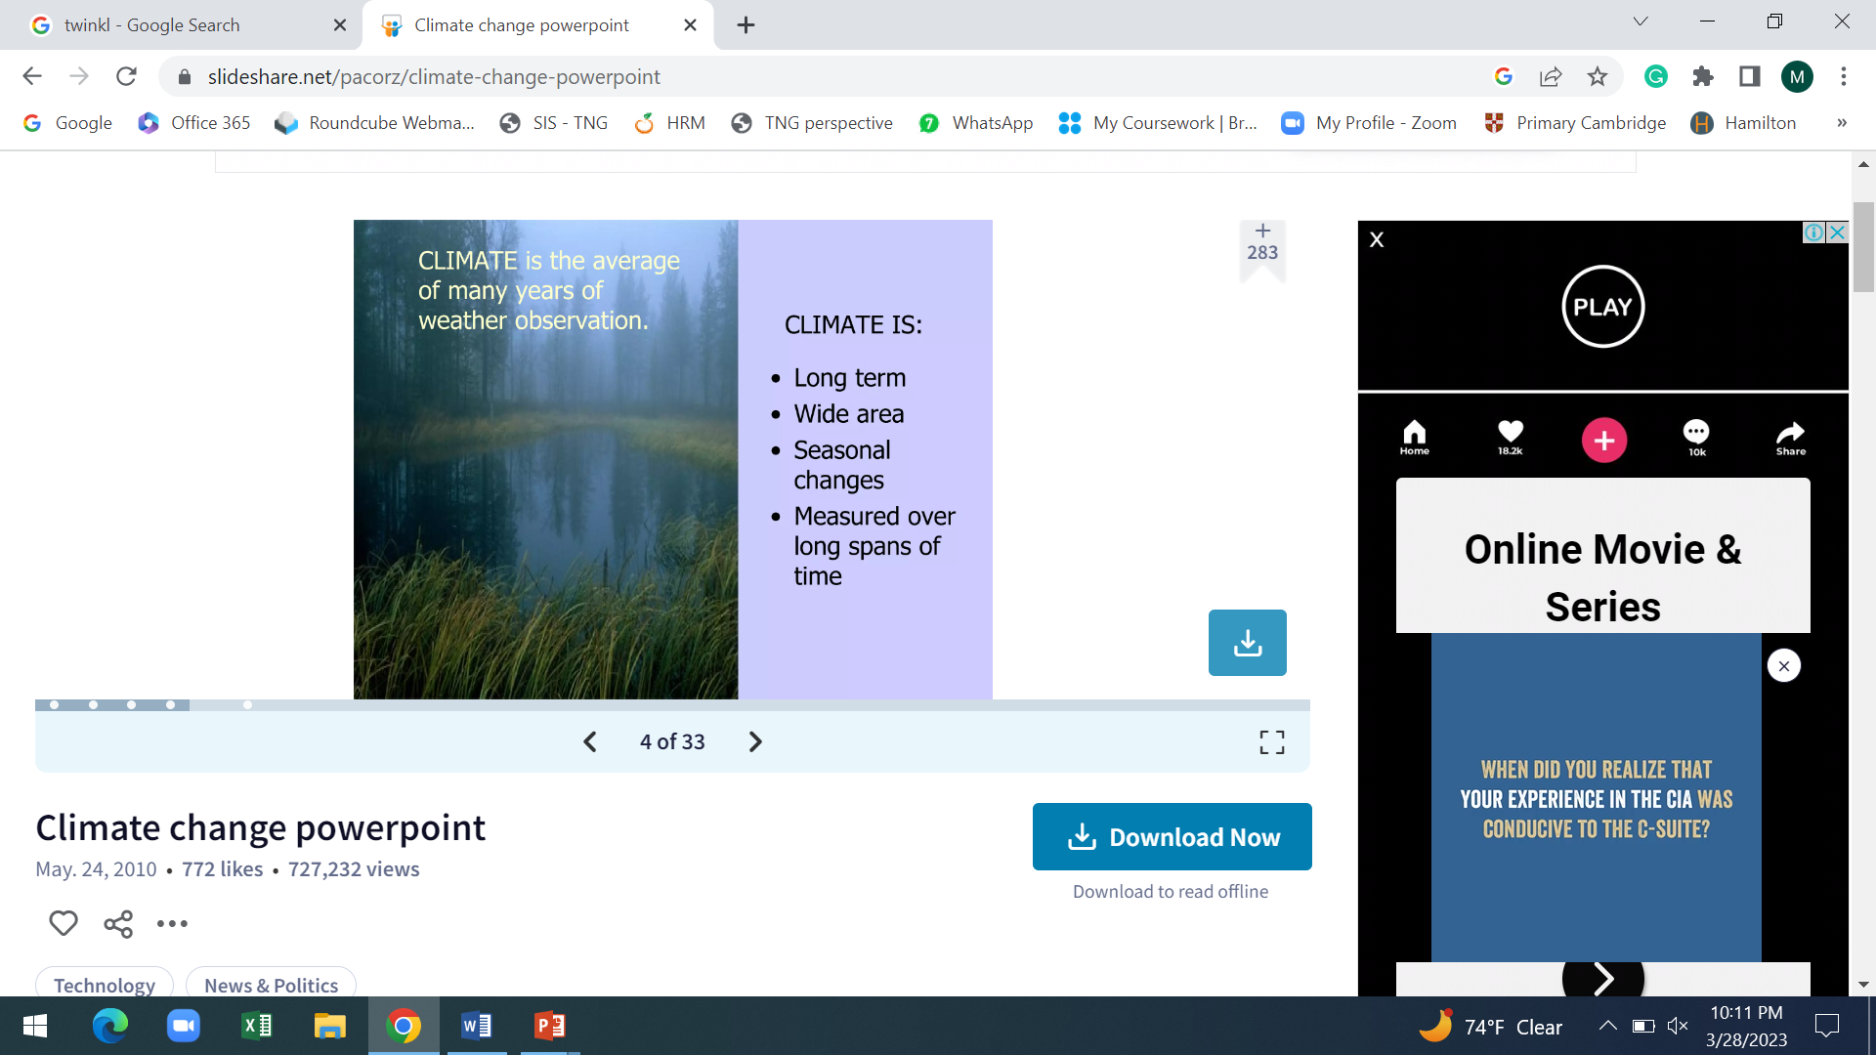

Slide 3

What Is Climate Change?
Climate change is a change in the average temperature and cycles of weather over a long period of time.

Slide 4
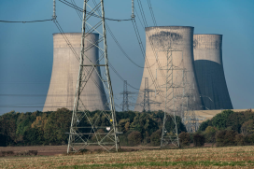
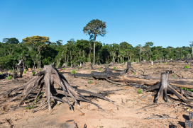
What Causes Climate Change?
The rapid climate change we are experiencing now is due to three main human activities:
Burning fossil fuels
Deforestation
Reduction of biodiversity
Deforestation for future agriculture plantation-Tahuamanu Province, heading to Centro Poblado de Alerta - Madre de Dios Region, Peru by © Nicolas Villaume / WWF-US licensed under CC BY
Untitled by © Sam Hobson / WWF-UK licensed under CC BY

Slide 5
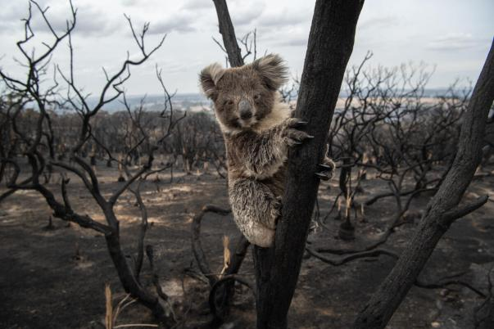
Why Is Climate Change a Problem?
A stable climate supports this process and allows living things to thrive. If the climate changes quickly, organisms don’t have enough time to adapt to new conditions and may no longer be able to survive.

Slide 6
Why Is Climate Change a Problem?
Climate change disrupts weather patterns and causes extreme weather events to become more common. These include hurricane activity, droughts and floods.

Slide 7
Why Is Climate Change a Problem?
Rising temperatures are causing sea levels to increase.
The rising water can cover coastal areas, destroying habitats and displacing whole populations from low-lying areas.

Slide 8

Who Can Fix It?
Governments can make laws and policies that reduce the amount
of greenhouse gas emissions.
Businesses can change their processes to run more sustainably.
We can all make choices in our own lives that reduce our carbon footprint (the impact our actions and purchases have on climate change).
We can also use our voices to let businesses and governments know that we want them to act quickly to reduce their impact on climate change.

Slide 9
What Can We Do?
Speak Up
We can make sure that world leaders know we are counting on them.
We can also reach out to businesses and our local council if we feel like they need to do things differently too.
Act
As a school community, we can help in the fight against climate change and biodiversity loss by improving the sustainability of all aspects of our school life.
The changes that we make as a school are seen by lots of people
in our local community. This means that we can influence positive change to spread through society.

Slide 10
THANK YOU
By Zara Habib

