Slide 1
Our Dream Sustainable School : Building a Better Tomorrow
Class 6C YLP project 2022-23

Slide 2
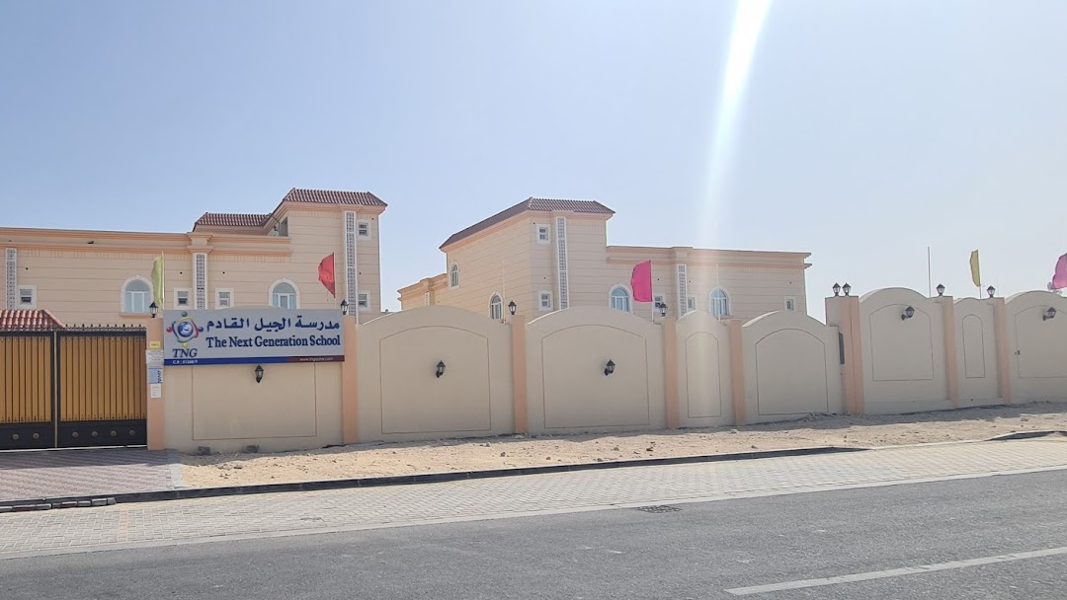

Slide 3
Vision and Mission
TNG is committed to the academic, personal, and social growth of its learners in a safe and positive learning environment, empowering them to meet global challenges with an emphasis on Islamic values and practices.
TNG aims to foster an enabling and technology-enhanced environment, which is collaborative, encourages innovation, independent learning and active participation in co-curricular and extra-curricular activities.

Slide 5
Big Questions
Analysis: How can you evaluate the current practices of the school to determine their sustainability? What data do we need to gather and analyze to determine the environmental impact of the school?
Evaluation: How effective are the current sustainability efforts of the school? What impact have they had on the environment, economy, and society? How can you measure and evaluate these impacts?
Synthesis: How can you create a sustainable school plan that integrates the social, economic, and environmental aspects of sustainability? How can you prioritize sustainability goals to ensure that the plan is effective and feasible?

Slide 6
Big Questions
•Application: How can you implement the sustainable school plan in a way that engages stakeholders and achieves buy-in? How can you overcome any obstacles or challenges that arise during the implementation process?
Reflection: How can you evaluate the success of the sustainable school plan and make adjustments based on feedback and results? How can you ensure that sustainability remains a priority for the school in the long term?

Slide 7
Challenges faced globally
Lack of awareness:
Limited resources:
01
02
Resistance to change:
03
Many schools may not have a proper understanding of what sustainability means and how it can be practiced effectively. However, we are blessed to be a part of TNG as we are a part of YLP program since Grade 1
Schools may have limited resources to invest in sustainable practices. For example, they may not have enough funds to purchase energy-efficient appliances or install solar panels.
Sometimes, there may be resistance to change among teachers, staff, and students, making it difficult to implement sustainable practices. For instance, some may find it challenging to switch to more sustainable materials or reduce waste.

Slide 8
Why We Chose This Topic?
We selected this topic after first determining the number of environmentally friendly, sustainable schools in Qatar. Since there were a few green schools, we then thought that if we raised awareness of this, we could expand the number of green schools while also putting these sustainable ideas into effect in the real world.

Slide 9
What is a Sustainable School?
-According to the UN, A Sustainable School Is a School That Has Proper Education As well As Takes Care Of The Environment
-By using renewable resources, reducing trash, and conserving energy and water, a sustainable school aims to lessen its impact on the environment. Prioritizing social responsibility involves educating people about green occupations and collaborating with local businesses to create a sustainable ecology.

Slide 10
What Makes a Green, Sustainable School?
Energy efficiency, renewable energy, waste reduction, water conservation, sustainable mobility, and environmental education are typical attributes of a green, sustainable school. While renewable energy can be produced using solar panels or wind turbines, energy efficiency makes use of energy-efficient appliances, lighting, heating, and cooling systems. Programs for recycling and composting, as well as water conservation measures like low-flow plumbing fixtures and rainwater collection systems, all work to reduce waste. Environmental education is incorporated into the curriculum, and sustainable transportation is promoted.

Slide 11
What Are The Materials That Should Be Used To Make a Sustainable School?
Green roofs: Install green roofs, which are covered with vegetation, to help insulate the building, reduce stormwater runoff, and provide a habitat for wildlife.
Solar panels: Install solar panels to generate renewable energy and reduce the school's reliance on non-renewable sources of energy.
Water-efficient fixtures: Install low-flow toilets, faucets, and showerheads to reduce water usage and conserve this valuable resource.

Slide 12
What are the benefits of a sustainable school?
A sustainable approach can help communities and societies become more resilient in the face of environmental, economic, and social challenges. It offers ethical benefits, economic advantages, and environmental advantages by preserving natural resources, cutting greenhouse gas emissions, and minimizing waste and pollution.

Slide 13
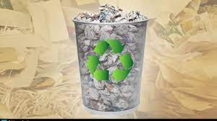
2,000
60,000
360,000
Papers are wasted per day in a school
Papers are wasted per month in a school
Papers are wasted per year in a school

Slide 14
Let's work together!
Let now work together to make a green, sustainable school so that we can save our environment. We can do this by working together and working hard. We just have to believe in ourselves.

Slide 15
Small actions with big impacts
Stage 1:
Stage 2:
01
02
Stage 3:
03
Re-Search Before moving on to the practical phase, students will research the subject again to gain a deeper grasp.
Making projects and posters during the practical stage. Students will be divided into groups, and they will create models and posters connected to the subject.
Conversation phase with several organizations. Students will engage in talks with various groups and organizations to learn about other people's perspectives on the subject.

Slide 16
—Anne of Green Gables
“Its Not What The World Holds For You Its What You Bring To It.”

Slide 17
Expensive Now but Life-Saving Later
Electric Cycle:
Solar panels:
1
2
Plastic recycling machine:
Paper Recycling Machine
3
4
Electric cycle provides motor assistance and can generate electricity for use in the school. It offers health benefits such as improved cardiovascular health, reduced stress, and an active lifestyle. Cost saving is a one-time investment that can be used to generate electricity later, reducing electricity bills.
Solar energy is a renewable and sustainable energy source that does not produce greenhouse gas emissions or contribute to climate change. It is cost-effective, requires minimal maintenance, and can last for 25 years or more, making it a cost-effective investment in the long term. Solar panels can provide energy independence by allowing homeowners and businesses to generate their own electricity and reduce their reliance on the grid.
Recycling plastic reduces the need for new plastic production from petroleum, helps to conserve natural resources, reduce energy consumption and greenhouse gas emissions, diverts waste from landfills, provides cost savings, and reduces water and air pollution.
Recycling paper reduces the need to cut down trees, helps conserve natural resources, reduces energy consumption and greenhouse gas emissions, diverts waste from landfills, provides cost savings, and reduces water pollution.

Slide 18
Our Goal
Recycle
Reduce
Re-use
PAPER
CARBON FOOTPRINTS
EVERYTHING POSSIBLE

Slide 19
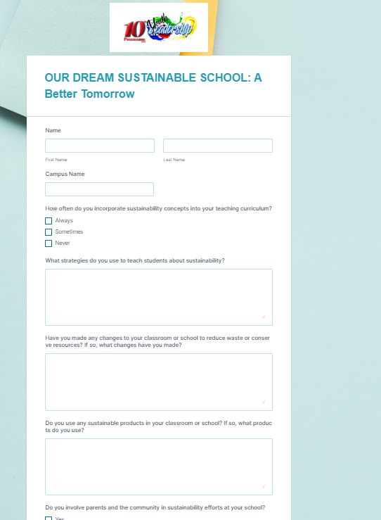
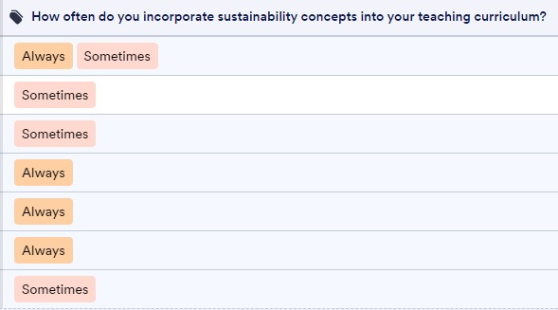
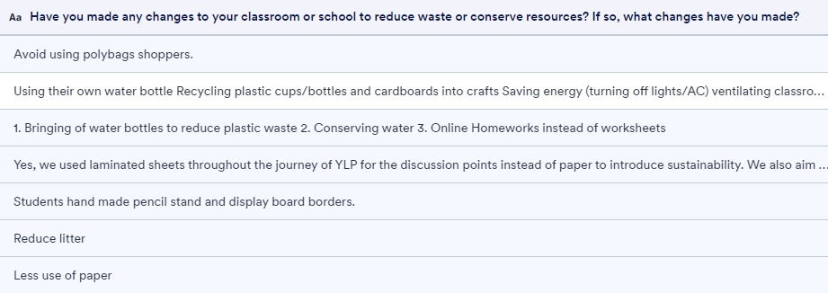
Survey

Slide 20
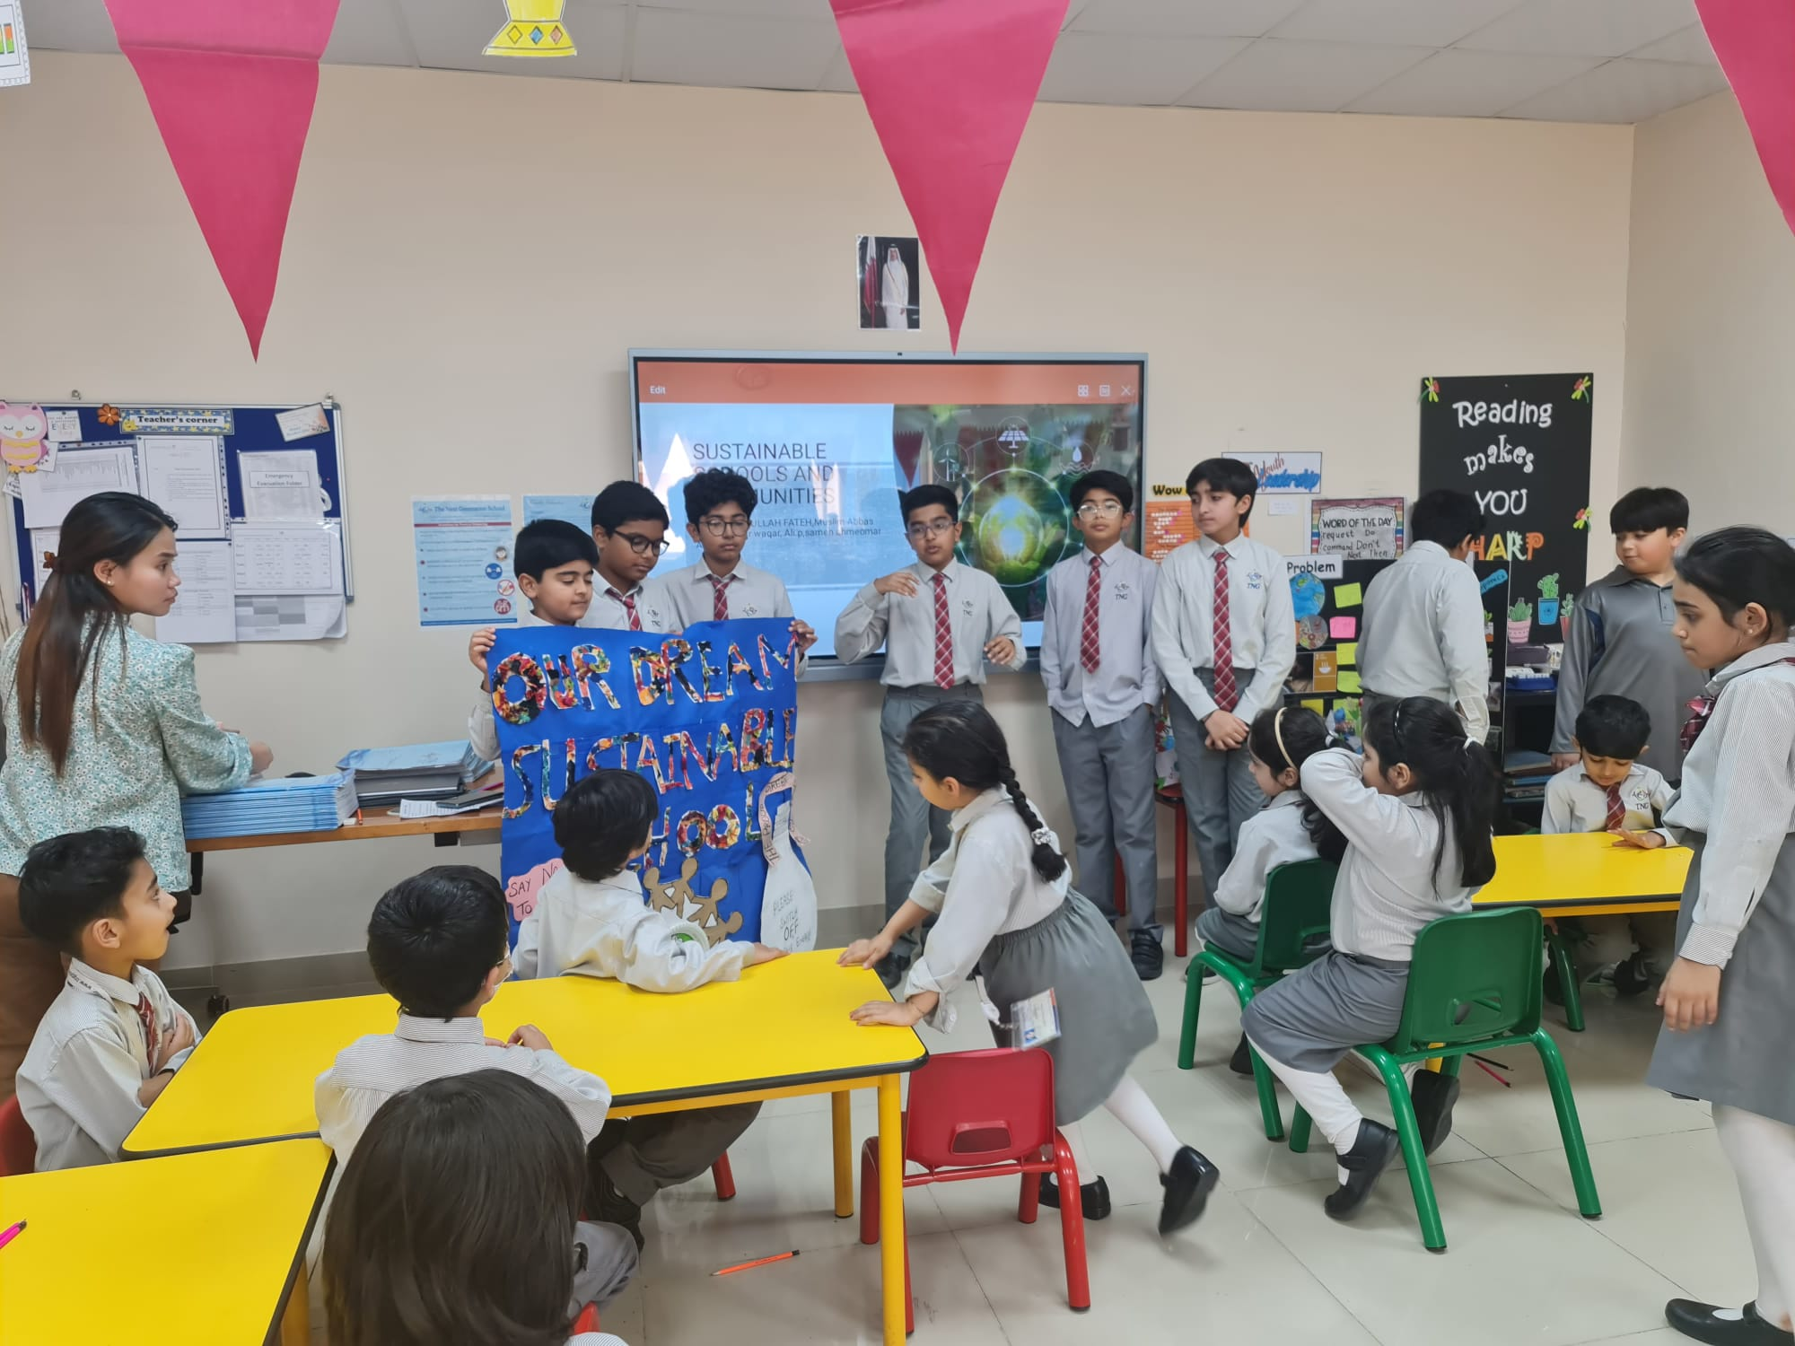
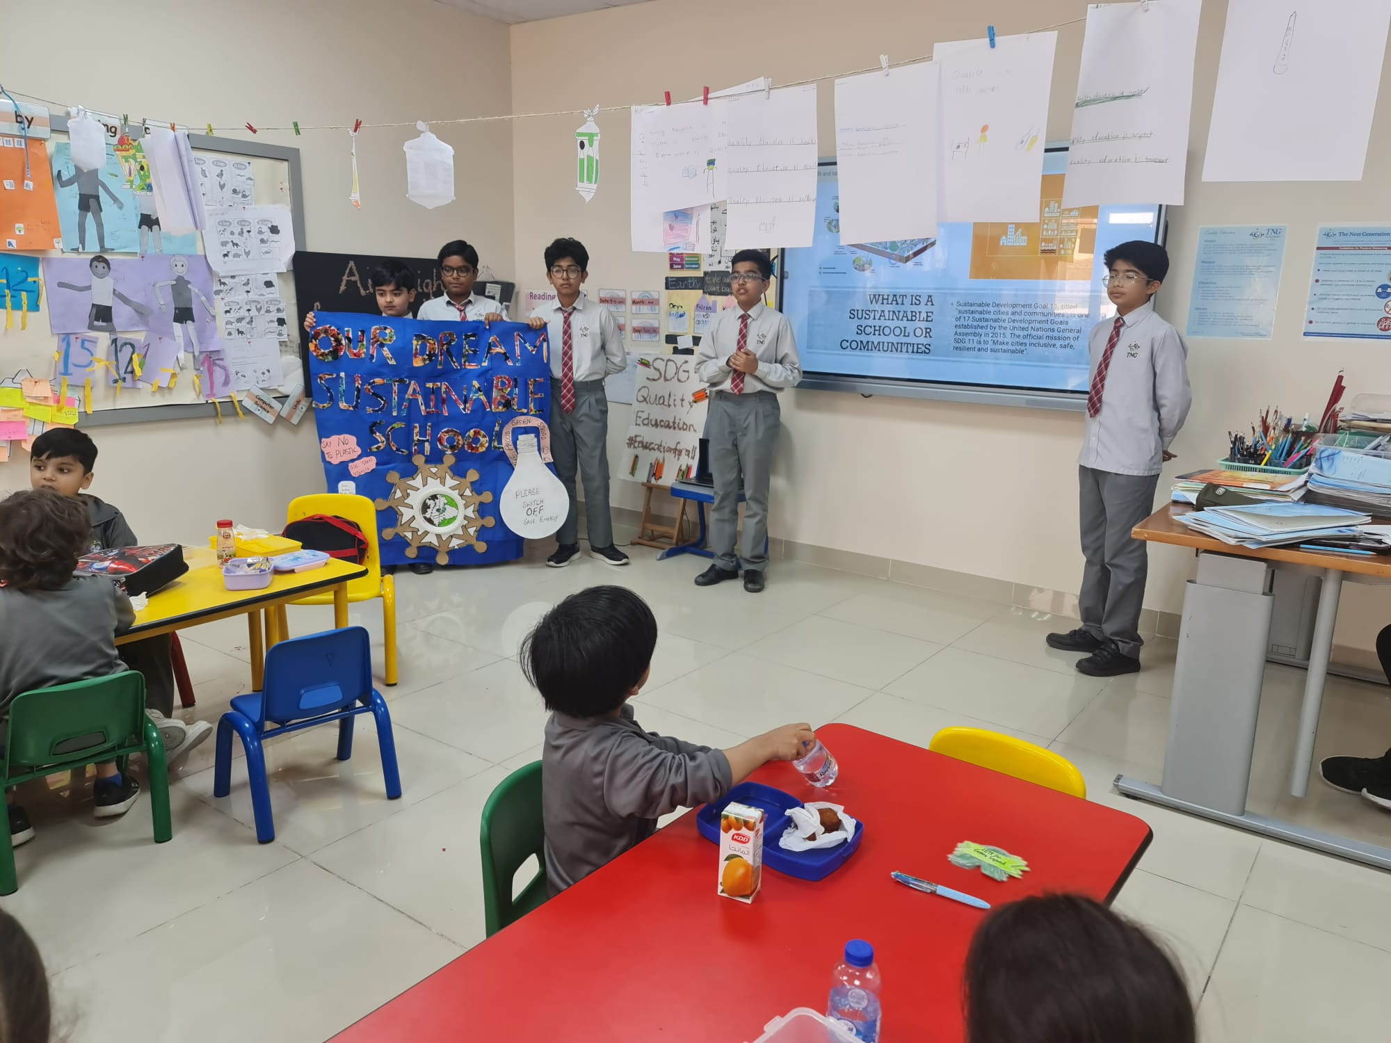
Campaign

Slide 21
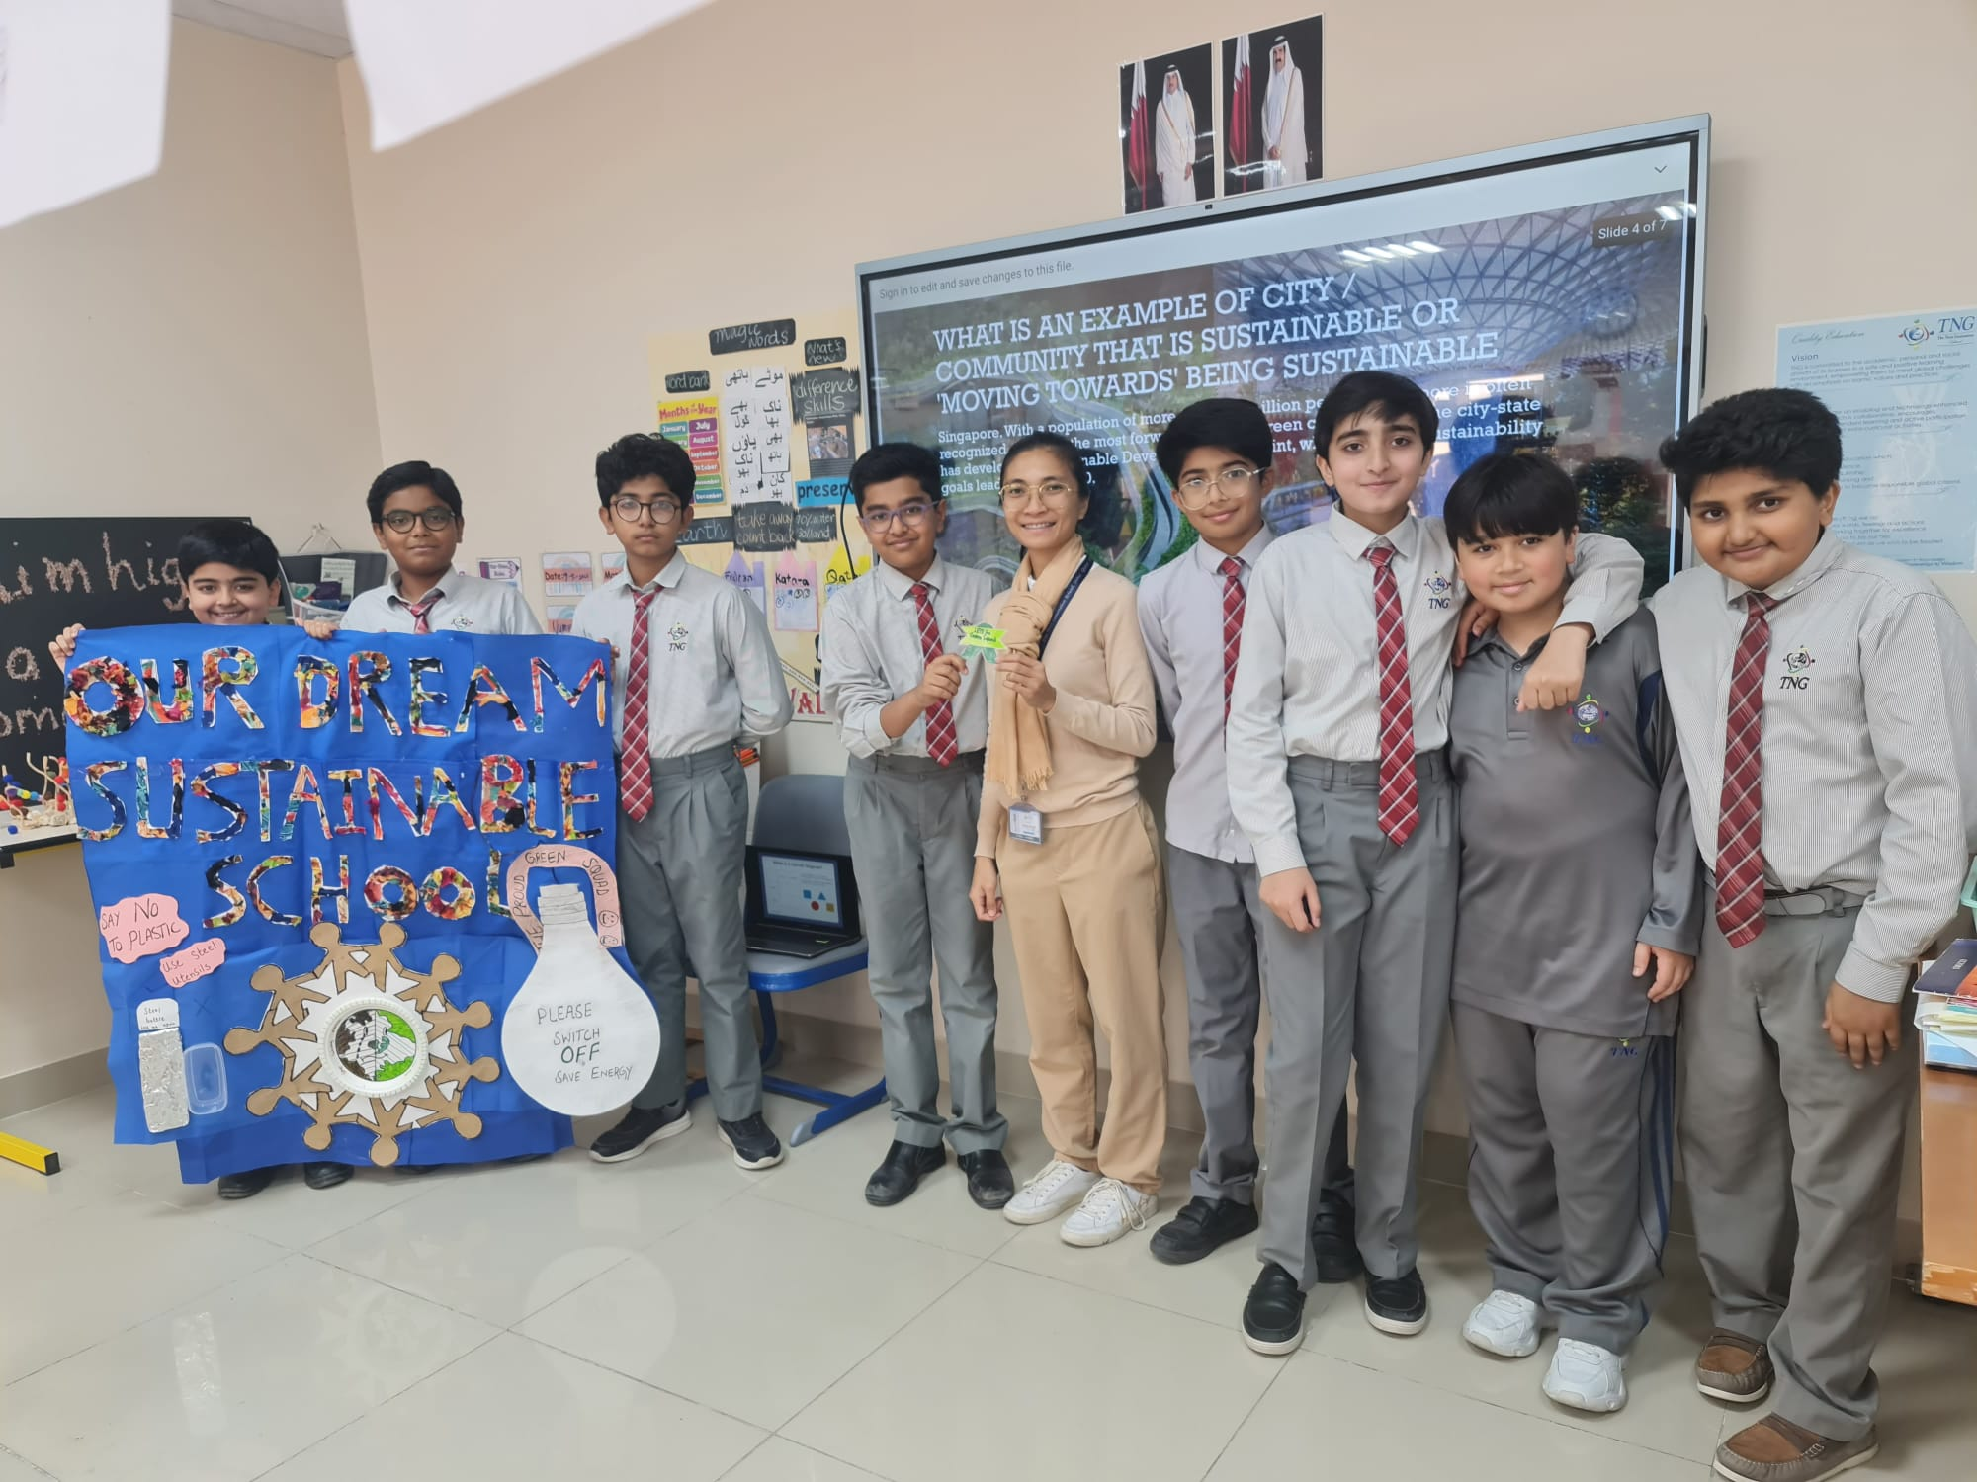
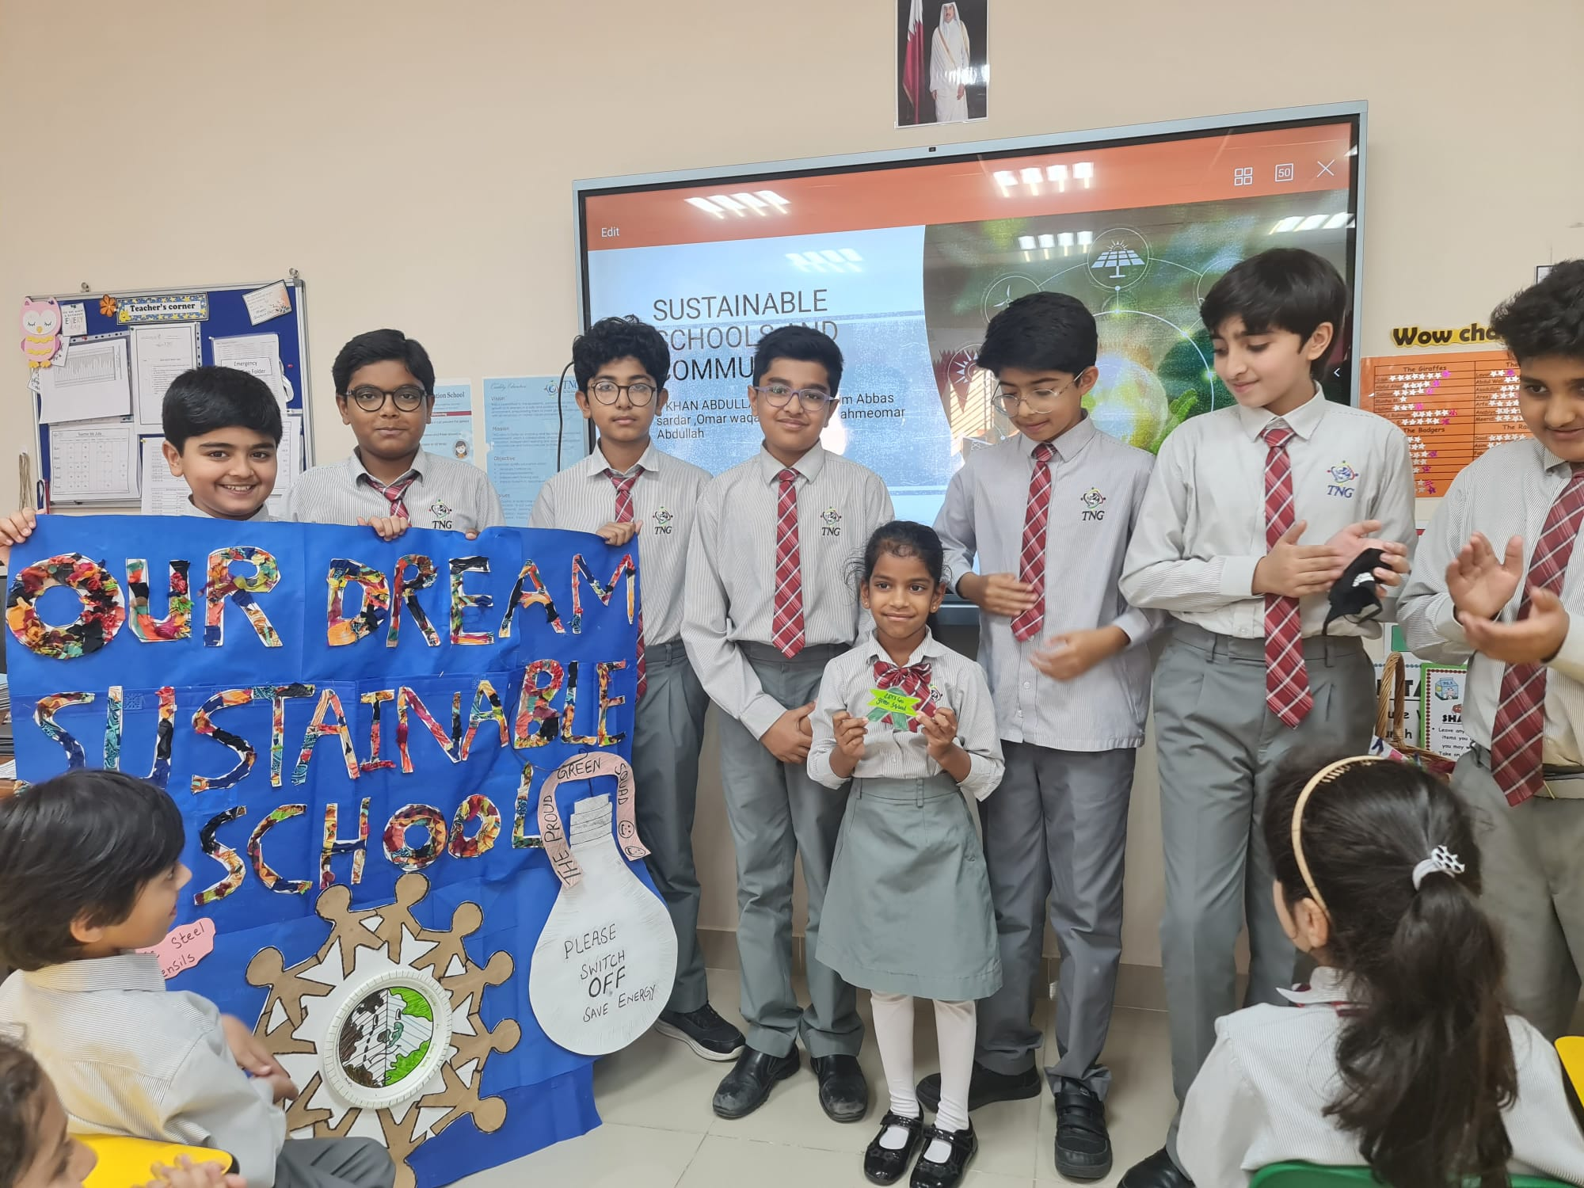
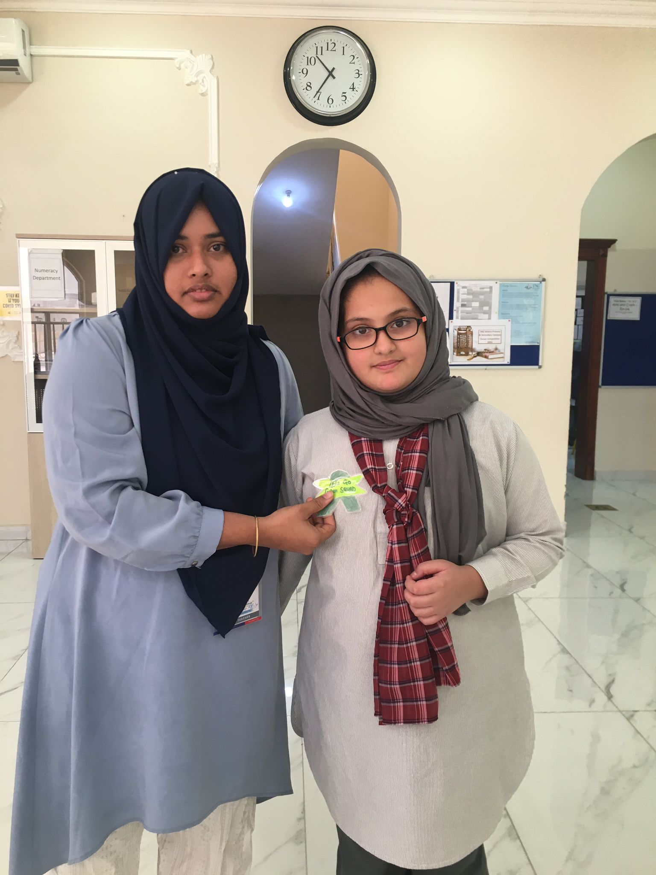
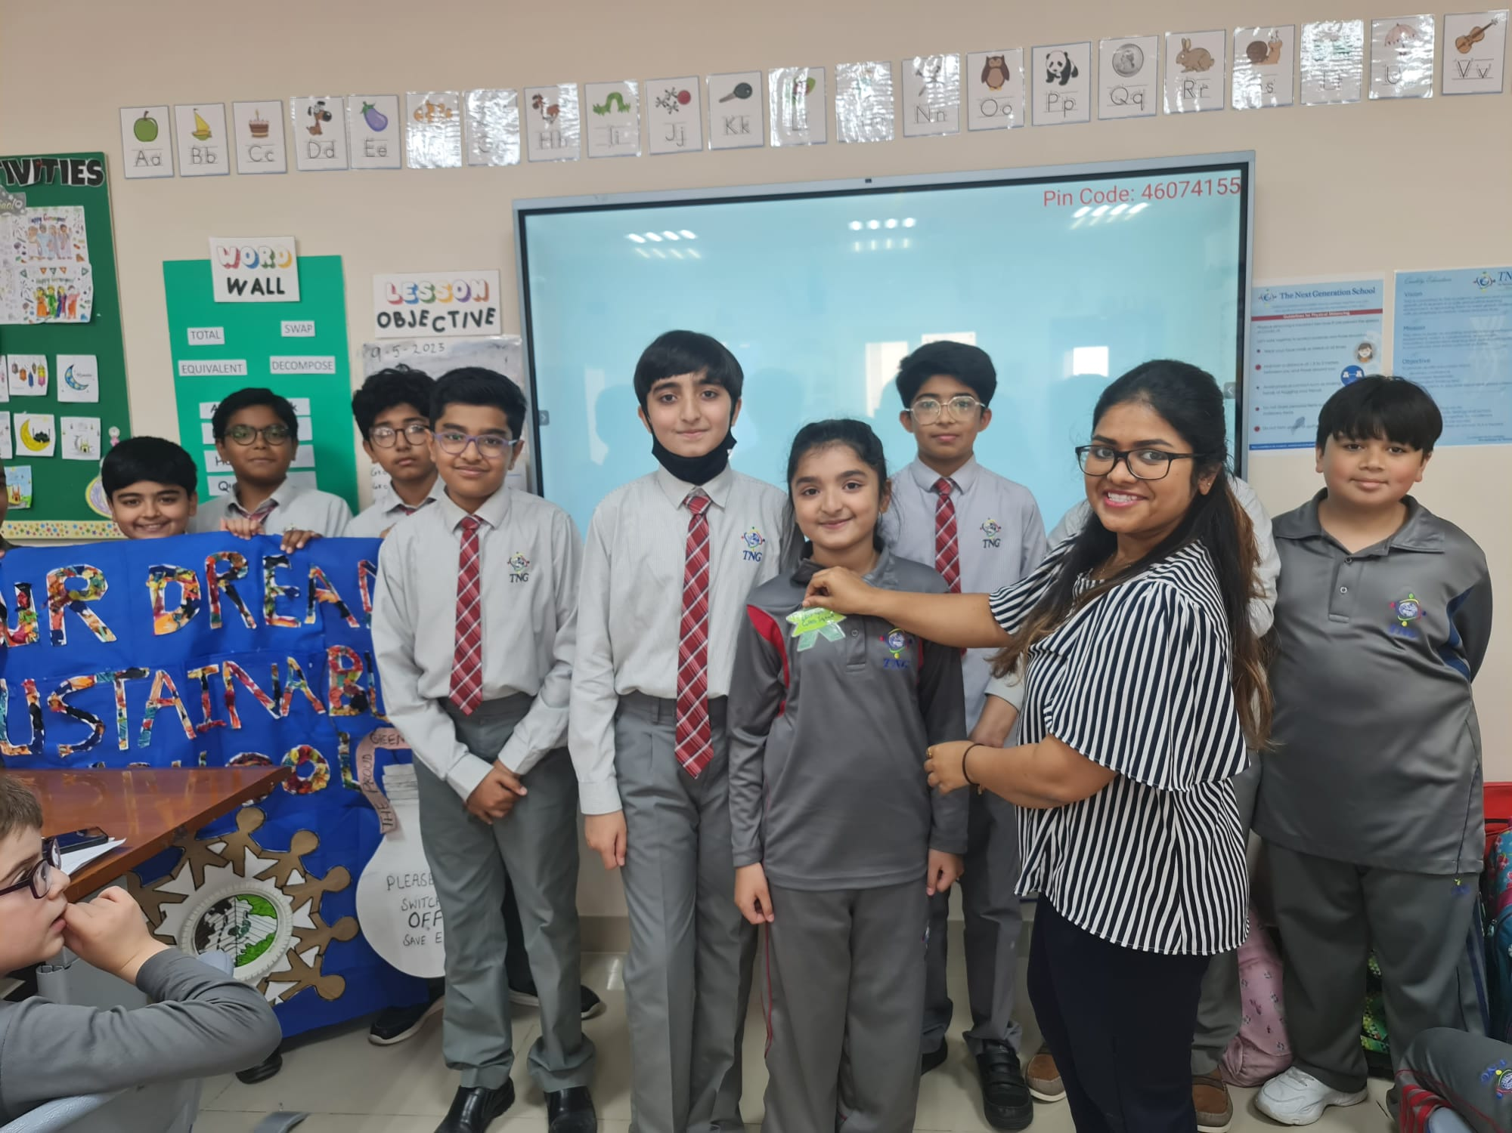
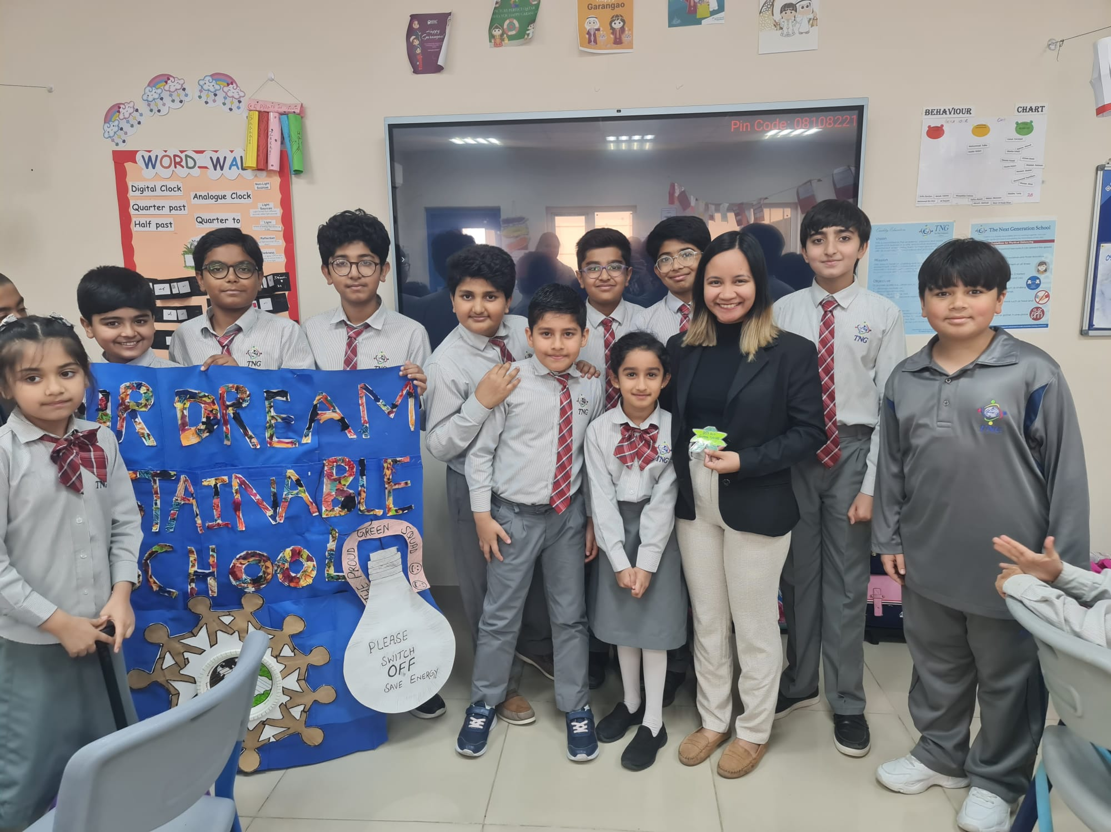
Our Active Green Squad

Slide 22
Meeting with Green Squad Provide checklist to them about actions to be taken Thank you Ms.Maryam Habib for your valuable suggestions and supporting our Green Squad

Slide 23
Campus Transformation 1) No wastage of electricity 2) Planting Trees 3) Replace plastic water bottles and tiffin 4) Understanding and setting up paper recycling booths in coordination with E-lite paper recycling company. 5) Sharing our regular blogs with community to keep them updated with our sustainable practices.

Slide 24
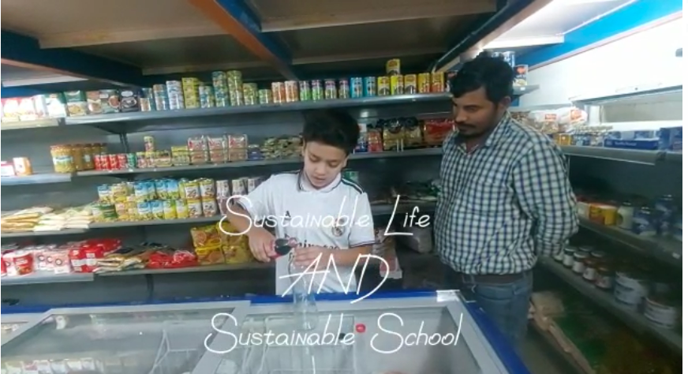
How we started making changes in our daily life...

Slide 25
Covering Community

Slide 26
Our Blog
https://mmustafayasir2011.wixsite.com/buildingabettertomor

Slide 27
Stay motivated
“The environment is where we all meet; where we all have a mutual interest; it is the one thing all of us share.”

Slide 28
Our success
0%
3/10
25
Trying our best to reduce the usage of plastic water bottles and tiffin
Sustainable goals achieved
Number of Plants/trees planted
Will be planted within a week

