Slide 1
HUMAN REPRODUCTION

Slide 2
SEXUAL REPRODUCTION
Specialised sex cells called gametes are produced
Sperm- a mobile male gamete
Egg Cell (Ovum)- stationary female gamete
Fertilisation- when the sperm move to the egg and fuse with it
Zygote-single cell formed by fertilisation

Slide 3
PRODUCTION OF GAMETES
SPERM- the testes
EGGS- the ovaries
MEIOSIS –Division of gametes cells producing 4 haploid cells
Haploid- half the number of chromosome as the original cell
Diploid- full number of chromosome

Slide 4
MALE REPRODUCTIVE SYSTEM

Slide 5
KEY WORDS
sperm duct: a tube that transports sperm from the testis to the urethra
penis: organ containing the urethra, through which urine and sperm are carried
prostate gland: organ that produces a nutritious fluid in which sperm are transported
epididymis: part of the testis in which sperm are stored
testes (singular: testis): organs in which the male gametes (sperm) are made
scrotum: the sac that contains the testes

Slide 6
FEMALE REPRODUCTIVE SYSTEM
http://ib.bioninja.com.au/standard-level/topic-6-human-physiology/66-hormones-homeostasis-and/female-reproductive-system.html

Slide 7
Key Words
ovaries: organs that produce female gametes (eggs)
oviducts: tubes leading from the ovaries to the uterus; also known as Fallopian tubes
uterus: the organ in which a fetus develops before birth; also known as the womb
cervix: a narrow opening leading from the uterus to the vagina
vagina: opening from the uterus to the outside of the body
ovulation: the release of an egg from an ovary

Slide 8
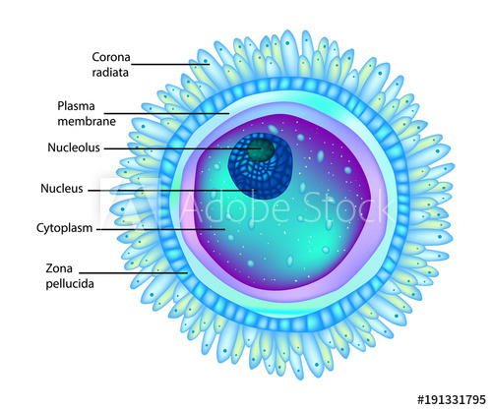
SPERM AND EGG
https://stock.adobe.com/images/structure-egg-cell-or-ovum-plural-ova/191331795
https://www.invitra.com/sperm-cell/structure-and-parts-of-a-sperm-cell/

Slide 9
Key Words
flagellum (plural: flagella): a long, whip-like
'tail' structure found on sperm cells, used for swimming
acrosome: a structure containing digestive enzymes, in the head of a sperm cell

Slide 10
FERTILISATION
https://www.storyblocks.com/stock-image/diagram-of-fertilisation-process-illustration-rumvqkhj3gj0kol6a3

Slide 11
IMPLANTATION
https://www.momjunction.com/articles/pregnancy-implantation_00386827/#gref

Slide 12
Key Words
embryo: the ball of cells that is produced by repeated division of the zygote
implantation: attachment of the embryo to the lining of the uterus

Slide 13
STAGES IN DEVELOPMENT OF EMBRYO
https://www.vectorstock.com/royalty-free-vector/stages-in-human-embryonic-development-vector-1855660

Slide 14
Key Words
placenta: an organ that connects the growing fetus to its mother, in which the blood of the fetus and mother are brought close together so that materials can be exchanged between them
fetus: an unborn mammal, in which all the organs have been formed
umbilical cord: a structure containing blood vessels that connects the fetus to the placenta

Slide 15
The Position of Fetus Before Birth and the Structure of the Placenta
https://getrevising.co.uk/revision-notes/the-placenta

Slide 16
Key Words
amniotic sac: a tough membrane that surrounds a developing fetus in the uterus
amniotic fluid: liquid secreted by the amniotic sac, which supports and protects the fetus

Slide 17
Three Stages to the birth of child
Dilation of the cervix
Delivery of the baby
Delivery of the afterbirth

Slide 18
Sources: Edexcel IGCSE (9-1) Biology (Pearson)
Biology for Cambridge IGCSE Coursebook
Images from Google

