Slide 1
Science - Year 3
Light – Block 3L
Light and Shadows
Session 3
Last Team Standing PowerPoint
© Original resource copyright Hamilton Trust, who give permission for it to be adapted as wished by individual users.
We refer you to our warning, at the foot of the block overview, about links to other websites.

Slide 2
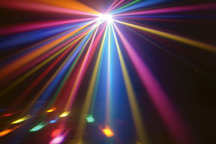
Last Group Standing!
Play this team game in your theatre group. Together, choose an answer to each question and all stand either to the left or the right of the line, depending on your choice.
If you are correct, stay standing ready to answer the next question, if you are wrong, all sit down – you are out for now!

Slide 3
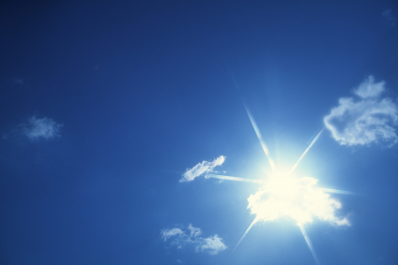
Some questions are easy and some are hard. If you are not sure, discuss it in your team and together give it your best guess! If all the teams are out, the whole class stands up and everyone is back in again! The teams standing at the end, win the game!

Slide 4
1. A light source…
generates light
reflects light

Slide 5
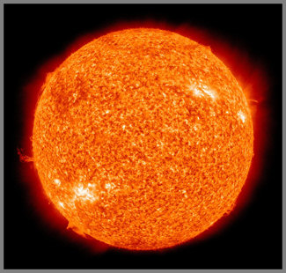
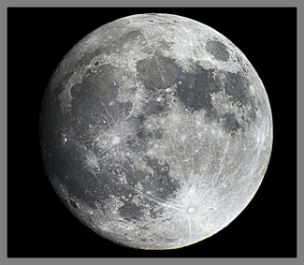
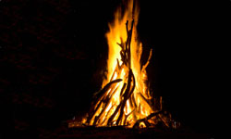
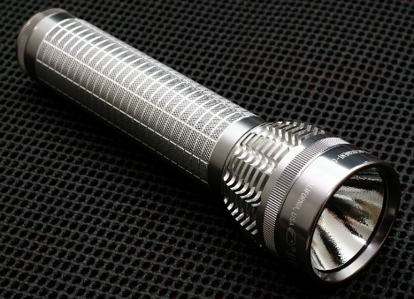
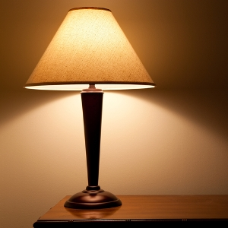
2. These are all light sources except for…
the fire
the moon

Slide 6
3. The moon does not make any light of its own but instead it
reflects the light of the sun
respects the light of the sun

Slide 7
4. The sun is in fact …
an average sized star
a giant planet

Slide 8
5. Looking directly at the sun is …
a bit risky
extremely dangerous

Slide 9
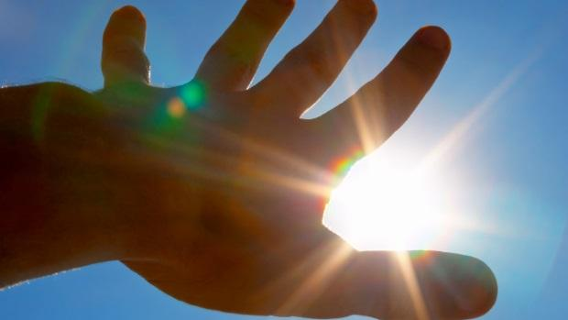
6. This is because the sun gives out more power than our eyes can handle. Looking at the sun, even for a moment can
hurt
cause blindness

Slide 10
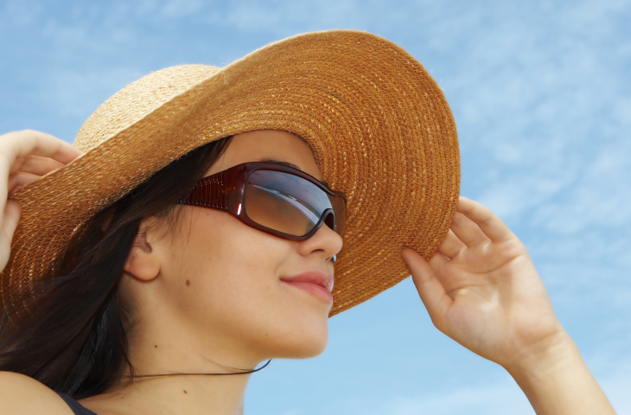
7. Sunlight does not just contain visible light, it also contains light energy which is invisible to humans, a powerful type of light energy called …
Ultra-violet (UV) light
Ultra-mauve (UM) light

Slide 11
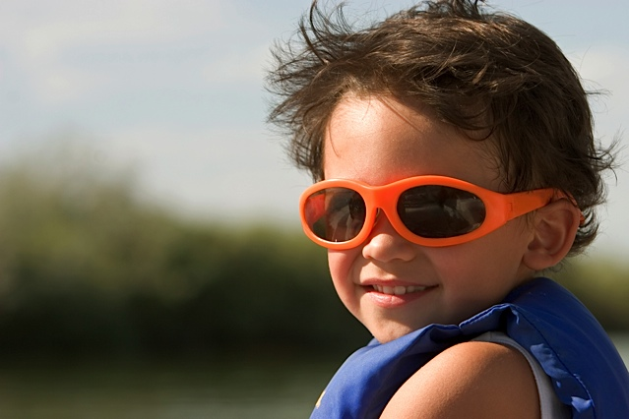
8. Ultra-Violet light can damage your skin and also your …
eyes
hair

Slide 12
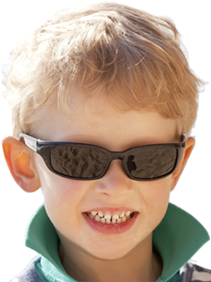
9. Remember you should never look at the sun even if you are wearing sunglasses. But if you are out playing in strong sunlight they can protect your eyes from UV damage. For maximum safety always choose glasses …
With 100% UV protection
With plastic lenses

Slide 13
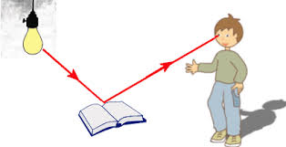
10. When light shines from a source, it bounces off objects. This is called …
Refraction
Reflection

Slide 14
11. Some colours reflect more light than others. Here are some colours that are good reflectors of light

Slide 15
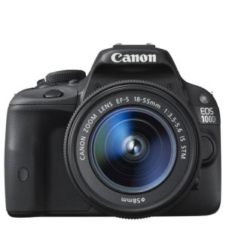
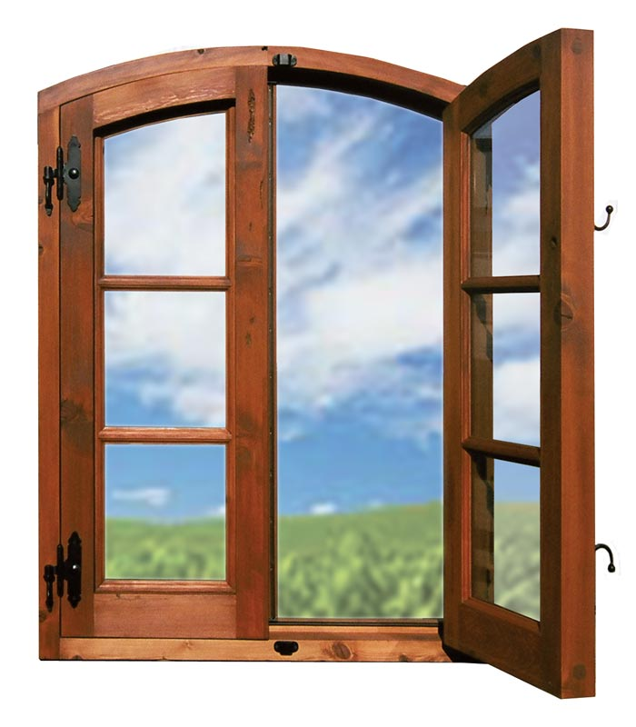
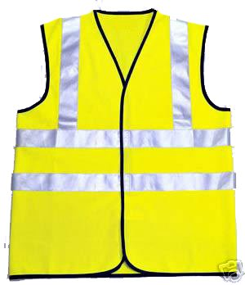
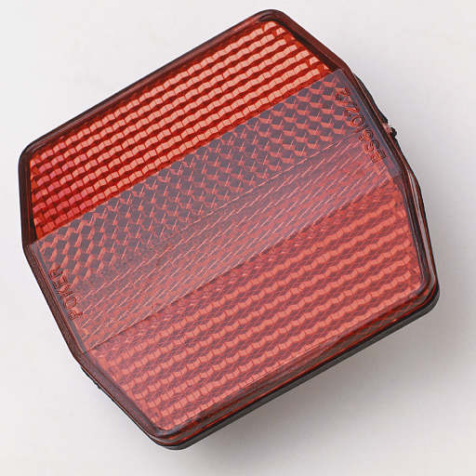
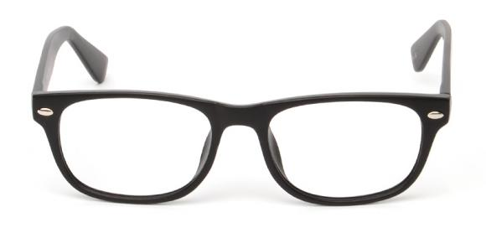
12. These objects are designed to reflect a beam of light

Slide 16
13. We see things when…
light from our eyes reflects off an object
light that is reflected from an object enters our eyes

Slide 17
End of Game!
Congratulations all teams that are still standing!

