Slide 1
Week 29
Lesson 1
5.6 Investigating Shadow Length

Slide 2
Learning objectives
By the end of the lesson, learners will be able:
To know how shadows are formed.
To explain changes in shadow in terms of Earth spinning on its axis.
To make predictions about a scientific enquiry.

Slide 3
Qatar National Identity
Shadows formed by beautiful architecture in Qatar.
Burj Doha

Slide 4
Key Vocabulary

Slide 5
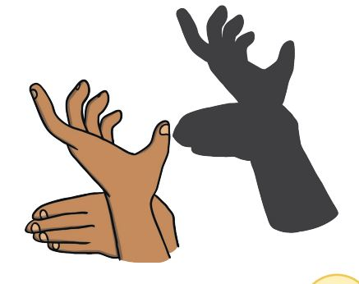
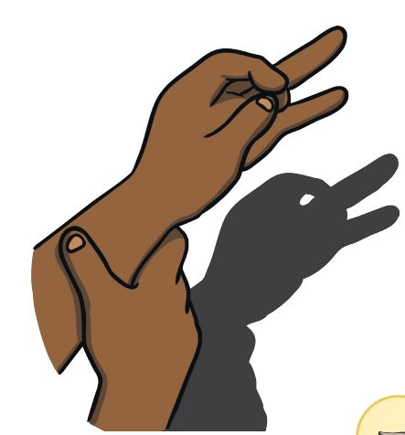
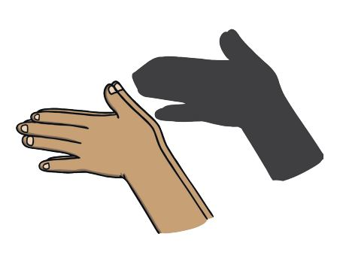
Animal puppet hand shadow

Slide 6
Hook activity-Class Discussion
What is the source of light here?
How shadows are formed?
What kind of material is the hand- opaque or transparent?
Where did the shadows formed- in the same side of the source or the opposite side of the source?

Slide 7
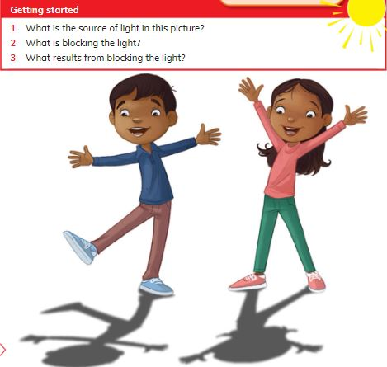
Pair Work

Slide 8
Teacher Feedback Time

Slide 9
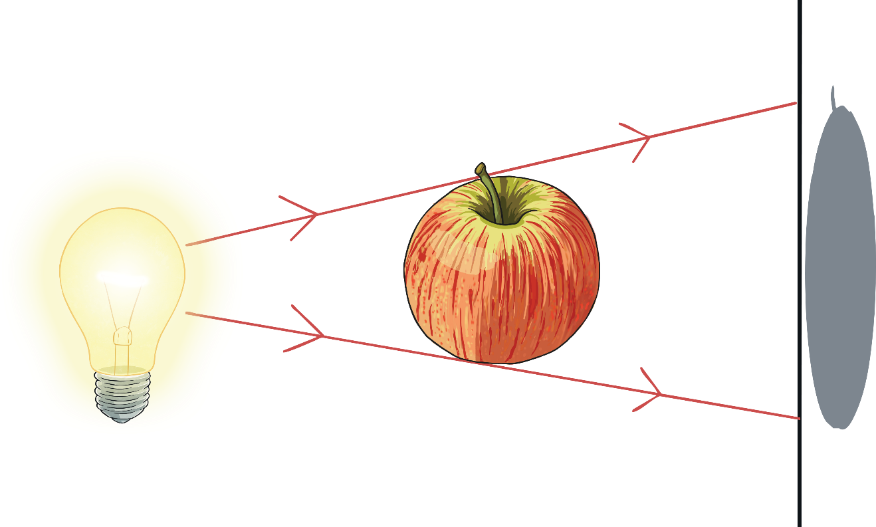
Shadows
Shadows are created when a source of light shines on an object but the light is blocked and does not pass through it.
shadow formed on the screen
object
light source
screen

Slide 10
Opaque
When light will not pass through an object.
When an object allows some light to pass through it.
Translucent
When light passes through an object.
Transparent

Slide 11
https://youtu.be/lOIGOT88Aqc

Slide 12
Apparent movement

Slide 13
Group discussion

Slide 14
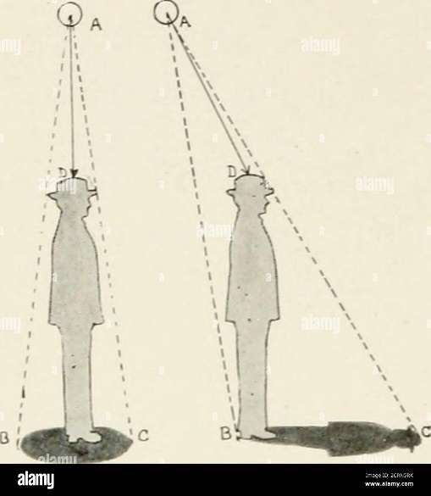
Extension Tasks
Team 1
Team 2 and 3
Draw the shadows of different objects like pencil/pen, bottle, pen stand etc on the paper.
Flash the light on the left side of the object, then top of the object and finally the right side of the object.
Trace the shadow formed on to the paper.
Draw a picture of yourself
Draw the shadows that will form when the sun is in different positions- left side, over the head and right side.

Slide 15
Explanation about next session’s scientific investigation-Think like a scientist

Slide 16
https://wordwall.net/resource/43360/science/light-and-shadow-quiz

Slide 17
Homework
Complete the homework worksheet.

