Slide 1
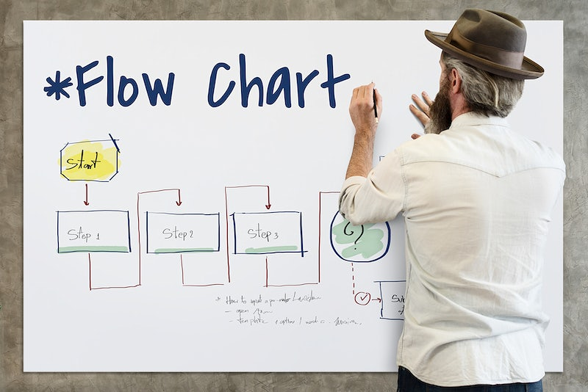
Unit 1- Go with the flow Predict the outcome of the flowchart
Year 6 Week 19 Day2

Slide 2
Learning objective
By the end of the lesson students will be able to analyse and predict the outcomes of flowcharts after having the class discussion and completing the practical task using MS Word.

Slide 3
Key Vocabulary
Flowchart symbols, Input, Output, Process, Outcomes

Slide 4
Big Question
What is the significance of a flowchart?

Slide 5
Hook Activity – Group (10 mins)
7 mins-Think-Pair-Share
Ask learners if they can predict the animal that is being described. Slowly list the facts about each animal, taking answers as they come.
• This bird lives in Antarctica. It cannot fly but it can swim. It eats fish.
• This animal can be found on farms. It is small and has feathers. They are farmed for their eggs.
• This animal is a reptile with short legs. It has a long tail and strong jaw. It can swim very fast. It is found in Africa, America, Asia and Australia. It has very sharp teeth.
•This animal lives in the ocean. It is very intelligent. It can expel ink and change colours. It is venomous and eats fish. It has eight arms.
2 mins-Critical Thinking
﻿Ask what strategy did they use to solve the animal puzzle
Learners should understand that they carefully compared the given facts with knowledge about different animals.
1mins-Teacher talking time
A similar approach is used when trying to predict the outcome of a flowchart. They need to carefully follow the instructions in the flowchart to come to the correct conclusion. As we acquire more information from each step in the flowchart our prediction becomes more accurate. If we do not read the flowchart correctly, or fully understand each step, then our prediction will be incorrect.

Slide 6
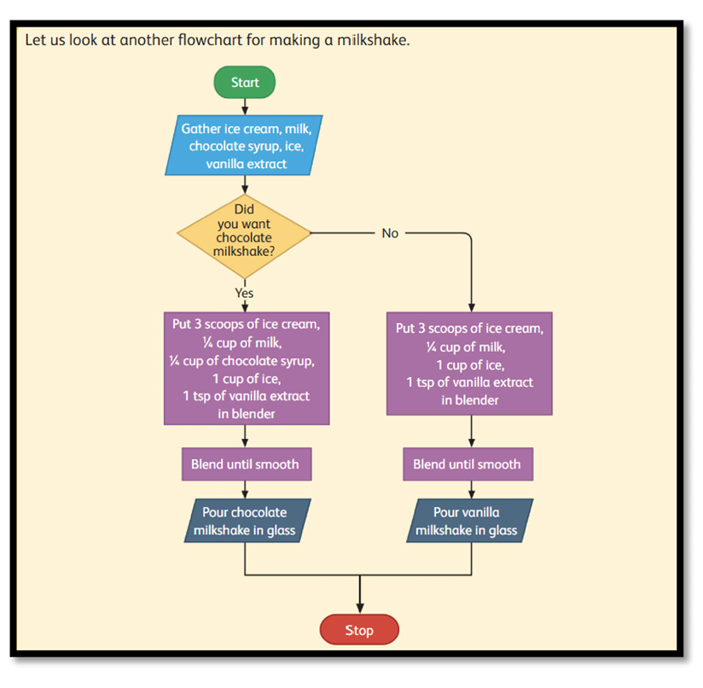
Main Activity Discussion–
5 mins-Visual Aid
Teacher will display the flow chart on the smart board and the students will predict the output by discussing their pair.
Teacher will randomly select the students and jot down the answers as their responses.

Slide 7
Main Activity
10 mins- Discussion
Ask learners to cover up each flowchart in the Learner's Book, and then reveal and read aloud each step. The class can discuss what they think happens in each Milkshake Flowchart. Learners can uncover the answers to see if they were correct.
Teacher then will explain them the different terms as reinforcement of the previous unit-
1)Linear chart
2)Flowchart with a loop
3)Flowchart with the decision
30 mins- Peer activity
Students will discuss with their peer and complete the Practical worksheet 7 using MS Word.

Slide 8
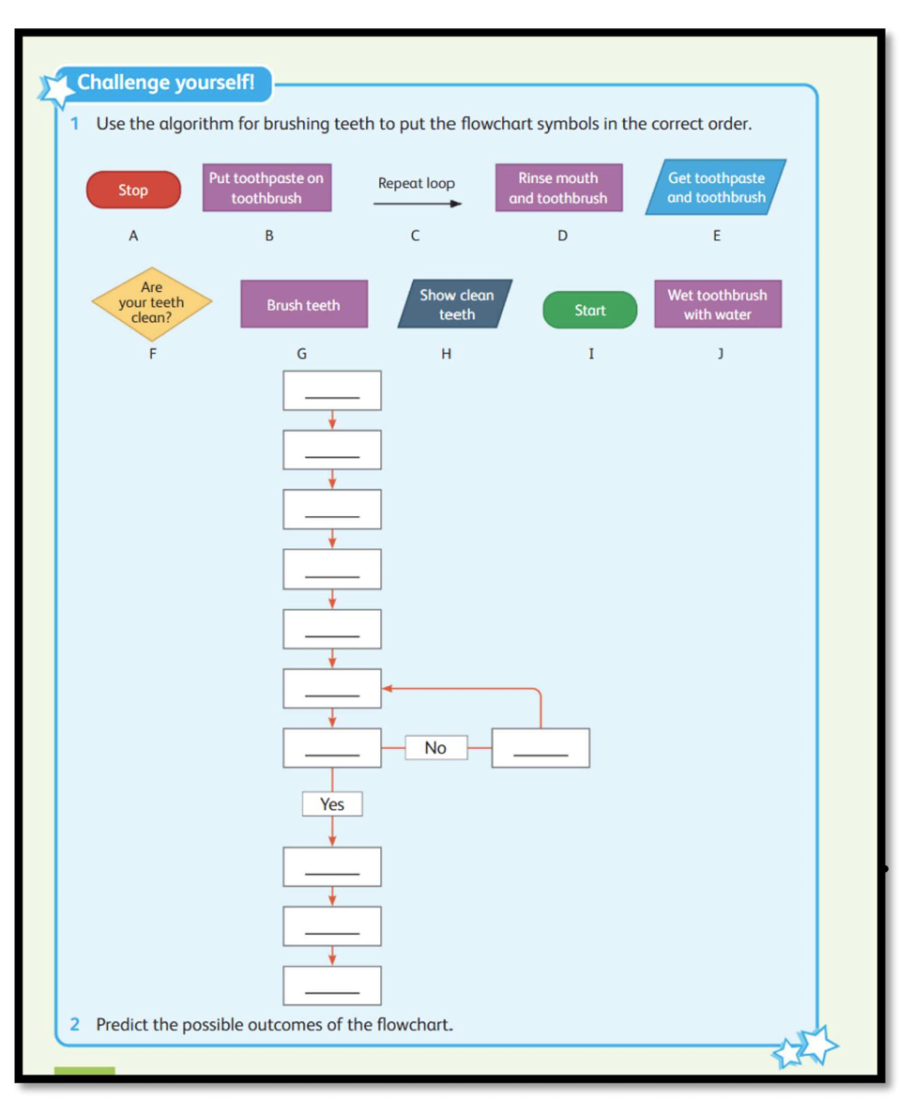
Extension Task

Slide 9
Plenary
Just a min-
Summarise in short how did they predict the outcomes using the flowchart?
Meanwhile others will note it down in the sticky note.

