Slide 1
Find The
Treasure!

Slide 2
Choose a chest!
1
2
3
4
5
6
7
8

Slide 3
Barcode reader is an automatic device
True / False

Slide 4
Biometric devices cannot identify a person based on features of their body
True / False

Slide 5
Computer software can be affected by virus.
True / False

Slide 6
A spreadsheet is made up of only rows.
True / False

Slide 7
In a spreadsheet, $10 is the format of currency.
True / False

Slide 8
There are 2 categories of hardware devices.
True / False

Slide 9
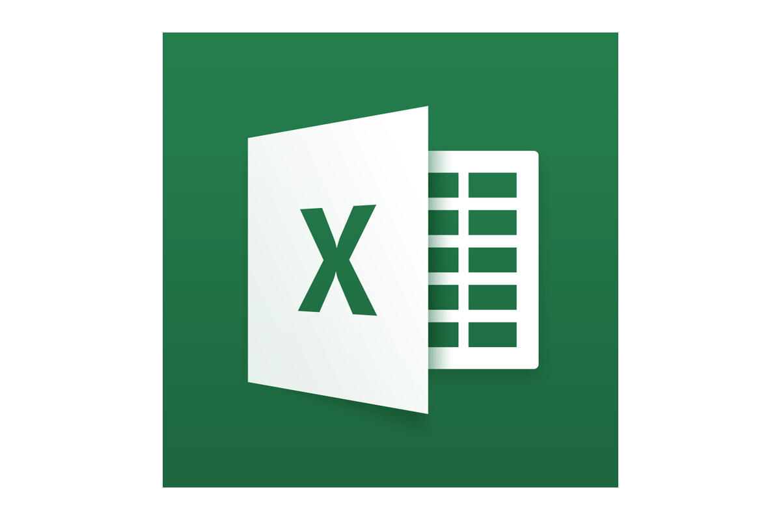
Name the Logo shown.
MS - Excel

Slide 10
Can a spreadsheet be formatted or changed according to our requirements.
True / False

Slide 11
Yeyyy!

