Slide 1
Science - Year 3/4B Autumn 1
Rocks
This Planet Rocks
Session 3
Last One Standing PowerPoint
© Original resource copyright Hamilton Trust, who give permission for it to be adapted as wished by individual users.
We refer you to our warning, at the foot of the block overview, about links to other websites.

Slide 2
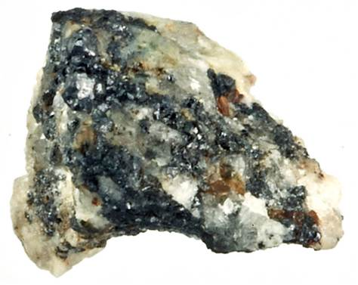
Last One Standing!
Choose an answer to each question and stand either to the left or the right of the line, depending on your choice.
If you are correct, stay standing ready to answer the next question. If you are wrong, sit down – you are out for now!

Slide 3
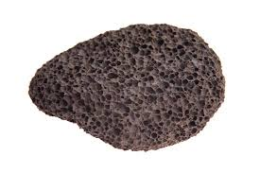
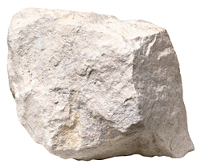
There are 11 questions. Some are easy and some are hard. If you are not sure, give it your best guess! If everyone is out, the whole class stands up and everyone is back in again! All those still standing at the end, win the game!

Slide 4
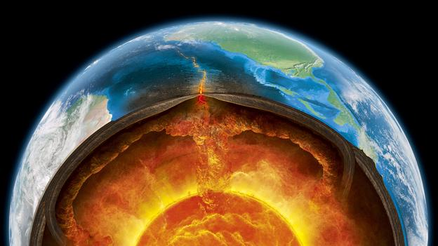
1. Deep within the earth there is molten (melted) rock called
Magma
Pumice

Slide 5
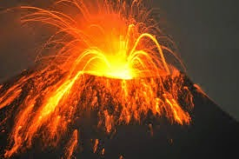
2. When magma comes to the surface or near the surface, it cools down to form rock. This type of rock is called
Igneous rock
Sedimentary rock

Slide 6
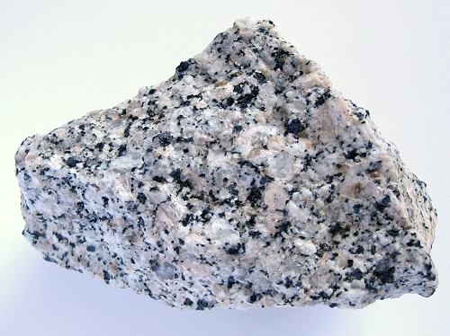
3. Igneous rocks can have lots of crystals in them which makes them
soft and crumbly
hard and strong

Slide 7
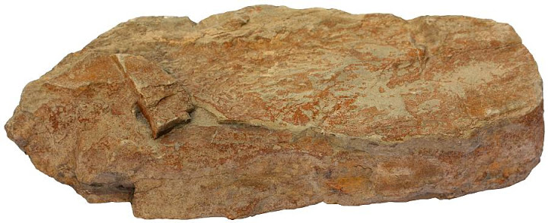
4. A different type of rock is formed when mud and the bodies of dead creatures
sink to the bottom of the sea in layers
build up in heaps

Slide 8
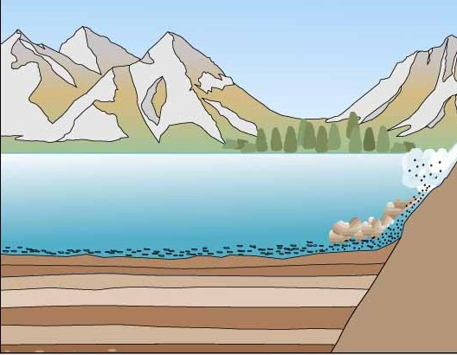
5. The layers gradually turn to stone after
A couple of centuries
Millions of years

Slide 9
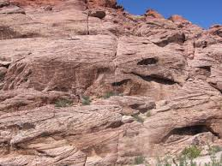
6. This type of rock is called
sedimentary rock
layered rock

Slide 10
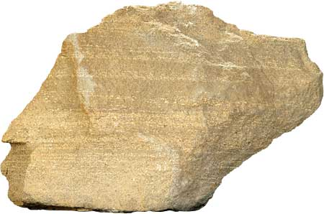
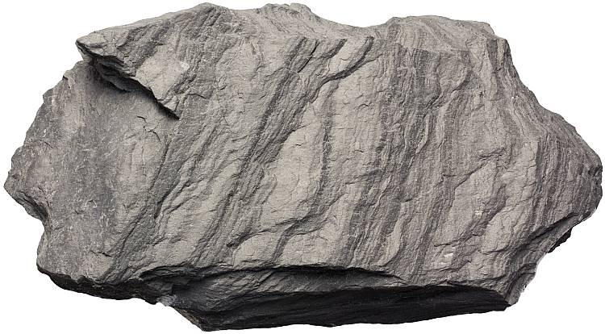
7. An example of sedimentary rock is
sandstone
slate

Slide 11
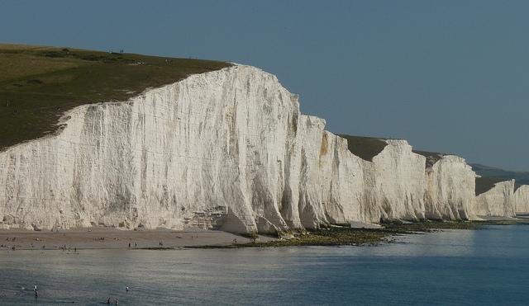
8. Sedimentary rocks are often
hard and strong
soft and crumbly

Slide 12
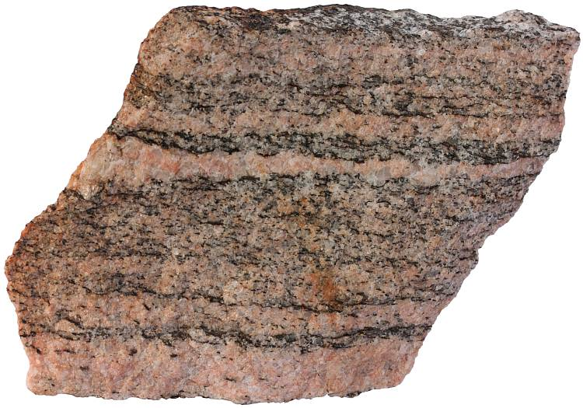
9. Sometimes Igneous and sedimentary rocks can be changed to make a new kind of rock called
Metamorphic rock
Megaheated rock

Slide 13
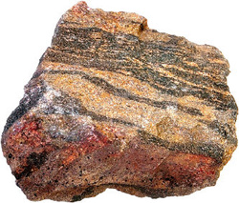
9. Metamorphic rocks are formed when there is a lot of
ice and snow
heat and pressure

Slide 14
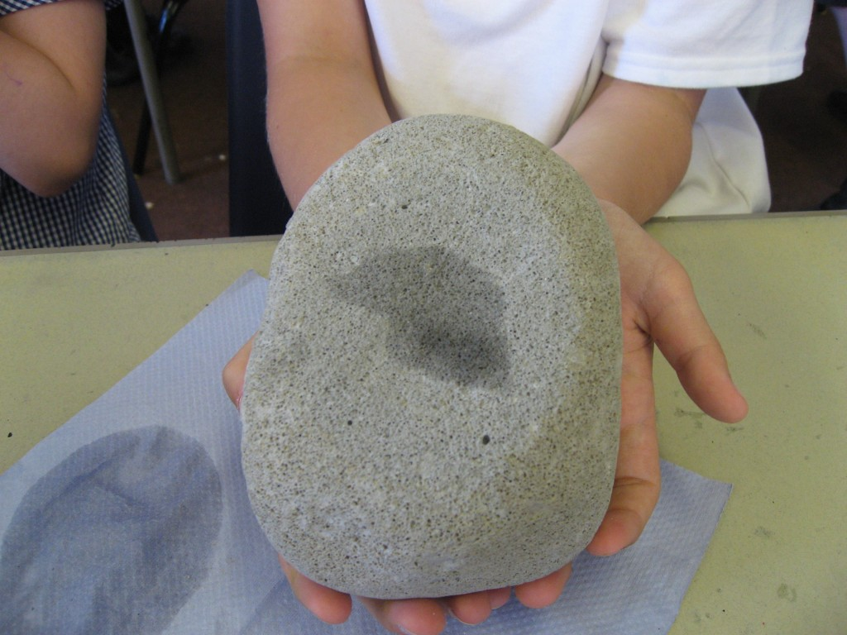
10. Some rocks allow water to soak into them. These rocks are said to be
permeable
impermeable

Slide 15
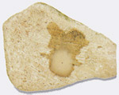
11. If a rock fizzes when acid is dripped onto it, it was probably formed from
the shells of creatures that lived long ago
different crystals

Slide 16
End of Game!
Congratulations to all of you who are still standing!

