Slide 1
Typing

Slide 2
Can You Type Your Name?
Did you use 2 hands?
Did you remember a capital letter?
How did you type the capital letter?
What did you do at the end of each line?
How many spaces did you use between each word?
Type your name and a sentence or two about yourself.

Slide 3
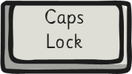
Upper and Lower Case
Always use 2 hands on the keyboard
2. Hold down the shift key for one or two capital letters.
3. Only use CAPS LOCK FOR LOTS OF CAPITALS.
Remember
CAPITALS on a computer is regarded as shouting.

Slide 4
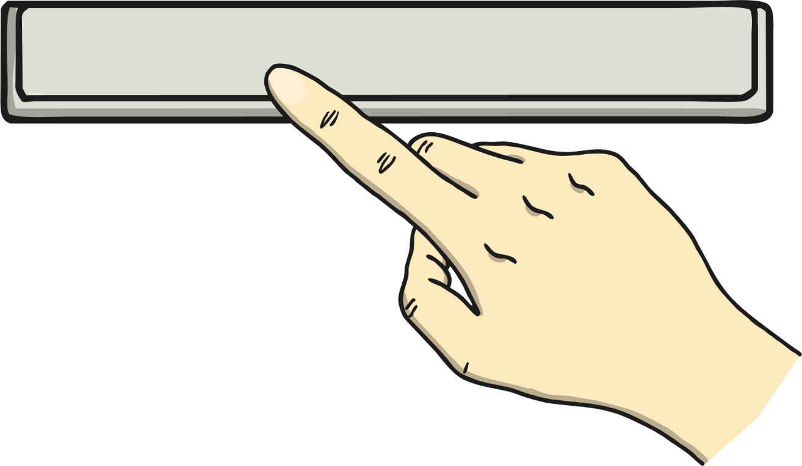
Space
Press the space bar once after each word and full stop.

Slide 5
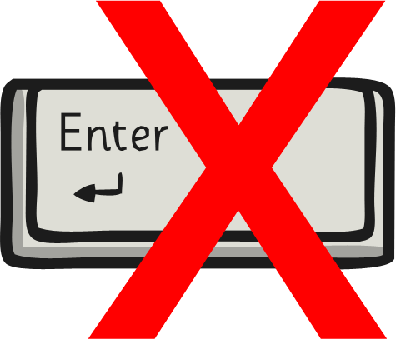
At the End of a Line…
Carry on typing at the end of a line…
… unless it’s the end of a paragraph, a title, a list or a poem.

Slide 6
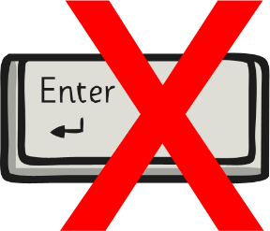
And Now For Some Sentences…
Remember:
2 hands.
Hold shift for capitals.
One space.
Keep on typing at the end of a line.

Slide 7
What Skills Have You Learnt Today?
Can you remember the key skills from this lesson?

Slide 8
Aim
I can type on a keyboard.
Success Criteria
I can use two hands to type.
I can use one space between words.
I can keep typing at the end of a line.
I can use the shift key for capitals.

