Slide 1
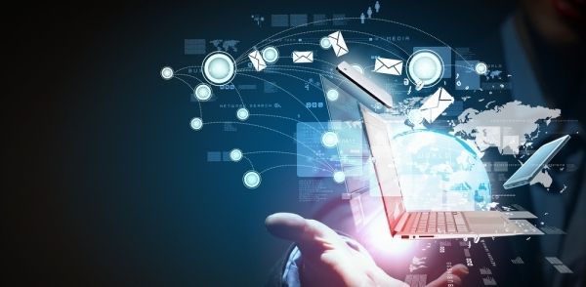
CHAPTER 5
THE EFFECTS OF USING IT

Slide 2
Objective
TO KNOW AND UNDERSTAND ABOUT THE EFFECTS OF MICROPROCESSOR CONTROLLED DEVICES

Slide 3
MICROPROCESSOR CONTROLLED DEVICES
EFFECTS OF USING DEVICES IN THE HOME
POSITIVE AND NEGATIVE EFFECTS ON
LIFESTYLE LESIURE TIME PHYSICAL FITNESS
DATA SECURITY SOCIAL INTERACTION

Slide 4
HOUSE HOLD DEVICES FITTED WITH MICROPROCESSORS
TWO GROUPS
LABOUR SAVING DEVICES (GROUP 1)
OTHER DEVICES (GROUP 2)

Slide 5
LABOUR-SAVING DEVICES (GROUP 1)
AUTOMATIC WASHING MACHINE
MICROWAVE OVENS
COOKERS
AUTOMATIC DISHWASHERS
ROBOTIC VACCUM CLEANERS
BREAD MAKING MACHINES
SMART FRIDGES AND FREEZERS

Slide 6
LABOUR SAVING DEVICES (GROUP 1)

Slide 7
OTHER DEVICES (GROUP 2)
ALARM CLOCKS
TELEVISION SETS
CENTRAL HEATING AAND AIR CONDTIONING SYSTEMS
HOME ENTERTAINMENT SYSTEMS
MOBILE PHONES AND TABLETS

Slide 8
IMPORTANCE
Allows people to get on with other things while the device carries out their tasks
Intelligent tuning-additional feature given to the television sets.

Slide 9
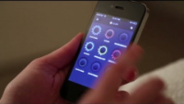
Advantages of microprocessor – controlled labour saving devices
No manual tasks
More time for leisure activities, hobbies and socializing
No need to stay while cooking or washing
Contol home appliances by using mobile phones
Automated burglar alarms
Using of Small fridges and freezers reduce the food wastage

Slide 10
Disadvantages of microprocessor – controlled labour saving devices
Lack of exercises
Make people lazy
Lose household skills
Cybersecurity threats

