Slide 1
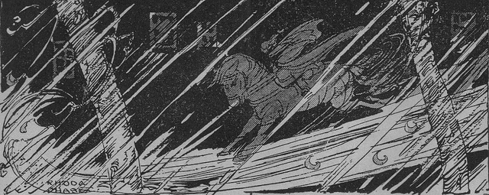
Adding description using conjunctions and prepositions

Slide 2
Clauses
Clauses are groups of words with an active verb and a subject; they make sense.
We built a ship on the stairs.
Tom fell out.
The moon shines on streets and fields.
Children close their eyes.
The subject is ‘the doer’ of the verb; it can be a noun or pronoun.

Slide 3
Conjunctions are joining words
They help add more detail by joining new clauses…
explaining where, when or why something happened.
Where?
where
wherever
When?
before
after
when
while
as
until
whenever
The moon shines on streets where children close their eyes.
We built a ship on the stairs before Tom fell out.
Tom hurt his knee so there was no one left but me.
Each of these sentences are made from two clauses linked by a conjunction.
Why?
because
as
so

Slide 4
Conjunctions are joining words
Where?
where
wherever
Whenever the moon and stars are set,
Whenever the wind is high,
All night long in the dark and wet,
A man goes riding by.
When?
before
after
when
while
as
until
whenever
Why?
because
as
so
Can you spot the conjunctions?
Which is the main clause?

Slide 5
Conjunctions are joining words
Where?
where
wherever
Whenever the moon and stars are set,
Whenever the wind is high,
All night long in the dark and wet,
A man goes riding by.
When?
before
after
when
while
as
until
whenever
Why?
because
as
so
Can you spot the conjunctions?
Which is the main clause?

Slide 6
Conjunctions are joining words
Where?
where
wherever
Whenever the moon and stars are set,
Whenever the wind is high,
All night long in the dark and wet,
A man goes riding by.
When?
before
after
when
while
as
until
whenever
Why?
because
as
so
Can you spot the conjunctions?
Which is the main clause?

Slide 7
Conjunctions can add detail
When?
before
after
when
while
as
until
whenever
When?
A clause
A girl goes dancing by.
A girl goes dancing by before the sun sets.
A girl goes dancing by while the stars twinkle.
A girl goes dancing by whenever lively music plays.
The main clause
conjunction
added clause
We can swap the clauses around…
starting the sentence with the conjunction.
Week 2 Tuesday Grammar 3

Slide 8
Conjunctions can add detail
When?
before
after
when
while
as
until
whenever
When?
A clause
A girl goes dancing by.
A girl goes dancing by before the sun sets.
A girl goes dancing by while the stars twinkle.
A girl goes dancing by whenever lively music plays.
Whenever lively music plays, a girl goes dancing by.
conjunction
added clause
The main clause
We can swap the clauses around…
starting the sentence with the conjunction.
What do you notice about the punctuation?

Slide 9
Opening with a conjunction
Identify the two clauses in each sentence.
Swap the order to open with a conjunction.
When?
before
after
when
while
as
until
whenever
When?
A cat goes slinking by when the dish is rattled.
When the dish is rattled, a cat goes slinking by.
A cat goes slinking by before the dog wakes up.
Before the dog wakes up, a cat goes slinking by.
A cat goes slinking by whenever darkness falls.
When you open with a conjunction, separate the clauses with a comma.
Whenever darkness falls, a cat goes slinking by.

Slide 10
Phrases
A phrase is a group of words which adds meaning to a sentence.
over the moor
in the air
till teatime
for days and days
There is no active verb in a phrase; it does not make sense on its own.

Slide 11
Prepositions
Prepositions tell us how words are related.
Prepositions link a phrase to a sentence.
Where?
inside
outside
between
over
under
from
above
with
When?
before
in
during
while
for
at
after
until/till
The wind is howling
over the moor.
I like to swing
in the air.
We played
till teatime.
We sailed along
for days.

Slide 12
Where?
When?
Prepositions
inside the bedroom
under the bed
before bedtime
in the evening
outside the window
while everyone slept
Are these prepositional phrases telling you where or when?

Slide 13


This is a Hamilton Trust Presentation. For more fantastic resources visit our website
https://www.hamilton-trust.org.uk/ .

