Slide 1
Owners of a company are called shareholders
Companies are jointly owned together by the people who have invested in it. They all have SHARES in the company.. Hence the name: shareholders.

Slide 2
There are two types of companies with shareholders:
PRIVATE LIMITED COMPANIES
PUBLIC LIMITED COMPANIES

Slide 3
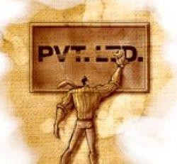
These types of companies tend to be owned by either family or friends and are quite often not that much larger in size than a sole trader or partnership.
Name of the business ends in ‘Limited’ or ‘Ltd’
The owners are called shareholders, each holding a share of the business.
They invest capital into the business
Have a say in the running of the business
Share the business profits
Shares cannot be sold or transferred to anyone else without the agreement of the other shareholders.
Shares are therefore not offered to the public.

Slide 4
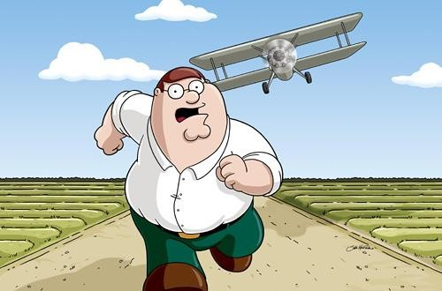
All shareholders have limited liability. They are only liable for the limited amount that they have invested.
Even if my debtor asks
for the payment,
they are not allowed to sell my car
or house to get their money back.
I am only losing what I initially
invested in the business!

Slide 5
1. The Articles of Association
2. The Memorandum of Association
Contains the rules under which the company will be
Contains extremely
important information
about the company and the
managed
directors.
It states
company
🞄 The rights and duties of all the directors
🞄 The rules concerning the
election of directors
🞄 The holding of official meetings
🞄 Procedure to be followed for the issuing of shares
The address of the registered
offices of the company
The objectives of the company
Amount of share capital that
the directors intend to raise
The number of shares to be
bought by each of the

Slide 6
Advantages
Disadvantages
1. Selling shares to a large number
1.
Significantly larger amount of legal
of people will raise large
paperwork to be filed before the
2. All shareholders have limited
2.
Shares cannot be transferred or sold to anyone else without the agreement of all other shareholders, hence causing
liability.
3. The company is a separate legal
investors to be reluctant before spending
capital.
identity from its shareholders.
3.
Secrecy decreases as the accounts of the business are now privy to more people. Each year, they must be sent to the Registrar of Companies for inspection.
4. The people who started the
business can still maintain
control of the business as long
as they do not sell shares to many other people.
4.
The company cannot offer its shares to
the general public, so less funds will be

Slide 7
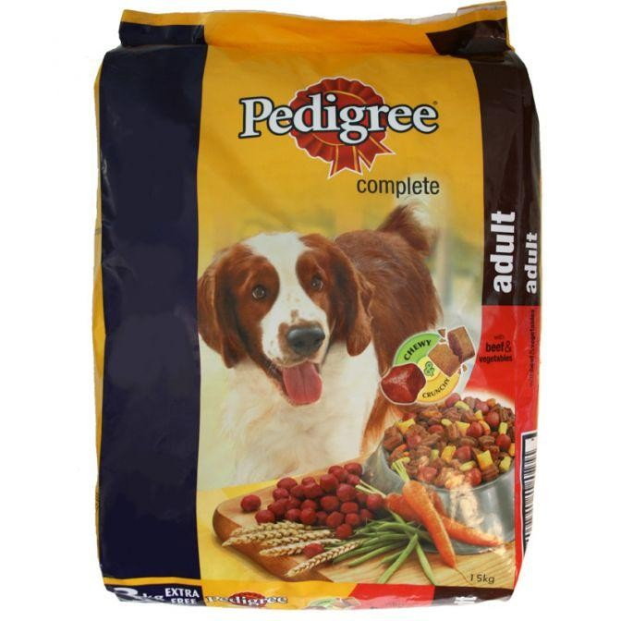
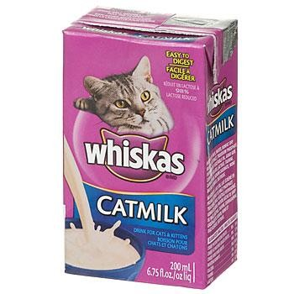
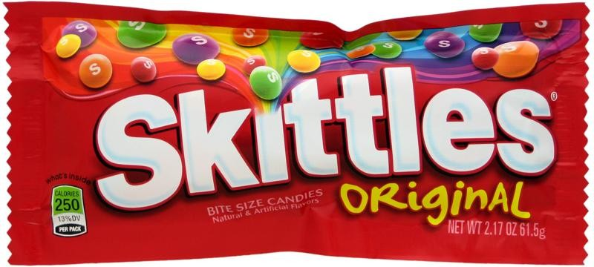
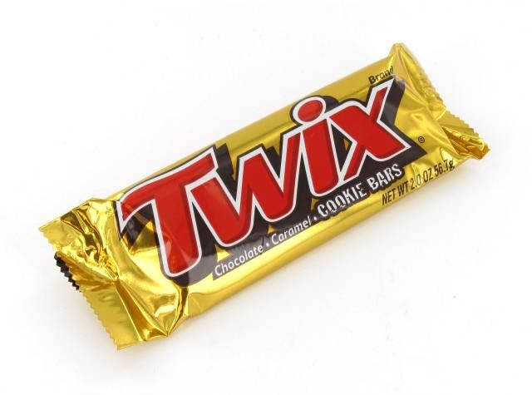
Master Foods (MARS Ltd)

Slide 8
Mike and Gita discussed these advantages and disadvantages together with their lawyer who told them that private limited companies are very suitable in certain situations…
Family businesses
Partnerships who wished to expand but still maintain
some control over the business
Firms who find that the amount of capital that they
can raise is sufficient amongst family and friends.

