Slide 1
Measures
Tell the time to ¹/₄ hour
Begin to tell to 5 mins
Objectives
Day 1
Read time on digital and analogue clocks to the half hour.
Day 2
Order time to the half hour, using digital and analogue clocks.
Day 3
Read time on analogue clocks to nearest quarter hour.
Day 4
Tell the time to the nearest quarter hour. Begin to tell the time to the nearest five minutes.
Notes:
Before teaching, be aware that:
On Day 1 children will need mini-whiteboards and pens, you can use a geared teaching clock or ITP ‘Tell the time’ to provide further examples.
On Day 2 children will need mini-whiteboards and pens.
On Day 3 children will need a paper circle, whiteboards and pens.
On Day 4 you can use a geared teaching clock or ITP ‘Tell the time’ to provide further examples.

Slide 2
Measures
Tell the time to ¹/₄ hour
Begin to tell to 5 mins
Starters
Day 1
Halves and quarters (pre-requisite skills)
Day 2
Read o’clock and half past times (analogue) (pre-requisite skills)
Day 3
Tell time to the quarter hour (pre-requisite skills)
Day 4
Match digital times to analogue (pre-requisite skills)
Notes:
Choose starters that suit your class by dragging and dropping the relevant slide or slides below to the start of the teaching for each day.

Slide 3
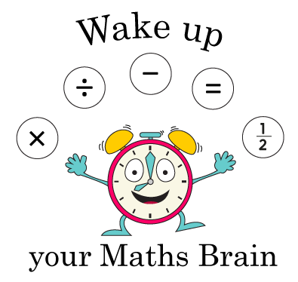
Measures
Tell the time to 1/4 hour
Begin to tell to 5 mins
Starter
Halves and quarters
Notes:
Pre-requisite skills – to use this starter, drag this slide to the start of Day 1
Display or draw a variety of squares, rectangles and circles on the board and divide each into 2 or 4 parts, some equal, some not. Which of these are divided into halves/quarters and which are not? How do you know? Give each pair of children a piece of squared paper. One child draws a shape, the other shades 1/2 or 1/4. If the first child agrees, the second child wins a cube. Swap and repeat.

Slide 4
Measures
Tell the time to 1/4 hour
Begin to tell to 5 mins
Starter
Read o’clock and half past times (analogue)
Notes:
Pre-requisite skills – to use this starter, drag this slide to the start of Day 2
Give each pair a number fan and 2 cards: ‘o’clock’ and ‘half past’. Draw half past 7 on the Hamilton clock (see resources). Children work in pairs to use their number fan and cards to show you the time when you say ‘Show me!’ Repeat with other o’clock and half past times.

Slide 5
Measures
Tell the time to 1/4 hour
Begin to tell to 5 mins
Starter
Tell time to the quarter hour
Notes:
Pre-requisite skills – to use this starter, drag this slide to the start of Day 3
Show children a large clock. Briefly recap the fact that a clock can be divided into 4. Recap o’clock, quarter past, half past and quarter to. Position hands to show quarter past 4. What is the time? Show quarter to 5. What time is it now? Explain that it has not reached the next hour yet so we say quarter to. Repeat with other examples.

Slide 6
Measures
Tell the time to 1/4 hour
Begin to tell to 5 mins
Starter
Match digital times to analogue
Notes:
Pre-requisite skills – to use this starter, drag this slide to the start of Day 4
Give children small analogue clocks, working in pairs or individually depending on the number of clocks available. Hold a digital clock or use one on the Interactive Whiteboard. Show a time. Children discuss the time shown and then make it on their analogue clocks. Repeat with other examples.

Slide 7
Measures
Tell the time to ¹/₄ hour
Begin to tell to 5 mins
Objectives
Day 4
Tell the time to the nearest quarter hour. Begin to tell the time to the nearest five minutes.

Slide 8
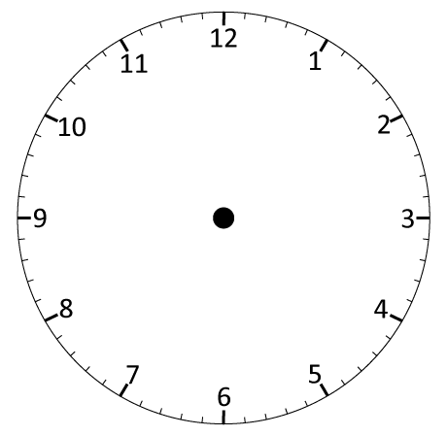
Day 4: Tell the time to the nearest quarter hour; Begin to tell the time to the nearest five minutes.
Let’s check…
All these times are in the afternoon. Which one is the earliest? Latest? Work with a partner to write the 4 times in order from earliest to latest.
Remember! On this clock the pink tells as ‘past’ times and the blue tells us ‘to’ times.
02:45 or
Quarter to 3
03:00 or
3 o’ clock
03:15 or
Quarter past 3
03:45 or
Quarter to 4

Slide 9
Day 4: Tell the time to the nearest quarter hour; Begin to tell the time to the nearest five minutes.
08:00
08:15
08:30
08:45
09:00
09:15
09:30
09:45
10:00
10:15
10:30
10:45
11:00
11:15
11:30
11:45
12:00
It is 8 o’clock in the morning. Joel is having his breakfast.
What time is it now?
Let’s continue in 15 minute steps until 12 o’ clock. What is Joel doing at each time?
What time is it now?
What time is it now?
What time is it now?
He’s getting his shoes and coat on, and picking up his book bag ready to go to school.
Now he’s in the classroom ready for the day!
He’s finished his breakfast and needs to get dressed, wash and brush his teeth.
He’s meeting his friends in the school playground.

Slide 10
Day 4: Tell the time to the nearest quarter hour; Begin to tell the time to the nearest five minutes.
12:00
12:05
12:10
12:15
12:20
12:25
12:30
We can also begin to count round in 5 minute intervals…
Notes:
Children can now go on to do differentiated GROUP ACTIVITIES. You can find Hamilton’s group activities in this unit’s TEACHING AND GROUP ACTIVITIES download.
WT/ARE: Match pairs of analogue and digital times.
GD: Explore telling time to the nearest 5 minutes.

Slide 11
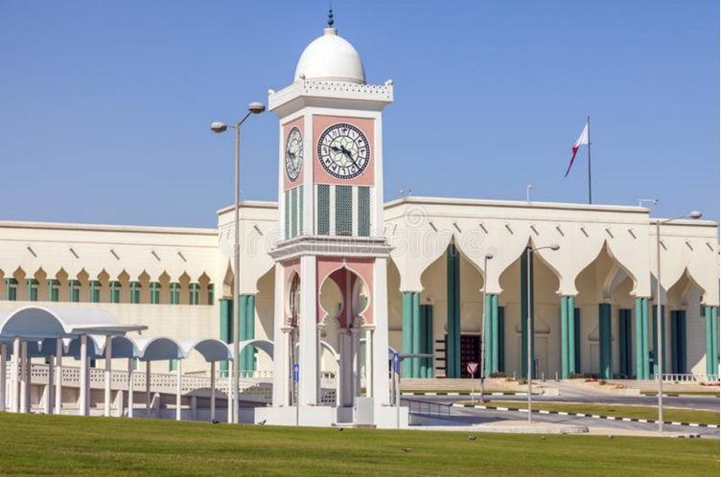
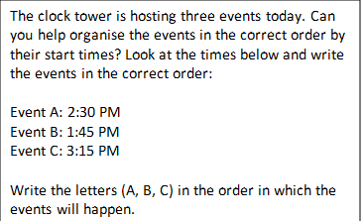
QNID

Slide 12
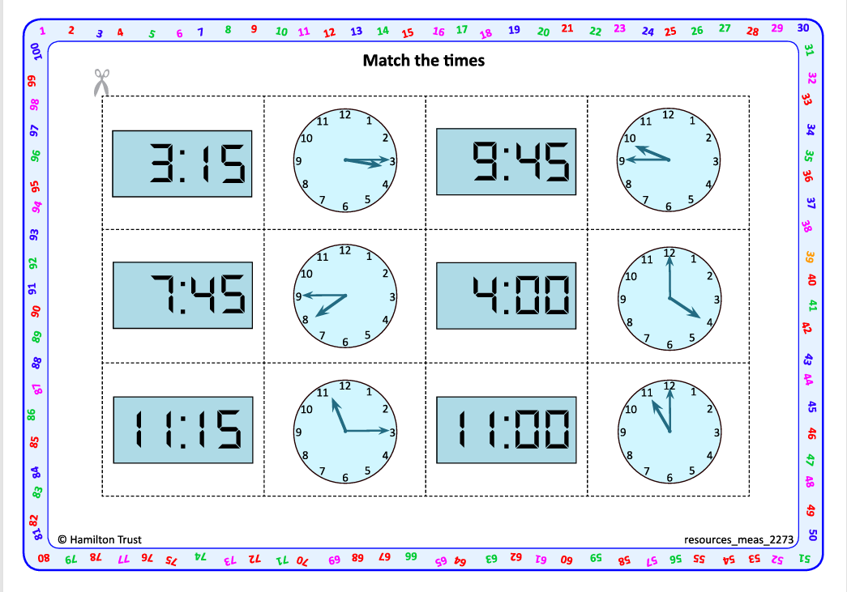
.
Task 1 – Pair/Group Work
Using one of the two sets of ‘Match the times’ cards,match pairs together, then write something you would be doing at each time.

Slide 13
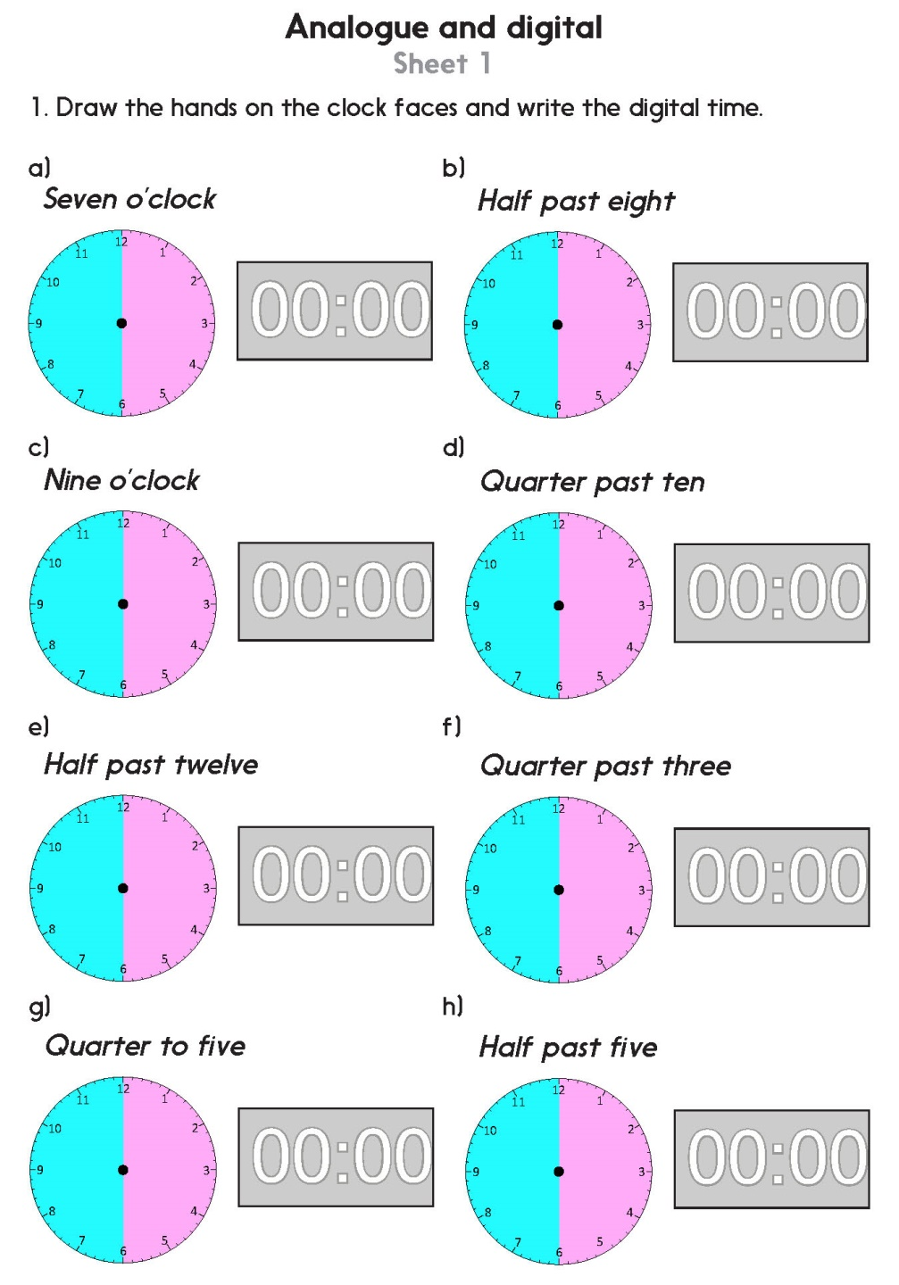
Task 2 – Independent Work
Notes:
The Practice Sheet on this slide is suitable for most children.
Differentiated PRACTICE WORKSHEETS are available on Hamilton’s website in this unit’s PROCEDURAL FLUENCY box.
WT: Analogue and digital Sheet 1 (2 sheets), with support.
ARE: Analogue and digital Sheet 1 (2 sheets).
GD: Analogue and digital Sheet 2 (2 sheets).

Slide 14
Measures
Tell the time to ¹/₄ hour
Begin to tell to 5 mins
Well Done! You’ve completed this unit.
Objectives
Day 1
Read time on digital and analogue clocks to the half hour.
Day 2
Order time to the half hour, using digital and analogue clocks.
Day 3
Read time on analogue clocks to nearest quarter hour.
Day 4
Tell the time to the nearest quarter hour. Begin to tell the time to the nearest five minutes.
Notes:
You can now use the Mastery: Reasoning and Problem-Solving questions to assess children’s success across this unit. Go to the next slide.

