Slide 1
What is Speed?

Slide 2
What is Speed?
Speed is the amount of distance covered in a certain amount of time.
It tells us how fast or slow something is travelling.

Slide 3
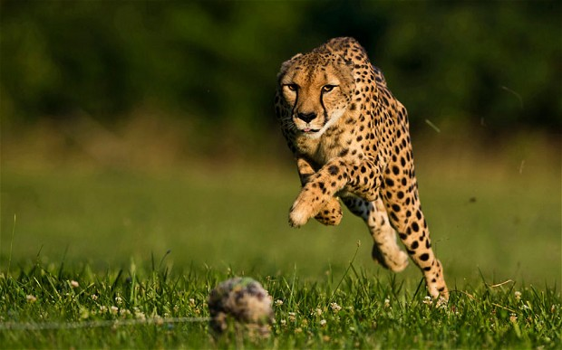
The world record for "fastest land animal" is held by a female cheetah named Sarah, living at the Cincinnati Zoo in Ohio.
When Sarah was 11 years old, she ran the 100 meter dash in 5.95 seconds, with a top speed of 61mph.
The current men’s 100m world record is 9.58 seconds, set by Usain Bolt in 2009
https://www.youtube.com/watch?v=T_vJPKh9p4c

Slide 4
Because speed is about comparing the distance travelled with the time taken,
The formula for speed is:
Speed = Distance ÷ Time
We can also use a formula triangle:
D
S
T

Slide 5
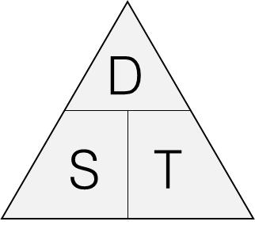
How to use the formula triangle:
What is the formula for Speed?
Cover up the S
D
T
We can see
So:
$$Speed =\frac{Distance}{Time}$$
= Distance ÷ Time

Slide 6
How to use the formula triangle:
What is the formula for Distance?
Cover up the D
We can see ST
So:
$$Distance =(Speed)(Time)$$
= Speed × Time

Slide 7
How to use the formula triangle:
What is the formula for Time?
Cover up the T
D
S
We can see
So:
$$Time =\frac{Distance}{Speed}$$
= Distance ÷ Speed

Slide 8
What are our units?
Speed = Distance ÷ Time
Distance is measured in
kilometres miles metres
Time is measured in
hours seconds
So Speed is measured in: km per hour (km/h)
miles per hour (mph)
m per second (m/s)

Slide 9
Speed = 5 m/s
Distance = 90 m
Time = .........
D
S
T

Slide 10
Speed = .........
Distance = 50 miles
Time = 2 hours
D
S
T

Slide 11
Speed = .........
Distance = 12 m
Time = 4 seconds
D
S
T

Slide 12
Speed = 14 km/h
Distance = .........
Time = 7 hours
D
S
T

Slide 13
Speed = 45 mph
Distance = 135 miles
Time = .........
D
S
T

Slide 14
Speed = .........
Distance = 12 m
Time = 4 seconds
D
S
T

Slide 15
Speed = 30 mph
Distance = .........
Time = 6 hours
D
S
T

Slide 16
Speed = .........
Distance = 60 km
Time = 3 hours
D
S
T

Slide 17
Speed = 8 m/s
Distance = .........
Time = 12 seconds
D
S
T

Slide 18
Speed = 25 km/h
Distance = 75 km
Time = .........
D
S
T

Slide 19
Speed = 32 mph
Distance = .........
Time = 4 hours
D
S
T

Slide 20
Patrick rides his bike at 6 m/s for 15 seconds.
How far does he travel?
Give units with your answer.
What is the average speed of a car that travels 126 miles in 3 hours?
Click to reveal
Speed = Distance ÷ Time
= 126 ÷ 3
= 42 mph
Click to reveal
D
S
T

Slide 21
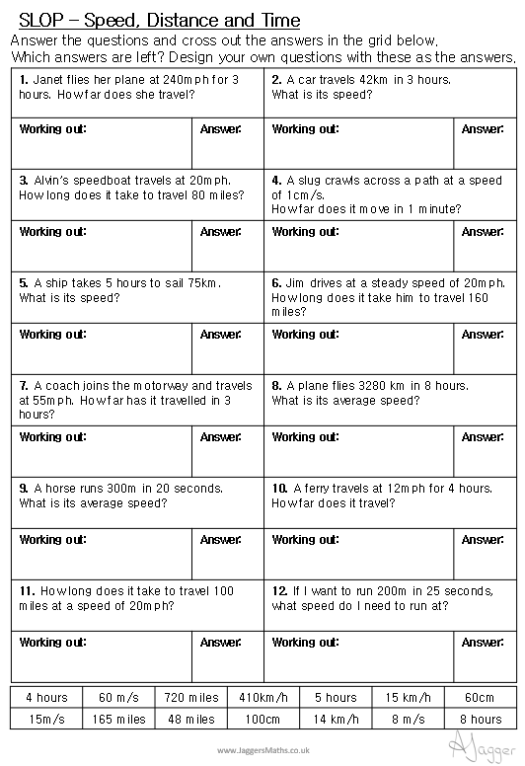

Slide 22
(a) Convert 7m/s into km/h
(b) Convert 90km/h into m/s
(a) Convert 9m/s into km/h
9 metres per second
540 metres per minute
32400 metres per hour
32.4 kilometres per hour
(b) Convert 144km/h into m/s
144 kilometres per hour
144000 metres per hour
2400 metres per minute
40 metres per second
Click to reveal
x 60
x 60
÷ 1000
x 60
x 60
÷1000
Click to reveal
Click to reveal
x 1000
÷ 60
÷ 60
x 1000
÷ 60
÷ 60
Click to reveal

Slide 23
Susan completes a journey in two stages.
In stage 1 of her journey, she drives at an average speed of 80 km/h and takes 1 hour 45 minutes. In stage 2 of her journey she travels for 49 km.
Altogether, Susan takes a total time of 2 hours 15 minutes.
What is her average speed, in km/h, in stage 2 of her journey?

Slide 24
Susan completes a journey in two stages.
In stage 1 of her journey, she drives at an average speed of 80 km/h and takes 1 hour 45 minutes. In stage 2 of her journey she travels for 49 km.
Altogether, Susan takes a total time of 2 hours 15 minutes.
What is her average speed, in km/h, in stage 2 of her journey?
 | Speed | Distance | Time
Stage 1
Stage 2
Overall

Slide 25
Abdul drives 105 miles at an average speed of 70 miles per hour. He then drives 100 miles at an average speed of 40 miles per hour. Calculate his average speed for the whole journey.

Slide 26
Abdul drives 105 miles at an average speed of 70 miles per hour. He then drives 100 miles at an average speed of 40 miles per hour. Calculate his average speed for the whole journey.
 | Speed | Distance | Time
Stage 1
Stage 2
Overall

Slide 27
Abdul drives 105 miles at an average speed of 70 miles per hour. He then drives 100 miles at an average speed of 40 miles per hour. Calculate his average speed for the whole journey.
 | Speed | Distance | Time
Stage 1 | 70 | 105
Stage 2 | 40 | 100
Overall

Slide 28
Abdul drives 105 miles at an average speed of 70 miles per hour. He then drives 100 miles at an average speed of 40 miles per hour. Calculate his average speed for the whole journey.
 | Speed | Distance | Time
Stage 1 | 70 | 105 | 1.5
Stage 2 | 40 | 100 | 2.5
Overall

Slide 29
Abdul drives 105 miles at an average speed of 70 miles per hour. He then drives 100 miles at an average speed of 40 miles per hour. Calculate his average speed for the whole journey.
 | Speed | Distance | Time
Stage 1 | 70 | 105 | 1.5
Stage 2 | 40 | 100 | 2.5
Overall |  | 205 | 4

Slide 30
Abdul drives 105 miles at an average speed of 70 miles per hour. He then drives 100 miles at an average speed of 40 miles per hour. Calculate his average speed for the whole journey.
51.25mph
 | Speed | Distance | Time
Stage 1 | 70 | 105 | 1.5
Stage 2 | 40 | 100 | 2.5
Overall | 51.25 | 205 | 4

Slide 32
PLENARY

Slide 33
If you increase the distance (and the time remains constant), the speed increases | If you increase the time (and the distance remains constant), the speed increases | If you increase the speed (and the time remains constant), the distance increases
If you increase the time (and the speed remains constant), the distance increases | If you increase the speed (and the distance remains constant), the time increases | If you increase the distance (and the speed remains constant), the time increases

Slide 34
$$Speed=\frac{Distance}{Time}$$ | $$Speed=\frac{Time}{Distance}$$ | $$Distance=Time ×Speed$$
$$Time=\frac{Distance}{Speed}$$ | $$Time=\frac{Speed}{Distance}$$ | $$Distance=Speed ×Time$$

Slide 35
Your average speed over a total journey can be calculated by finding the mean of the average speeds for each part of the journey | If someone can run 100m in 12 seconds, they can run 1000m in 2 minutes | Travelling in a straight path is the quickest route from one place to another
Travelling in a straight path is the shortest route from one place to another | The average speed of an object and its speed are the same | Distance, time and speed cannot be measured with 100% accuracy

