Slide 1
Week 30 Lesson 3 Unit: 6
Seasons and adaptations of plants and animals
6.2 Seasonal changes

Slide 2
Learning Objectives
By the end of the lesson, learners will be able to understand and analyze how the tilt of the Earth creates different seasons in different places how plants are adapted to the through different sources to get information.

Slide 3
Key Vocabulary

Slide 4
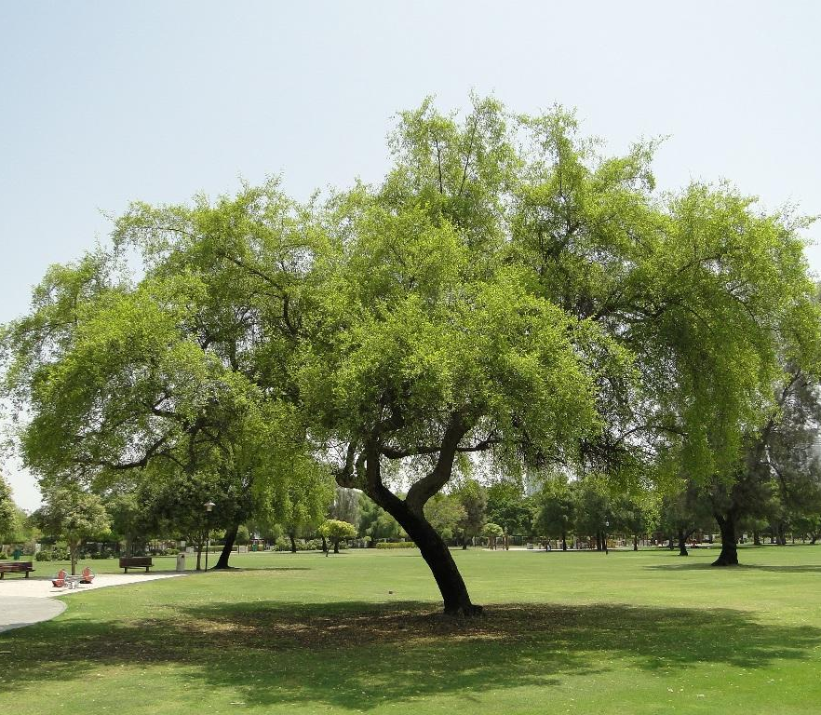
QNI- My Values Shape My Identity
In the Qatari culture, the Sidra tree is the iconic symbol of the country's heritage. The Sidra has grown in the deserts of Qatar for generations. With roots that reach deep into the earth, fruit and flowers that nourish and leaves that heal, the Sidra became a beacon of comfort in the harsh desert environment, allowing life to flourish. The Sidra also provided shade and shelter to travelers and scholars, who would escape the desert heat, gather together and share knowledge.
Over time, the Sidra came to represent nourishment, strength and courage, as well as learning and growth. In the hearts and the minds of the people of Qatar, the Sidra tree exemplifies perseverance, solidarity and determination.

Slide 5
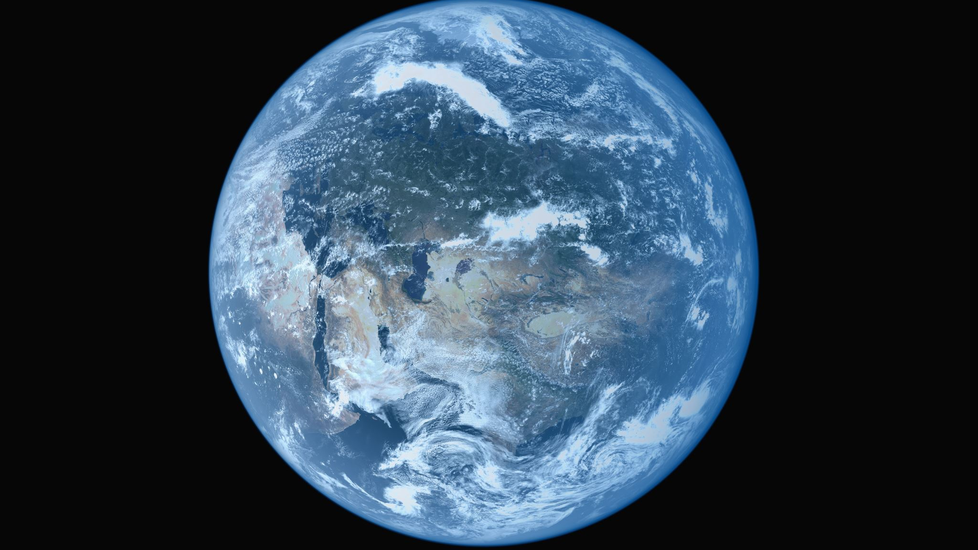
Big Question
Why do leaves change their color during different seasons

Slide 6
Activity 1: QNI
Do you know which tree is this?
What is the national tree of Qatar?
Why is the color of leaves green?
Have you ever seen the leaves changing colors?
When do they change it?
Can you tell what season it is by looking at the color in the picture?
How can you tell it's summer season?

Slide 7
Learners Feed back time

Slide 8
Activity 2: Educational Video Analysis
https://edpuzzle.com/media/63ff998d3e79214140adb584

Slide 9
Activity 2: Learners book

Slide 11
ESL Support:
Chlorophyll is a pigment present in all green plants and a few other organisms. It is required for photosynthesis, which is the process by which light energy is converted into chemical energy. The chlorophyll pigment is responsible for the green colouration in plants.
Dormant: Something that is dormant is not active or growing but can be active later. It also means sleeping.

Slide 12
Plenary: 3-2-1 Activity
3 ideas you have understood from today’s lesson,
2 things you want to know more about
1 thing you need clarification.

