Slide 1
More Addition and Subtraction
Add/subtract 11, 12, 21, 22, etc. to/from 2-digit numbers
Objectives
Day 3
Add and subtract 11 and 21.

Slide 2
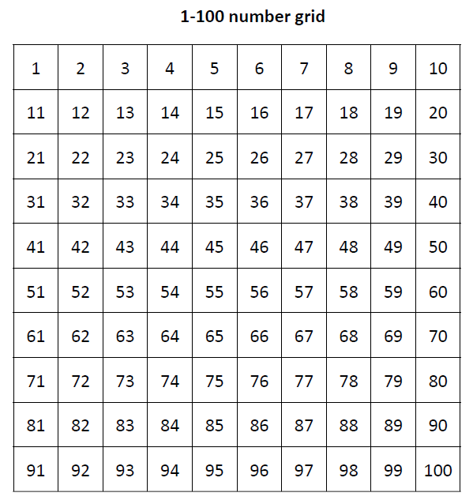

Day 3: Add and subtract 11 and 21.
65 – 11 = 54
65 – 11
Note that Spider moves to the left when counting back in 1s.
Notes:
Tell children that they have done lots of addition recently and that today they will be subtracting too.

Slide 3
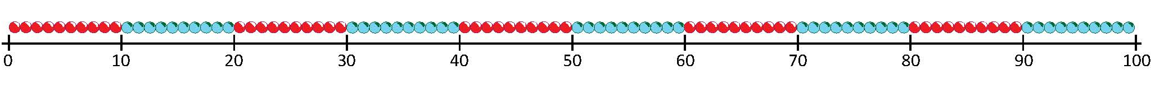

Day 3: Add and subtract 11 and 21.
We’re going to complete the same subtraction on the beaded line.
65 – 11 = 54
65 – 11
-1
-10
54
65
Did you prefer finding 65 – 11 on the 1-100 grid or on the beaded line?

Slide 4

Day 3: Add and subtract 11 and 21.
I’ve given a secret calculation for this person to show on the 1-100 grid.
Write what you think the calculation is on your whiteboard.
48 – 11 = 37
Notes:
Write 48 – 11 on a card and give to a child so that the rest of the class do not see it.

Slide 5
Day 3: Add and subtract 11 and 21.
65 – 21 = 44
65 – 21

Slide 6
Day 3: Add and subtract 11 and 21.
We’re going to complete the same subtraction on the beaded line.
65 – 21 = 44
65 – 21
-1
-10
-10
44
65

Slide 7
Day 3: Add and subtract 11 and 21.
I’ve given a secret calculation for this person to show on the 1-100 grid.
Write what you think the calculation is on your whiteboard.
48 – 21 = 27
Notes:
Write 48 – 21 on a card and give to a child so that the rest of the class do not see it.

Slide 8
Day 3: Add and subtract 11 and 21.
I’ve given a secret calculation for this person to show on the 1-100 grid.
Write what you think the calculation is on your whiteboard.
75 – 21 = 54
Notes:
Write 75 – 21 on a card and give to a child so that the rest of the class do not see it.
Children can now go on to do differentiated GROUP ACTIVITIES. You can find Hamilton’s group activities in this unit’s PLANNING download.
WT/ARE/GD: Play a game to practise adding and subtracting on the 1-100 grid.

Slide 9
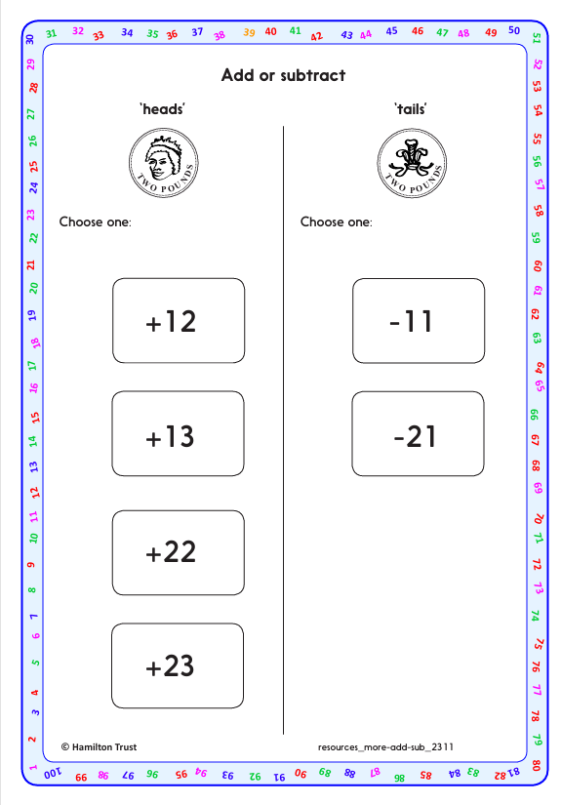
Task 1 – Pair/Group Work
Play in pairs.
Each place a counter on 55 on a 1-100 grid. Take it in turns to flip a coin.
If it lands heads, look at the additions on the Add or Subtract sheet and pick one, e.g. you might choose to add 23. Move your counter accordingly. Your partner checks that you have performed the addition correctly.
If it lands tails, look at the subtractions on the Add or Subtract sheet and choose one, e.g. you could subtract 11. Move your counter accordingly. Your partner checks that you have performed the subtraction correctly.
The first player to reach any red number (multiple of 10) wins.
Repeat as time allows.

Slide 10
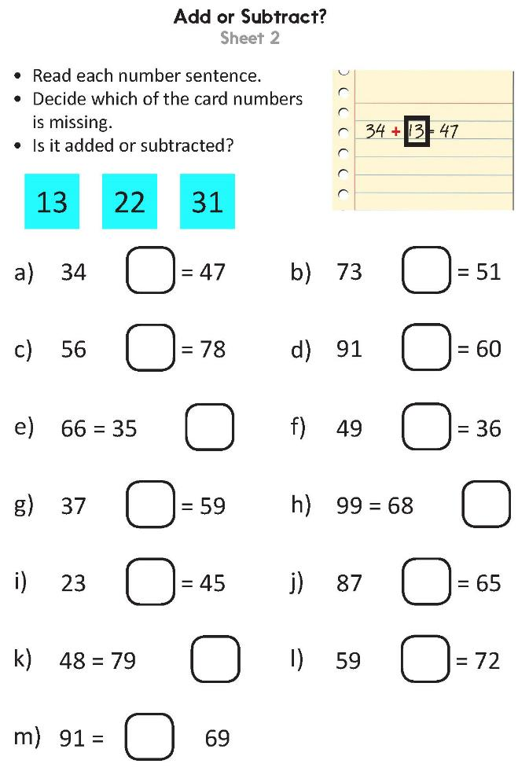
Task 2 – Independent Work
Notes:
The Practice Sheet on this slide is suitable for most children.
Differentiated PRACTICE WORKSHEETS are available on Hamilton’s website in this unit’s WORKSHEETS box.
WT: Add or subtract? Sheet 1 – decide whether 11, 30 or 21 has been added or subtracted.
ARE/GD: Add or subtract? Sheet 2 - decide whether 13, 22 or 31 has been added or subtracted.

Slide 11
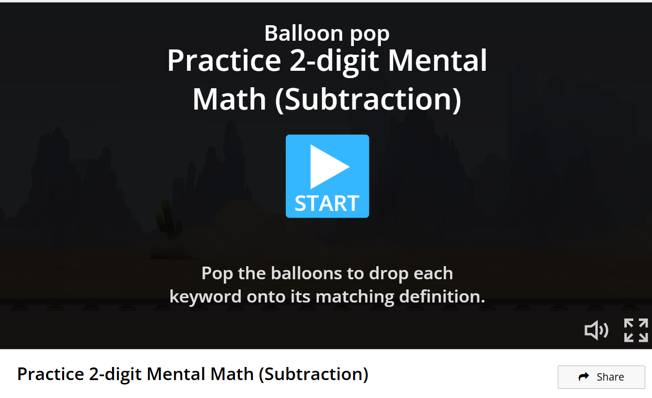
Plenary
Interactive Game
https://wordwall.net/resource/9377756/math/practice-2-digit-mental-math-subtraction

Slide 12
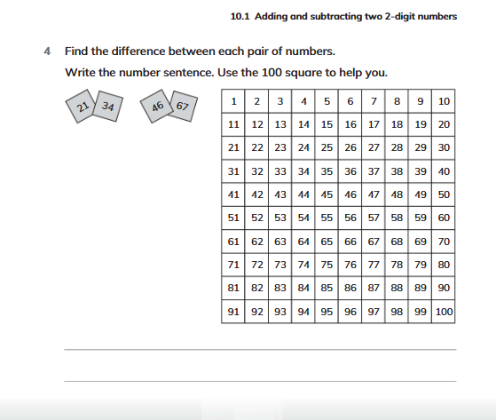
Homework
Solve Q4 on page 155, workbook.

Slide 13

More Addition and Subtraction
Add/subtract 11, 12, 21, 22, etc. to/from 2-digit numbers
Well Done! You’ve completed this unit.
Objectives
Day 1
Add 11, 12, 13, 21, 22 and 23.
Day 2
Add 11, 12, 13, 21, 22, 23, 31, 32, and 33.
Day 3
Add and subtract 11 and 21.
Notes:
You can now use the Mastery: Reasoning and Problem-Solving questions to assess children’s success across this unit. Go to the next slide.

Slide 14
Problem solving and reasoning questions
Write the missing numbers in these calculations:
Complete these diagrams.
I think of a number, then add 11, then 22, then 33 to it.
My answer is 70. What number did I start with?
?
48 | 21
63
31 | ?

Slide 15
Problem solving and reasoning: Answers
Write the missing numbers in these calculations:
Complete these diagrams.
Errors likely if children count on or back in 1s rather than 10s and 1s, e.g. 48 + 21, add 20 (or two 10s), then 1.
I think of a number, then add 11, then 22, then 33 to it.
My answer is 70. What number did I start with? 4
Either by using inverse operations and subtracting 33, 22 and 11 or adding 11, 22 and 33 (66) and knowing that 4 more is needed to equal 70.
30
1
31
51
69
48 | 21
63
31 | 32

