Slide 1
Be a Designer
Year 3 Week 12 Day 2

Slide 2
Lesson Objective
Make coding with multiple algorithms

Slide 3
Key Vocabulary
Repetitive: doing the same thing over and over again

Slide 4
Hook Activity – Pair Activity (10 mins)
Each pair brainstorm and write what are some examples of computer-controlled devices that demonstrate multitasking capabilities, and how do they perform simultaneous tasks?

Slide 5
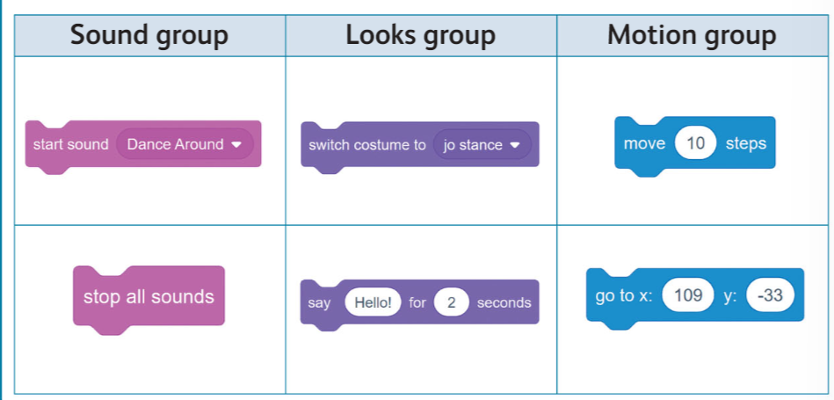
Main Activity (Pair activity – 35 mins): Perform Project “Coding the program for a Dance Battle’ on pg 76-77.

Slide 6
Extension Task

Slide 7
Exit Ticket
The teacher will display the question and take feedback from the student.
"How can coding incorporate multiple algorithms to enhance functionality and efficiency in a given application or system?"

Slide 8
Exit Ticket
https://quizlet.com/848677438/programs-with-multiple-algorithms-flash-cards/?i=37i6vf&x=1jqt
Mark as Quiz 5.

