Slide 1
SELECTION

Slide 2
Natural Selection
A process in which individuals with advantageous features are more likely to survive, reproduce and pass on their alleles to the next generation.

Slide 3
Natural Selection
1. Variation
2. Overproduction
3. Best-adapted individuals more likely to survive and reproduce.
4. Alleles that confer useful adaptations more likely to be passed on.

Slide 4
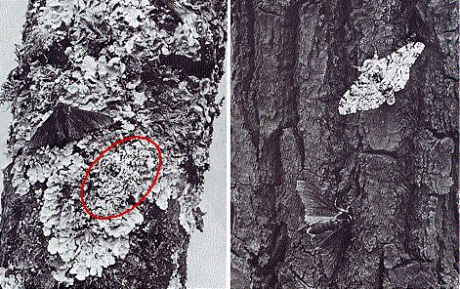
Peppered Moth
http://www.blc.arizona.edu/courses/schaffer/182hEssays.html

Slide 5
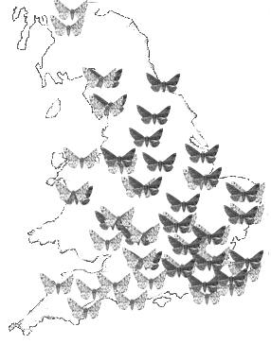
Distribution of the Pale and Dark Forms of Peppered Moth
http://www.saburchill.com/IBbiology/chapters02/028.html

Slide 6
Selection pressure
Something in the environment that affects the chance that individuals with different features will survive and reproduce

Slide 7
ANTIBIOTIC RESISTANCE IN BACTERIA
Penicillin- stop bacteria from forming cell walls
Super bug or MRSA (Methicillin-resistant Staphylococcus aureus)
Can divide into two in as short as 20 minuntes

Slide 8
KEY WORD
adaptation: the process, resulting from natural selection, by which populations become more suited to their environment over many generations
drug: any substance taken into the body that modifies or affects chemical reactions in the body
antibiotic: a substance that is taken into the body, and which kills bacteria but does not affect human cells or viruses

Slide 9
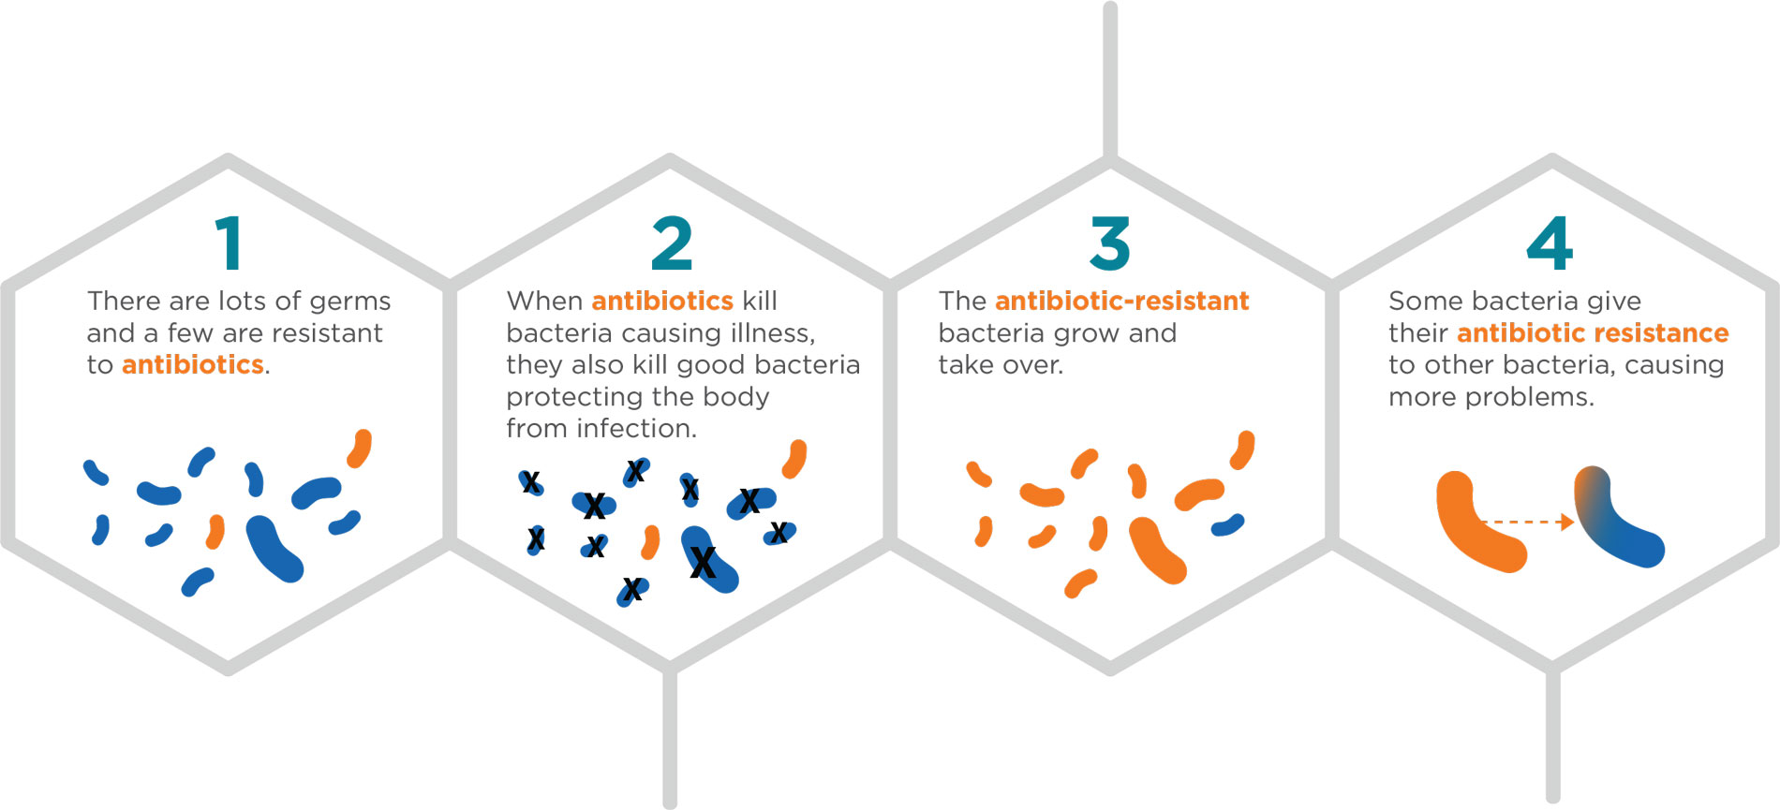
ANTIBIOTIC RESISTANCE IN BACTERIA
https://www.biomerieux-diagnostics.com/antimicrobial-stewardship-old

Slide 10
Artificial Selection
Choosing particular organisms with desired characteristics to breed together, and continuing this over many generations
Used to cultivate plants and domesticate animals
Also known as selective breeding

Slide 11
Improving herd for milk production
1. Choose only the cows that produce large volumes of high-quality milk.
2. Choose a bull whose mother, sisters and/or daughters produce large volumes of high-quality milk.
3. Breed the chosen cows with the chosen bull.
4. Allow the calves to grow to adults. From this generation, select the cows that produce the greatest volumes of high-quality milk, and breed them with the chosen bull (which could be the same one, or a different one).
5. Repeat for many generations.

Slide 12
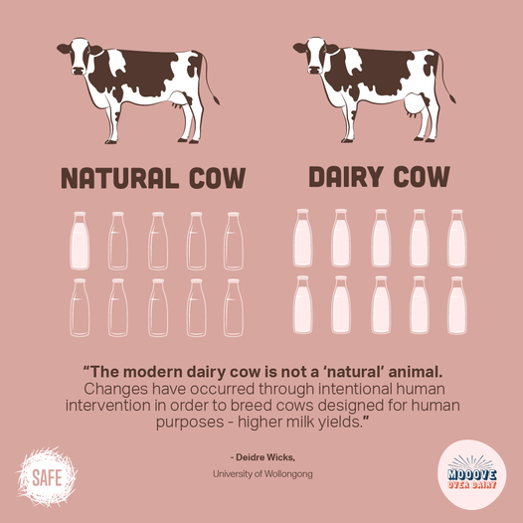

Slide 13
Natural Selection vs Selective Breeding
Construct a comparison table and give at least three differences

Slide 14
Natural Selection vs Selective Breeding
Natural Selection | Selective Breeding
Environment selects the individual to survive | Human selects
Random mating | Human determines the individuals to breed
Involves adaptive features | The features that the breeder wants
Chance of reproduction to the one with best features and those who don’t have the best adaptive features | Only the very ‘best’ will reproduce
Greater variation in a wild population | Less variation
Gradual change | Quite large change in a short period of time

Slide 15
Source:
Edexcel IGCSE Biology (Pearson)
Biology for Cambridge IGCSE Coursebook 4th ed.

