Slide 1
Place Value and Fractions
Ordinal numbers, Place value
Properties of 2-digit numbers, Rounding
Objectives
Day 1
Use ordinal numbers in context up to 10th and beyond.
Day 2
Compare numbers using the symbols < and >.
Day 3
Round 2-digit numbers to nearest multiple of 10.
Day 4
Round 2-digit numbers to nearest multiple of 10.
Notes:
Before teaching, be aware that:
On Day 1 you will need a selection of age birthday cards (to include 1st, 2nd, 3rd, 6th, 9th; children will need mini-whiteboards and pens.
On Day 2 you will need 0-100 landmarked line (see resources), black card strips and fasteners to make <, and > signs, cubes, card, 0-9 cards.
On Day 3 you would be best-served by using a 0-100-bead bar and tags; children will need mini-whiteboards and pens.
On Day 4 you will need items for sale with price labels [17p, 25p, 32p, 49p, 55p, 63p, 74p, 86p and 99p], a 0-100 landmarked line (see resources).

Slide 2
Place Value and Fractions
Ordinal numbers, Place value
Properties of 2-digit numbers, Rounding
Starters
Day 1
1 more/1 less (pre-requisite skills)
Day 2
Order 2-digit numbers (pre-requisite skills)
Day 3
Place value (simmering skills)
Day 4
Rounding (simmering skills)
Notes:
Choose starters that suit your class by dragging and dropping the relevant slide or slides below to the start of the teaching for each day.

Slide 3
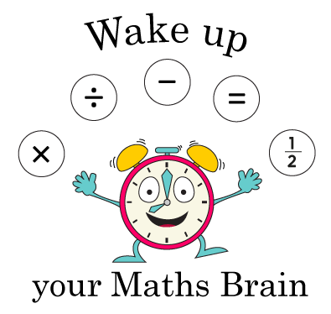
Place Value and Fractions
Ordinal numbers, Place value
Properties of 2-digit numbers, Rounding
Starter
1 more/1 less
Notes:
Pre-requisite skills – to use this starter, drag this slide to the start of Day 1
Ask children to write a number on their whiteboards between 10 and 50. Choose a child to stand up and show their number. Draw 3 boxes next to each other on IWB. Write that number in the middle box. Choose children to come up and write the number one more on the right side and the number that is one less on the left. Repeat with other numbers. As children get used to the activity, simply point at the boxes and have children call out/ show you with a number fan the numbers 1 more and 1 less

Slide 4
Place Value and Fractions
Ordinal numbers, Place value
Properties of 2-digit numbers, Rounding
Starter
Order 2-digit numbers
Notes:
Pre-requisite skills – to use this starter, drag this slide to the start of Day 2
Put children in groups of 4. They each write a 2-digit number on a whiteboard and then work together to put them in order from the smallest to largest. Show a 1-100 grid (see resources) for them to check. Repeat then ask 2 groups of 4 to combine and order all 8 on whiteboards.

Slide 5
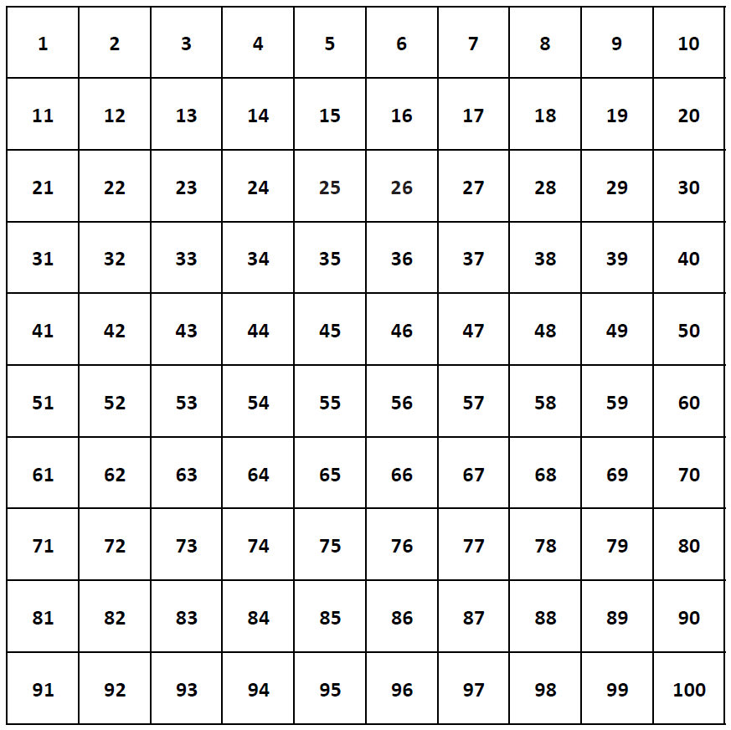
Notes:
Pre-requisite skills – to use this starter, drag this slide to the start of Day 2
Put children in groups of 4. They each write a 2-digit number on a whiteboard and then work together to put them in order from the smallest to largest. Show a 1-100 grid (see resources) for them to check. Repeat then ask 2 groups of 4 to combine and order all 8 on whiteboards.

Slide 6
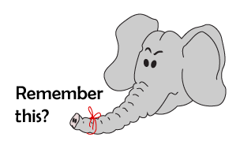
Place Value and Fractions
Ordinal numbers, Place value
Properties of 2-digit numbers, Rounding
Starter
Place value
Notes:
Simmering skills – to use this starter, drag this slide to the start of Day 3
Show children how to show 35 using hands. Close your hands, flash 10, three times, and then hold up 5 fingers. Hold up a 2-digit number, say 3, 2, 1. Children show the number. Repeat.

Slide 7
Place Value and Fractions
Ordinal numbers, Place value
Properties of 2-digit numbers, Rounding
Starter
Rounding
Notes:
Simmering skills – to use this starter, drag this slide to the start of Day 4
Use the hall or an outside space. Children stand holding numbers: 0, 10, 20… 100. Give other children a 1-100 card each. A group at a time, they stand between the correct multiples of 10, then move to the closest 10.

Slide 8
Day 1: Use ordinal numbers in context up to 10th and beyond.
Look at these birthday cards.
Talk to your partner.
What do you notice about the numbers on the cards?
Numbers like this that show an order are called ordinal numbers.
1st, 2nd, 3rd…
Notes:
Show children a selection of birthday cards which show ordinal numbers, e.g. Happy 9th Birthday! Ensure that they include 1st, 2nd and 3rd so that you can discuss how these are written differently.

Slide 9
Day 1: Use ordinal numbers in context up to 10th and beyond.
Look at how 21st is written on this card.
You don’t normally get birthday cards for someone who is 22... But how might it be written?
22nd
And 23?
23rd
Which person is the oldest?
And the youngest? ?

Slide 10
Day 1: Use ordinal numbers in context up to 10th and beyond.
Look at these two birthday cards…
If a person is older than 6 but younger than 9, what might be on their card?
7th, 8th

Slide 11
Day 1: Use ordinal numbers in context up to 10th and beyond.
Time to line up…
Take your whiteboard and pen with you…
Now write your position in the order on your whiteboard!
Now read your ordinal number – who’s 1st?

Slide 12
Day 1: Use ordinal numbers in context up to 10th and beyond.
Can you crack this code?
15th
Gina, Peter and Sam are 2
m , 6th, 8th, 7th, 2nd, 3rd, 1st
m e e t i n g
a t
4th, 7th
19th, 5th, 15th
2 cp m
Notes:
Today would be a great day to use a problem-solving investigation – Racing Riddles – as the group activity, which you can find on the next slides and in this unit’s IN-DEPTH INVESTIGATION box on Hamilton’s website.
Alternatively, children can now go on to do differentiated GROUP ACTIVITIES. You can find Hamilton’s group activities in this unit’s TEACHING AND GROUP ACTIVITIES download.
WT: Describe multi-coloured cube towers using ordinal numbers
ARE/ GD: Work out secret messages using ordinal numbers.

Slide 13
Qatar National Identity
Using the gold line metro station, the learners will answer the following questions:
-Starting from the left, what is the first station?
-Starting from the left, what is 5th station?
-What is the position of the Msheireb Station starting from Al Aziziyah?

Slide 14
Task 1 – Pair/Group Work
Use the ‘Who will be at the secret meeting?’ sheet to work out short children’s
• Sit back-to-back with your partner.
• Each of you gets 4 red, 2 blue, 3 green, and 1 yellow cubes.
• Child 1: Make a stick and describe it using words like "first," "second," etc.
• Child 2: Listen and build the same stick.
• Turn around and compare your sticks.
• Swap roles and repeat.
In pairs, work out secret messages (see resources).
Create your own secret message for another pair to decipher.

Slide 15
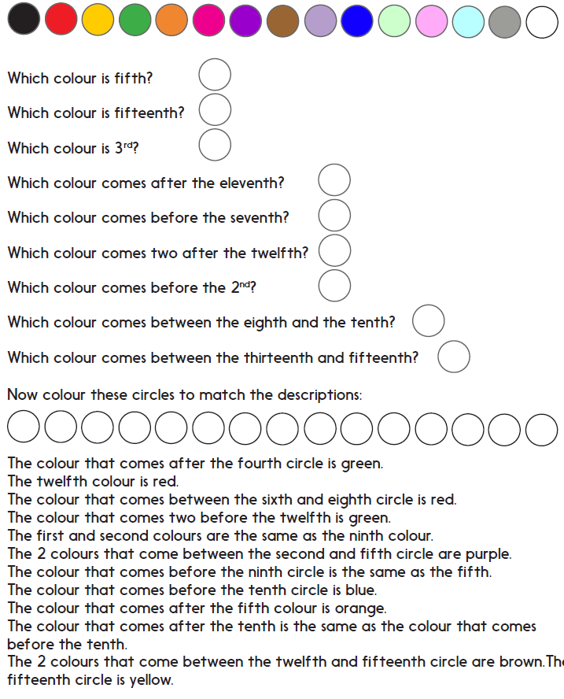
Task 2 – Independent Work
Challenge
Notes:
The Practice Sheet on this slide is suitable for most children.
Differentiated PRACTICE WORKSHEETS are available on Hamilton’s website in this unit’s PROCEDURAL FLUENCY box.
WT: Solve puzzles with ordinal numbers to 10th (Sheet 1).
ARE/ GD: Solve puzzles with ordinal numbers to 15th (Sheet 2).

Slide 16
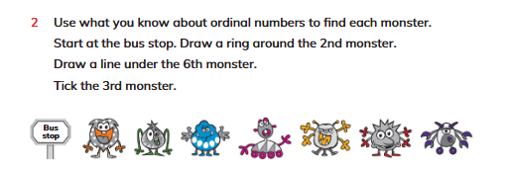
Plenary
Solve Q2, on page 24, Learners book.

Slide 17
Homework
Play https://wordwall.net/resource/298720/maths/ordinal-numbers-quiz

