Slide 1
Multiplication and Division
Understand doubling and halving (numbers to 20)
Objectives
Day 2
Find halves of even numbers using strips to help.

Slide 2
Day 2: Find halves of even numbers using strips to help.
Take your strip of 12 shapes and fold it in half…
Check you have the same number of shapes in each half…
What is half of 12?
Half of 12 is 6.

Slide 3
Day 2: Find halves of even numbers using strips to help.
Take your strip of 28 shapes and fold it in half…
Check you have the same number of shapes in each half…
What is half of 28?
Half of 28 is 14.

Slide 4
Day 2: Find halves of even numbers using strips to help.
Take your strip of 22 stars and fold it in half…
Check you have the same number of stars in each half…
What is half of 22?
Half of 22 is 11.

Slide 5
Day 2: Find halves of even numbers using strips to help.
11 stars…
How many stars were on the whole strip?
Unfold the strip to check.
Double 11 is 22…
and half of 22 is 11.
22
11 | 11
We can show that on
this bar model.

Slide 6
Day 2: Find halves of even numbers using strips to help.
Take your strip of 24 shapes and fold it in half…
Check you have the same number of shapes in each half…
What is half of 24?
Half of 24 is 12.
What is double 12?
12 | 12
24
Notes:
Today would be a great day to use a problem-solving investigation – Double or Halve? – as the group activity, which you can find in this unit’s IN-DEPTH INVESTIGATION box on Hamilton’s website.
Alternatively, children can now go on to do differentiated GROUP ACTIVITIES. You can find Hamilton’s group activities in this unit’s TEACHING AND GROUP ACTIVITIES download.
WT: Finding halves using cubes.
ARE: Folding strips to find halves of numbers.
GD: Halves and doubles using bar models.

Slide 7
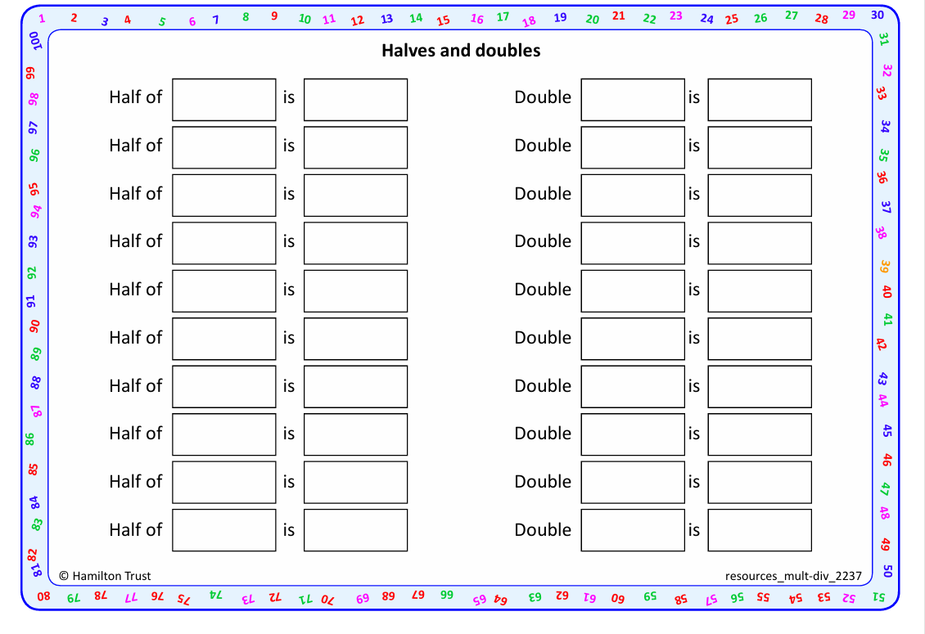
Work in pairs to fold strips of different numbers of images in half, using ‘Folding’ activity sheets.
For each strip of shapes, write the corresponding half and double. Fill in ‘half of □ is □’ and ‘Double □ is □’, using ‘Halves and doubles’ sheets.
Task 1 – Pair/Group Work

Slide 8
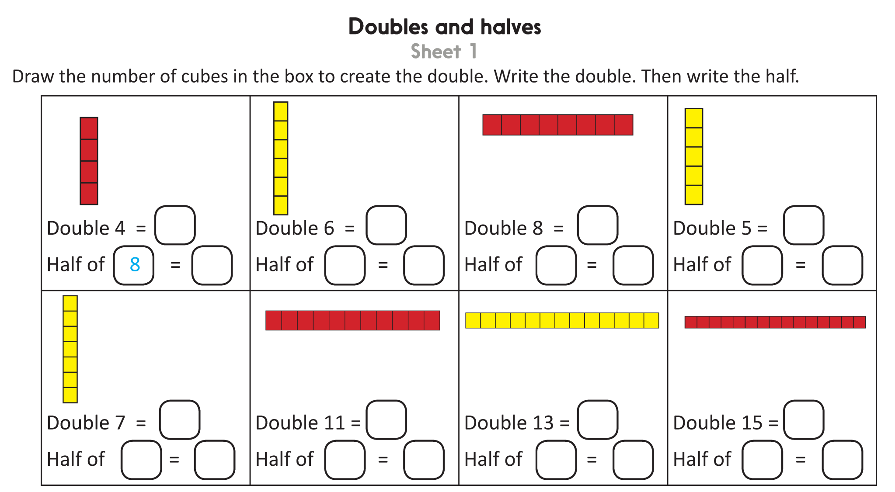
Task 2 – Independent Work
Challenge
Notes:
The Practice Sheet on this slide is suitable for most children.
Differentiated PRACTICE WORKSHEETS are available on Hamilton’s website in this unit’s PROCEDURAL FLUENCY box.
WT: Doubles and halves Sheet 1.
ARE: Doubles and halves Sheet 1 or 2 (a-f).
GD: Doubles and halves Sheet 2.

Slide 9
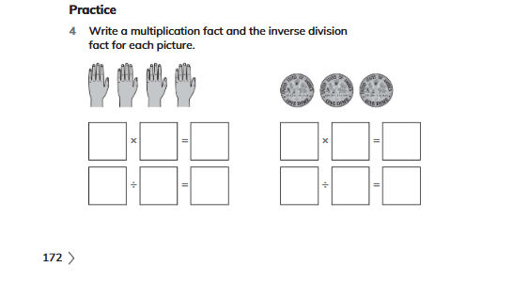
Plenary
Work in pairs to solve Q4 on page 172.

Slide 10
Homework
Play https://wordwall.net/resource/33013/doubles-and-halves-quiz

