Slide 1
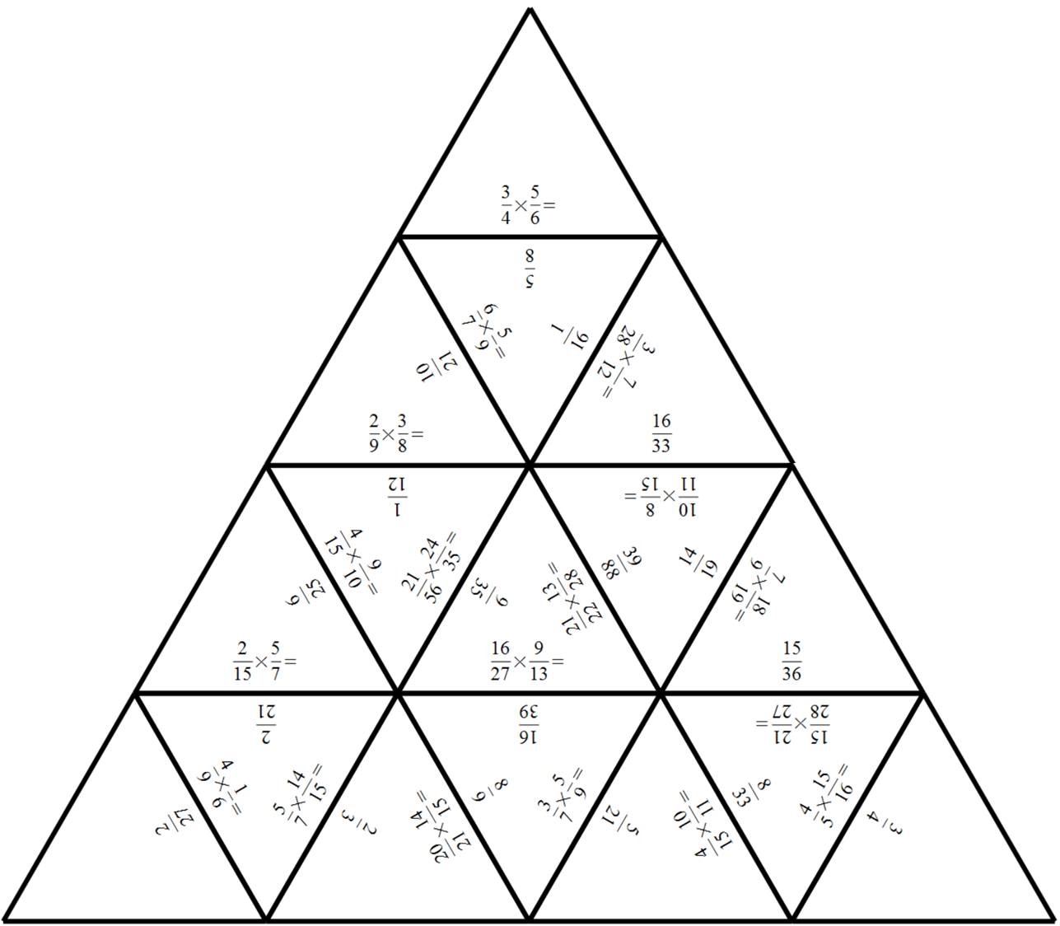
Can you finish
the puzzle?

Slide 2
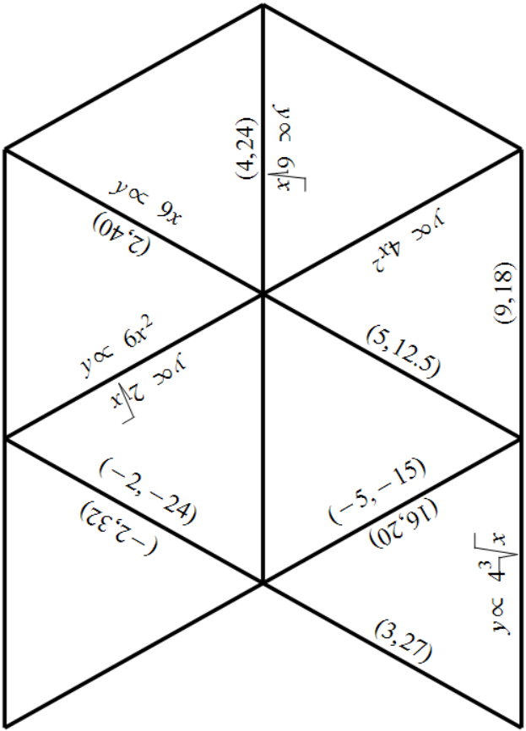
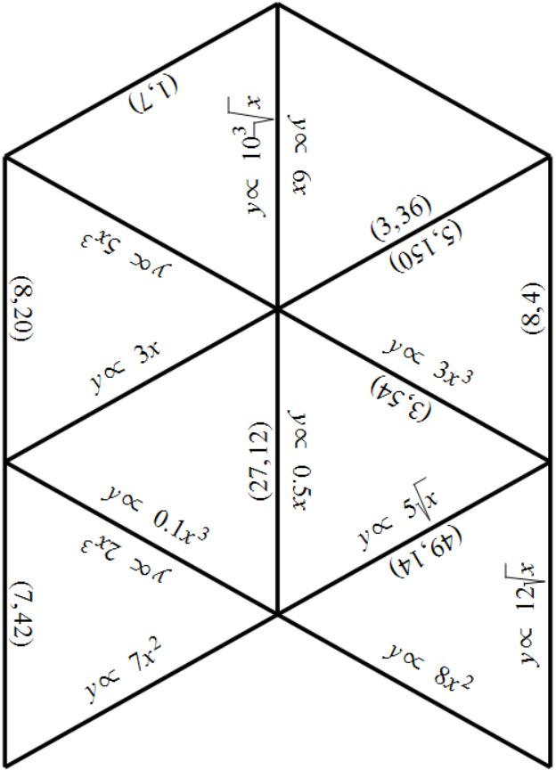

Slide 3
Notes:
Puzzle pieces to print.

Slide 4
