Slide 1
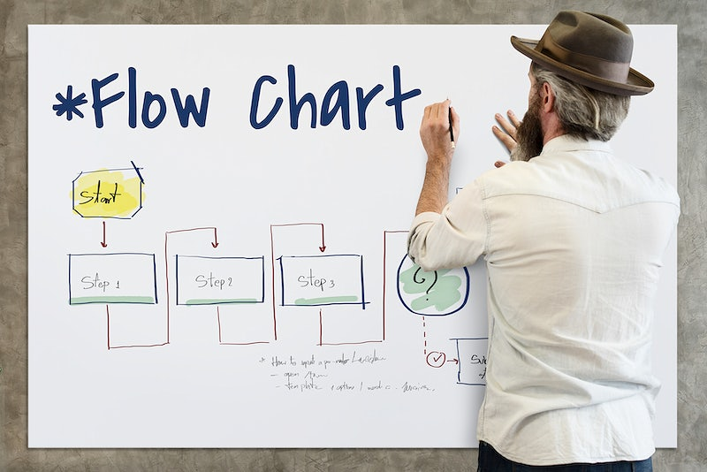
Unit 1- Go with the flow •Flowchart symbol •Understanding flowcharts
Year 6 Week 13 Day1

Slide 2
Learning objective
By the end of the lesson students will be able to analyse and understand
How algorithms are presented as flowcharts?•
Which symbols are used in flowcharts, limited to start, stop, process, procedure (subroutine), decision and the connector?

Slide 3
Key Vocabulary
Flowchart symbols, Input, Output, Process, Outcomes

Slide 4
Big Question
How can a flowchart help you to understand the process and solve the problem?
What type of problem does the flowchart solve? Can you relate it with your real life example?

Slide 5
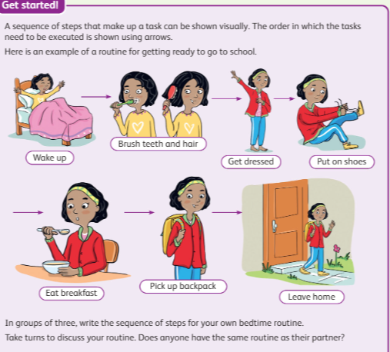
Hook Activity – Group (10 mins)
10mins-Think-Pair-Share
Using the Think-Pair-Share (TPS) collaborative learning strategy, learners work in groups of three to discuss the activity. Learners write their own bedtime routine sequence of steps/activities in A4 sheet and then compare their list with other group members.
Learners can be asked to draw diagrams/write the routines with arrows, as in the Learner's Book, to represent their answer.
Students can refer to the Page 8 of the learners book.

Slide 6
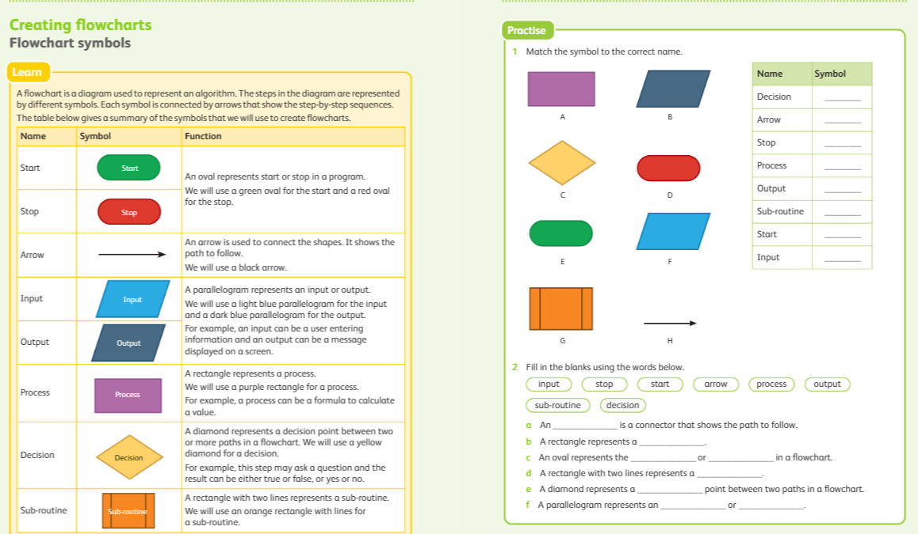
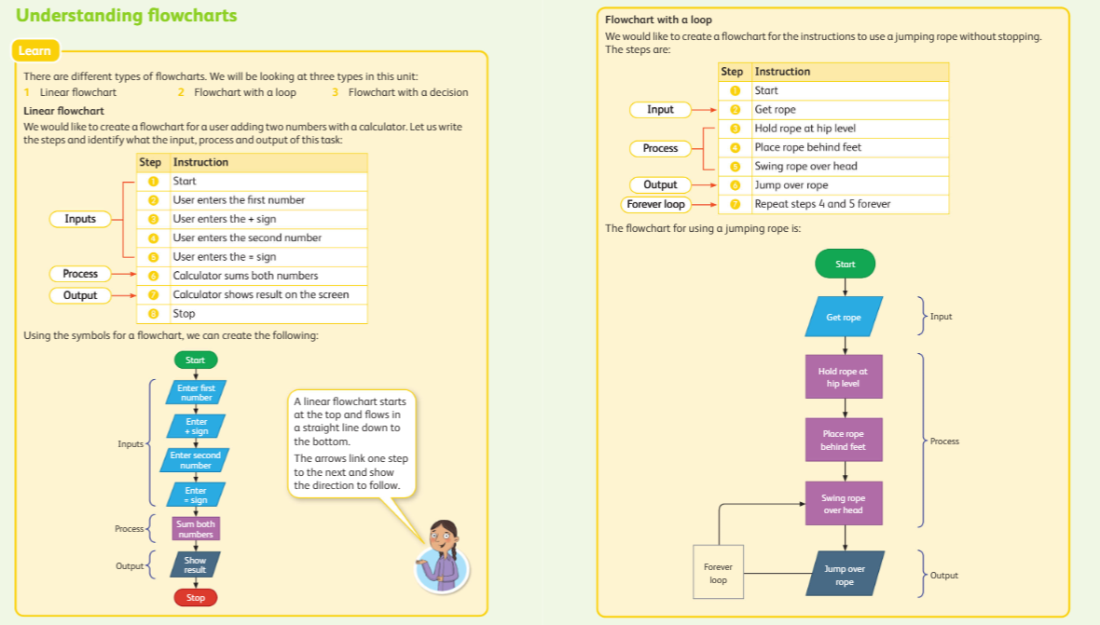
Main Activity Discussion–
12 mins- Class Discussion
Teacher will lead the class discussion and make them understand the flow chart symbols and understand the flowchart representation from the given algorithm from the learner’s book learn panel.

Slide 7
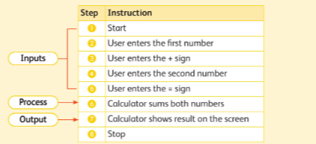
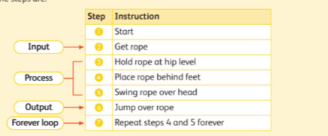
Main Activity
8 mins- Demonstration
Teacher will randomly select the students and ask him/her to demonstrate the given algorithm using the given resources.
Student 1- Will hold the calculator or open the calculator app and demonstrate the steps of subtracting the numbers.
Student 2- Will take the jumping the rope and other student will read the algorithm for him/her and he will follow.
Teacher will explain them the input, output and process.
25 mins- Peer activity
Students will complete the Practise which is given the page -15 of the learner’s book in the barcoded sheets.

Slide 8
Extension Task
Enrichment task:
Make the same flow charts which they have done as a peer activity above using the MS word.

Slide 9
Plenary
Students will write down the answers for the big questions in the sticky note.
How can a flowchart help you to understand the process and solve the problem?
What type of problem does the flowchart solve? Can you relate it with your real life example?

