Slide 1
Science - Year 3/4B Autumn 1
Rocks
This Planet Rocks
Session 5
What Am I? PowerPoint
© Original resource copyright Hamilton Trust, who give permission for it to be adapted as wished by individual users.
We refer you to our warning, at the foot of the block overview, about links to other websites.

Slide 2
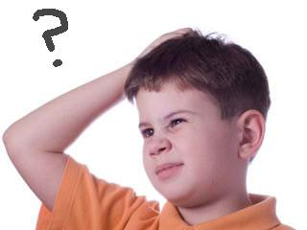
What am I?
Read the clues and guess
How many clues will you need?

Slide 3
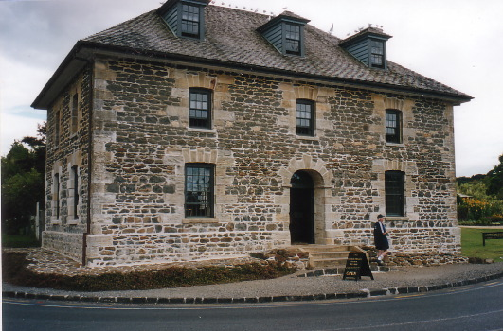
I am made of rock
But I’m not a building

Slide 4
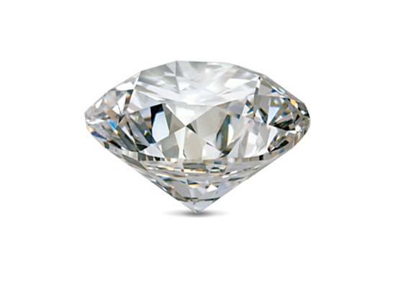
I am very precious
But I’m not a diamond

Slide 5
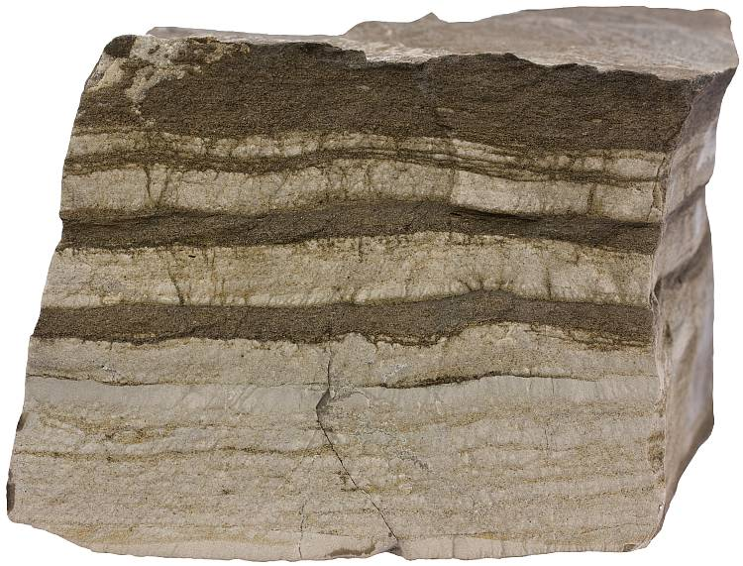
I am made of different layers
But I am not sedimentary rock

Slide 6
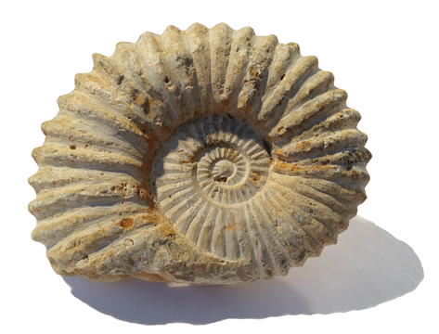
It takes 500 years to make 2cm of me
But I’m not a fossil

Slide 7
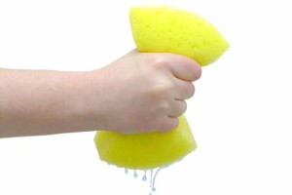
Half of me is made of air and water
But I’m not a wet sponge

Slide 8
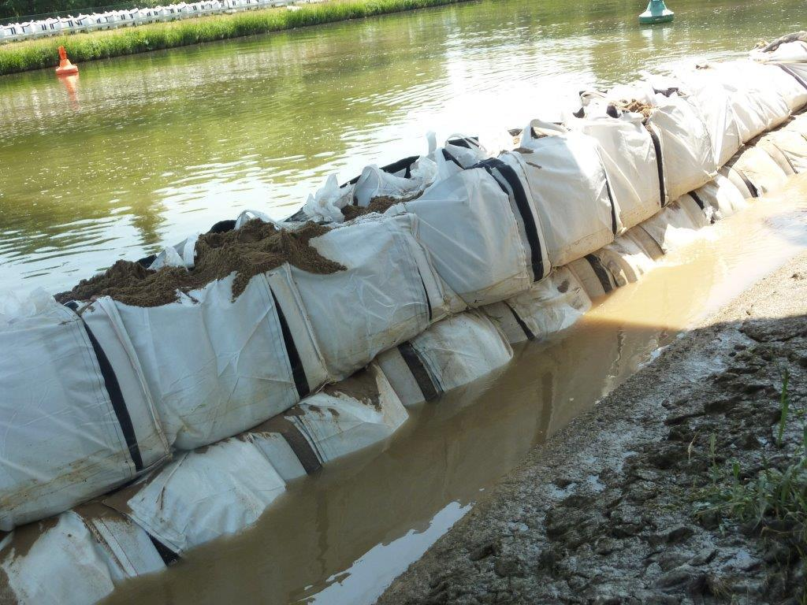
I can help prevent flooding
But I’m not a flood barrier

Slide 9
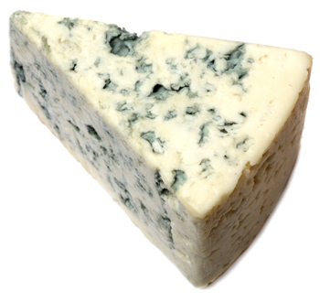
A handful of me contains more micro-organisms than there are people on the Earth
But I’m not mouldy cheese!

Slide 10
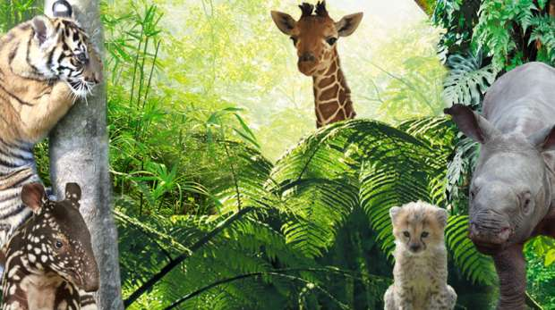
I am home to many creatures
But I’m not a zoo or a farm

Slide 11
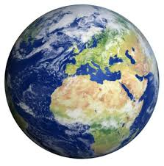
Without me there would be no life on Planet Earth!

Slide 12
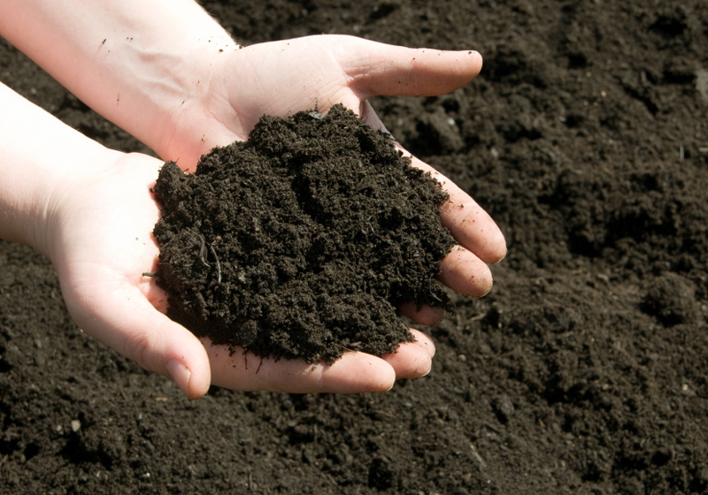
?
Have you guessed what I am?
Soil

Slide 13
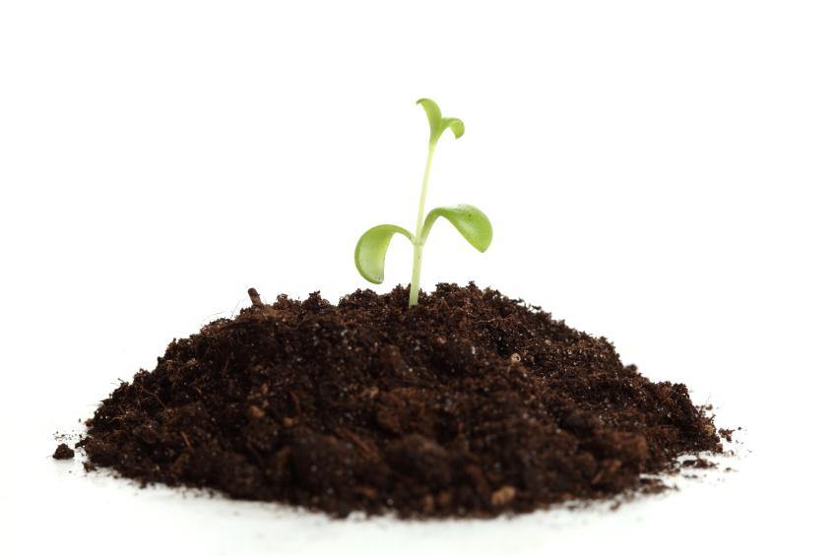
Let’s recap on what we know about soil

Slide 14
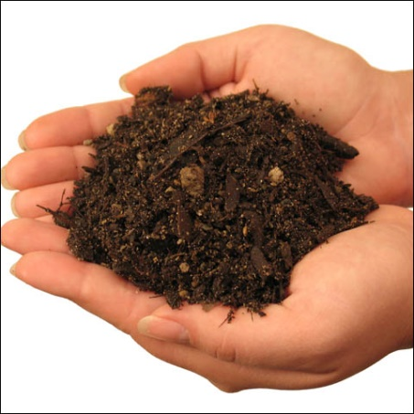
A handful of soil contains more micro-organisms than there are people on the planet
Without soil there would be no life on Earth
It can help prevent flooding because it can absorb large amounts of water
It is made from rock and other things
It is very precious because everything needs it to survive
Half of it is made of air and water
Soil
It takes more than 500 years to make 2cm of soil
Is made of different layers in the ground

