Slide 1
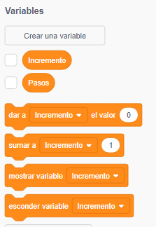
Unit4-
Variables in programming
Year 6 Week 20 Day 1

Slide 2
Learning objective
By the end of the lesson students will be able to identify and explain about the use of variables in different algorithm after a class discussion and completing the activities.

Slide 3
Key Vocabulary
Variables, Alphanumeric, Data type.

Slide 4

Big Question
How can variables in Scratch 3 be used to create dynamic and interactive storytelling experiences?

Slide 5
Hook Activity – Group (10 mins)
10 mins-Visual Aid-Peer Work
Students will watch the video about the variables used in Scratch 3. In between the teacher will pause the video and ask the following questions.
1.What kinds of data or information can be stored in variables?
2.What are the standard or default building blocks provided in Variable?
3.Jot down the steps to create the variable with name score.
4.What is the function of set and change variable block?
Discuss with their peer and jot down the answers in the sticky note.
https://www.youtube.com/watch?v=wS1QETPfgGE&t=84s

Slide 6
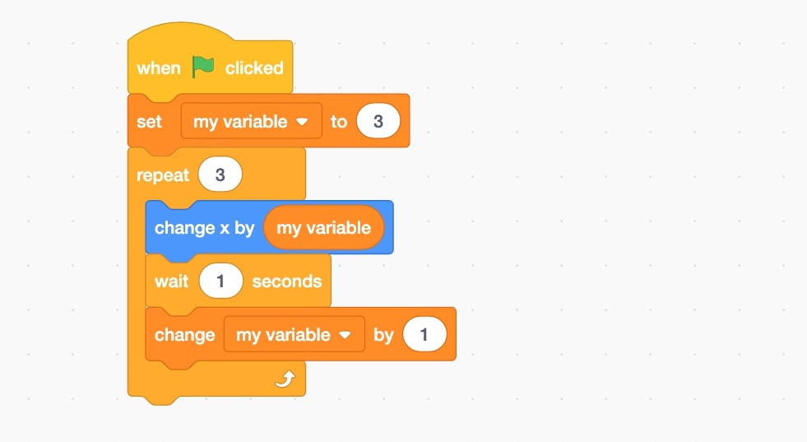
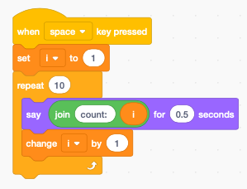
Main Activity Discussion–
10 mins- Class discussion
Student will identify variables from the given Scratch 3 program. Teacher can randomly choose the students using the ClassDojo and give point if they identify correctly.

Slide 7
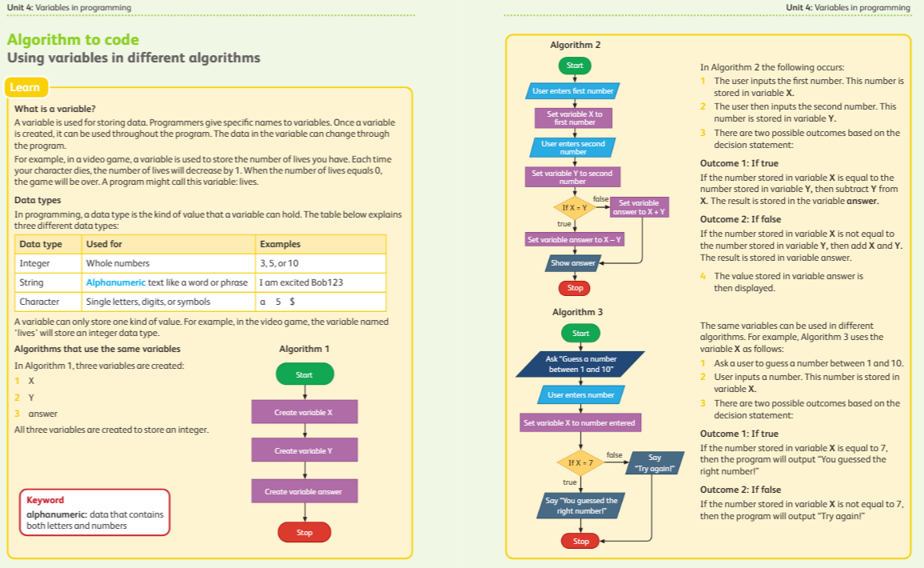
Main Activity Discussion–

Slide 8
Main Activity Discussion–
35 mins- Group Work
Group 1-
Discuss with the group and complete the Worksheet 1.
Group 2-
Discuss with the group and complete the Support worksheet1.

Slide 9
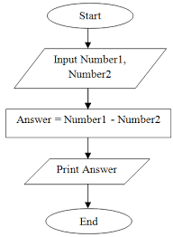
Enrichment task
Enrichment task
Students will create an algorithm for adding two numbers with variables in barcoded sheet.
sample of algorithm of subtraction.

Slide 10

Plenary
5 mins- Just a min
You will be randomly selected by the teacher and ask to summaries the lesson. Meanwhile others write down in sticky notes two things which they have learnt today.

