Slide 1
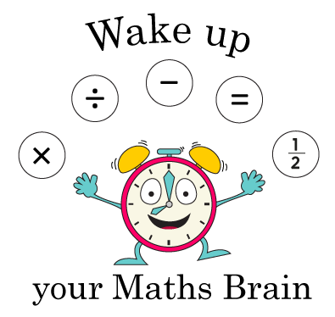
Addition and Subtraction
Adding by counting on (numbers to 20)
Starter
Count on
Notes:
Pre-requisite skills – to use this starter, drag this slide to the start of Day 1
Hold up a card with the number 10. Get ready to say the next 2 numbers after 10. Ready, steady, go! Repeat starting at other numbers from 5 to 18.

Slide 2
Addition and Subtraction
Adding by counting on (numbers to 20)
Objectives
Day 1
Find 1 more/1 less than any number up to 20.

Slide 3
Day 1: Find 1 more/1 less than any number up to 20.
1
2
3
4
5
6
7
8
9
10
11
12
13
14
15
16
17
18
19
20
Say the numbers in order from 1 to 20. Point to the washing line numbers as you do so.
Repeat, counting back
from 20 to 1.

Slide 4
Day 1: Find 1 more/1 less than any number up to 20.
1
2
3
4
5
6
7
8
9
10
11
12
13
14
15
16
17
18
19
20
Point to any number on the line and start counting on from there to 20.
Then count back to your starting number.
Notes:
Repeat. Include lots of counting that passes through 10.

Slide 5
Day 1: Find 1 more/1 less than any number up to 20.
1
2
3
4
5
6
7
8
9
10
11
12
13
14
15
16
17
18
19
20
Ask a child to pick a card from a pack of shuffled 1-20 cards. They point to their number on the line.
13
Make a tower using this number of cubes.

Slide 6
Day 1: Find 1 more/1 less than any number up to 20.
1
2
3
4
5
6
7
8
9
10
11
12
13
14
15
16
17
18
19
20
Who can add one more to the tower?
14
13
Notes:
Once 1 more cube has been added to the tower find the number on the line.
Point out that it is the next number.

Slide 7
Day 1: Find 1 more/1 less than any number up to 20.
1
2
3
4
5
6
7
8
9
10
11
12
13
14
15
16
17
18
19
20
13 + 1 = 14

Slide 8
Day 1: Find 1 more/1 less than any number up to 20.
1
2
3
4
5
6
7
8
9
10
11
12
13
14
15
16
17
18
19
20
Take the extra cube off again to go back to the original number.
13
Choose a child to take 1 cube off.

Slide 9
Day 1: Find 1 more/1 less than any number up to 20.
1
2
3
4
5
6
7
8
9
10
11
12
13
14
15
16
17
18
19
20
Who can take one cube off?
13
12
Notes:
Point out that this is the number before 13.

Slide 10
Day 1: Find 1 more/1 less than any number up to 20.
1
2
3
4
5
6
7
8
9
10
11
12
13
14
15
16
17
18
19
20
13 – 1 = 12
Notes:
Repeat with other numbers up to 20, including several ‘teens’ numbers.
Children can now go on to do differentiated GROUP ACTIVITIES. You can find Hamilton’s group activities in this unit’s TEACHING AND GROUP ACTIVITIES download.
WT: Finding 1 more and 1 less and demonstrating this on a number track.
ARE/GD: Adding 1 and subtracting 1 from number cards and recording number sentences.

Slide 11
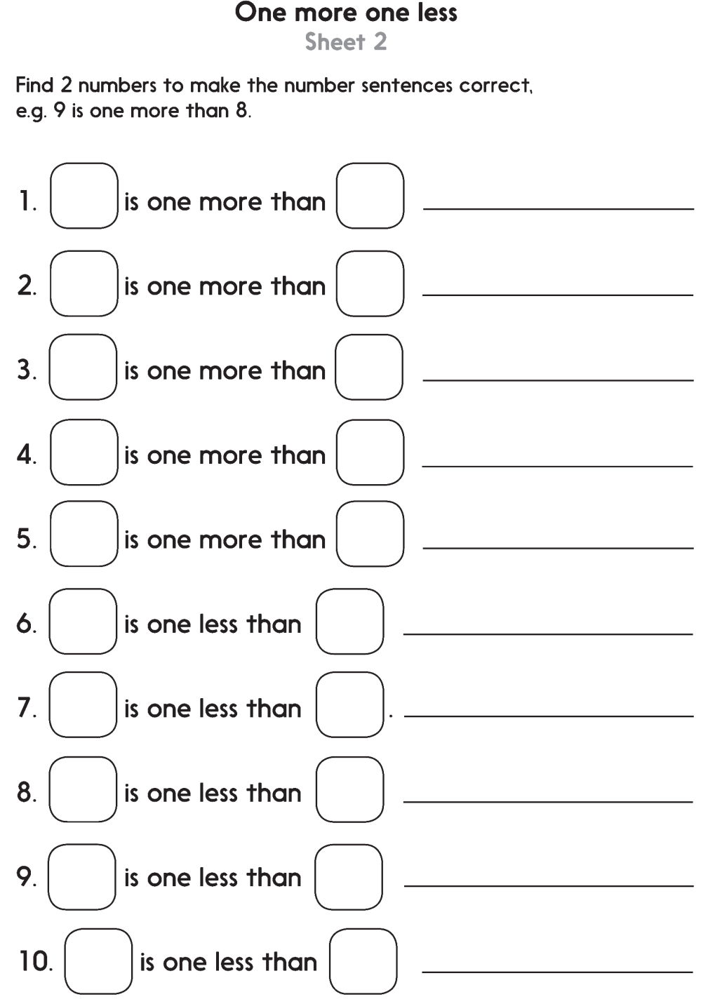
Notes:
The Practice Sheet on this slide is suitable for most children.
Differentiated PRACTICE WORKSHEETS are available on Hamilton’s website in this unit’s PROCEDURAL FLUENCY box.
WT: One more one less Sheet 1
ARE/GD: One more one less Sheet 2

Slide 12
Show me – Mini Board Time
1) 8 + 1 =
2) ___ is more than ___
3) ___ is less than ___
4) 5 – 1 =

