Slide 1
Addition and Subtraction
Written subtraction
Objectives
Day 1
Subtract 3-digit numbers using expanded decomposition with one move.
Day 2
Subtract 3-digit numbers using expanded decomposition with one move.
Day 3
Use expanded decomposition for 3-digit – 3-digit numbers with 1 or 2 moves.
Day 4
Use expanded decomposition for 3-digit – 3-digit numbers with 1 or 2 moves.
Day 5
Subtract using decomposition or Frog.
Notes:
Before teaching, be aware that:
On each day children will need whiteboards and pens to try out calculations during the main teaching. It would also be useful to have a set of place value cards for modelling partitioning and recombining and Base 10 blocks for small group work.
On Days 2 and 3 you can use the Top Marks ‘Decomposition’ demonstration on the Interactive Whiteboard at: http://www.topmarks.co.uk/Flash.aspx?f=DecompExpandv2
On Day 4 you can use a jug of squash to model the pouring.

Slide 2
Addition and Subtraction
Written subtraction
Starters
Day 1
Subtract any 1-digit number from a teens number (pre-requisite skills)
Day 2
Subtract multiples of 10, crossing 100 (pre-requisite skills)
Day 3
Subtract any pair of 2-digit numbers (pre-requisite skills)
Day 4
Bonds to 100 (pre-requisite skills)
Day 5
Round 3-digit numbers to the nearest 10 and 100 (simmering skills)
Notes:
Choose starters that suit your class by dragging and dropping the relevant slide or slides below to the start of the teaching for each day.

Slide 3
Addition and Subtraction
Written subtraction
Starter
Subtract any 1-digit number from a teens number
Digit Work-out
Notes:
Pre-requisite skills – to use this starter, drag this slide to the start of Day 1
Display ‘Digit Work-out’ at http://www.crickweb.co.uk/ks1numeracy.html#digitmenu on the Interactive Whiteboard. Select Level 2 and then play as a class; children write the answer on their whiteboards then hold them up to show. You input the answer when nearly all children are showing you the correct answer. Alternatively, you could use mobile devices and ask children to play individually or in pairs.

Slide 4
Addition and Subtraction
Written subtraction
Starter
Subtract multiples of 10, crossing 100
Subtracting Multiples of 10 (Crossing 100) Alien Attack
Notes:
Pre-requisite skills – to use this starter, drag this slide to the start of Day 2
Display ‘Subtracting Multiples of 10 (Crossing 100) Alien Attack’ at http://www.snappymaths.com/subtraction/subm10c100/interactive/subm10c100attack.htm. Initially select A→B and then play as a class; children write the answer on their whiteboards then hold them up to show. You input the answer when nearly all children are showing you the correct answer. Alternatively, you could use mobile devices and ask children to play individually or in pairs.

Slide 5
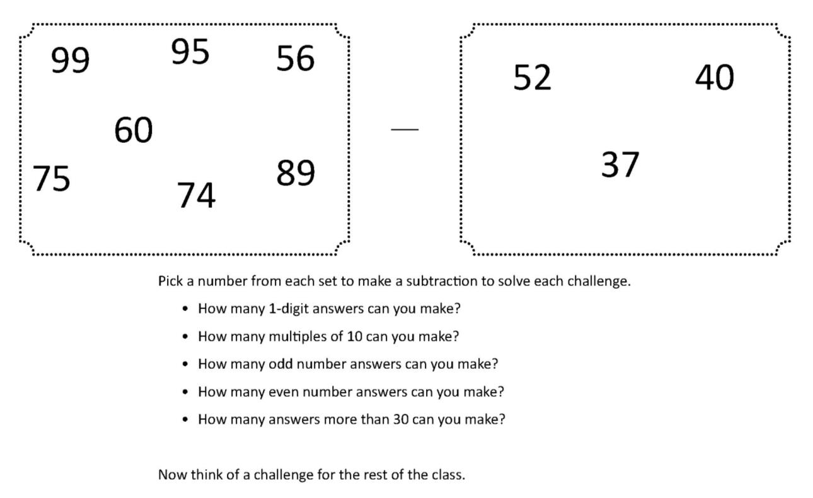
Addition and Subtraction
Written subtraction
Starter
Subtract any pair of 2-digit numbers
Notes:
Pre-requisite skills – to use this starter, drag this slide to the start of Day 3
Display two sets of numbers and challenges on the Interactive Whiteboard from the ‘Subtracting two-digit numbers’ resource (see starters resources). Explain that children need to pick pairs of numbers to subtract in order to find the answers to the challenges. As they work, focus your attention on less able children, revising strategies for mental subtraction.

Slide 6
Addition and Subtraction
Written subtraction
Starter
Bonds to 100
Notes:
Pre-requisite skills – to use this starter, drag this slide to the start of Day 4
Play ‘Ping-Pong’. Say a number between 1 and 100. Children respond with its bond to 100: ping, pong; fifty two, forty eight, etc.

Slide 7
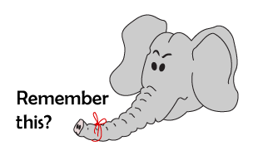
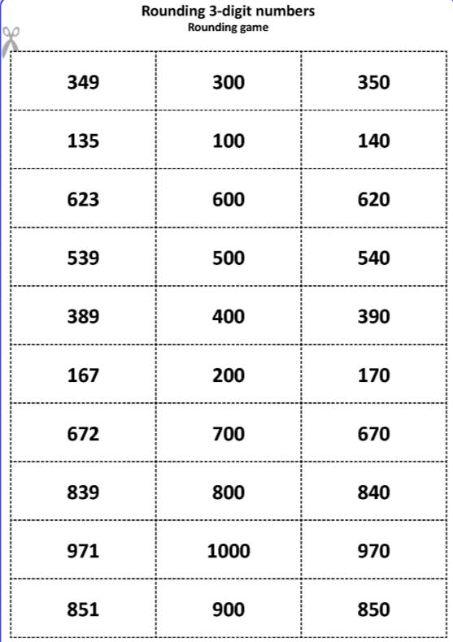
Addition and Subtraction
Written subtraction
Starter
Round 3-digit numbers to the nearest 10 and 100
Notes:
Simmering skills – to use this starter, drag this slide to the start of Day 5
Give each child a number card from the Rounding Game set (see starters resources). Explain that children need to find the other two members of their number families. Each family has a 3-digit number, its nearest 10 and its nearest 100. For instance, in the family of 324 are 320 (nearest 10) and 300 (nearest 100). Once all the families have been found, collect and shuffle the cards then play again.

Slide 8
Addition and Subtraction
Written subtraction
Objectives
Day 1
Subtract 3-digit numbers using expanded decomposition with one move.

Slide 9
Day 1: Subtract 3-digit numbers using expanded decomposition with one move.
How could we work out 654 - 321?
We could use Frog but today we are going to try another way.
First we need to partition the two numbers.
Write the two numbers as 100s, 10s and 1s.
4
4
5 0
5 0
6 0 0
6 0 0
1
3 0 0
2 0
1
2 0
3 0 0

Slide 10
Day 1: Subtract 3-digit numbers using expanded decomposition with one move.
Set out 654 – 321 like this with the numbers partitioned.
600 50 4
- 300 20 1
300
30
3
Subtract the 1s
4 - 1 = ?
Finally recombine and write the answer:
300 + 30 + 3 = 333
Subtract the 10s
50 - 20 = ?
Subtract the 100s
600 - 300 = ?

Slide 11
Day 1: Subtract 3-digit numbers using expanded decomposition with one move.
600 50 1
- 300 20 4
How could we work out 651 - 324?
40 11
300
20
7
Partition the numbers and set it out.
651 - 324 = 327
4 is bigger than 1!
Now subtract the 1s, 10s and 100s.
We take 10 from 50 and add it to the 1s.
What do you notice about 50 + 1 and 40 + 11?
This is called decomposition.

Slide 12
Day 1: Subtract 3-digit numbers using expanded decomposition with one move.
Look how we change the numbers.
How could we work out 742 - 328?
700 40 2
- 300 20 8
30 12
Set it out like before.
400
10
4
8 is bigger than 2.
We take 10 from 40 and add it to the 1s
12 - 8 = ?
30 - 20 = ?
700 - 300 = ?
So, 742 - 328 = 414

Slide 13
Day 1: Subtract 3-digit numbers using expanded decomposition with one move.
Now on your whiteboards try 445 - 339.
400 40 5
- 300 30 9
30 15
100
0
6
Set it out like this.
15 - 9 = ?
Let’s check through.
30 - 30 = ?
400 - 300 = ?
9 is bigger than 5.
We take 10 from 40 and add it to the 1s.
So, 445 - 339 = 106
Notes:
Children can now go on to do differentiated GROUP ACTIVITIES. You can find Hamilton’s group activities in this unit’s TEACHING AND GROUP ACTIVITIES download.
WT: Modelling decomposition using Base 10 equipment.
ARE: Start to subtract 3-digit numbers that need one move to the ones column: in small groups.
GD: Start to subtract 3-digit numbers that need one move to the ones column: in small groups.

Slide 14
Challenge
Notes:
The Practice Sheet on this slide is suitable for most children.
Differentiated PRACTICE WORKSHEETS are available on Hamilton’s website in this unit’s PROCEDURAL FLUENCY box.
WT: Written subtraction, Sheet 1.
ARE: Written subtraction, Sheet 2.
GD: Written subtraction, Sheet 2, including the Challenge.

Slide 15
Addition and Subtraction
Written subtraction
Objectives
Day 2
Subtract 3-digit numbers using expanded decomposition with one move.

Slide 16
Day 2: Subtract 3-digit numbers using expanded decomposition with one move.
How could we work out 657 - 432?
600 50 7
- 400 30 2
200
20
5
Partition the numbers and set it out like this.
Now subtract the 1s, 10s and 100s.
Don’t forget to recombine at the end:
200 + 20 + 5 = 225

Slide 17
Day 2: Subtract 3-digit numbers using expanded decomposition with one move.
600 50 7
- 400 70 2
Now let’s try 657 - 472.
500 150
657 – 472
= 185
100
80
5
First subtract the 1s. 7 - 2 = ?
70 is bigger than 50…
What do you notice about the 10s?
What might we do about this?
…so take 100 from 600 and add it to the 10s.
Now we can subtract the 10s.
150 - 70 = ?
Finally subtract the 100s. 500 - 400 = ?

Slide 18
Day 2: Subtract 3-digit numbers using expanded decomposition with one move.
Now on your whiteboards try these 465 - 283, 625 - 362 and 936 - 571.
Set them out carefully!
Let’s try 465 - 283.
80 is bigger than 60.
We take 100 from 400 and add it to the 10s.
400 60 5
- 200 80 3
300 160
5 - 3 = ?
100
80
2
160 - 80 = ?
465 - 283 = 182
300 - 200 = ?

Slide 19
Day 2: Subtract 3-digit numbers using expanded decomposition with one move.
Let’s try 625 - 362.
60 is bigger than 20.
We take 100 from 600 and add it to the 10s.
600 20 5
- 300 60 2
500 120
5 - 2 = ?
200
60
3
120 - 60 = ?
625 - 362 = 263
500 - 300 = ?

Slide 20
Day 2: Subtract 3-digit numbers using expanded decomposition with one move.
Let’s try 936 - 571.
70 is bigger than 30.
We take 100 from 900 and add it to the 10s.
900 30 6
- 500 70 1
800 130
6 - 1 = ?
300
60
5
130 - 70 = ?
936 - 571 = 365
800 - 500 = ?
Notes:
Children can now go on to do differentiated GROUP ACTIVITIES. You can find Hamilton’s group activities in this unit’s TEACHING AND GROUP ACTIVITIES download.
WT: In groups, use ‘Subtraction cards’ (see resources) to create difference calculations; rehearse decomposition.
ARE: Find and correct mistakes when using expanded decomposition to subtract 3-digit numbers.
GD: Find and correct mistakes when using expanded decomposition to subtract 3-digit numbers.

Slide 21
Challenge
Notes:
The Practice Sheet on this slide is suitable for most children.
Differentiated PRACTICE WORKSHEETS are available on Hamilton’s website in this unit’s PROCEDURAL FLUENCY box.
WT: Written subtraction, Sheet 1, plus a Challenge.
ARE: Written subtraction, Sheet 2, plus a Challenge.
GD: Written subtraction, Sheet 3, plus a Challenge.
.

Slide 22
Addition and Subtraction
Written subtraction
Objectives
Day 3
Use expanded decomposition for 3-digit – 3-digit numbers with 1 or 2 moves.

Slide 23
Day 3: Use expanded decomposition for 3-digit - 3-digit numbers with 1 or 2 moves.
Let’s try these subtractions:
460 - 238 and
734 - 351.
In the first we moved 10s to 1s, in the second we moved 100s to 10s.
Who can talk us through this one?
Who can talk us through this one?
400 60 0
- 200 30 8
50 10
700 30 4
- 300 50 1
600 130
200
20
2
300
80
3
460 - 238 = 222
734 - 351 = 383

Slide 24
800 1
Day 3: Use expanded decomposition for 3-digit - 3-digit numbers with 1 or 2 moves.
Talk to your partner. What will happen with this subtraction?
966 - 177.
900 60 6
- 100 70 7
50 16
700
80
9
966 - 177 = 789
7 is bigger than 6.
We take 10 from 60 and add it to the 1s.
70 is bigger than 50.
We take 100 from 900 and add it to the 10s.
800 - 100 = ?
16 - 7 = ?
150 - 70 = ?
That was a
2 move subtraction!!

Slide 25
700 1
Day 3: Use expanded decomposition for 3-digit - 3-digit numbers with 1 or 2 moves.
Let’s try another:
842 - 467.
800 40 2
- 400 60 7
30 12
300
70
5
842 - 467 = 375
7 is bigger than 2.
We take 10 from 40 and add it to the 1s.
30 is bigger than 60.
We take 100 from 800 and add it to the 10s.
700 - 400 = ?
12 - 7 = ?
130 - 60 = ?
That was another
2 move subtraction!

Slide 26
Day 3: Use expanded decomposition for 3-digit - 3-digit numbers with 1 or 2 moves.
Whole class investigation
In pairs, think of a 3-digit number with three different digits.
Write the number, then follow this process.
- Reverse the last two digits, e.g. 352.
- Write the new number, e.g. 325.
- Find the difference between the two numbers using expanded
decomposition.
- Add the digits of the answer, e.g. 27, so 2 + 7 = 9.
- If there are still two digits, add the digits of that answer too.
Try with another 3-digit number, e.g. 783 – 387.
Think of your own 3-digit numbers to replicate this.
- What do you notice?
- Does this always happen?
- Can you find any exceptions?
Notes:
Today would be a great day to use a problem-solving investigation – Hole-y Subtractions – as the group activity, which you can find in this unit’s IN-DEPTH INVESTIGATION box on Hamilton’s website.
Today’s GROUP ACTIVITY is also a whole class investigation.
Look at children’s subtractions and check their use of expanded column subtraction. Use Base 10 equipment to model exchanging between columns if any children are confused.
WT: Children can work together as a group with an adult and use Base 10 equipment.
GD: Children should look at the numbers and begin to explain the pattern. (Hint: look at the difference between the last 2 digits of the number you start with. Try some with a difference of 1).

Slide 27
Challenge
Challenge
Notes:
The Practice Sheet on this slide is suitable for most children.
Differentiated PRACTICE WORKSHEETS are available on Hamilton’s website in this unit’s PROCEDURAL FLUENCY box.
WT: Start at Bronze.
ARE: Start at Silver.
GD: Start at Gold.
.

Slide 28
Addition and Subtraction
Written subtraction
Objectives
Day 4
Use expanded decomposition for 3-digit – 3-digit numbers with 1 or 2 moves.

Slide 29
Day 4: Use expanded decomposition for 3-digit - 3-digit numbers with 1 or 2 moves.
This glass has 533ml of squash in it.
I pour out 251ml.
Talk to your partner. Estimate how much squash is left in the glass.

Slide 30
Day 4: Use expanded decomposition for 3-digit - 3-digit numbers with 1 or 2 moves.
Let’s check our estimates using decomposition.
3 - 1 = ?
50 is bigger than 30.
We take 100 from 500 and add it to the 10s.
500 30 3
- 200 50 1
400 130
130 - 50 = ?
200
80
2
400 - 200 = ?
533 - 251 = 282
We can check our answer by addition. On your whiteboards add 282 back to 251.
282 + 251 = ?

Slide 31
Day 4: Use expanded decomposition for 3-digit - 3-digit numbers with 1 or 2 moves.
Let’s try
626ml - 351ml.
6 - 1 = ?
50 is bigger than 20.
We take 100 from 600 and add it to the 10s.
Estimate first.
120 - 50 = ?
600 20 6
- 300 50 1
500 120
500 - 300 = ?
200
70
5
We can check our answer by addition. On your whiteboards add 275 back to 351.
275 + 351 = ?
626ml - 351ml = 275ml

Slide 32
Day 4: Use expanded decomposition for 3-digit - 3-digit numbers with 1 or 2 moves.
Let’s try
731ml - 228ml.
700 30 1
- 200 20 8
20 11
500
0
3
Estimate first.
731ml - 228ml = 503ml
Let’s check through.
11 - 8 = ?
8 is bigger than 1.
We take 10 from 30 and add it to the 1s.
20 - 20 = ?
700 - 200 = ?
Check with addition.
Notes:
Children can now go on to do differentiated GROUP ACTIVITIES. You can find Hamilton’s group activities in this unit’s TEACHING AND GROUP ACTIVITIES download.
WT: Children solve and check subtractions and create a poster with ‘top tips’ on solving these problems (simpler examples).
ARE/GD: Children solve and check subtractions and create a poster with ‘top tips’ on solving these problems.

Slide 33
Challenge
Challenge
Notes:
The Practice Sheet on this slide is suitable for most children.
Differentiated PRACTICE WORKSHEETS are available on Hamilton’s website in this unit’s PROCEDURAL FLUENCY box.
WT: Subtraction using expanded decomposition Sheet 1
ARE: Subtraction using expanded decomposition Sheet 2.
GD: Subtraction using expanded decomposition Sheet 2.
.

Slide 34
Addition and Subtraction
Written subtraction
Objectives
Day 5
Subtract using decomposition or Frog.

Slide 35
700
Day 3: Use expanded decomposition for 3-digit - 3-digit numbers with 1 or 2 moves.
Let’s try
802 - 374.
800 0 2
- 300 70 4
90 12
400
20
8
4 is bigger than 2 but there are no 10s!
802 - 374 = 428
….and put 90 of it in the 10s and 10 in the 1s
We have to take 100 from the 800…
12 - 4 = ?
700 - 300 = ?
90 - 70 = ?

Slide 36
Day 5: Subtract using decomposition or Frog.
Which strategy did you find more straightforward?
Let’s try that one with Frog instead.
Add the jumps.
400 + 26 + 2 = ?
Frog jumps 26 to 400…
… and then 400 from 400 to 800...
… then 2 from 800 to 802.
26
400
2
374
400
800
802

Slide 37
800
Day 3: Use expanded decomposition for 3-digit - 3-digit numbers with 1 or 2 moves.
Let’s try 904 - 785.
Work in pairs. One use decomposition, the other Frog.
Decomposition first...
900 0 4
- 700 80 5
90 14
100
10
9
904 - 785 = 119
5 is bigger than 4 but there are no 10s!
We have to take 100 from the 900…
….and put 90 of it in the 10s and 10 in the 1s
800 - 700 = ?
14 - 5 = ?
90 - 80 = ?

Slide 38
Day 5: Subtract using decomposition or Frog.
Which do you think was more efficient?
Now with Frog.
100 + 15 + 4 = ?
Add the jumps.
… and then 100 to from 800 to 900...
… then 4 from 900 to 904.
Frog jumps 15 to 800…
100
4
15
785
800
900
904

Slide 39
Day 5: Subtract using decomposition or Frog.
Talk to your partner.
How would you each choose to solve 406 – 375 ?
Who preferred Frog for that one?
Can you explain why?
Notes:
Children can now go on to do differentiated GROUP ACTIVITIES. You can find Hamilton’s group activities in this unit’s TEACHING AND GROUP ACTIVITIES download.
WT: Children solve subtraction questions with different strategies and agree which works best (with support).
ARE: Children solve subtraction questions with different strategies and agree which works best .
GD: Children think up subtractions best solved by each strategy.

Slide 40
Challenge
Challenge
Notes:
The Practice Sheet on this slide is suitable for most children.
Differentiated PRACTICE WORKSHEETS are available on Hamilton’s website in this unit’s PROCEDURAL FLUENCY box.
WT: Start at Bronze.
ARE: Start at Silver.
GD: Start at Gold.

Slide 41
Addition and Subtraction
Written subtraction
Well Done! You’ve completed this unit.
Objectives
Day 1
Subtract 3-digit numbers using expanded decomposition with one move.
Day 2
Subtract 3-digit numbers using expanded decomposition with one move.
Day 3
Use expanded decomposition for 3-digit – 3-digit numbers with 1 or 2 moves.
Day 4
Use expanded decomposition for 3-digit – 3-digit numbers with 1 or 2 moves.
Day 5
Subtract using decomposition or Frog.
Notes:
You can now use the Mastery: Reasoning and Problem-Solving questions to assess children’s success across this unit. Go to the next slide.

Slide 42
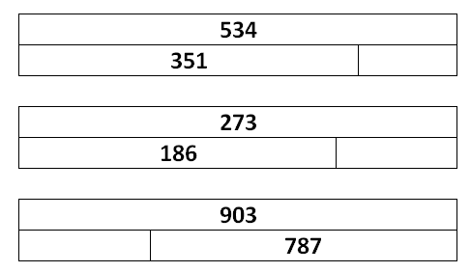
Problem solving and reasoning questions
What would need to be added to 547 to give 752?
Complete each diagram:
Here is Janie’s homework.
(i) 502 – 468 =
(ii) 673 – 348 =
(iii) 713 – 583 =
(iv) 919 – 845 =
Advise her how to do each one, explaining why you are suggesting that method. Then work out the correct answers.

Slide 43
Problem solving and reasoning answers
What would need to be added to 547 to give 752? 205
Complete each diagram:
Here is Janie’s homework.
(i) 502 – 468 = 34 (ii) 673 – 348 = 325 (iii) 713 – 583 = 130 (iv) 919 – 845 = 74
Advise her how to do each one, explaining why you are suggesting that method. Then work out the correct answers.
Best solved by Frog (counting up) since the numbers are close, with 10s and 1s digits larger in the smaller number.
Best solved by expanded decomposition as the gap is large.
Best solved by Frog (counting up) as both numbers are close to 100s.
Best solved by Frog (counting up) since the numbers are close, with 10s digit larger in the smaller number.
Children may argue differently - which is fine - as long as they have a valid reason and, of course, are able to find the correct answer.

