Slide 1
Unit 4.Be an animator
Year 2

Slide 2
Learning Objective:
LO
Learners will be able to
know how to develop programs to produce desired outputs, including the use of the repeat block.

Slide 3
TNG Vision & Mission Independent learning, active participation, a safe and positive environment, technology-enhanced environment
Annual revenue growth

Slide 4
Big Question
1. Can you think of a fun game or activity where we can use a repeat block to make the computer do something cool?
2. What are some other things we can do with programming to make our schoolwork or fun activities easier and more exciting?

Slide 5
Warm up Activity
Teaching point:
The Repeat block can be used to repeat one line of instruction or a set of instructions.
Animation uses the "repeat" block to make a character do something multiple times.

Slide 6
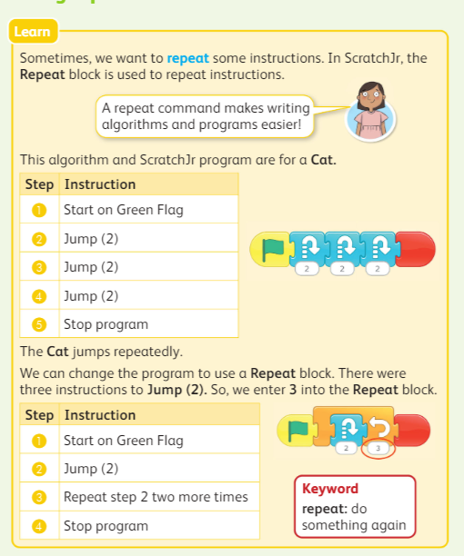
Main Activity
Task 1: (20 mins):
Pairs of students will collaborate to discuss and work together to solve the provided problem.
The learners are expected to use the algorithm from the Learn panel to program the Cat character to jump repeatedly using the Scratch]r program. The code with the Repeat block, shown in the Learn panel, should be used in the program.(page no. 60)

Slide 7
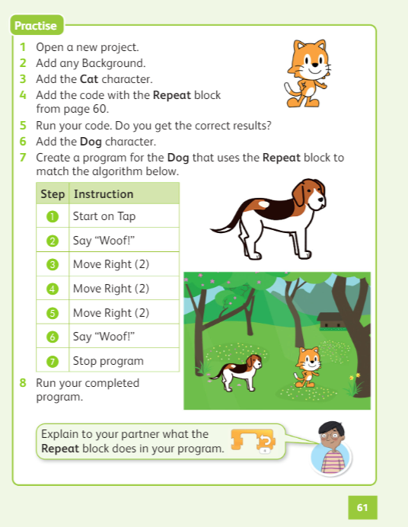
Task 2 (Continuation of task 1- 20 mins): Learners should then add the Dog character and create a program for the Dog character using the Repeat block to match the algorithm.
Richard Branson

Slide 8
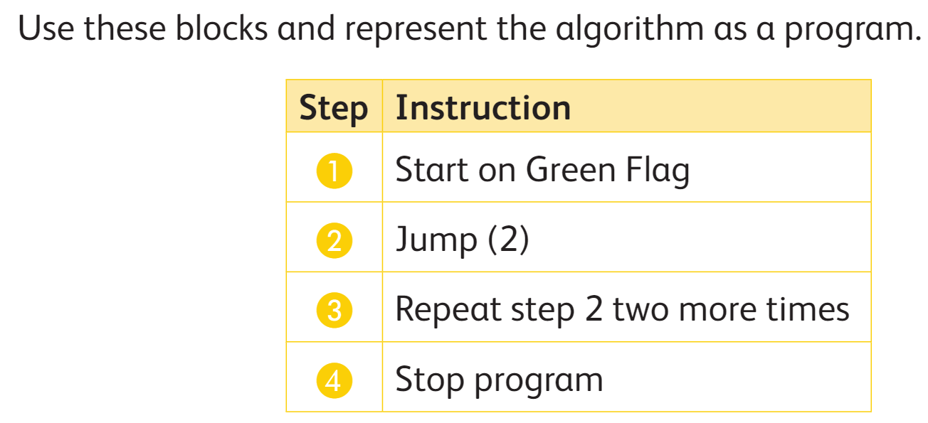
Extension task:
Early finishers will use the algorithm and make a ScratchJr program.

Slide 9
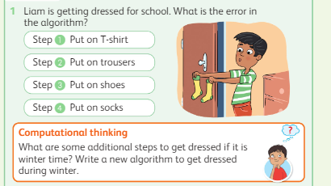
Plenary
Exit Ticket
Learners give the answer in sticky notes.

Slide 10
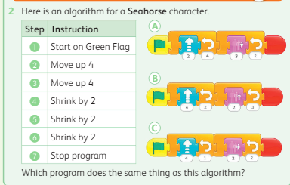
Homework
Enjoy your
day

