Slide 1
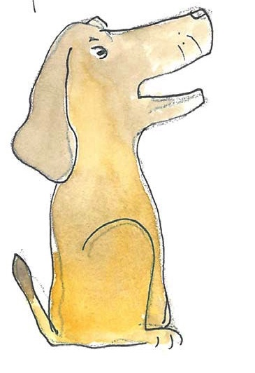
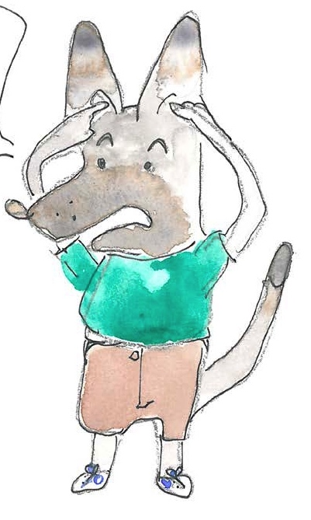
Using conjunctions and prepositions to
add information about time, place and cause

Slide 2
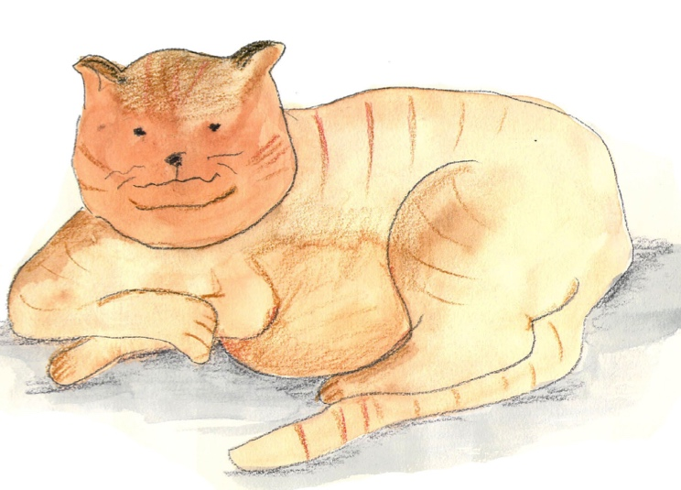
The Dog
The dog,
when he got a chance,
raced after the sleek, ginger cat
but failed to catch her as she jumped in the tree.

Slide 3
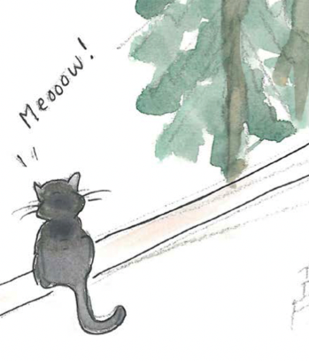
Verbs
Verbs indicate that someone or something is
doing, feeling or being.
He smells.
The cat miaows.
A cloud drifts.
I cheered!
Usually verbs have the name of a person or thing or a pronoun in front of them.
Revision

Slide 4
Clauses
Clauses are groups of words with an active verb and a subject.
The dog smelt something.
He looked all around.
Then he spotted the cat, sitting on the wall.
He barked loudly, ready to chase her.
The subject is ‘the doer’ of the verb; it can be a noun or pronoun.
Revision

Slide 5
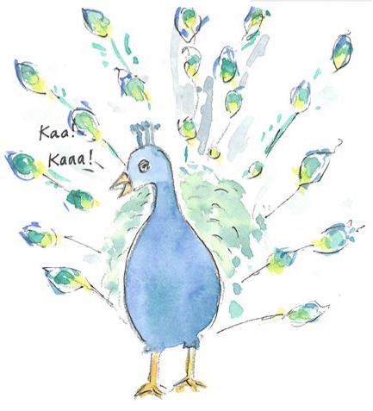
Conjunctions
Conjunctions are joining words.
because
when
where
as
after
wherever
so
before
until
while
since
as
Can you see a pattern in the grouping of these conjunctions?

Slide 6
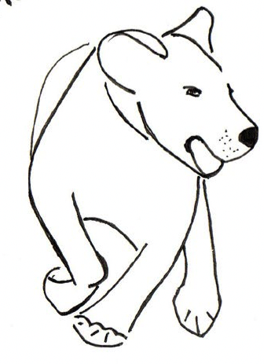
The dog smelt something.
Conjunctions
Conjunctions join clauses.
as
join clauses.
He looked around.
because
so
He spotted the cat.
I love chasing cats!
before
after
He barked loudly.
when
since
until
The dog looked around because he smelt something.
as
while
He barked loudly when he spotted the cat.
wherever
where
Wherever he spotted a cat, the dog chased it away.
Remember – a clause always has an active verb.

Slide 7
Conjunctions
Conjunctions help us express time, place and cause.
The dog feared the cat…
while she lay on the wall.
When?
The dog feared the cat…
after she scratched him.
The dog feared the cat…
when he was a puppy.
Spot the active verb in each clause.
Try adding your own clause to express time.

Slide 8
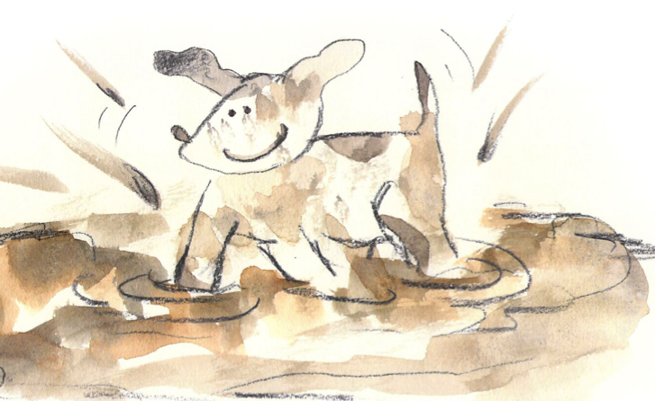
Conjunctions
Conjunctions help us express time, place and cause.
The dog feared the cat …
where the wall was high.
Where?
The dog feared the cat…
where the branches were low.
The dog feared the cat…
where there was no escape.
Wherever is useful for more general statements.
You find mess wherever you have a puppy.
I like to take photos wherever I go.
Cats leave fur wherever they sleep.
Spot the active verb in each clause.
Try adding your own clause to express place.

Slide 9
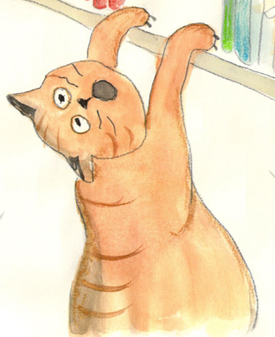
Conjunctions
Conjunctions help us express time, place and cause.
The dog feared the cat …
because she could scratch him.
How?
The dog feared the cat…
since she was always very fierce.
Why?
The dog feared the cat…
as she took every chance to attack him!
Why?
Spot the active verb in each clause.
Try adding your own clause to express cause.

Slide 10
The Cat
The cat
faced down the dog
when he had chased her up a tree.
She purred softly, “A dog can never catch a cat!”

Slide 11
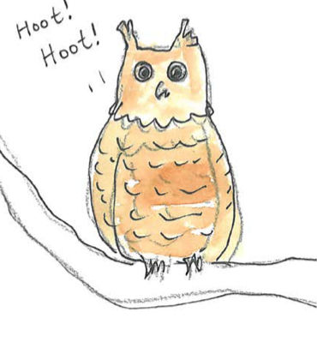
Verbs
Verbs indicate that someone or something is
doing, feeling or being.
She hoots.
The mouse creeps.
The owl stares.
I listen!
Usually verbs have the name of a person or thing or a pronoun in front of them.
Revision

Slide 12
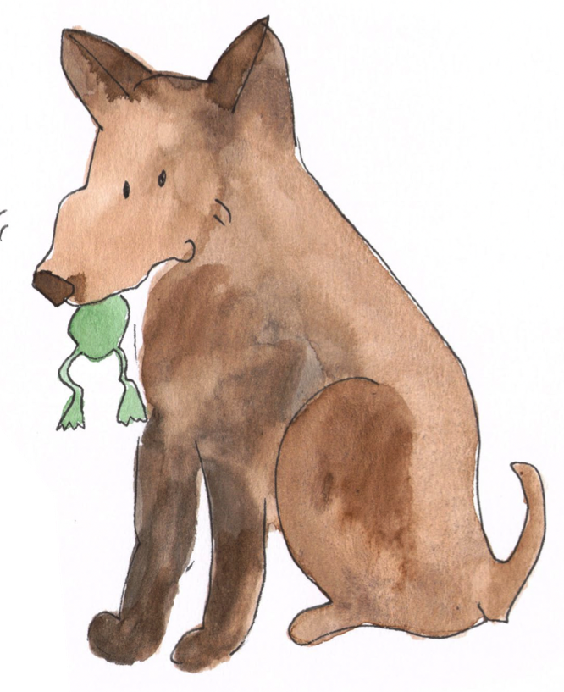
Phrases
A phrase is a group of words which adds meaning to a sentence.
under the tree
with a tasty titbit
in the night
because of the storm
There is no active verb in a phrase.
Revision

Slide 13
Prepositions
Prepositions show the relationship between words.
above
on
over
before
because of
from
due to
between
while
in
since
outside
inside
under
from
at
on
below
after
for
during
Can you see a pattern in the grouping of these prepositions?

Slide 14
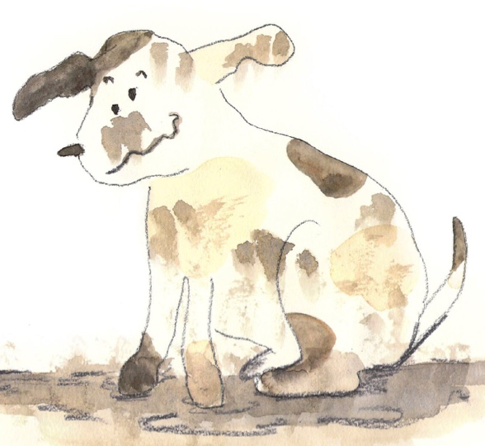
Prepositions
Prepositions link a phrase to a clause.
I think there is a puppy
in the wet mud puddle!
I lie down comfortably
with the soft, warm cat.
She often goes out
in the middle of the night.

Slide 15
Prepositions
Prepositions help us express time, place and cause.
time
, place
and cause.
When?
The cat woke up
at dawn.
The puppy played
during the afternoon.
We found both pets
after breakfast time.
Prepositions
while, since,
before, during, after, at, on
Try adding your own prepositional phrase to express time.

Slide 16
Prepositions
Prepositions help us express time, place and cause.
time,
place
and cause.
Where?
The cat woke up
outside the kitchen.
The puppy played
below the bridge.
We found both pets
in the middle of the garden.
Prepositions
above, below,
inside, outside, on, in, between
Try adding your own prepositional phrase to express place.

Slide 17
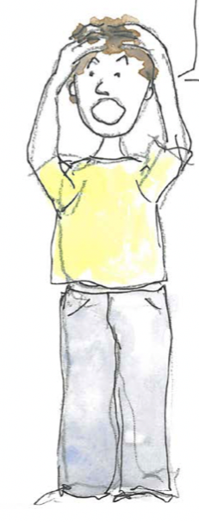
Prepositions
Prepositions help us express time, place and cause.
time,
place and
cause.
The cat woke up
from a dreamless sleep.
How?
The puppy played
due to excess energy.
Why?
We found both pets
because of the awful smell.
How?
Prepositions
because of, due to,
from, for
Try adding your own prepositional phrase to express cause.

Slide 18
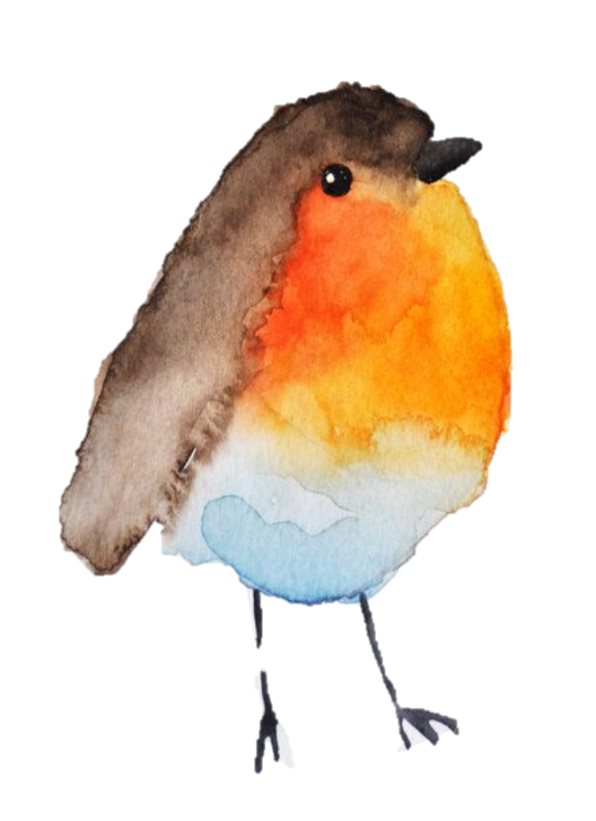
The Robin
The robin
hopped along the branch
where the cat had perched in the warm sunlight.
After the cat jumped down on top of the dog, the robin sang.

Slide 19
Placing and punctuating phrases and clauses
Subordinate clauses can be added at the start, in the middle or at the end of a sentence.
When the cat purrs, I feel so very contented.
when
No comma is needed when the clause is at the end.
I feel, when the cat purrs, so very peaceful.
because
I feel so very honoured when the cat purrs.
that
Notice how we need commas in the first two.
if
Commas separate the clause from the rest of the sentence.

Slide 20
Placing and punctuating phrases and clauses
Phrases can be added at the start, in the middle or at the end of a sentence.
No comma is needed when the phrase is at the end.
Beside the door, the dog is whining to go out.
I hope, in the morning, not to find a mess on the floor!
The dog eats his dinner on the floor by the door.
Notice how we need commas in the first two.
Commas separate the phrase from the rest of the sentence.

Slide 21
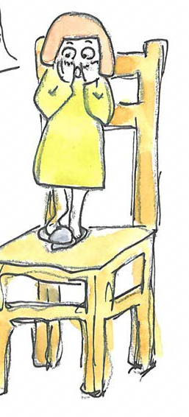

Placing and punctuating phrases and clauses
Phrases and clauses can be at the beginning or the end of a sentence.
A cat is purring
a cat is purring.
under my bed.
Under my bed,
I play football
When my dog is tied up,
I play football.
when my dog is tied up!
The cat went hunting
Under the trees,
the cat went hunting.
under the trees.
Highlight the subordinate clause.
Because the mouse was alive,
we shut the cat
in the bathroom.
Choose a sentence to write out.
Underline the main clause.
Or circle the phrase.

Slide 22
The dog,
when he got a chance,
raced after the sleek, ginger cat
but failed to catch her as she jumped in the tree.
The cat
faced down the dog
when he had chased her up a tree.
She purred softly, “A dog can never catch a cat!”
The robin
hopped along the branch
where the cat had perched in the warm sunlight.
After the cat jumped down on top of the dog, the robin sang.

Slide 23
End

