Slide 1
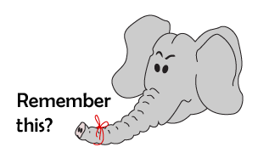
Addition and Subtraction
Adding by counting on (numbers to 20)
Starter
Place value of teens numbers
Notes:
Simmering skills – to use this starter, drag this slide to the start of Day 4
Children sit with feet stretched out in front of them. Show number 11. Show me this number with your fingers and toes. Children wiggle their feet (they can keep socks on!) to show 10 and show the 1 with their fingers. Repeat for each number to 20. Shuffle a pack of 10–20 cards; hold up numbers randomly, children to show using feet and fingers.

Slide 2
Addition and Subtraction
Adding by counting on (numbers to 20)
Objectives
Realise that addition can be done in any order.

Slide 3
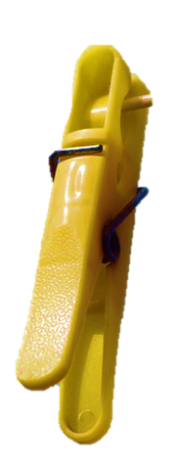
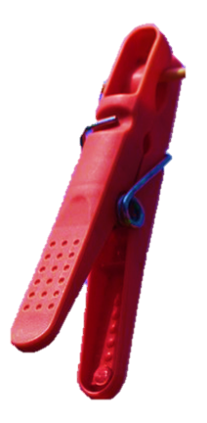
Day 4: Realise that addition can be done in any order.
Let’s add 7 pegs.
Notes:
Count on saying 3, 4, 5, … 9 and note that it was a lot to count on!

Slide 4
Day 4: Realise that addition can be done in any order.
Let’s start with 7 pegs this time and count on 2.
Notes:
Ask if you turn the coat hanger round, if there are still the same number of pegs.
Point to the 7, and count on 8, 9.

Slide 5
Day 4: Realise that addition can be done in any order.
What number sentences can we write?
2 + 7 = 9
7 + 2 = 9

Slide 6
Day 4: Realise that addition can be done in any order.
3 + 6
Notes:
Ask children if it would it be easier to work out 3 count on 6, or 6 count on 3? Will you get the same answer?
Count on saying 4, 5, … 9.

Slide 7
Day 4: Realise that addition can be done in any order.
6 + 3
Notes:
Try it the other way. Count on saying 7, 8, 9.

Slide 8
Day 4: Realise that addition can be done in any order.
What number sentences can we write?
3 + 6 = 9
6 + 3 = 9

Slide 9
Day 4: Realise that addition can be done in any order.
Would you swap around any of these additions to make counting on quicker?
2 + 13
15 + 3
11 + 4
2 + 17
3 + 9
14 + 4
Notes:
Note that it is easier to put the larger numbers first.
Children can now go on to do differentiated GROUP ACTIVITIES. You can find Hamilton’s group activities in this unit’s TEACHING AND GROUP ACTIVITIES download.
WT/ARE/GD: Discuss and decide whether to stick or switch the addition number sentence.

Slide 10
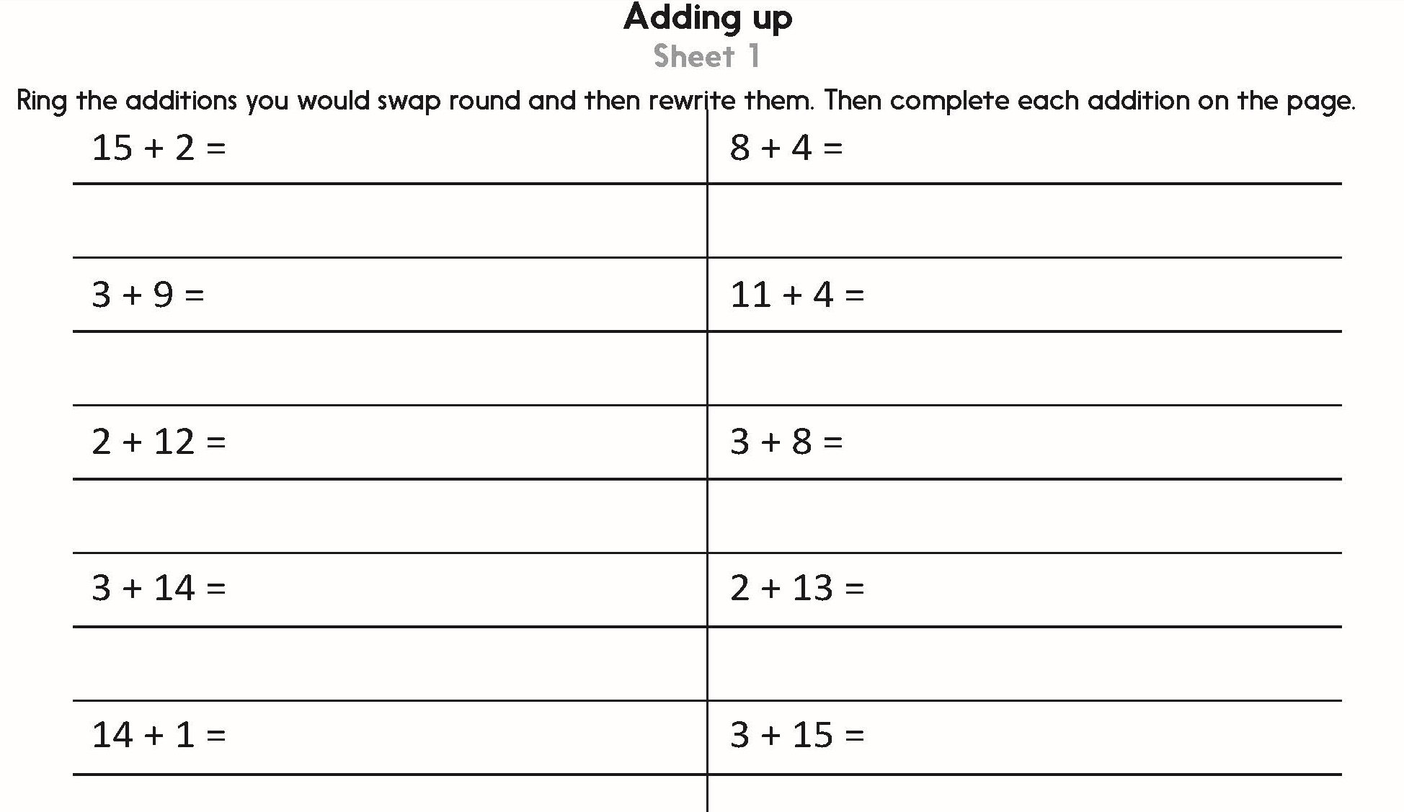
Challenge
Notes:
The Practice Sheet on this slide is suitable for most children.
Differentiated PRACTICE WORKSHEETS are available on Hamilton’s website in this unit’s PROCEDURAL FLUENCY box.
WT: Adding up Sheet 1
ARE/GD: Adding up Sheet 2

Slide 11
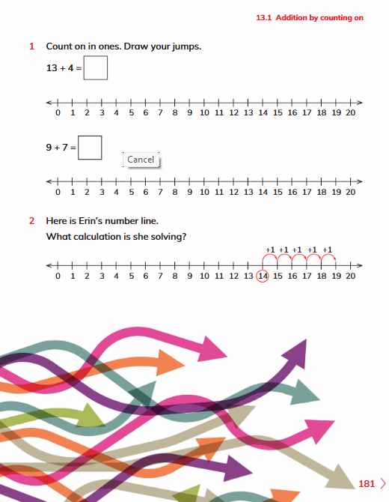
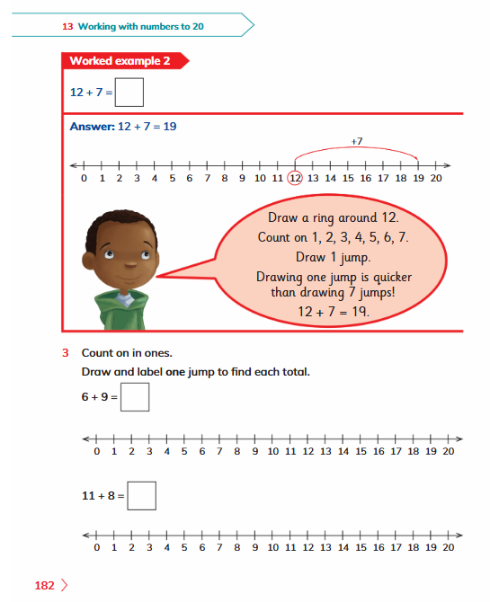
Book Exit
Complete Learners Book pages 181-182 nos. 1,2 and 3

