Slide 1
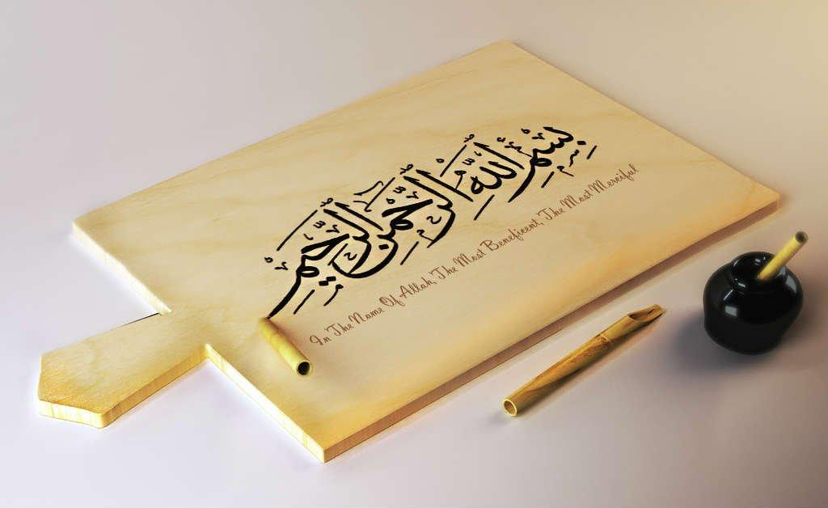
https://youtu.be/Sta_p-oB_d4?si=PSzflbzQ7wHiQ1tU

Slide 2
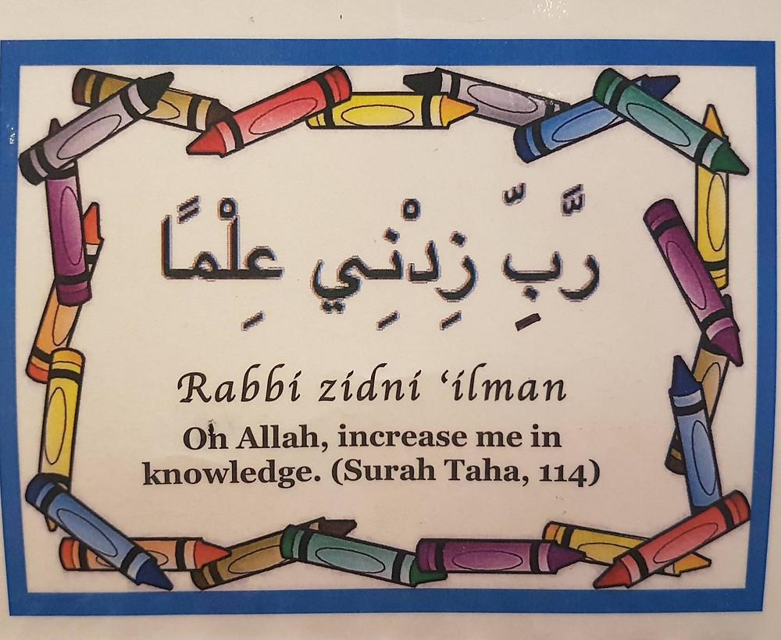
https://youtu.be/Sn3ElZG_WwQ?si=XDsPu9P89Av1dU5L

Slide 3
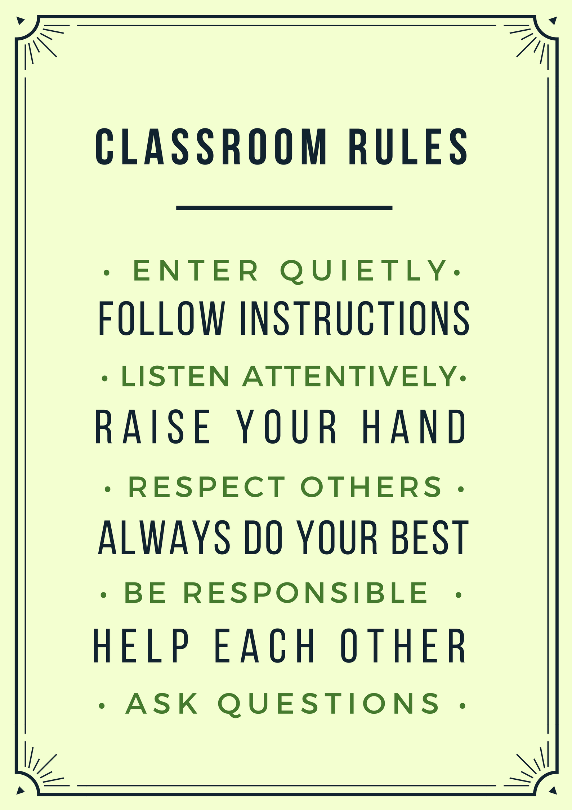
QUR'AN CLASS RULES
Please maintain silence and Respect Qur'an (speech of Allah)

Slide 4
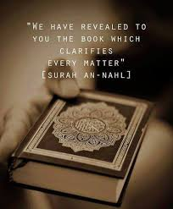
What is the main theme of surah al Qariah?
The main theme of Surah Al-Qariah is the Day of Judgment. This Surah describes a very important day when everyone will be judged for their actions. It talks about how everything will be shaken, and people will be divided based on their good or bad deeds. On this day, those who have done many good deeds will be rewarded with Jannah (Paradise), and those who did not will face a difficult time.
The Surah teaches us to always do good and remember that our actions in this life will decide our place in the hereafter

Slide 5
By the end of the lesson students will be able to Recite the Surah al Qariah with proper Tajweed and correct articulation points and focus on heavy letters and Light Letters. Memorize the surah by repeating it in chorus many times.

Slide 6
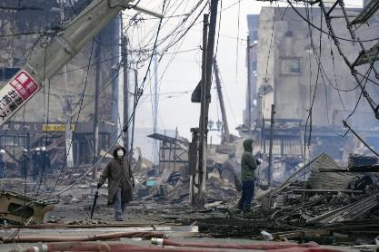
QATAR IDENTITY
https://www.volcanodiscovery.com/place/46992/earthquakes/doha-today.html
The above link is to find out the latest updates about earthquakes in the region.
My Values shape my identity: Pride
Qatar’s national language is Arabic and it’s a pride for us as Muslims that our holy Book is in Arabic. This is a very influential language and has deep meanings in simple words.

Slide 7
REPEATITION TIME
https://www.youtube.com/watch?v=jldIY3-PBM0

Slide 8
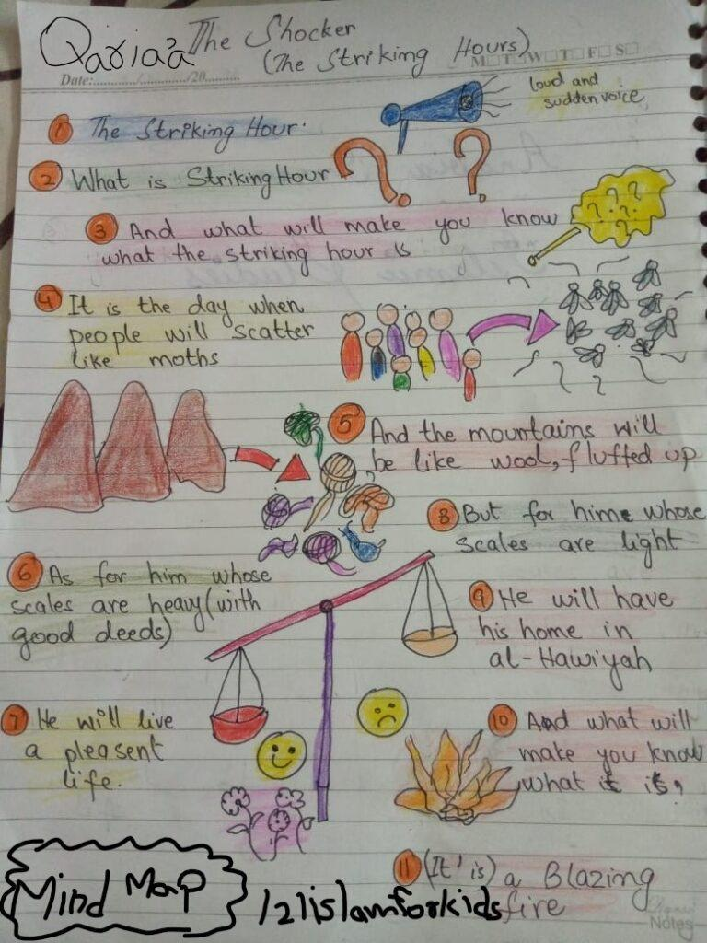
Key Vocabulary
Al-Qariah القارعة) – The Great Calamity( Day of Judgment
Thaqeel ثَقِيلَة) – Heavy (good deeds that weigh a lot on the scale)
Khafeef خَفِيفَة) – Light (bad deeds that don’t weigh enough on the scale)
Meezan مِيزَان) – Scale (used to weigh good and bad deeds)
Hawiyah هَاوِيَة) – A deep pit (a place for those with few good deeds)
Surah Al-Qariah teaches us that on the Day of Judgment, our deeds will be weighed, and the result will decide our place in the hereafter

Slide 9
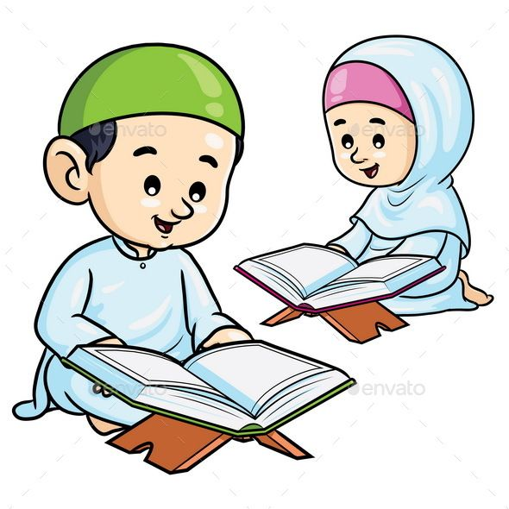
SURAH AL QARIAH
Task 2: Interpretation
Teacher will explain the main theme of the surah with the help of picture prompts used in videos.
101. Surah Al-Qariah | Ziyaad Patel | Understand & Memorize Quran Project | Juz 30 – YouTube
Learn the Quran for children : Surat 101 Al-Qari'ah (The Calamity) – YouTube
https://www.youtube.com/watch?v=kETg2fb15xc

Slide 10
Online quiz: https://wordwall.net/resource/9684543/surah-al-qariah
Students will do the online quiz about surah Qariah through the above link.

Slide 11
students will write 3 words from surah Qariah that have throat letters. They will also write the throat letters in their notebooks.

Slide 12
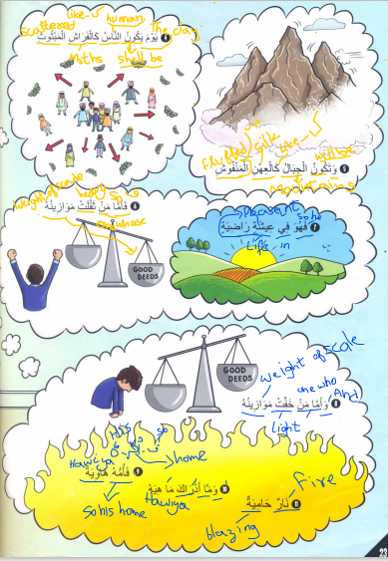
"The Answer Is..."
Prepare index cards with questions about Surah Al-Qariah.
What does "Al-Qariah" mean?
What will happen on the Day of Judgment?
How are good deeds weighed in Surah Al-Qariah?
What is the significance of the "scale" mentioned in the Surah?
Students take turns picking a card and reading the question.
Class discusses and answers the questions.
Conclude with a discussion on lessons learned and their application in daily life
We did recitation and explanation of surahal Qaria in last lesson. We already have done some tafseer with picture book during word to word translation. Now we just read and explain a bit moreabout”
How people would react?
How body parts will speak?
Where people would be gathered?

Slide 13
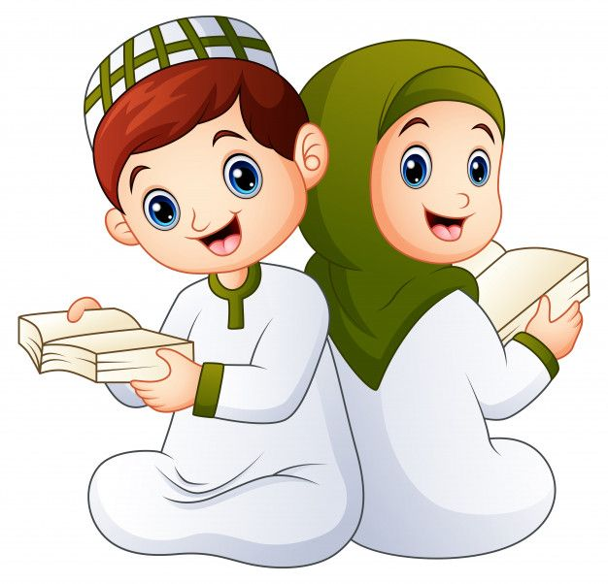
END……. ANY QUESTIONS OR DOUBTS????

