Slide 1
Shape and Data
Draw and describe 2-D shapes and polygons
Objectives
Day 1
Describe and recognise regular and irregular 2-D shapes.
Day 2
Describe and visualise common 2-D shapes.
Day 3
Make, recognise and describe 2-D shapes.
Notes:
Before teaching, be aware that:
On Day 2 you can also use shapes hidden behind a box for further practice with children selecting (without revealing) shapes to try out.
On Day 3 children will need mini-whiteboards and pens.

Slide 2
Shape and Data
Draw and describe 2-D shapes and polygons
Starters
Day 1
2-D shape (pre-requisite skills)
Day 2
Recognise 2-D shapes (pre-requisite skills)
Day 3
Pattern (simmering skills)
Notes:
Choose starters that suit your class by dragging and dropping the relevant slide or slides below to the start of the teaching for each day.

Slide 3
Shape and Data
Draw and describe 2-D shapes and polygons
Objectives
Day 2
Describe and visualise common 2-D shapes.

Slide 4
Day 2: Describe and visualise common 2-D shapes.
Some shapes are hidden behind the wall. What can they be?
Let’s try another.
What’s could the shape be? What is it
definitely not?
Talk to your partner.
What’s could the shape be? What is it definitely not?

Slide 5
Day 2: Describe and visualise common 2-D shapes.
Here are all the shapes! Can you name them all?
Notes:
Children can now go on to do differentiated GROUP ACTIVITIES. You can find Hamilton’s group activities in this unit’s TEACHING AND GROUP ACTIVITIES download.
WT/ARE: Create range of shapes on geoboards.
GD: Draw a range of different looking pentagons, hexagons and octagons on dotty paper.

Slide 6
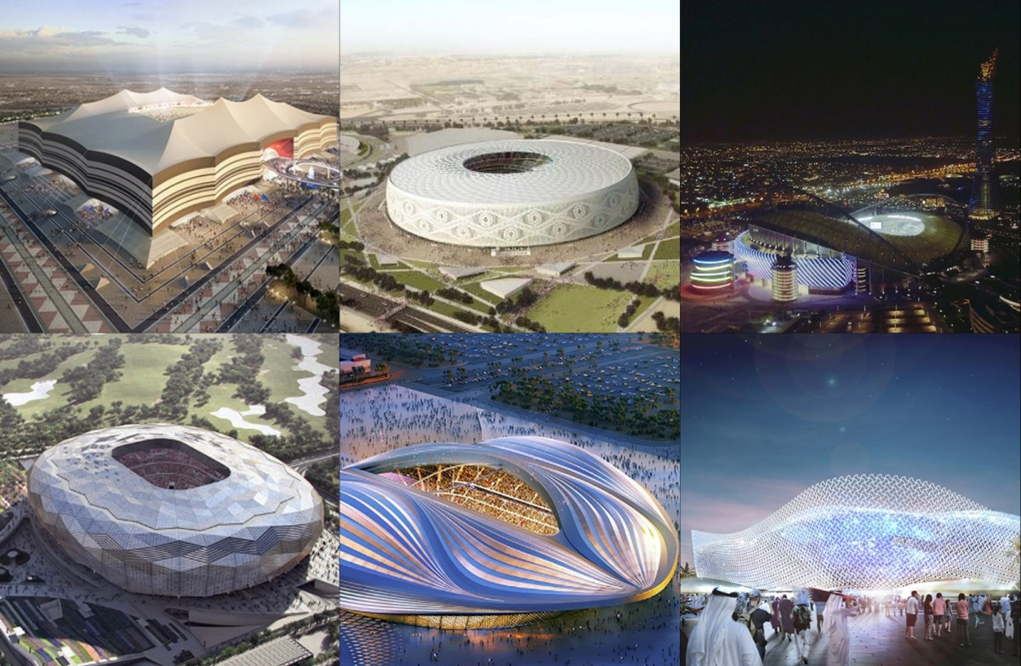
QNID
Can you recognise the stadiums’ 2D shapes from the top?
.

Slide 7
Task 1 – Pair/Group Work
Work with your group to make a square and a rectangle on the geoboard or dotty paper.
Talk about what is the same and what is different between the two shapes.
Use the elastic band to make a new 4-sided shape. How many pegs did you use for the corners?
Show your shapes to your group. Talk about how they are the same or different.
Make a triangle. Try to make it different from your friend's triangle. How is it different?
Now try making pentagons, hexagons, and octagons. Have fun!

Slide 8
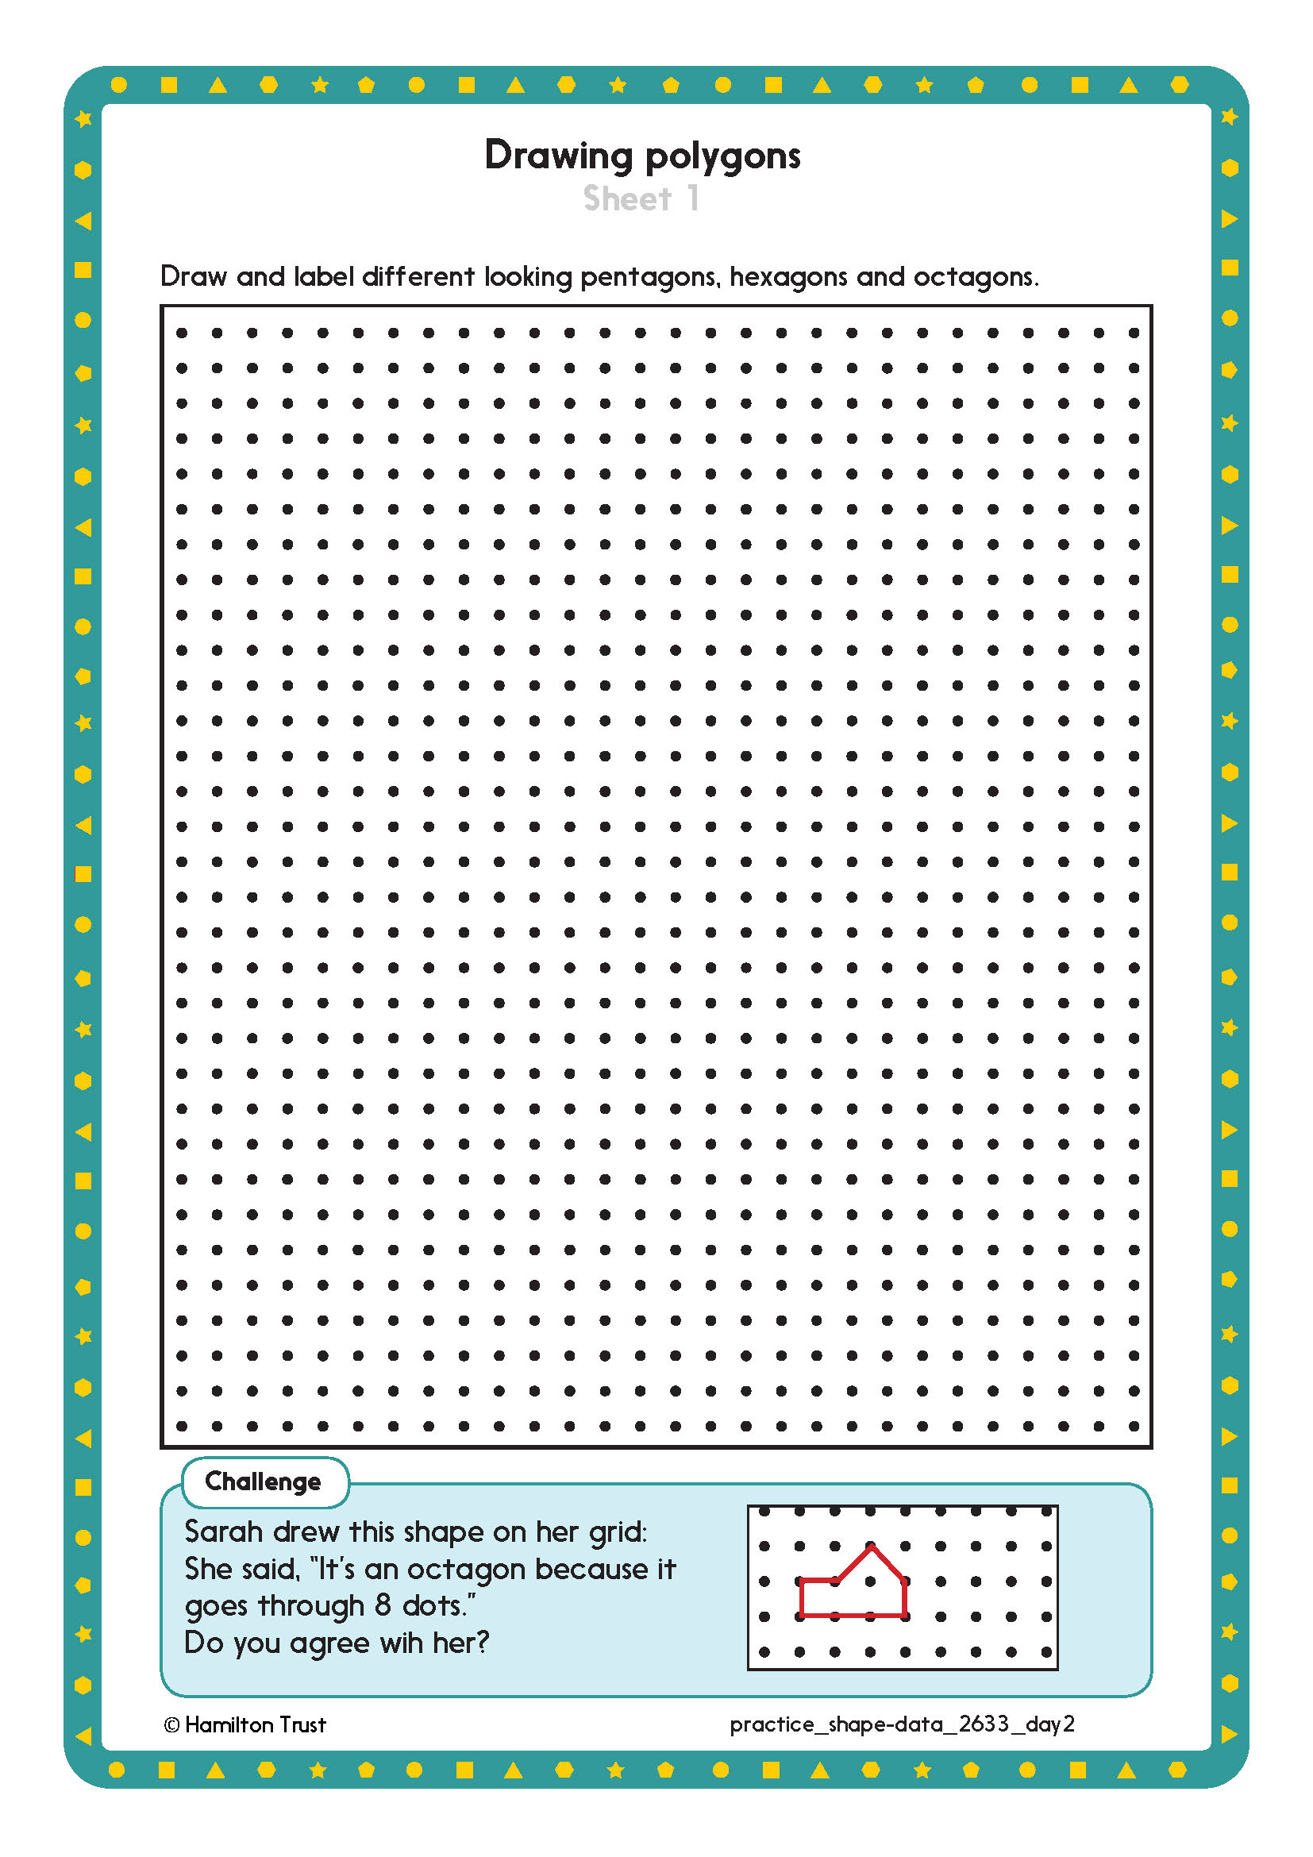
Task 2 – Independent Work
Challenge
Notes:
The Practice Sheet on this slide is suitable for most children.
Differentiated PRACTICE WORKSHEETS are available on Hamilton’s website in this unit’s PROCEDURAL FLUENCY box.
WT/ARE: Drawing polygons Sheet 1 - draw 3 of each type.
GD: Drawing polygons Sheet 1 - draw 5 of each type and complete Challenge.
NB Children may use as many copies of sheet 1 as necessary.

Slide 9
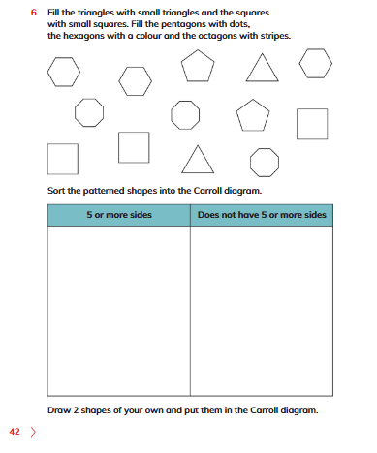
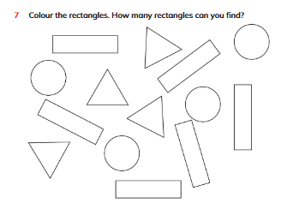
Plenary
Learner’s Book Exercise 2.2 nos. 6 and 7 on pages 42-43

Slide 10
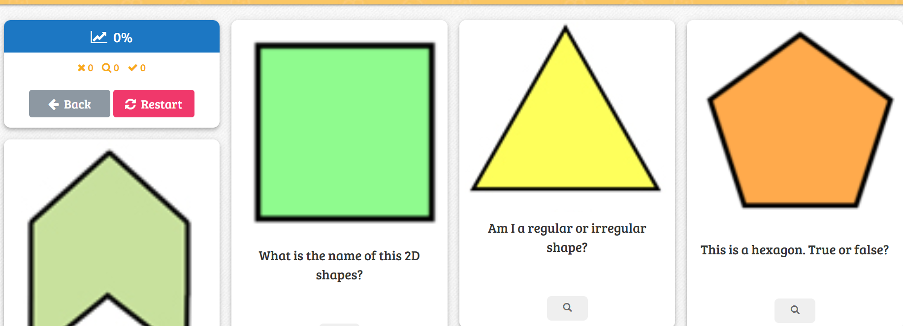
Homework
Play
https://www.baamboozle.com/study/1107304
Notes:
The Practice Sheet on this slide is suitable for most children.
Differentiated PRACTICE WORKSHEETS are available on Hamilton’s website in this unit’s PROCEDURAL FLUENCY box.
WT: Weight Sheet 1.
ARE/GD: Weight Sheet 2.

