Slide 1
PROJECT 2024-2025
CLASS 8

Slide 2
TOPIC
Create a documentation on the topic “Cyber Security and Usability in the State of Qatar”

Slide 3
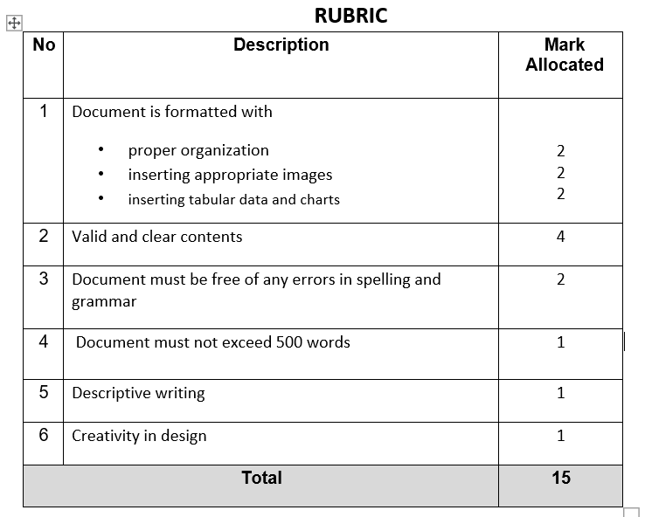
RUBRIC

Slide 4
SUBMISSION DATE : NOVEMBER 30,2024

