Slide 1
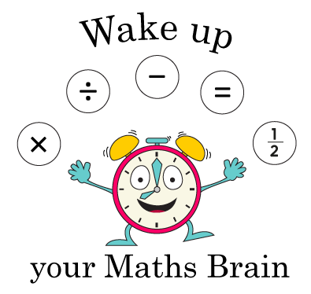
Addition and Subtraction
Using place value to add/subtract
Starter
Add/subtract multiples of 10 to or from any 2-digit number
Notes:
Pre-requisite skills – to use this starter, drag this slide to the start of Day 1
Write 37 + 30 on a card and show to a child. Amy adds a number to 37. She jumps in 10s. She jumps 3 times to the right as children see her. Write the addition on your whiteboards. Repeat with different children adding/ subtracting 20, 30, 40 or 50 (answers < 100).

Slide 2
Addition and Subtraction
Using place value to add/subtract
Objectives
Day 1
Add multiples of 1, 10 and 100 to 3-digit numbers.

Slide 3
Day 1: Add multiples of 1, 10 and 100 to 3-digit numbers.
100s | 10s | 1s
2 | 5 | 6
Copy this place value grid onto your whiteboards.
100s | 10s | 1s
How many 100s are there?
Now write the number 256 in the grid.
How many 10s are there?
How many 1s are there?

Slide 4
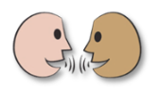
Day 1: Add multiples of 1, 10 and 100 to 3-digit numbers.
100s | 10s | 1s
2 | 5 | 6
Let’s read this together:
256 + 10
100s | 10s | 1s
2 | 6 | 6
Talk to your partner. Which digit did you change? How did you know which to change?
Now write the answer on your place value grid.
Now try
256 + 20 and 256 + 30.

Slide 5
Day 1: Add multiples of 1, 10 and 100 to 3-digit numbers.
100s | 10s | 1s
2 | 5 | 6
100s | 10s | 1s
3 | 5 | 6
Let’s read this together:
256 + 100
Talk to your partner. Which digit did you change? How did you know?
Now write the answer on your place value grid.
Now try
256 + 200 and 256 + 400.

Slide 6
Day 1: Add multiples of 1, 10 and 100 to 3-digit numbers.
100s | 10s | 1s
2 | 5 | 9
Let’s read this together:
256 + 3
Talk to your partner. Which digit did you change? How did you know?
Now write the answer on your place value grid.
Now try
256 + 1 and 256 + 5.
Notes:
Children can now go on to do differentiated GROUP ACTIVITIES. You can find Hamilton’s group activities in this unit’s TEACHING AND GROUP ACTIVITIES download.
WT: Adding 10ps and 1ps using place value grid.
ARE: Using spinners (sheet 1) to generate additions.
GD: Using spinners (sheet 2) to generate additions.

Slide 7
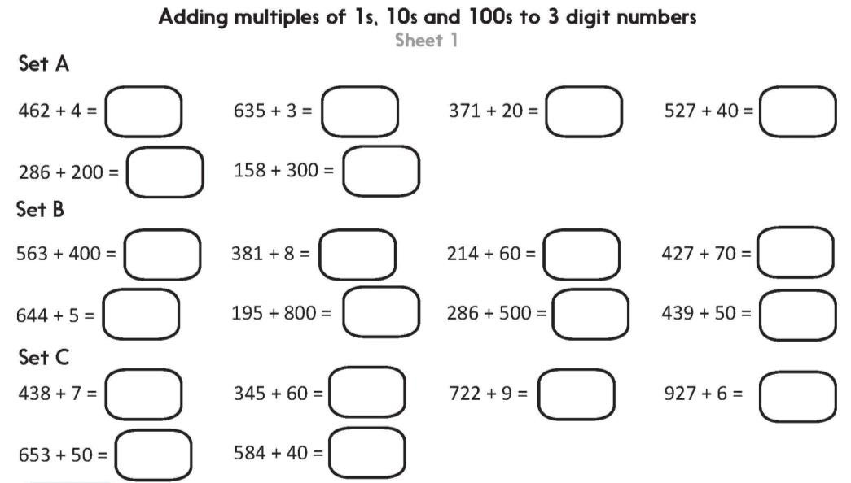
Day 1: Add multiples of 1, 10 and 100 to 3-digit numbers.
Challenge
Notes:
The Practice Sheet on this slide is suitable for most children.
Differentiated PRACTICE WORKSHEETS are available on Hamilton’s website in this unit’s PROCEDURAL FLUENCY box.
WT: Set A using place value grids to help. Children confident with Set A can attempt Set B.
ARE: Set A, then Set B.
GD: Set B, then Set C and the Challenge.

