Slide 1
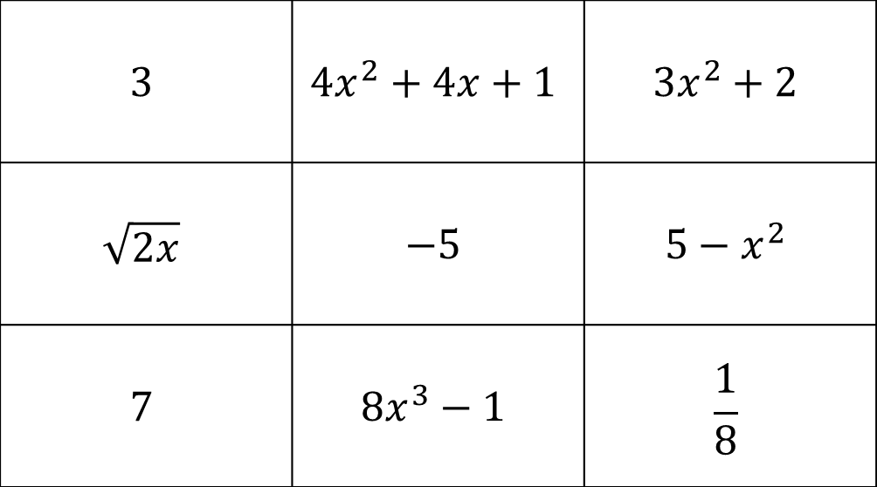
Functions Bingo
$$3$$ | $${4x}^{2}+4x+1$$ | $$3x^{2}+2$$
$$\sqrt{2x}$$ | $$−5$$ | $$5−x^{2}$$
$$7$$ | $${8x}^{3}−1$$ | $$\frac{1}{8}$$
Draw a 2x2 grid in your books
Choose 4 answers from the board to put in your grid
First to a ‘full house’ wins

Slide 2
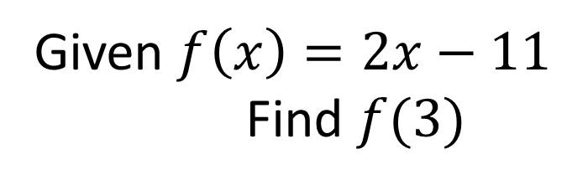
Given $f\left(x\right)=2x−11$
Find $f(3)$
Notes:
-5

Slide 3
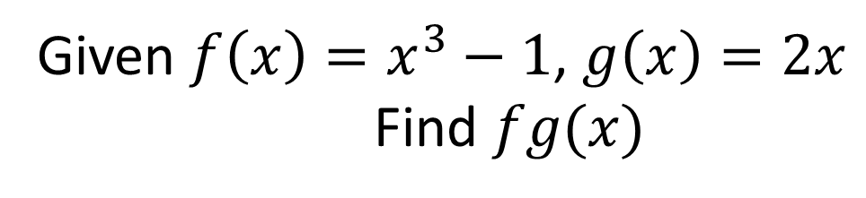
Given $f\left(x\right)=x^{3}−1$, $g\left(x\right)=2x$
Find $fg(x)$
Notes:
8x³ - 1

Slide 4
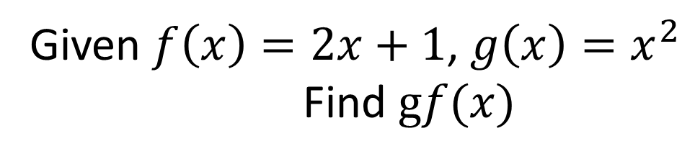
Given $f\left(x\right)=2x+1$, $g\left(x\right)=x^{2}$
Find $gf(x)$
Notes:
4x²+4x+1

Slide 5
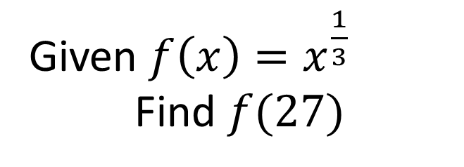
Given $f\left(x\right)=x^{\frac{1}{3}}$
Find $f(27)$
Notes:
3

Slide 6
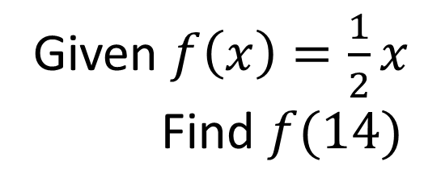
Given $f\left(x\right)=\frac{1}{2}x$
Find $f(14)$
Notes:
7

Slide 7
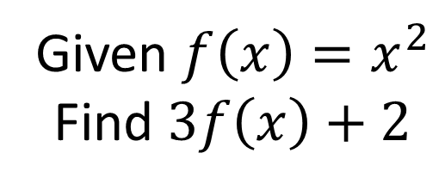
Given $f\left(x\right)=x^{2}$
Find $3f\left(x\right)+2$
Notes:
3x² + 2

Slide 8
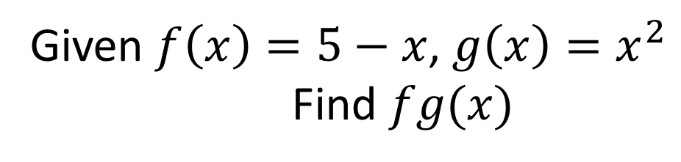
Given $f\left(x\right)=5−x$, $g\left(x\right)=x^{2}$
Find $fg(x)$
Notes:
5-x²

Slide 9
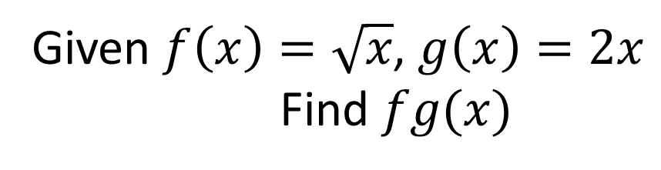
Given $f\left(x\right)=\sqrt{x}$, $g\left(x\right)=2x$
Find $fg(x)$
Notes:
(2x)^{1/2}

Slide 10
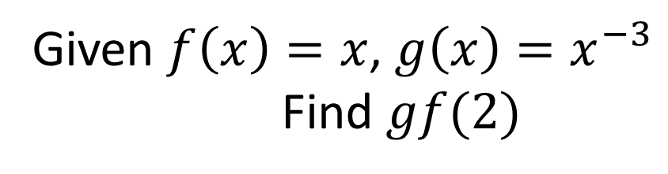
Given $f\left(x\right)=x$, $g\left(x\right)=x^{−3}$
Find $gf(2)$
Notes:
1/8

