Slide 1
Shape and Data
Understand left, right, clockwise and anti-clockwise as turns
Objectives
Day 1
Identify left and right; give accurate directions.
Day 2
Recognise clockwise and anticlockwise turns and right angles as quarter turns.
Notes:
Before teaching, be aware that:
On Day 1 instruction for the whole class practical activity is in the notes for Slide 7.
On Day 2 you will need number cards for 3, 6, 9 and 12. Instruction for the whole class practical activity is in the notes for Slide 12.

Slide 2
Shape and Data
Understand left, right, clockwise and anti-clockwise as turns
Starters
Day 1
Left and right (pre-requisite skills)
Day 2
Follow directions (pre-requisite skills)
Notes:
Choose starters that suit your class by dragging and dropping the relevant slide or slides below to the start of the teaching for each day.

Slide 3
Shape and Data
Understand left, right, clockwise and anti-clockwise as turns
Starter
Left and right
Notes:
Pre-requisite skills – to use this starter, drag this slide to the start of Day 1
Remind children how they can make an ‘L’-shape using their left hands by holding their hand, palm facing away, fingers together, thumbs ‘stuck out’. Remember, L is for left! Play ‘Simon says…’ Wave your left arm. Simon says wave your left arm. Simon says look to the right. Remember that children should look to their right, not yours! Raise your right hand. Simon says touch your left shoulder. Repeat with similar instructions.

Slide 4
Shape and Data
Understand left, right, clockwise and anti-clockwise as turns
Starter
Follow directions
Notes:
Pre-requisite skills – to use this starter, drag this slide to the start of Day 2
Give each pair a copy of the robot’s maze from previous day’s ‘Directional instructions’ practice sheet. Secretly choose a white square on the grid and give children instructions to reach it from the start. They draw the journey the robot takes. Did they all end up in the same place?

Slide 5
Shape and Data
Understand left, right, clockwise and anti-clockwise as turns
Objectives
Day 1
Identify left and right; give accurate directions.

Slide 6
Day 1: Identify left and right; give accurate directions.
Secretly choose an object and we’ll take turns to describe where they are on the shelves.
It’s on the shelf above the book and right of the dinosaur. What am I thinking of?
It’s on the shelf below the car, and left of the dinosaur. What am I thinking of?
I’m thinking of one of the objects on the shelves.
Now it’s your turn..
I’m thinking of another object.

Slide 7
Day 1: Identify left and right; give accurate directions.
We’re going to write instructions to help someone reach the door.
Who shall we choose?
Okay - stand up and face the board and listen to everyone’s instructions!
We can give instructions like turn left, turn right, or a number of steps forwards.
Notes:
Choose a child and explain: We’re going to write instructions to help *child* to reach the door. Choose a route that will mean circumnavigating some tables.
Children give instructions: turn left, turn right, any number of steps forwards.
Chosen child stands up and faces the board. Ask: What does *child* need to do first? Which way does s/he need to turn? How many steps do you think s/he needs to take now? Ask *child* to take this number of steps. Was this too many or too few? What does s/he need to do next?
Record the instructions as you discuss them, making any necessary alterations.
Once the child has reached the door, ask her/him to the board again, and re-read the instructions. This time see if s/he can make it to the door more smoothly. If the classroom is not too congested, ask the child if they would like to try it blindfolded!

Slide 8
Day 1: Identify left and right; give accurate directions.
Let’s try again – can we make it a smoother journey this time?
Who shall we choose?
If we get good at this we could try it with a blindfold!
Notes:
Children can now go on to do differentiated GROUP ACTIVITIES. You can find Hamilton’s group activities in this unit’s TEACHING AND GROUP ACTIVITIES download.
WT: Program a floor robot with directional instructions to reach a specified destination.
ARE: Program a floor robot with directional instructions to reach a specified destination or Give directional instructions for someone to follow to a specified end destination.
GD: Give directional instructions for someone to follow to a specified end destination.

Slide 9
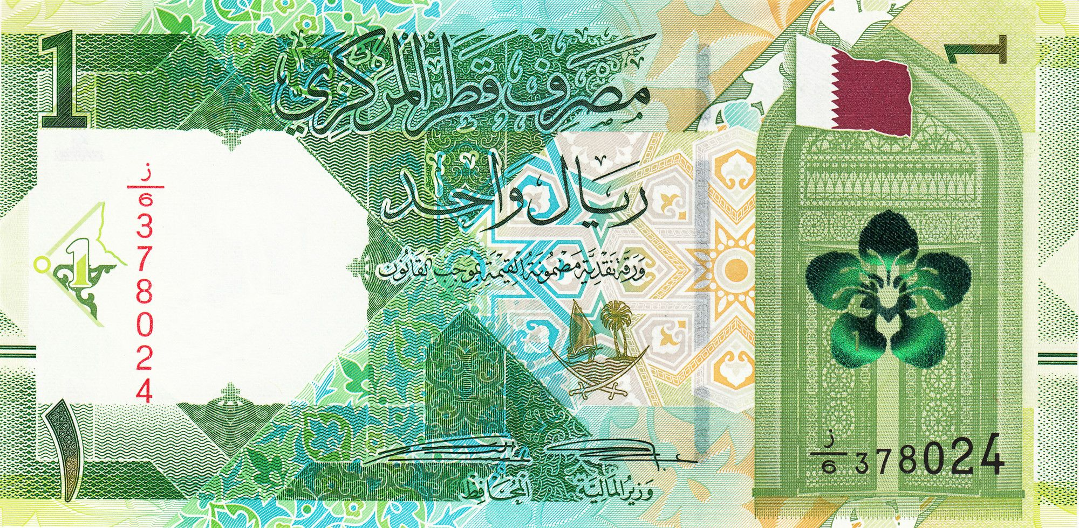
QNID
What do you see on the left? What is the image below the flag? Answer: Qatar flag and Dreama Flower which blossoms on a plant that is well known to grow in the state of Qatar.

Slide 10
Task 1 – Pair/Group Work
· Place your map on the table and set Robbie the Robot at the starting point.
· Plan Robbie's path to get home without crashing into any houses.
· Decide the steps Robbie needs to take (forward, backward, left, or right) and write or say them in order.
· Test your program by entering the commands and watching Robbie move.
· If Robbie doesn’t get home, adjust your program and try again.
· Once Robbie gets home, celebrate your success!
Once done try to find another possible route.

Slide 11
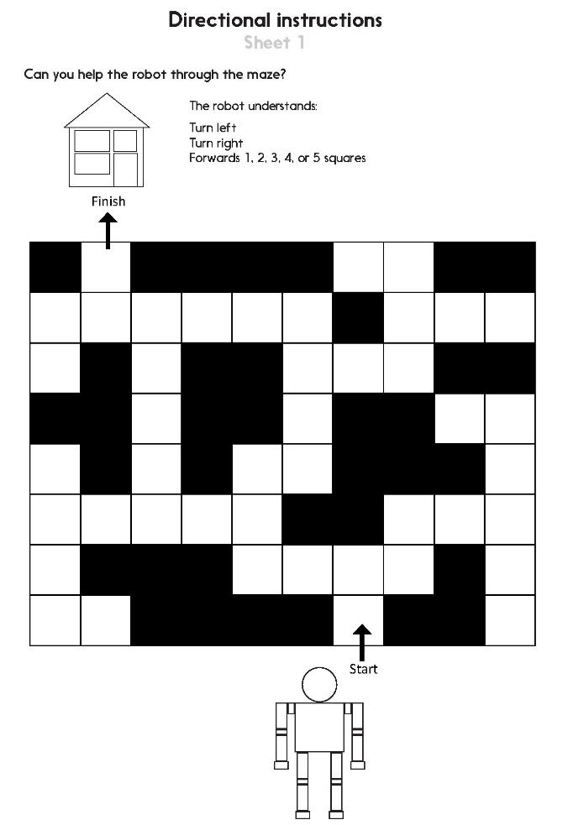
Task 2 – Independent Work
Notes:
The Practice Sheet on this slide is suitable for most children.
Differentiated PRACTICE WORKSHEETS are available on Hamilton’s website in this unit’s PROCEDURAL FLUENCY box.
WT: Directional instructions Sheet 1, CAN use a small world person to help.
ARE: Directional instructions Sheet 1.
GD: Directional instructions Sheet 1, describe two possible routes.

Slide 12
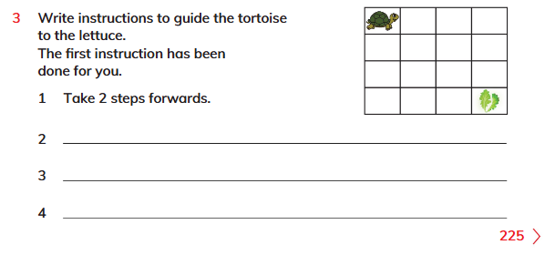
Plenary
Solve Learner's Book Exercise 15.1 no. 3 on page 225. .

Slide 13
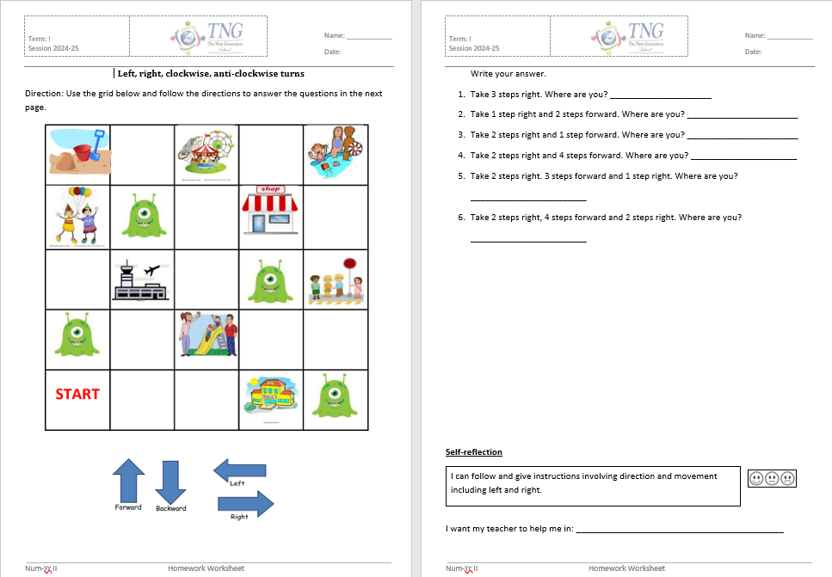
Homework
Solve homework worksheet.
Notes:
The Practice Sheet on this slide is suitable for most children.
Differentiated PRACTICE WORKSHEETS are available on Hamilton’s website in this unit’s PROCEDURAL FLUENCY box.
WT: Weight Sheet 1.
ARE/GD: Weight Sheet 2.

