Slide 1
Before the lesson… let’s play “Odd One Out”!
Which word is different from the others?
How about the rest? What is in common?
pleased
pleased
glad
glad
happy
happy
sad
sad

Slide 2
Odd One Out!
Which word is different from the others?
How about the rest? What is in common?
ugly
beautiful
ugly
beautiful
pretty
handsome
pretty
handsome

Slide 3
Odd One Out!
Which word is different from the others?
How about the rest? What is in common?
weep
weep
sob
sob
cry
unhappy
cry
unhappy

Slide 4
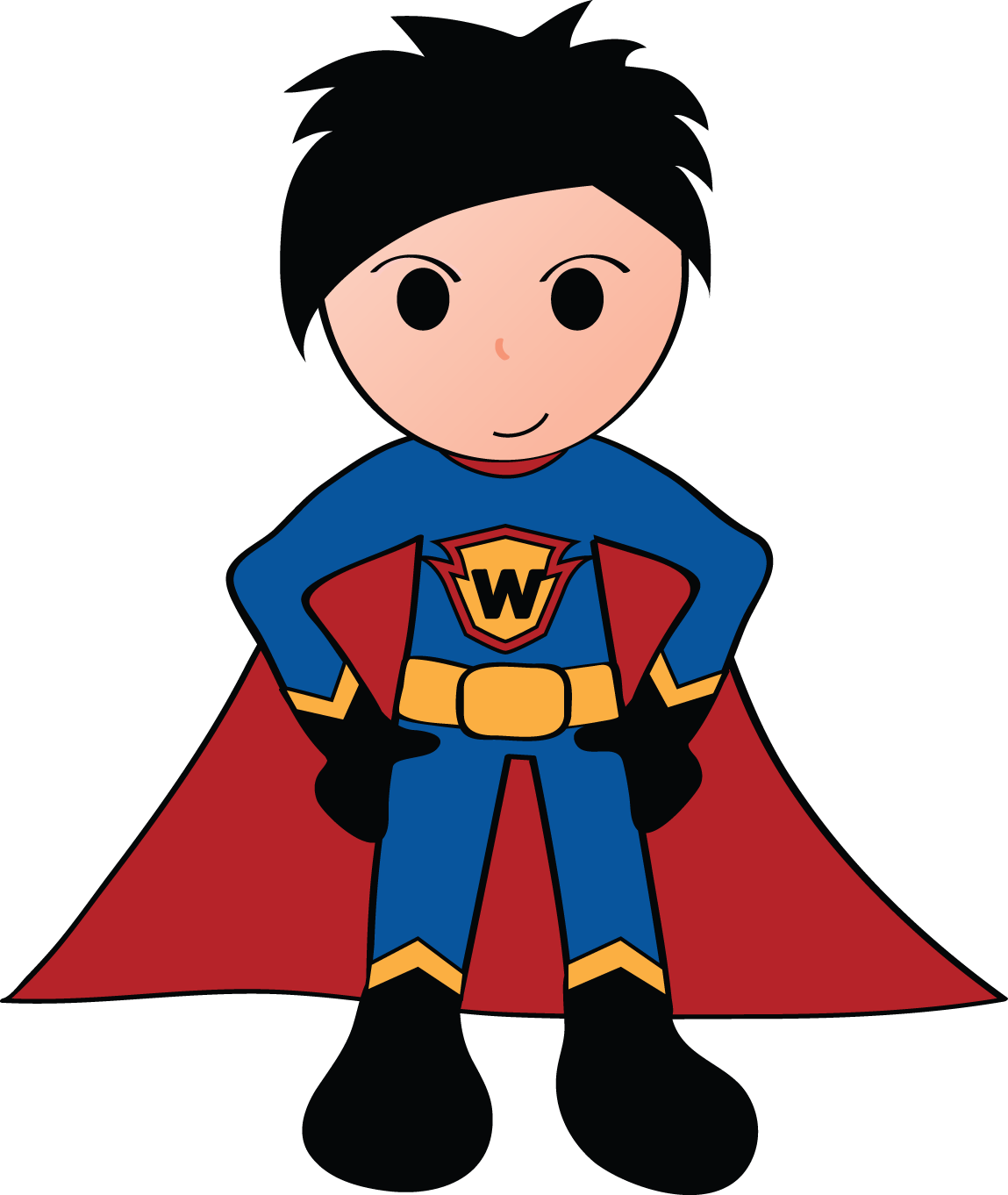
Who is he?
Let’s read about him!

Slide 5

Date today 26/03/2046
LOCAL NEWS
Who is Super Word Kid?
Super Word Kid is actually a Primary 6 student in disguise! His real name is Jack White.
Born on Planet Word, Jack left his home planet when he was a baby. He was raised by Mr. and Mrs. White on Earth since then.
Jack is a great kid. His parent discovered his great power and great love of words when he was young. He read all the great books in the house at the age of one. When he was four, he already knew every word in the dictionary.
Having the power to fly faster than light, to lift things as heavy as a building, to bend steel with his strong arms and to travel in time, Super Word Kid fights bad guys for world peace and for the right use of words.
A story about a person’s life.

Slide 6
Look at the paragraph again.
What can you see?
Jack is a great kid. His parent discovered his great power and great love of words when he was young. He read all the great books in the house at the age of one.
great
great
great
great
There are too many ‘great’!
The writing is boring.

Slide 7
What should we do to make it
more interesting ?

Slide 8
What are synonyms?
Synonyms are words that have the same, or very similar meaning.
They need to be the same part of speech.
Part of speech
Word
Synonym
adjective
sad
unhappy
verb
cry
weep
noun
child
kid
adverb
sadly
unhappily

Slide 9
How to find a right synonym
for the repeated words ?

Slide 10

1. Look it up in a thesaurus
What is a thesaurus?
It is a book that lists words and their synonyms.
 | definitions | synonyms | antonyms
Dictionary
Thesaurus
in detail
short and simple

Slide 11
Where can you find synonyms?
1. Look up the word in a thesaurus.
Go to Thesaurus.com:
http://www.thesaurus.com/

Slide 12
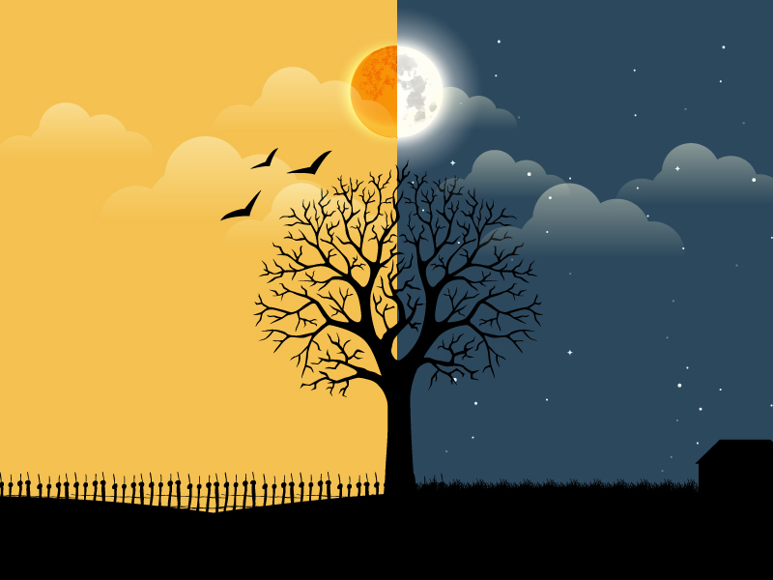

Slide 13
All About Antonyms
Down
Up
White
Black
Learning Objective
To Identify and Use Antonyms
Success Criteria
I can use use antonyms in a sentence.
I can identify antonyms and synonyms

Slide 14
Antonyms
What are antonyms?
Words that mean the opposite.
Miserable
Sad
Microscopic
Small
Big
Happy
Tiny
Little
Unhappy
Upset

Slide 15
Match the Antonyms
Young
Dirty
Full
Kind
Cold
Girl
Hot
Empty
Boy
Old
Mean
Clean

Slide 16
Review: Synonyms
What are synonyms?
Words that mean the same thing.
Cheerful
Glad
Enormous
Huge
Big
Happy
Giant
Large
Merry
Joyful

