Slide 1
Be a Storyteller
Year 3 T2 Week 1 Day 1

Slide 2
Lesson Objective
understand logical thinking

Slide 3
Key vocabulary
Logical thinking: to understand a problem and come up with a solution that makes sense

Slide 4
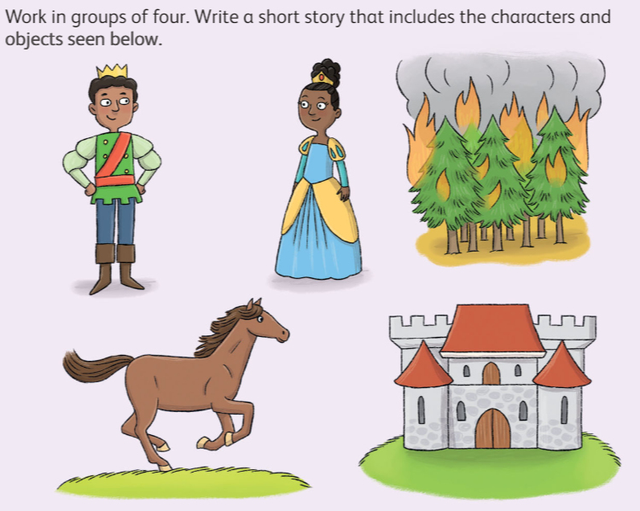
Hook Activity - Group
Brainstorm and write the story including given characters and objects in the A4 sheet.

Slide 5
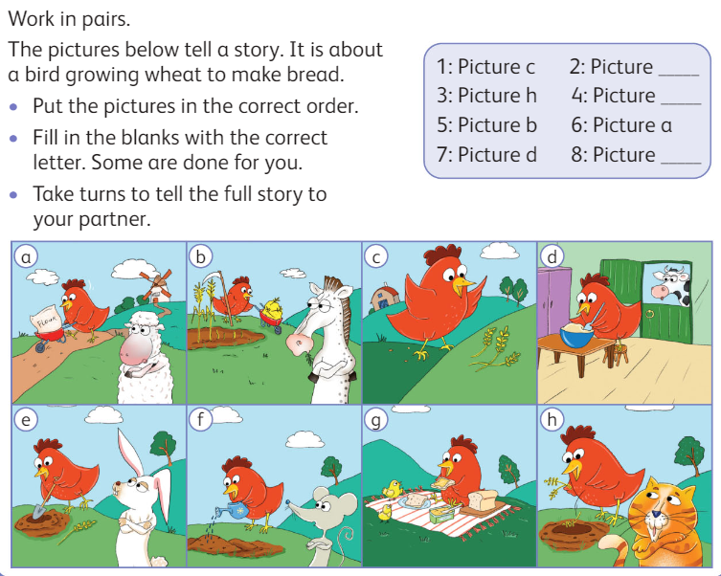
Main Activity– Pair Work (10 mins)
Use the attached activity sheet and direct each group to collectively brainstorm ideas, cut out the provided pictures from the activity sheet, and paste them onto an A4 sheet.

Slide 6
Discussion Time
logical thinking is to:
break down a problem into smaller pieces
look at each piece and think about the steps that give us the results, we need to arrange the steps in an order that makes sense.

Slide 7
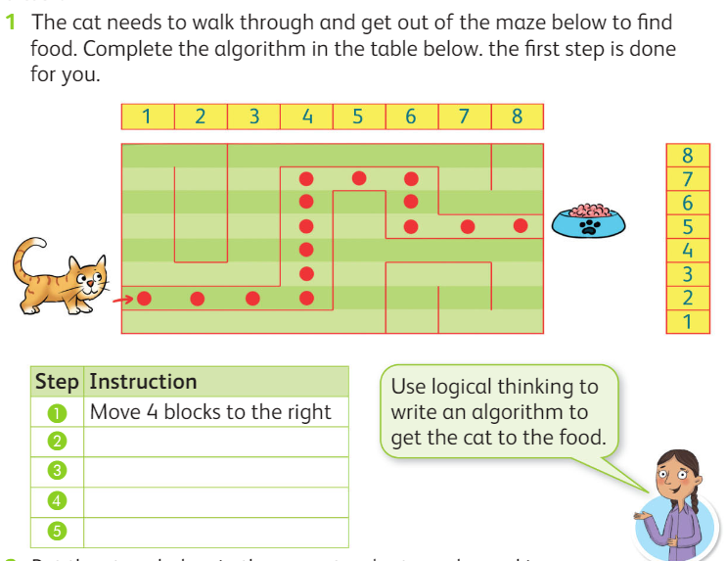
Main Activity (Individual activity – 20 mins
Do Practice question 1 in the book pg 96in Worksheet 1.

Slide 8
Extension Task (pg 96)

Slide 9
Exit Ticket
True or False
Logica thinking helps break down a problem into smaller pieces. [True/False]
It involves examining each piece and considering the steps that lead to the desired results. [True/False]
Logical thinking doesn't involve arranging the steps in a sensible order. [True/False]

