Slide 1
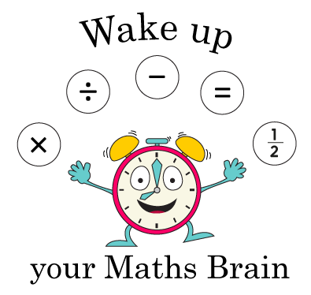
Addition and Subtraction
Number bonds to 10
Starter
Number bonds to 10
Notes:
Pre-requisite skills – to use this starter, drag this slide to the start of Day 3
Children sit facing a partner. One child puts their hands up to show a number. Their partner shows the matching number bond to 10 on their fingers. They swap roles and start with a new number.

Slide 2
Addition and Subtraction
Number bonds to 10
Objectives
Know number bonds to 10.

Slide 3
Day 3: Know number bonds to 10.
Give each child a 1-20 number fan.
9
3
6
5
4
2
1
8
Notes:
Show a number card 1–10; ask children to hold up the matching number card to add to make 10 on their fans, e.g. you hold up 6, children should show 4 on their fans.
Repeat.
Check answers by asking children to show one number using fingers standing and the other number with the fingers still folded down.

Slide 4
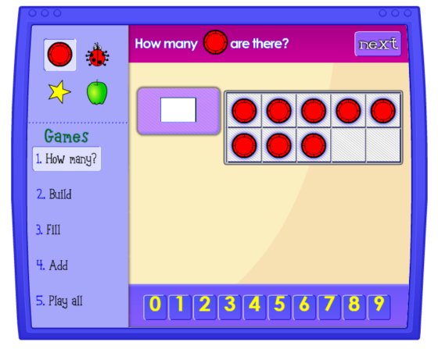
Day 3: Know number bonds to 10.
Let’s play a game…
Notes:
If time allows, play one of these online games:
https://www.nctm.org/Classroom-Resources/Illuminations/Interactives/Ten-Frame/ choose children to type in the matching number pair to 10.
https://www.topmarks.co.uk/maths-games/hit-the-button Select ‘Number Bonds’ then ‘Make 10’.
Children can now go on to do differentiated GROUP ACTIVITIES. You can find Hamilton’s group activities in this unit’s TEACHING AND GROUP ACTIVITIES download.
WT: Relating addition and subtraction number bonds to 10 and subtracting numbers rolled on a dice from 10.
ARE/GD: Using dominoes to investigate number bonds to 10.

Slide 5
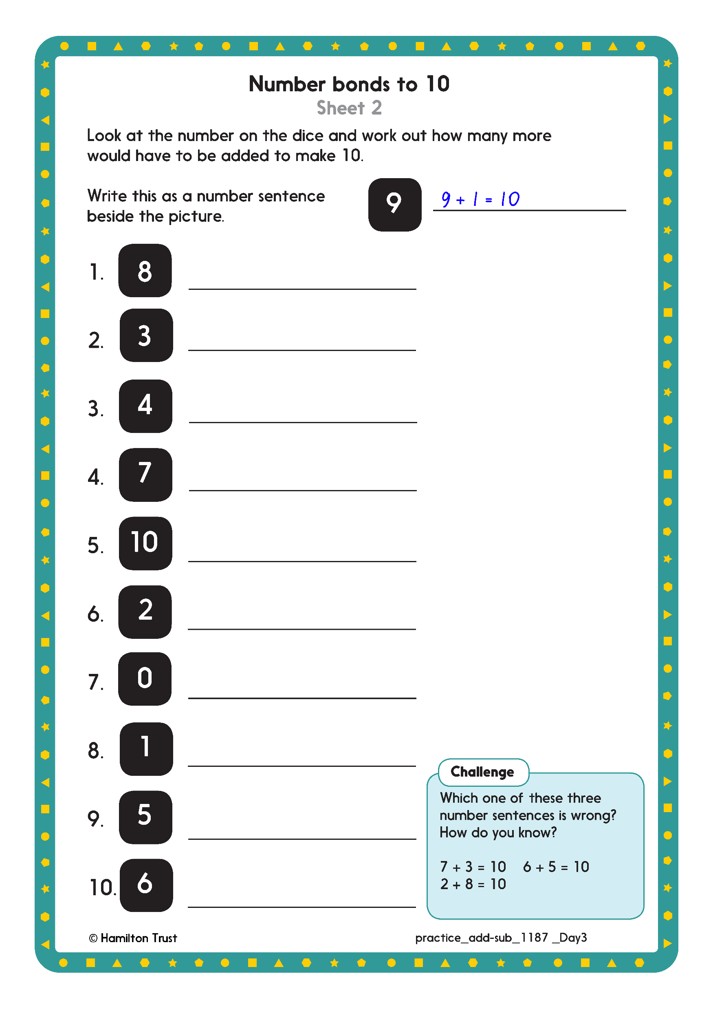
Challenge
Notes:
The Practice Sheet on this slide is suitable for most children.
Differentiated PRACTICE WORKSHEETS are available on Hamilton’s website in this unit’s PROCEDURAL FLUENCY box.
WT: Number bonds to 10 Sheet 1
ARE: Number bonds to 10 Sheet 2
GD: Number bonds to 20 Sheet 3

Slide 6
Quick Fire Number Bonds
To check understanding of number bonds to 10, have students stand in a circle for a quick-fire game. Call out a number between 0 and 10, and each student quickly responds with the number needed to make 10. To keep it engaging, toss a soft ball to the student as you say the number; they respond with the matching number and toss it back. This fast-paced activity encourages quick recall and confidence. Wrap up by asking a few students which pairs were easiest or what helped them remember, reinforcing their understanding in a fun, collaborative way.

